Slide 1
Best Practices in Siting Battery Energy Storage Systems (BESS)

Slide 2
Agenda
1.
About RWE
2.
International Fire Code and NFPA Requirements
3.
Best-Practice Design and Safety Systems
4.
Partnering with Local Emergency Services
5.
Project Examples
6.
Questions

Slide 3
David Raines
RWE HSSE Sr. Director
40 years in Fire/EMS Services in NYS
NYS Certified Fire Inspector
Deputy Chief in Putnam County, NY
Served on NYS Fire Marshals and Inspectors Association as an Executive Board member and past President
Member of NYS Chiefs, FASNY, NYSBOC, and International Fire Chiefs Association
Supported by HSSE team of senior fire service experts

Slide 4

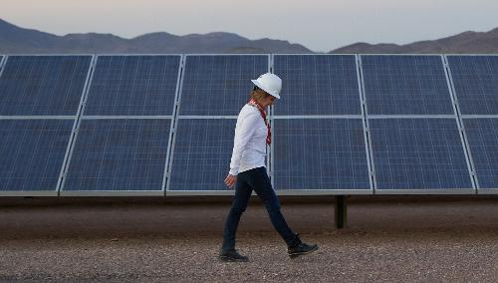
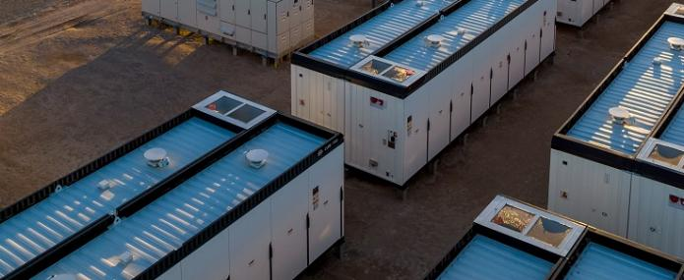
About RWE
  RWE has been present in the US for more than 15 years where we currently are the #3 renewable energy company, with operations in 27 states.
  RWE is committed to growing our U.S. asset base of more than 11 GW of operating wind, solar and battery storage projects in support of American energy dominance.
  This is further backed by a development pipeline of 36+ GW.
  Team RWE in the US: ~2000 FTE
Page 4

Slide 5
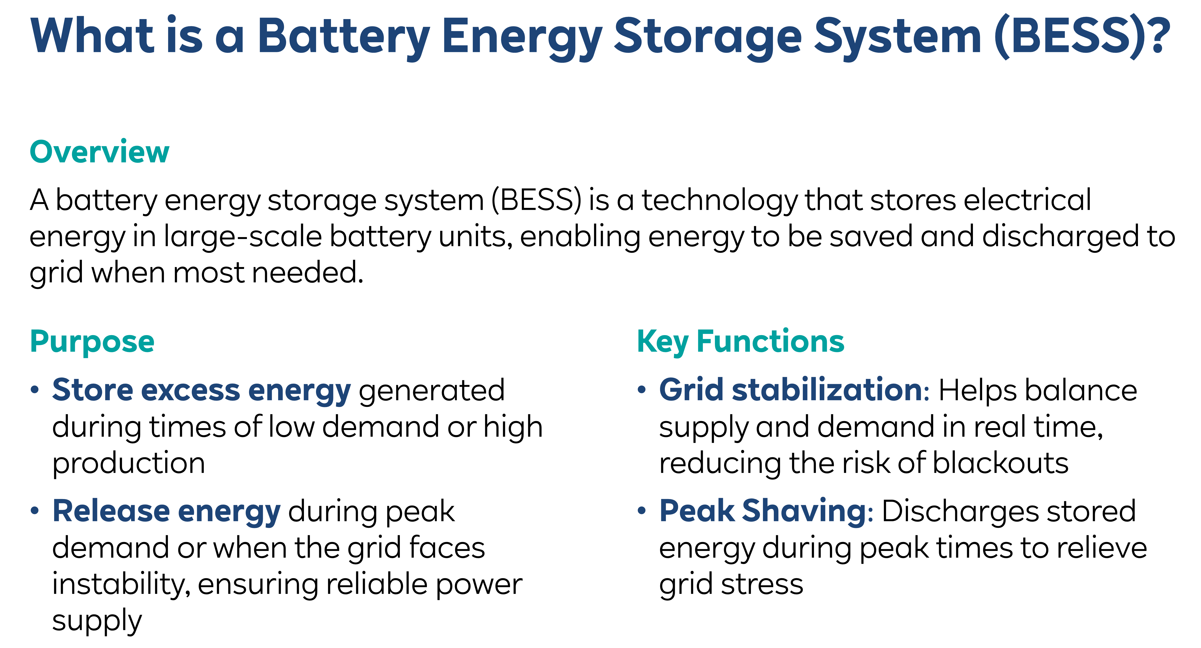
Page 5

Slide 6
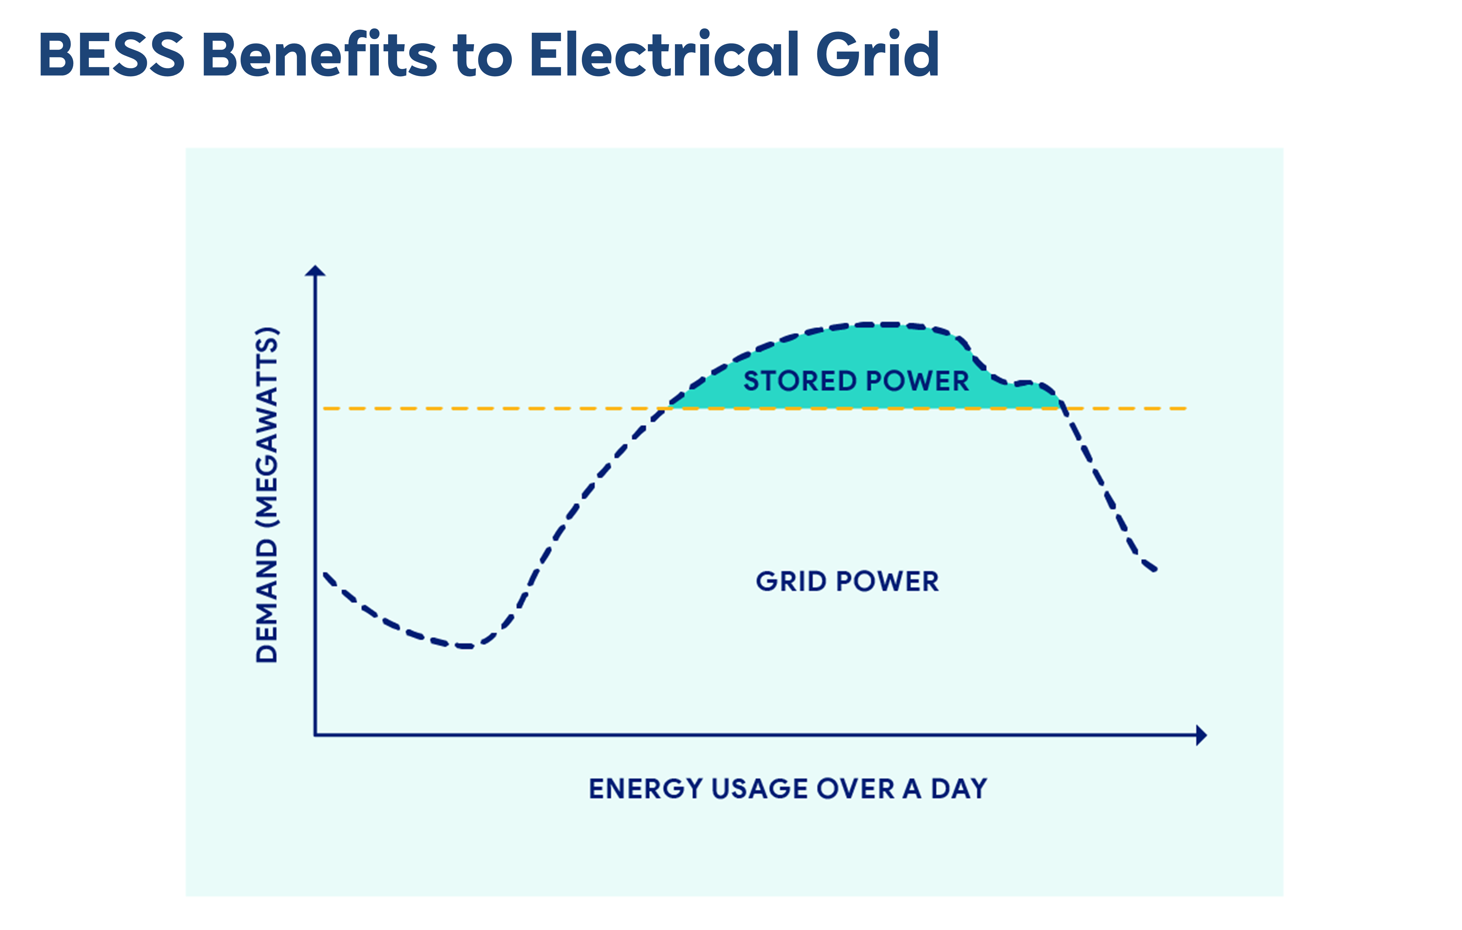

Reliable power supply
Dispatchable Power
Grid Power
Page 6

Slide 7
Best Practice Design and Safety Systems

Slide 8
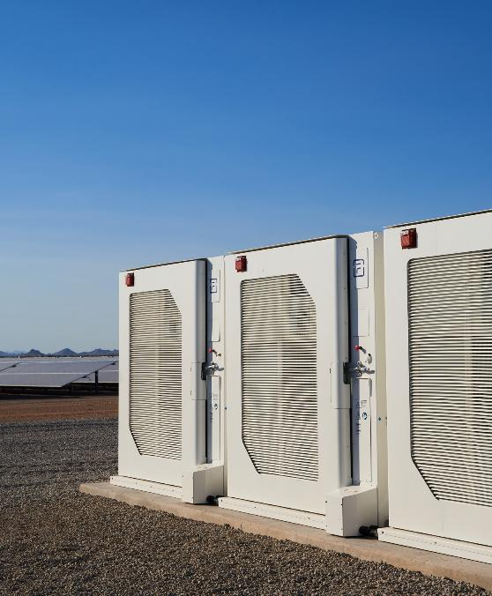

Battery Technology
RWE, across its projects only uses equipment that is meets and or exceeds Industry Standards for design and installation requirements.
The battery units most likely to be used for this project, are either the Tesla Megapack 2 XL or the LG JF-2/JF-4. Lithium Iron Phosphate Chemistry.
These units not only meet RWE’s standards for safety and performance but have also been selected by many utilities as their trusted technology.

Slide 9
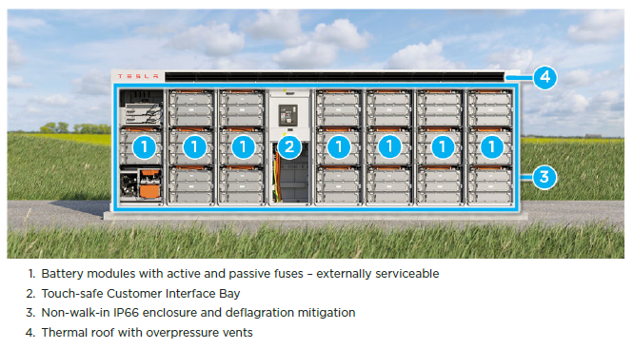
State of the Art BESS Design
Integrated Energy Storage System

Slide 10
Design Criteria
BESS Systems installed by RWE are listed to major market grid codes, including the following standards, by OSHA-recognized Nationally Recognized Testing Laboratories:
    UL 1642 (cell-level certification)
    UL 1973 and IEC 62619 (battery module-level certification)
    UL 9540, IEC 62933-5-2, IEC 62109-1 (system-level certification)
    UL 1741, CSA C22.2 #107.1 (power electronics)
    UL 1998 and IEC 60730 Annex H (functional safety of software)
    IEC 61000-6-2, and EN 55011 (EMC)
    UN 38.3 (transportation, self-certified)
    IEEE 693 (seismic safety)
    UL 9540A (large-scale fire testing): Tested at the cell, module, and unit level
BESS systems are designed to comply with major installation codes for energy storage systems, including NFPA 855 and IFC.

Slide 11
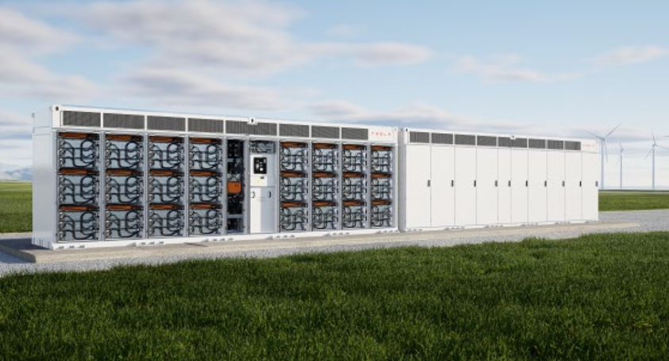
State of the art BESS Design
Integrated Energy Storage System
Safety features and compliance:
    Battery Management System (BMS)
    Thermal Management System (TMS)
    24/7 remote monitoring
    Remote shutoff
    Explosion prevention
    Stringent design criteria adherent to national and international standards
    Environmental compliance
Figure 2: Interior and exterior view of a Tesla Megapack 2XL. Source: Tesla.

Slide 12
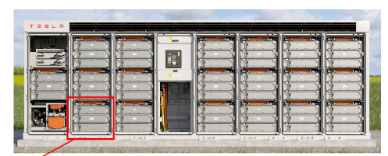
State of the art BESS Technology
Battery Management System (BMS)
Monitors State of Charge
Voltage
Performance
Temperature
Communication
Each Module has its own BMS
Feed to a Unit BMS in the Customer Interface Cabinet
Can isolate individual module or entire enclosure
Figure 4: Interior view of a Tesla Megapack 2XL. Source: Tesla.

Slide 13
Hazard Mitigation Analysis
Third Party testing shows Tesla BESS and LG JF2 are safe even under worst-case scenario
Key takeaways:
Maximum flame height of 2.5ft above cabinet ceiling and 3ft wide.
Fire was contained within the enclosure and only burned half the cabinet
Propagation to another enclosure is extremely unlikely due to the robust design
Exhaust system prevented a build up of pressure
Air quality monitoring did not detect hazardous substances above allowable levels.
RWE has its own testing facilities in WI to stress-test BESS systems

Slide 14
Fire Safety and Protection
Fire Safety and Protection are RWE’s most important factors in developing BESS projects. RWE has never had a fire event occur at one of its BESS installations.
All battery storage systems are designed in accordance with the state’s Building and Fire Code and comply with NFPA 855 requirements. BESS projects comply with stringent rules and regulations established by local fire departments.
Prior to installation, BESS projects are subject to a detailed permit review process by the Department of Building and the Office of Technical Certification and Research.
BESS systems are monitored on a 24-hour basis, 7 days a week, can be remotely shut down, and provide immediate notification to the fire departments in the event of an incident. BESS systems are required to have a Hazard Mitigation Analysis approved by the local fire departments prior to operation.

Slide 15
Partnering with Local Emergency Services

Slide 16
Emergency Services Response Plan (ESRP)
Fire Department provides final sign off on ESRP prior to construction
RWE works closely with the fire departments to ensure safe system design and operation, including providing training to fire personnel so first responders are prepared to respond in the unlikely event of an emergency at a BESS site.
Key considerations:
A determined number of gallons of on-site water is available to FD 24/7
Training is provided to FD and mutual aid agencies
Our site layouts provide adequate road access and staging during an unlikely response to the site
Our battery systems are compliant with Industry Standards (UL 9540, NFPA 855).
Step-by-step process is in place to respond to an unlikely emergency scenario

Slide 17
Project Sites

Slide 18

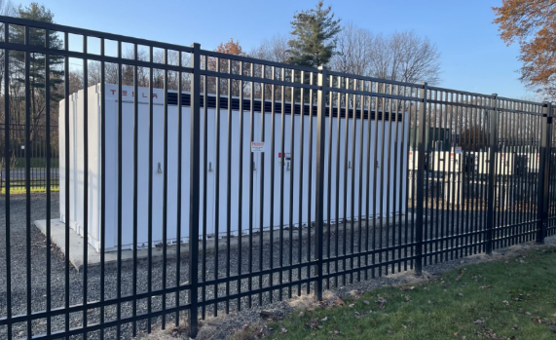
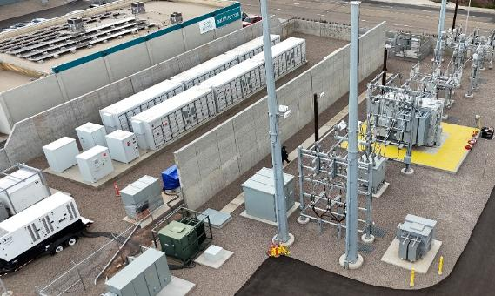
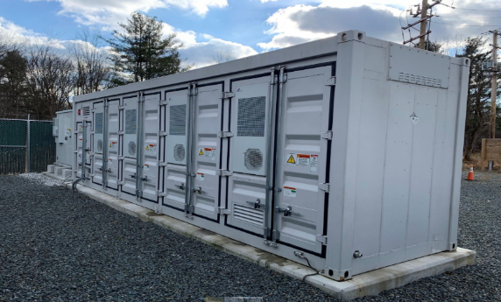
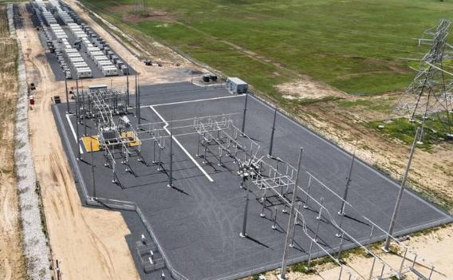
RWE BESS Projects in Operation
Ventasso – El Cajon, CA
University of Massachusetts, Amherst, MA
Hudson Avenue – Stillwater, NY
Cartwheel – Sulphur Springs, TX

Slide 19

Questions

