Slide 1
Statewide Imagery Program Study

Slide 2
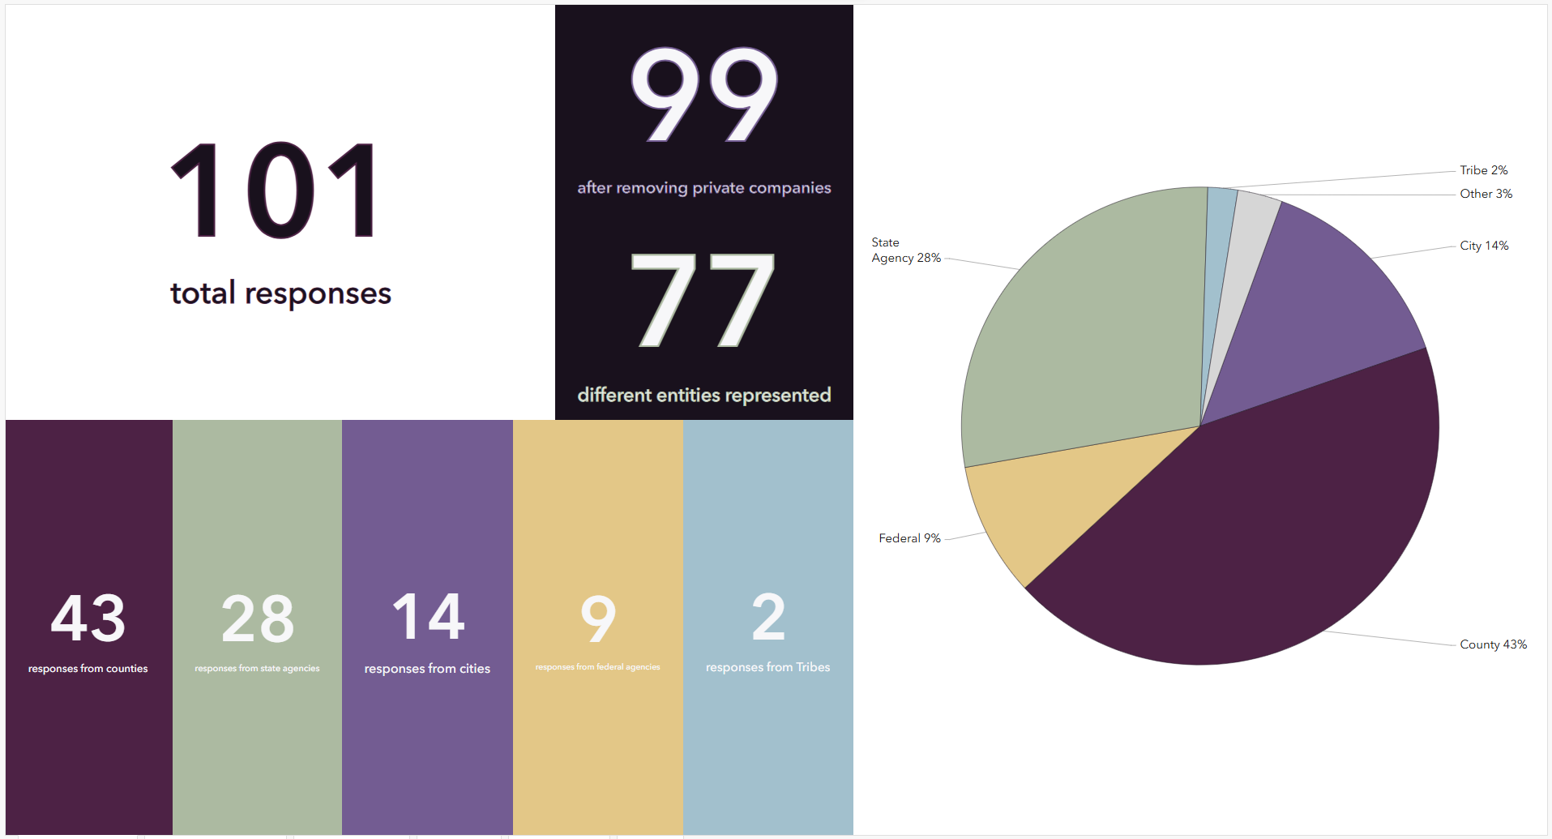

Slide 3
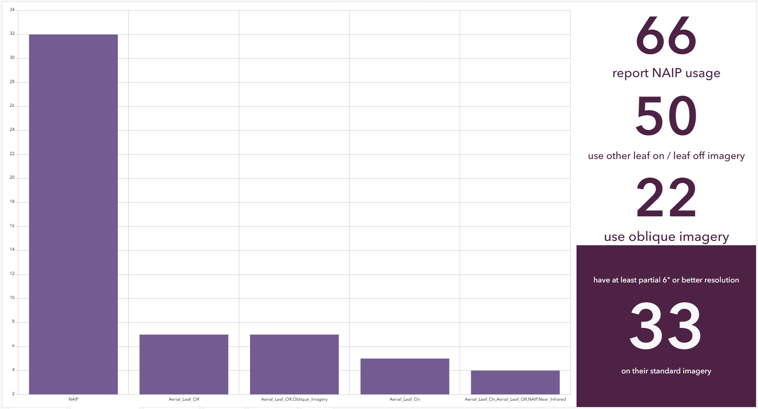

Slide 4
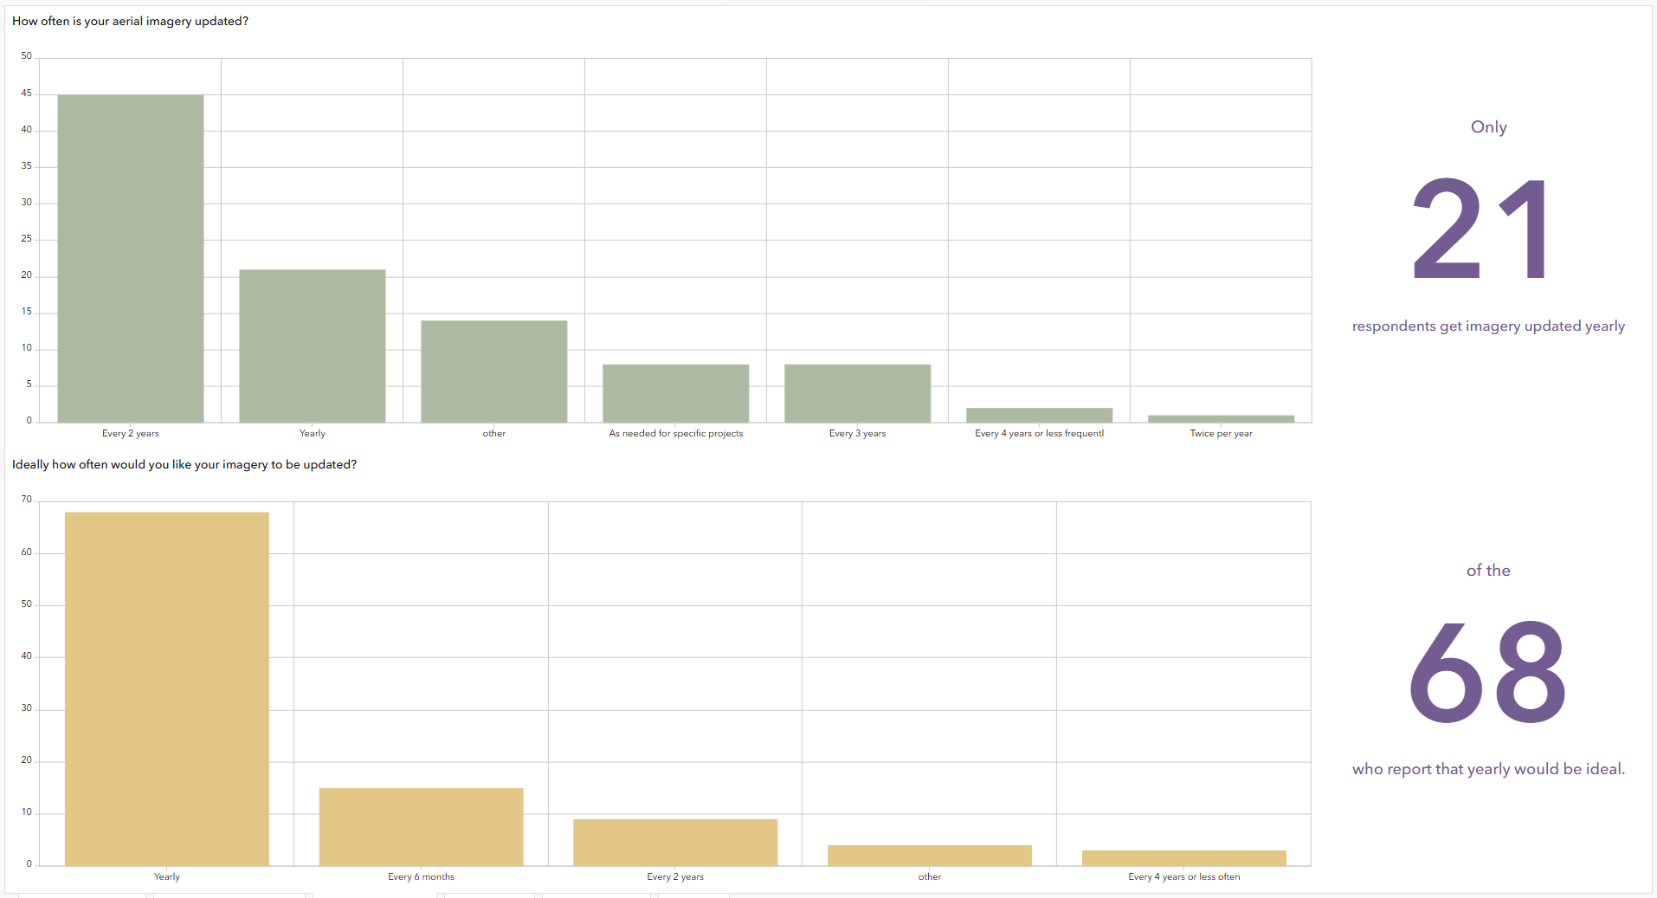

Slide 5


Slide 6
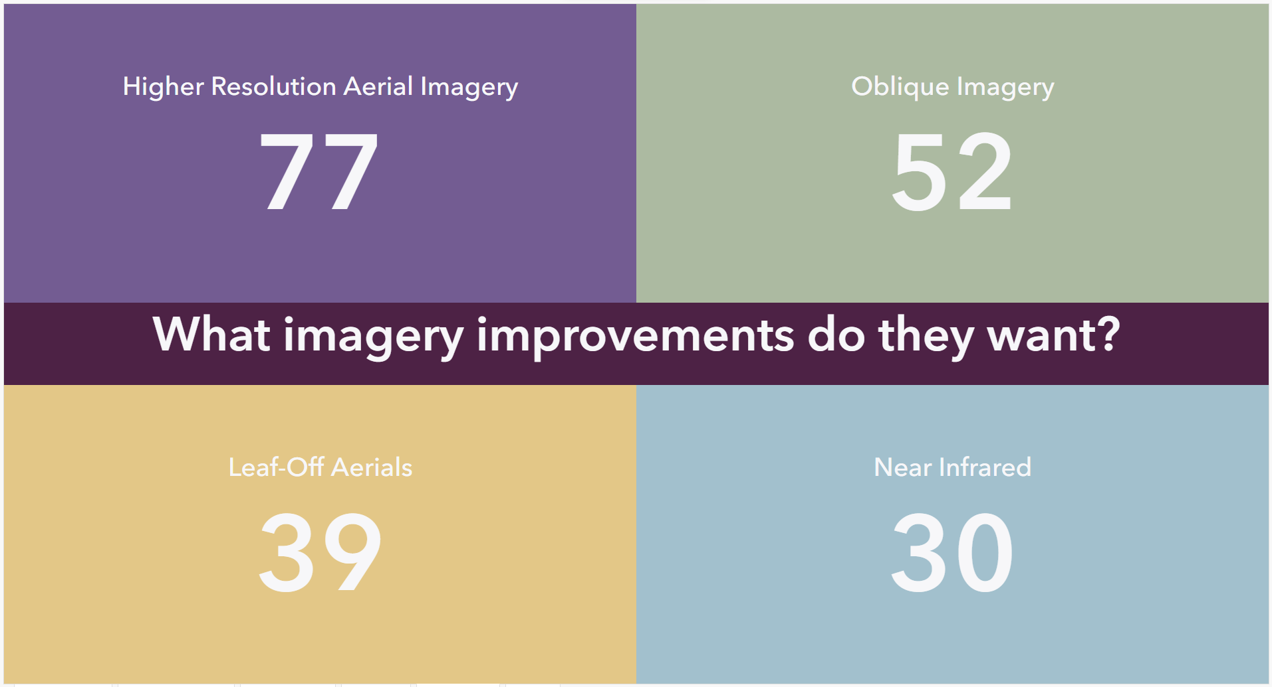

Slide 7
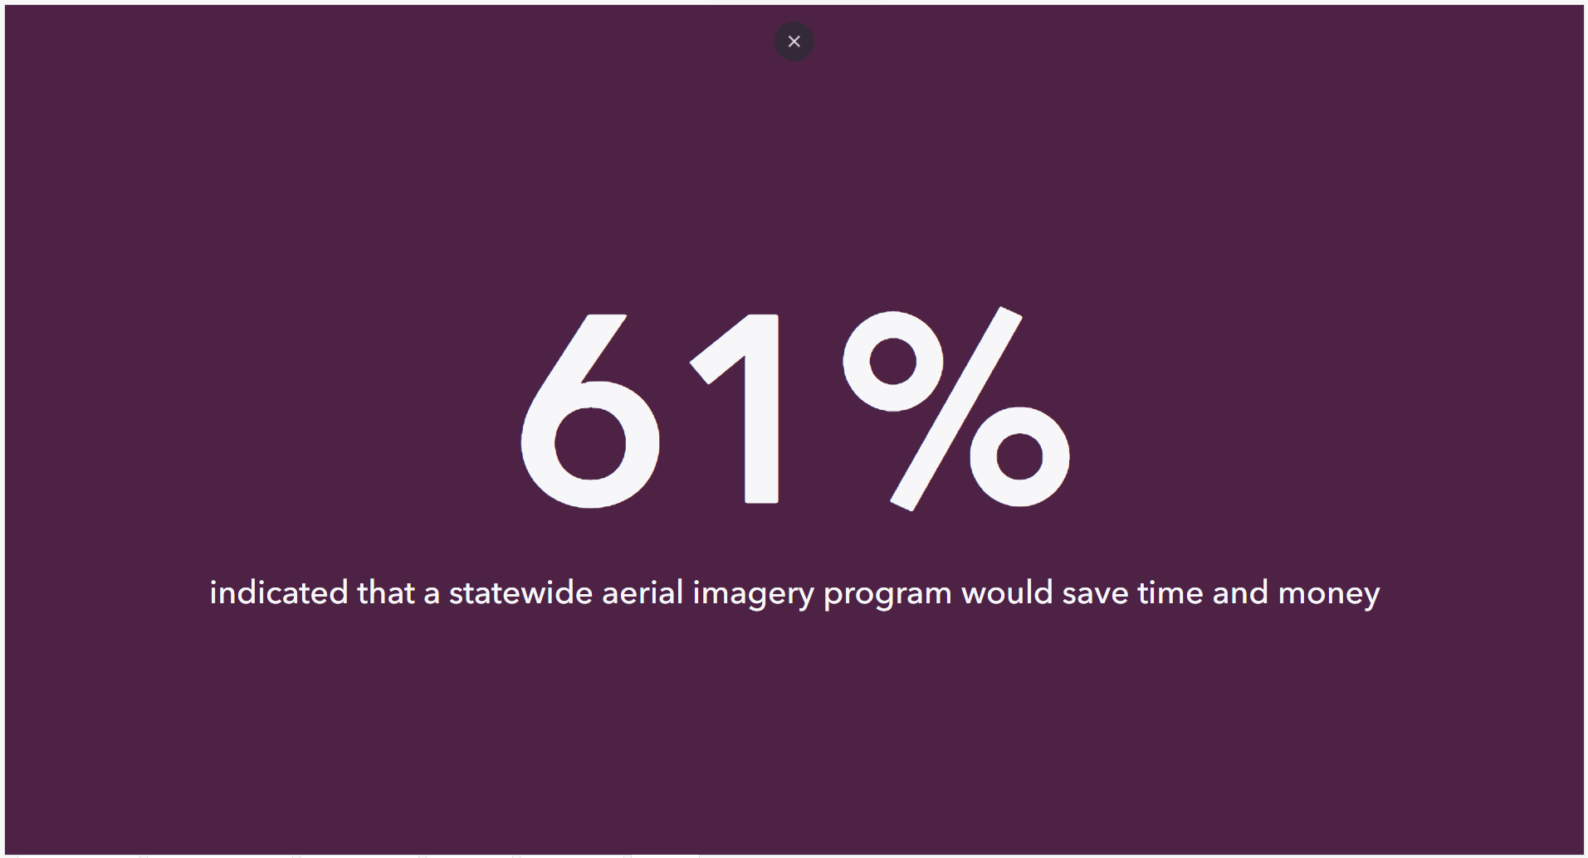

Slide 8
Parcels
Last update in May
Consideration for changing cadence to every 6 months
13 counties so far on the statewide layer
No adjustments for gaps/overlaps – Counties are the data stewards
The counties that have allowed us to do so have been submitted to the NAD

Slide 9
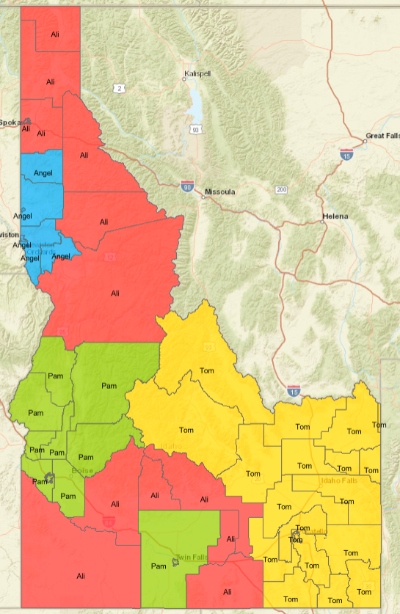
Current Contractor Distribution
Mark Reyes also helping with the SIRCOMM area
Collaborative efforts but contact will remain the same

Slide 10
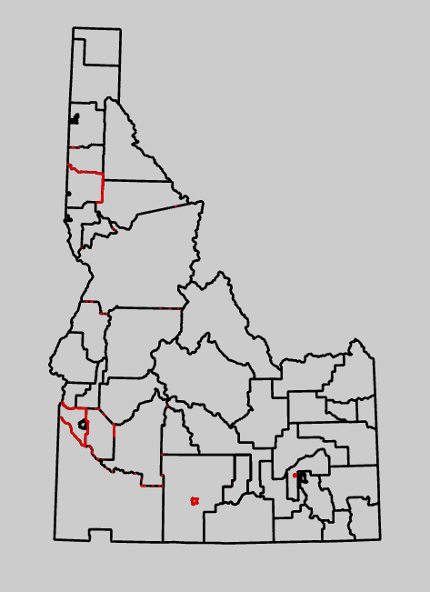
Public Safety Answering Point Boundary Clean-Up
Based on the County Boundary project
All boundaries must be coincident
Currently
  205 Gaps
  40 Overlaps

Slide 11
GIS Data Readiness Project vs
NG 9-1-1 Public Safety GIS Program
GIS Contractors moved from ITS to IOEM
  Continued data remediation
Next Gen Core Services with Motorola
  IPSCC NG 9-1-1 Sub-Committee
  Single Point of Contact with PSAPs
Future work with Public Safety GIS

