Slide 1
Idaho State Tax Commission
Ratio Study Compliance
Market Value, Statistical Tests, and Category Comparisons
Alan S. Dornfest, Property Tax Policy Bureau Chief
Kathlynn Ireland, Property Tax Policy Specialist
Benefit the people of Idaho with courteous customer service and education by providing fair, efficient, and effective revenue and tax administration.

Slide 2
The New Paradigm
What’s the same?
  Legal requirements – assessments to reflect market value as of Jan. 1
  Tested by STC
  Primary categories must have median ratios not provably more than ±10% from market value (100%)
  Statistical proof of non-compliance is based on confidence intervals, not just the sample medians
  Ratio Study Tested Categories
      Improved Residential
      Residential Land
      Improved Commercial
      Commercial Land
      Manufactured Housing
Timelines – sales, notification of compliance issues by April 1

Slide 3
What’s new for 2026?
(2025 ratio studies)
  Primary categories must have median ratios with not provably more than 5% difference between categories
  Failure would be cause for STC intervention

Slide 4
Statistical Significance (proof)
Based on confidence intervals
Definition – The range within which the true measure of assessment level for a population being studied will fall within a known degree of certainty
Assessment level – Median
Known degree of certainty - 90% Confidence Interval
Poor uniformity –
  High Coefficient of Variation (COV) – Based on mean and standard deviation
  High Coefficient of Dispersion (COD) – Expresses the average difference of the sample’s ratios from the median as a percentage

Slide 5
What can be tested in this way?
  Is assessment level for a category lower or higher than market value?
  Is assessment level for a category more than ±10% from market value?
  Is assessment level for one category more than 5% different from that of a different category?

Slide 6
What cannot be tested in this way?
  Are individual properties in a given category at market value?
  Are individual properties in a given category within 10% of market value?
  Similar statistical measures can provide estimates of the proportion of properties above or below:
      market value
      Selected point, such as 120% of market value
  Small samples and poor uniformity lead to wide confidence intervals which make proving any of these conditions doubtful
  In the absence of proof, compliance is assumed

Slide 7
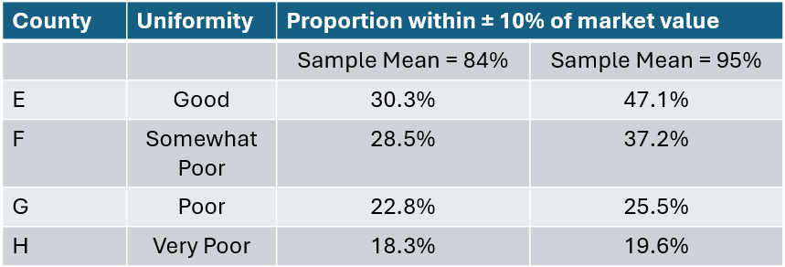

Slide 8
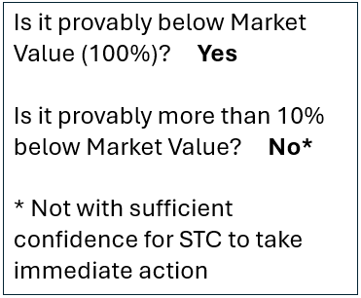
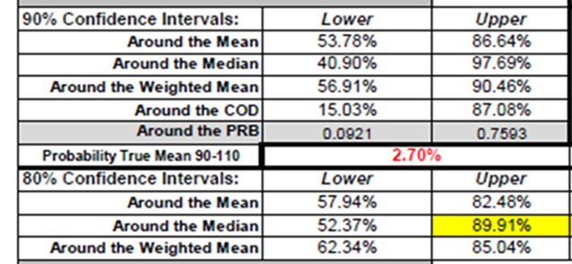

Proving a Difference
Example Compliance with Market Value requirements
Sample consisted of:
8 sales
Median ratio of 70.8%
80% Confidence Interval – only used in third year of similar results
*Less certainty

Slide 9
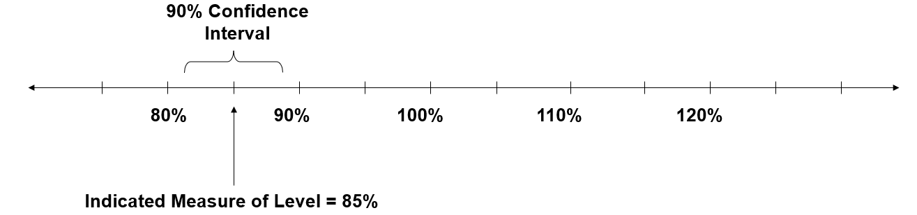
Confidence Interval Example 1

Slide 10
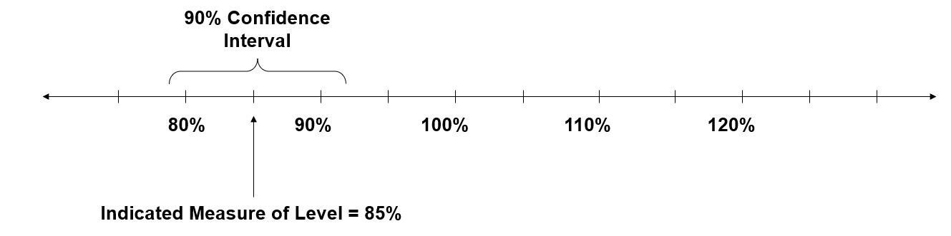
Confidence Interval Example 2

Slide 11
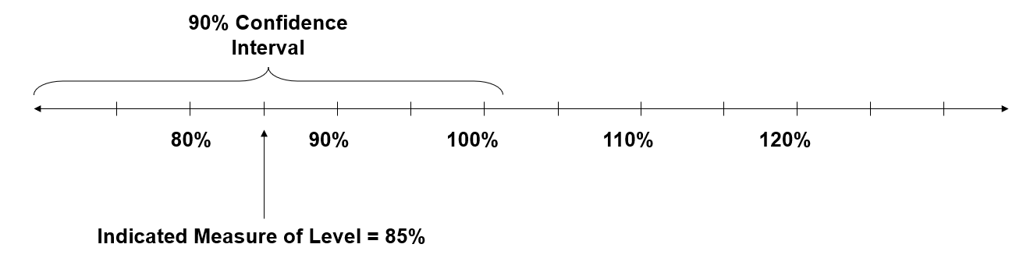
Confidence Interval Example 3

Slide 12
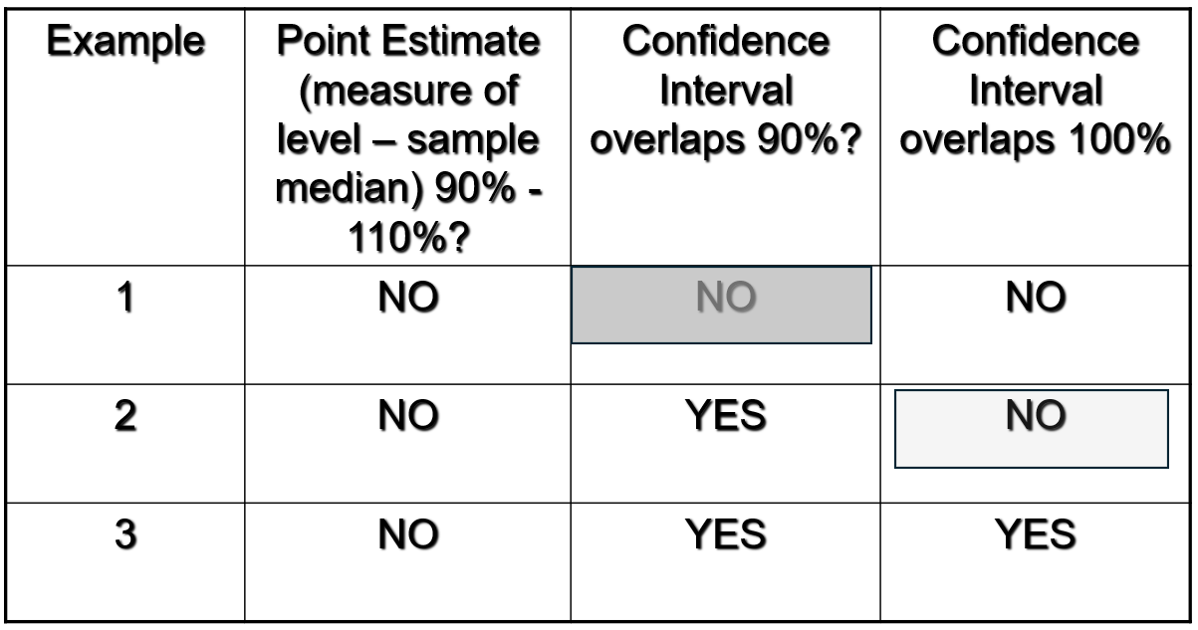
Contrasting the Three Confidence Interval Examples
Provably not
± 10%
Provably not market value

Slide 13
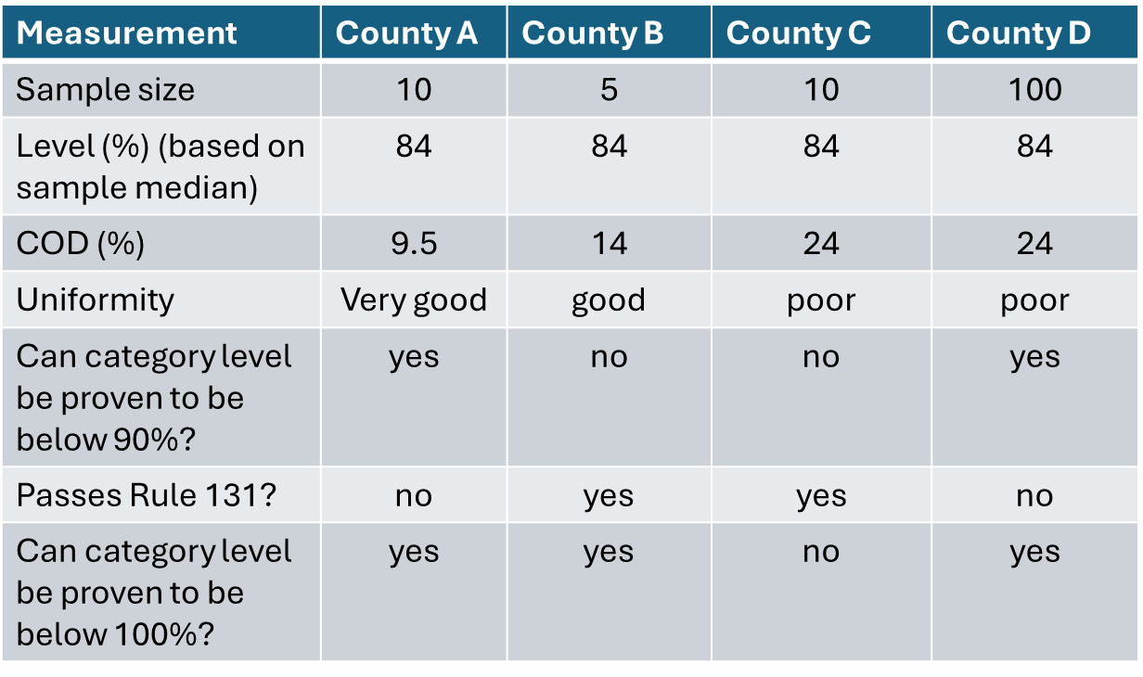
Effect of Sample Size and Uniformity on Compliance Determinations
B and C – confidence intervals overlap 90%
C’s Confidence interval overlaps 100%

Slide 14
Using the Data as a Predictive Tool
What proportion of parcels are predicted to be within ± 10% of market value?
This determination can only be made using the mean.
  Two different sample means (84% and 95%)
The estimates are applicable for sample sizes >30
Results are shown using
  good
  somewhat poor
  poor
  very poor uniformity statistics
  (standard deviations of 15%, 20%, 30%, 40%)

Slide 15
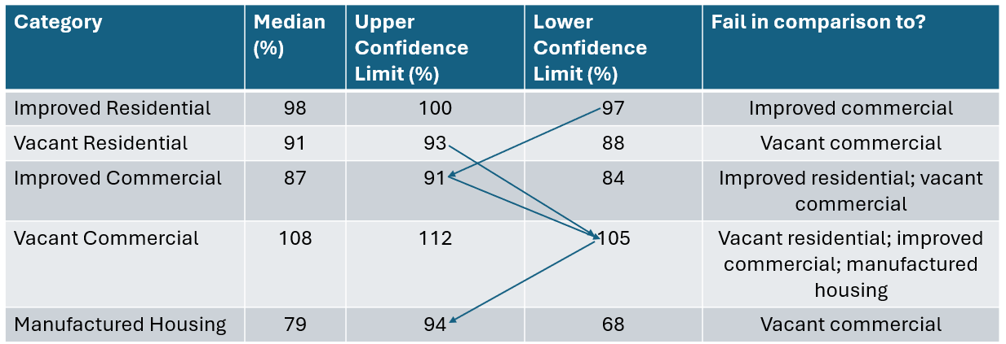
Compliance with the ±5% Test
Note: Categories all pass Rule 131 ±10% requirement

Slide 16
