Slide 1
EMS Sustainability Task Force Update & Discussion -EMS Challenges- IAC Commissioners Breakout Meeting September 28th, 2022

Slide 2
Thank You - Idaho Association of Counties - County Commissioners

Slide 3
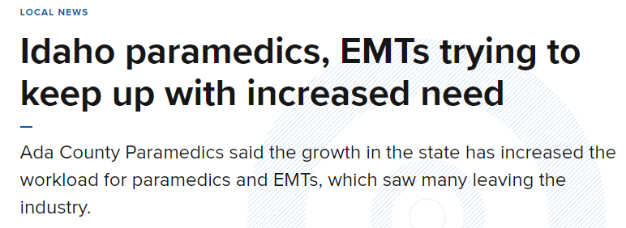
Idaho EMS Crisis: All areas and communities are impacted. - Rural - Suburban - Urban - Wilderness

Slide 4
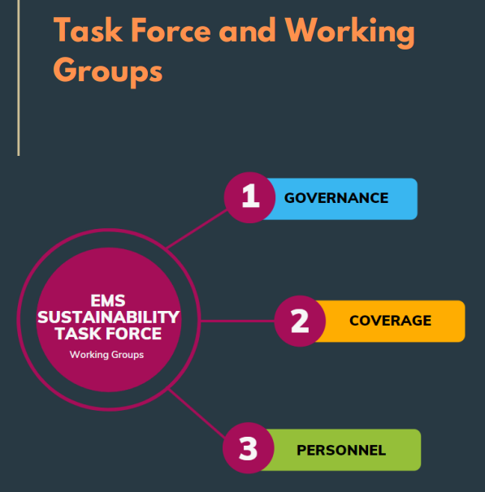
Office of Performance Evaluation (OPE) - Evaluation Report, November 2021: Volunteer Providers of Emergency Medical Services
Idaho Bureau of EMS and Preparedness - EMS Sustainability Task Force (EMSSTF)

Slide 5
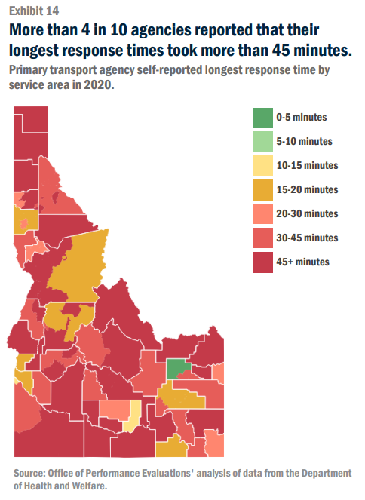
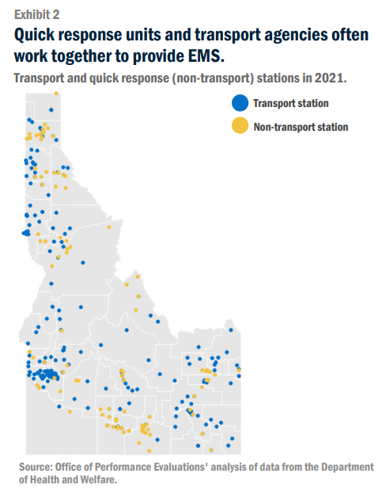
Ada County & Boise County -Bogus Basin-
EMS Challenges: Coverage Example

Slide 6
Ada County -New Developments-
EMS Challenges: Funding Example

Slide 7
Thank You!
Contact Information – Shawn Rayne:
Email: srayne@adacounty.id.gov
Phone: 208-287-2975
Contact Information – Mark Babson:
Email: mbabson@adacounty.id.gov
Phone: 208-287-2993

