Slide 1
How A Bill Becomes Law: The Idaho Legislative Process
Seth Grigg
Executive Director

Slide 3
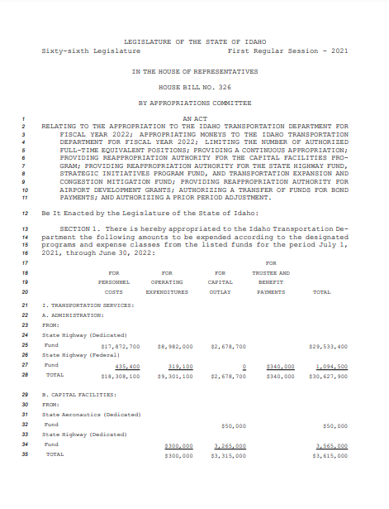
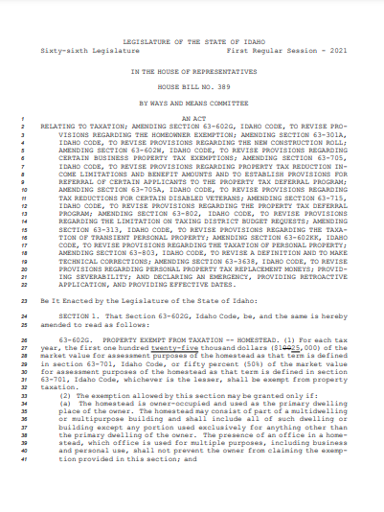
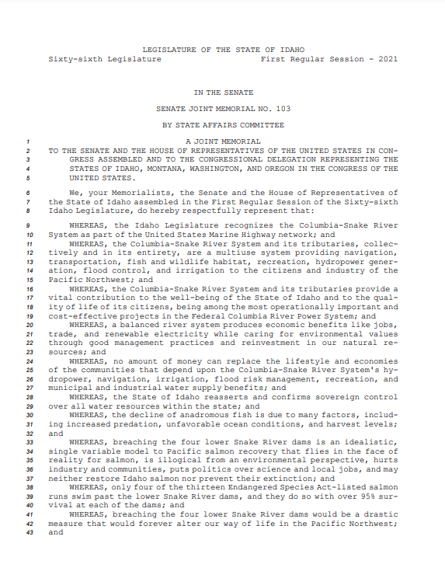
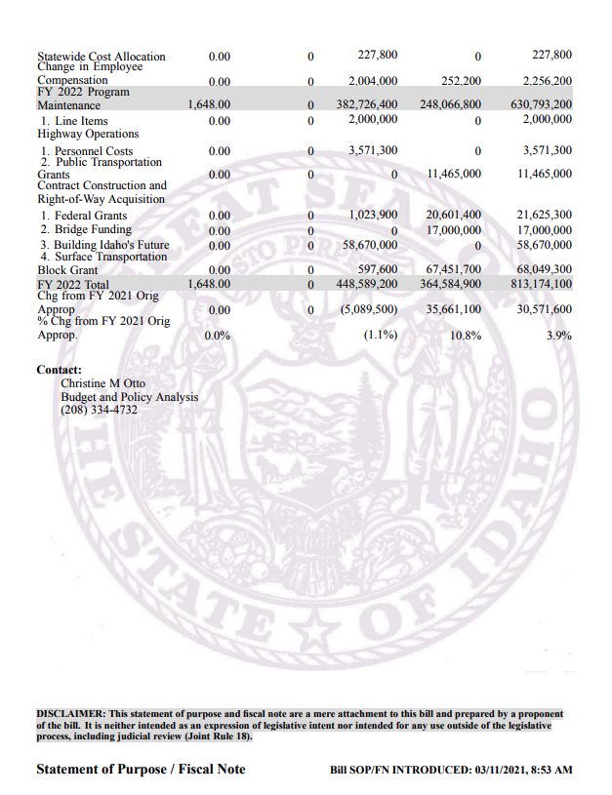

Slide 4
The Basics
A bill is a proposal for the enactment, amendment or repeal of existing law or the appropriation of public money.
A bill can start in either the House or Senate except for bills that raise revenue which must originate in the House.
A bill must pass both the House and Senate.
A bill must be signed by the Governor (or not vetoed) in order to become law.

Slide 5
More Basics
A joint memorial is a legislative petition addressed to the President, Congress, or a federal agency.
A joint resolution is a measure requiring two-thirds vote of House and Senate to amend the Idaho Constitution or ratify an amendment to the US Constitution.
A concurrent resolution is an action to regulate the affairs of the legislature.
Joint memorials or resolutions must pass both the House and Senate.
Memorials and resolutions are not subject to approval of the Governor.

Slide 6
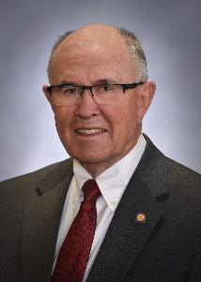
Assignment of Bills
Bills are assigned to a committee by the Speaker of the House and the Senate President Pro Tem.
The Speaker and Pro Tem can control when and where a bill is heard and can prevent a bill from advancing.

Slide 7
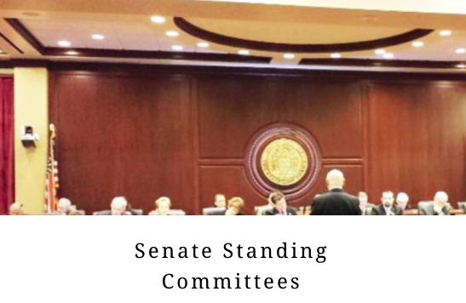
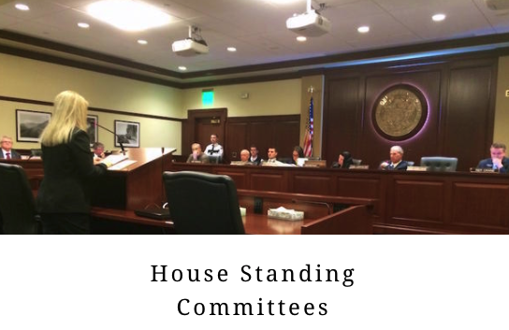
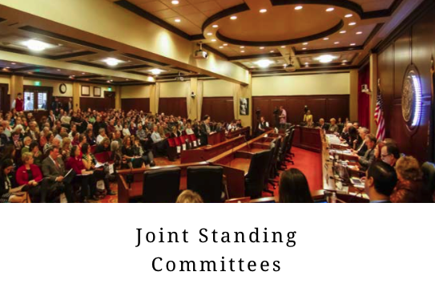
The Role of Committees
The House and Senate are made up of several germane committees.
Each committee consists of a chair, vice chair, and committee members.
Committee chairs and vice chairs are of the majority party.
The majority party also comprises a majority of each germane committee.

Slide 8
The Role of Committee Chairs
In Idaho, committee chairs have great power.
Committee chairs are appointed by the Speaker of the House and Senate President Pro Tem.
Committee chairs set the committee agenda.
A committee chair can choose to not give a bill a hearing.
If you hear that a chair has “put a bill in a drawer” it means the chair has filed the bill away and is not planning on hearing it.

Slide 9
So how does a bill become law in Idaho?

Slide 10
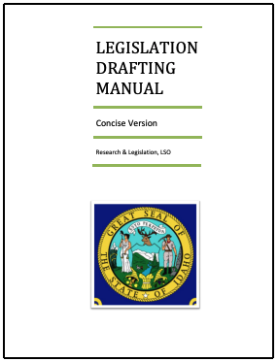
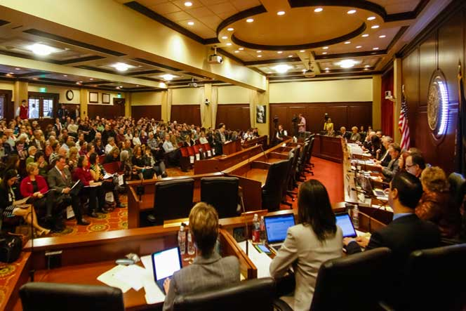
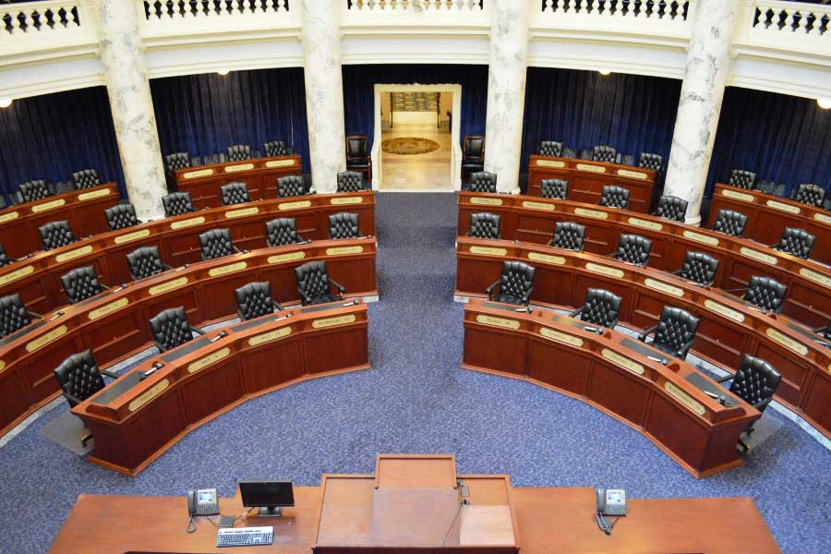
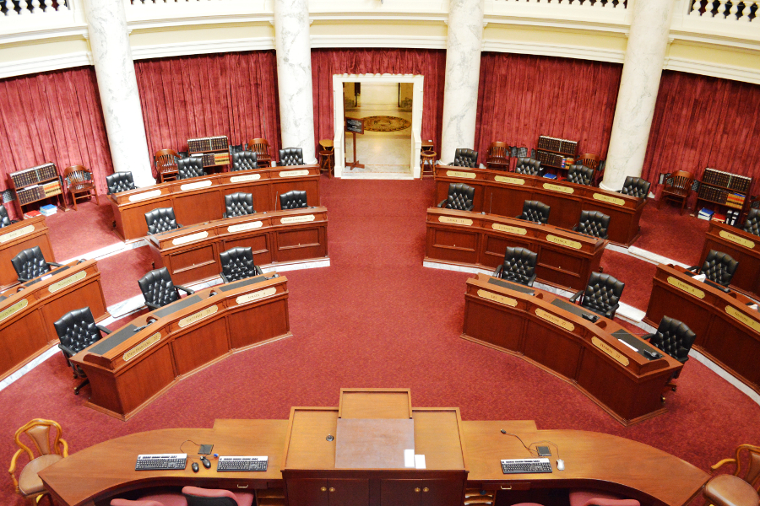
Bill Drafting
Bill Introduction
Committee Hearing
Transmittal
Floor Vote
Committee Hearing
Floor Vote
Bill Becomes Law
APPROVE
Governor Action
Transmittal
Bill Dies
VETO

Slide 11
Step 1: Bill Drafting
Legislative Services Office staff draft and edit legislation.
A “purple slip” is required before legislation can be drafted.
The sponsor prepares a statement of purpose with fiscal note.

Slide 12
Step 2: Bill Introduction
The committee germane to the bill (i.e.: Revenue and Taxation) holds an introductory or “print” hearing to determine if a bill should be formally introduced.
Only the proposal’s sponsor may present information to the committee.
The committee can move to introduce the proposal or return it to the sponsor.

Slide 13
Step 3: Committee Hearing
After introduction, a bill can be heard in committee.
At the hearing, anyone can provide testimony.
Committee members examine the testimony and may ask questions of presenters.
After public testimony, the committee debates and votes on the bill.
The committee may advance, amend, or hold the bill.
A motion to hold “kills” the bill.

Slide 14
Step 4: Floor Vote
Upon clearing the committee, a bill is brought to the floor of the body for a vote.
Only members of the body are allowed to examine and debate the bill.
If a bill is recommended by committee for amendment, amendments are considered by the full body, not the committee.
If the bill is approved, it is transmitted to the other chamber.

Slide 15
Step 5: Committee Hearing
After transmittal, a bill can be heard in committee by the other chamber.
At the hearing, anyone can provide testimony.
Committee members examine the testimony and may ask questions of presenters.
After testimony is given, the committee debates and votes on the bill.
The committee may advance, amend, or hold the bill.
A motion to hold “kills” the bill.

Slide 16
Step 6: Floor Vote
Upon clearing the committee, a bill is brought to the floor of the body for a vote.
Only the members of the body are allowed to examine and debate the bill.
If a bill is recommended by committee for amendment, amendments are considered by the full body, not the committee.
If the bill is approved, it is transmitted to the Governor.

Slide 17
Step 7: Governor Action
After a bill passes both the House and Senate, it is transmitted to the Governor.
The Governor has ten days to SIGN or VETO a bill while the legislature is in session and five days if the legislature has adjourned.
A bill becomes law if the Governor takes no action.

Slide 18
Step 8: Bill Becomes Law
If a bill is passed by both the House and Senate and approved by the Governor, it will become law.
An approved bill becomes law on its enactment date.
Most bills become law on July 1.
A bill may be enacted on another date as specified in the legislation.
Bills can also be enacted retroactively is so stated in the legislation.

Slide 19
How to Get Involved

Slide 20
Build Relationships
Get to know your legislators!!!
Ask for them for their cell phone numbers (texting is more effective than email).
Meet with them when they are home over the weekend.
Schedule regular calls in session between your county and your legislators.
Be honest.
Provide factual information.
Let them know how legislation impacts your county.

Slide 21
Watch Committee Hearings

Slide 22
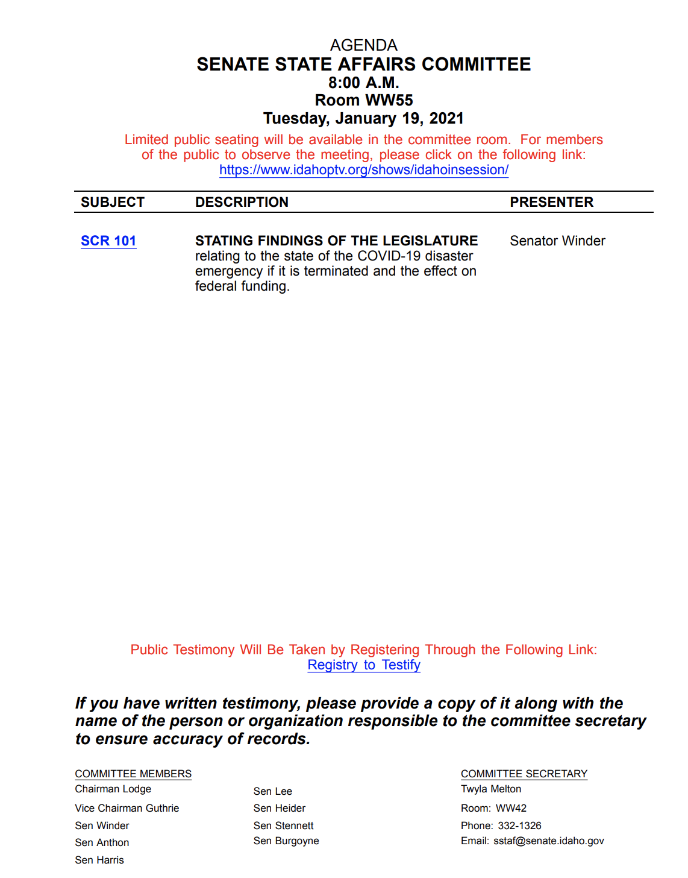
Testify Before a Committee
Watch the committee live
You can testify in person or remote via Zoom.
Committee agendas include links to stream committee meetings, look up bill information, and register to testify (both in person and remote).
Check in with IAC staff if you need assistance.
Link to bill info
Register to testify

Slide 23
Any questions?

