Slide 1
Ethics in Public Service
Jim McNall
ICRMP
Dr. Stephanie Witt
School of Public Service
Boise State University

Slide 2
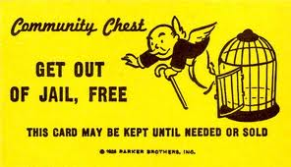
First goal

Slide 4
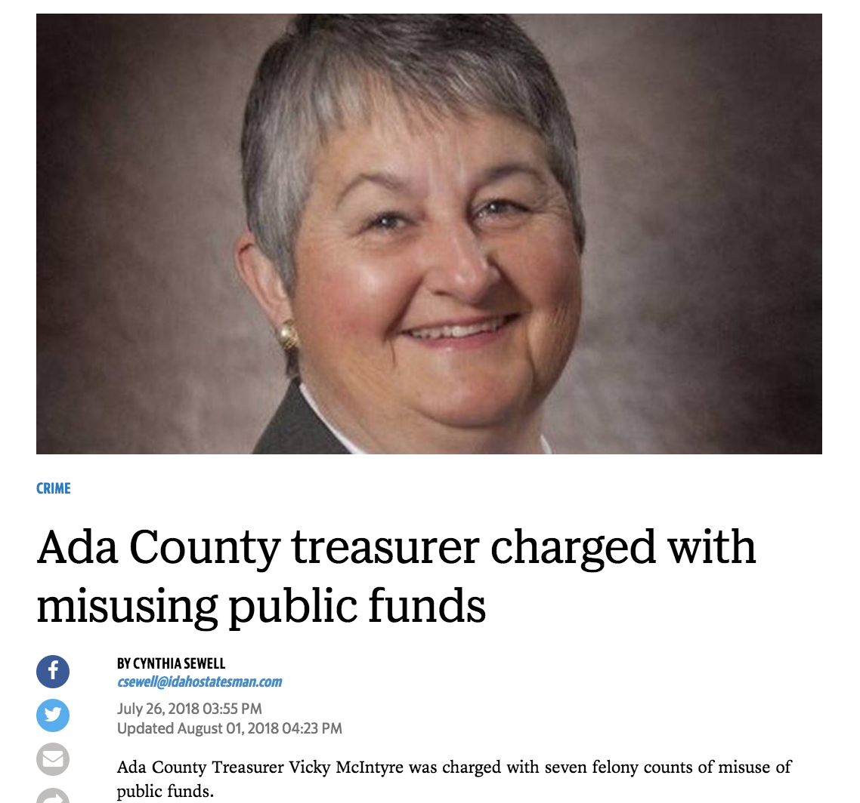

Slide 5
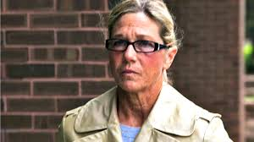
Rita Crundwell

Slide 6
Second Goal

Slide 7
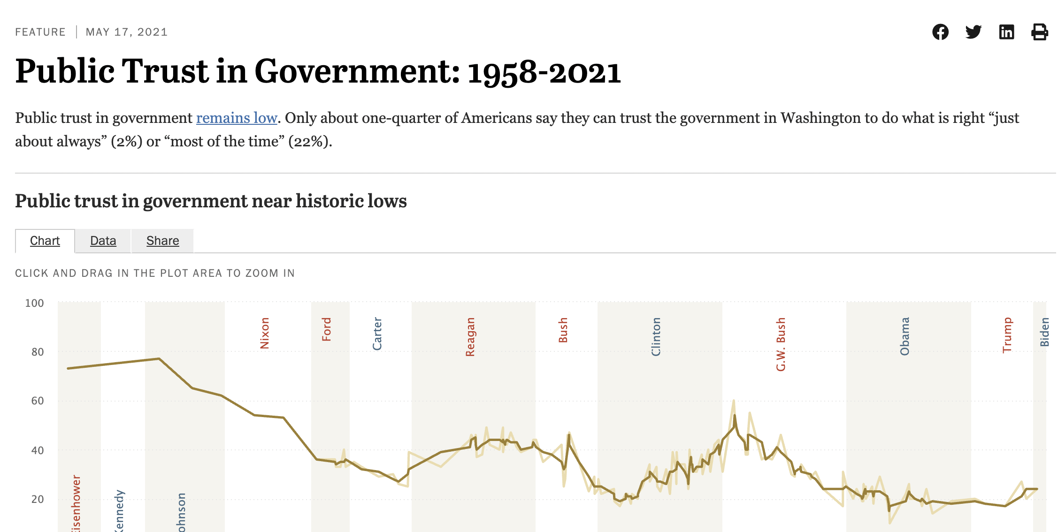
Trust in Government has declined source: Pew research Center

Slide 8
The floor and the ceiling: where are you?
Ceiling: doesn’t even take a paper clip home
Floor: the law and administrative rules.

Slide 9
Why is ethics NOT like “doing your taxes?”
Ethics
The argument “it’s technically legal” may fail the “higher standard for public service” test
Being “technically legal” doesn’t help with the appearance of impropriety
Taxes
It is legal and rational to
take every single legal way to
reduce your tax burden.

Slide 10
How Ethics Problems Happen
Information
Problems
Reasoning
Problems
Loyalty
Problems
“Sector Confusion”
Didn’t know policy
Believed they had implicit permission
Ends justify the means
Justifications
Right v Right choices

Slide 11
Information Problems
“Sector confusion”
open meetings
open records
disclosure requirements
receipt of gifts
accounting for expenses

Slide 12
Information Problems
Didn’t know the rule or policy
Believed they had implicit permission

Slide 13
Thinking problems
Ends justify the means
“working around” bothersome rules or laws to get a good thing done
Protecting the jurisdiction or colleague by covering something up

Slide 14
Thinking problems
Justifications
“We aren’t paid enough so…”
“That’s how they do it at the state, the city, etc.”
“That’s how we’ve always done it”
“Just this one time…”

Slide 15
Loyalty problems
When more than one right thing is involved
Loyalty to family or friends versus office
Professional training versus politics
Electoral survival versus ???

Slide 16
Case Study: Conflicting Loyalties
Your best friend is an employee of the County. In a meeting over potential budget cuts, you learn that her job might be eliminated. As the meeting ends, the Dept. head reminds everyone that the meeting is CONFIDENTIAL and everyone nods yes. On your way home, you remember that your friend is just about to put a down payment on a new house. Do you tell her about the job cut possibility?

Slide 17
When people choose “bad actions”
POTENTIAL REASONS
Evil Person
Don’t know policy or rules
Thought there was implicit permission
Under coercion or pressure from boss, coworkers, interest group, profession, conscience
POTENTIAL RESULTS
Termination
Legal actions
Training
Coaching
Review of policy
Hiring practices
POTENTIA

Slide 18
Ethics
74-501. Officers not to be interested in contracts.
“Members of the legislature, state, county, city, district and precinct officers, must not be interested in any contract made by them in their official capacity, or by any body or board of which they are members.”

Slide 20
Ethics
Bribery & Corrupt Influence Act—Idaho Code Title 18, Chapter 13
Public officials are prohibited from accepting gifts, but there are a few exceptions:
Fees prescribed by law to be received by a public servant or other benefits for which the recipient gives legitimate consideration or is otherwise legally entitled.
Gifts from family, friends, or business acquaintances.
Trivial gifts under $50 in value involving no risk of undermining official impartiality.

Slide 21
Case Study: The Vase
You are an County official. A few days before Christmas, a package arrives at your office. Inside is a card from the vice-president of a large corporation in your city. The company has never done business with the county. The card says, “You are doing a great job for our county and we just wanted you to know that we appreciate it. We hope you will accept this token of our gratitude.”
You open the package and find a beautiful crystal vase that you estimate to be worth $75 to $100. Do you accept the vase? Would your answer be different if you worked for a private company?

Slide 22
The “Gift Equation,” or why it is problematic to accept gifts
The “Giver”
May think they’ve “bought you”
May tell everyone
May be harmless
You (the only part you control)
Know what the gift means to you
Know you can’t be bought
The Public
May think your impartiality is impacted
May be hearing that you’re accepting favors

Slide 23
Ethics
Bribery & Corrupt Influence Act—Idaho Code Title 18, Chapter 13
Nepotism
No person related to a Commissioner or hiring person by blood or marriage within the 2nd degree can be paid to work for the County.
Relatives within the 2nd degree include: spouses, parents, siblings, children, grandparents, grandchildren, cousins, aunts & uncles, nieces & nephews.

Slide 24
Case Study: The Son-in-Law
You have just been elected to the County Commission. Your son-in-law is employed by the County Roads Department. Does this violate the Idaho Nepotism Statute?

Slide 25
Ethics
Bribery & Corrupt Influence Act—Idaho Code Title 18, Chapter 13
Nepotism
A person currently employed when a relative is elected retains their position and continues receiving cost of living increases, bonuses and promotions.

Slide 26
TITLE 74 TRANSPARENT AND ETHICAL GOVERNMENT
CHAPTER 1 PUBLIC RECORDS ACT
CHAPTER 2 OPEN MEETINGS LAW
CHAPTER 3 [RESERVED]
CHAPTER 4 ETHICS IN GOVERNMENT
CHAPTER 5 PROHIBITIONS AGAINST CONTRACTS WITH OFFICERS
CHAPTER 6 prohibition against using public funds for campaigning.

Slide 27
Conflict of interest in Idaho
. A conflict of interest is generally defined as any “official action or any decision or recommendation by a person acting in a capacity as a public official, the effect of which would be to the private pecuniary benefit of the person or a member of the person’s household, or a business with which the person or a member of the person’s household is associated.”

Slide 28
Conflict of Interest
When a conflict of interest exists, the public official must disclose the conflict. Under the Ethics in Government Act, disclosure does not affect an elected public official’s authority to be counted for the purpose of determining a quorum and to debate and to vote on the matter.

Slide 29
Exemptions to Conflict of Interest
Question No. 11: Are there exceptions to the definition of conflict of interest in chapter 4 of title 74, Idaho Code, the Ethics in Government Act?
Answer: Yes. Under the Act, there is no conflict of interest if the pecuniary benefit received arises out of:
(a) An interest or membership in a particular business, industry, occupation or class required by law as a prerequisite to the holding by the person of the office or position;
(b) Any action in the person's official capacity which would affect to the same degree a class consisting of an industry or occupation group in which the person, or a member of the person's household or business with which the person is associated, is a member or is engaged;
(c) Any interest which the person has by virtue of his profession, trade or occupation where his interest would be affected to the same degree as that of a substantial group or class of others similarly engaged in the profession, trade or occupation;
(d) Any action by a public official upon any revenue measure, any appropriation measure or any measure imposing a tax, when similarly situated members of the general public are affected by the outcome of the action in a substantially similar manner and degree.

Slide 30
Open Meetings Law
http://www.ag.idaho.gov/publications/legalManuals/OpenMeeting.pdf
When in doubt: open the meeting!

Slide 31
Case Study: Privacy and Public Officials
Your county’s Deputy Clerk attended her high school reunion out of state and partied hard with her old friends. One of the friends took a picture of the drunken Deputy Clerk passed out on a table surrounded by empty bottles, posted it on Face book and “tagged her.” Before long, the photo was being emailed and posted by many. Angry citizens are now calling and demanding she be fired as a “bad example.” Should she be fired?

Slide 32
The Expectation of Privacy increases as you go down the organization
Lowest
Highest ranking officials
Issue may be relevant to their office
Medium
Middle ranking officials
Issue is relevant to their office
Highest
Lower ranking employees
Issue not relevant to their office

Slide 33
Ethics resources
Attorney General’s Ethics handbook.
http://www.ag.idaho.gov/publications/manuals.html
Lists the statutes addressing ethics in Idaho
Contains a listing of Attorney General findings in answer to specific ethics inquiries

Slide 34
First goal

