Slide 1
The American rescue plan act
August 12, 2021

Slide 2
Presenters
Bobby Lawrence, Partner blawrence@eidebailly.com 208.383.4742

Slide 3
Agenda
What is ARPA?
Some FAQs – Separating Fact from Fiction
What About Reporting ARPA Funds?
Questions
Requirements Under the Uniform Guidance

Slide 4
caution
In May, US Treasury issued an Interim Final Rule seeking comment / feedback on regulatory aspects of ARPA.
Comments were due to US Treasury on July 16, 2021.
Some of the aspects of the Coronavirus State and Local Fiscal recovery Funds (CSFRF / CLFRF) may change as a result of adjudication of comments.
Notes:
Treasury received over 1100 comments that they have to read and determine the resolution.
Until Treasury adopts a final rule and the final rule becomes effective, the Interim Final Rule is, and will remain, binding and effective. This means that recipients can and should rely on the Interim Final Rule to determine whether uses of funds are eligible under this program. Treasury encourages recipients to use funds to meet needs in their communities.
Funds used in a manner consistent with the Interim Final Rule while the Interim Final Rule is effective will not be subject to recoupment.

Slide 5
What is ARPA

Slide 6
American
Recovery
Plan Act
US Department of Treasury
Coronavirus State Fiscal Recovery Fund (CSFRF)
Coronavirus Local Fiscal Recovery Fund (CLFRF)
Non-entitlement Units of Local Government (NEUs)
Notes:
March 6, 2020 – Coronavirus Preparedness and Response Supplemental Appropriations Act - $8.3 billion
Kicked off research, funding for COVID response, $20 million in loan subsidies, expanded Telehealth
March 27, 2020 - Coronavirus Aid, Relief and Economic Security Act (CARES) - $2 Trillion
Giant bill – expanded previous two acts, added small business forgivable loans (PPPs)
December 27, 2020 – Coronavirus response and Relief Supplemental Appropriations Act (CRRSA) - $900 Billion (part of additional appropriations act)
March 11, 2021 – American Rescue Plan Act (ARPA) - $1.9 Trillion, includes $350 Billion in aid for State and Local governments

Slide 7
ARPA – of the $1.9 Trillion
(Economic impact payments, child tax credits, homeowner assistance, emergency rental assistance, small business credits, employee retention credits, other items)
Additional $10 billion in infrastructure funds also in ARPA

Slide 8
Of the CSRF and CLRF $350B ‘slice’ in ARPA…

Slide 9
There are additional elements in ARPA even though state and local gets most of the ‘ink’ that may impact governments
Federal Agency | ARPA Funds
Housing and Urban Development (HUD) | Direct Homeowners Assistance (Mortgages, property taxes, property insurance, utilities and related housing costs)
Education (US ED) | Education Stabilization Fund (includes Elementary and Secondary School Emergency Relief Fund and Higher Education Emergency Relief Fund)
Transportation (US DOT) | $30.5 billion for Section 5307, 5310, 5311 programs (Urban, Enhanced Mobility of Seniors and Individuals with Disabilities, Rural Area, Tribal Nation, Bus Operator Programs) $8 billion for airports (including $800 million for concessionaires)
FEMA | $50 billion Disaster relief funds, PPE $3 billion in economic adjustments
HHS | $5 billion in low-income home energy assistance program, drinking water, wastewater expenses
US DOT Funds need to be spent sooner than other funds!!
Notes:
US DOT funds available until September 30, 2024

Slide 10
REPORTING REQUIREMENTS

Slide 11
REPORTING REQUIREMENTS
SAM.gov Requirements.
Recordkeeping Requirements.
Single Audit Requirements.
Notes:
All eligible recipients are also required to have an active registration with the System for Award Management (SAM) (https://www.sam.gov).
Generally, your organization must maintain records and financial documents for five years after all funds have been expended or returned to Treasury, as outlined in paragraph 4.c. of the Award Terms and Conditions.
Recipients and subrecipients that expend more than $750,000 in Federal awards during their fiscal year will be subject to an audit under the Single Audit Act and its implementing regulation at 2 CFR Part 200, Subpart F regarding audit requirements.

Slide 12
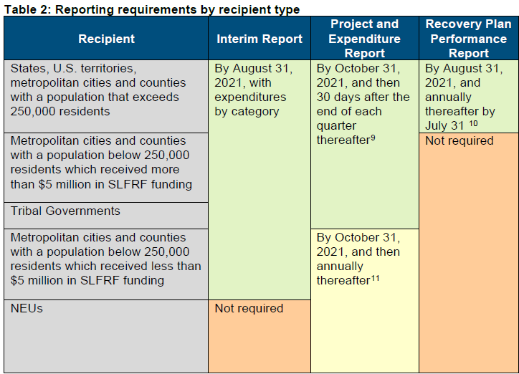
https://41g41s33vxdd2vc05w415s1e-wpengine.netdna-ssl.com/wp-content/uploads/2021/06/SLFRF-Compliance-and-Reporting-Guidance_6.17.21.pdf
Notes:
There are three types of reporting requirements for the SLFRF program.
• Interim Report: Provide initial overview of status and uses of funding. This is a one-time report.
Remember – The interim report is due 60 days after receipt of funds if the 60 days is after August 31, 2021
• Project and Expenditure Report: Report on projects funded, expenditures, and contracts and subawards over $50,000, and other information
• Recovery Plan Performance Report: The Recovery Plan Performance Report (the “Recovery Plan”) will provide information on the projects that large recipients are undertaking with program funding and how they plan to ensure program outcomes are achieved in an effective, efficient, and equitable manner. It will include key performance indicators identified by the recipient and some mandatory indicators identified by Treasury. The Recovery Plan will be posted on the website of the recipient as well as provided to Treasury.

Slide 13
Recovery Plan Performance Report
Counties with a population that exceeds 250,000 residents will also be required to publish and submit to Treasury a Recovery Plan performance report (“Recovery Plan”). Each Recovery Plan must be posted on the public-facing website of the recipient by the same date the recipient submits the report to Treasury. This reporting requirement includes uploading a link to the publicly available document report along with providing data in the Treasury reporting portal.

Slide 14
What about auditing of ARPA FunDS?

Slide 15
Auditing and reporting
What we know so far…
IFR Page 97 – “As provided for in the award terms, payments from the Fiscal Recovery Funds as a general matter will be subject to the provisions of the Uniform Administrative Requirements, Cost Principles, and Audit Requirements for Federal Awards (2 CFR 200) (the Uniform Guidance), including the cost principles and restrictions on general provisions for selected items of cost.”
Would be subject to Yellow Book per GAO
Period of Performance through December 31, 2026
ALN 21.027

Slide 16
What could this mean to your county?
Uniform Guidance requires an audit of the federal expenditures (single audit) if total expenditures from all federal programs exceed $750,000.
Even if no individual program exceeds $750,000
“Expenditures” does include lost revenue
Single audit means you will be audited for compliance with program requirements AND your controls over compliance will be audited
Noncompliance or deficiencies in your control over compliance could result in a material noncompliance and/or a material weakness or significant deficiency in internal control over compliance
Findings will be reported on the Schedule of Findings and Questioned Costs
Findings will be reported to the federal agencies through the Data Collection Form which is required to be submitted 9 months after year-end but no later than 30 days after your report is issued.
Notes:
Audit costs are an allowable use of ARPA funds;

Slide 17
How to prepare for a single audit
System of Internal Controls
Record and capture information
Policies and procedures, laws and regulations
Qualified auditor
Notes:
Make sure your auditor is qualified to perform a single audit; factors to consider include:
Demonstration of qualifications and experience with single audit
Availability of staff with appropriate technical abilities
Results of the external peer review
Participation in quality improvement programs like the GAQC
And has proper CPE

Slide 18
Eligible uses of arpa funds

Slide 19
Treasury’s Funding objectives
Treasury is launching this much-needed relief to:
Support urgent COVID-19 response efforts to continue to decrease spread of the virus and bring the pandemic under control
Replace lost revenue for eligible state, local, territorial, and Tribal governments to strengthen support for vital public services and help retain jobs
Support immediate economic stabilization for households and businesses
Address systemic public health and economic challenges that have contributed to the inequal impact of the pandemic
Notes:
The Coronavirus State and Local Fiscal Recovery Funds provide substantial flexibility for each government to meet local needs—including support for households, small businesses, impacted industries, essential workers, and the communities hardest hit by the crisis. These funds can also be used to make necessary investments in water, sewer, and broadband infrastructure.

Slide 20
Core eligible uses – state and local
Respond to public health emergency and its negative economic impacts.
Premium pay for eligible workers that provide essential work during the pandemic.
Pay for government services to the extent of reduced general revenues due to COVID-19.
Specific uses for water, sewer, broadband.
Notes:
Use of Fiscal Recovery Funds is generally forward looking. The Interim Final Rule permits funds to be used to cover costs incurred beginning on March 3, 2021.
Treasury’s Interim Final Rule establishes a framework for determining whether a specific project would be eligible under the SLFRF program, including some helpful definitions.
A framework for determining whether a project “responds to” a “negative economic impact” caused by the COVID-19 public health emergency;
• Definitions of “eligible employers”, “essential work,” “eligible workers”, and “premium pay” for cases where premium pay is an eligible use;
• A definition of “general revenue” and a formula for calculating revenue lost due to the COVID-19 public health emergency;
• A framework for eligible water and sewer infrastructure projects that aligns eligible uses with projects that are eligible under the Environmental Protection Agency’s Drinking Water and Clean Water State Revolving Funds; and
• A framework for eligible broadband projects designed to provide service to unserved or underserved households, or businesses at speeds sufficient to enable users to generally meet household needs, including the ability to support the simultaneous use of work, education, and health applications, and also sufficiently robust to meet increasing household demands for bandwidth.

Slide 21
Respond to public health emergency and its negative economic impacts
AREA OF IFR | POTENTIAL USE | POTENTIAL ALLOWABLE COSTS
COVID-19 | Reducing COVID-19 | Vaccine incentives PPE Medical Expense reimbursements Health Data Systems (and Apps) Facilities expansion
 | Behavioral Health | Mental health / substance treatment Crisis intervention Hotlines Social services
 | Payroll for health / safety employees | Payroll for COVID-19 related Eligible employee benefits
Negative Economic Impact to Targeted Industries / Communities | Travel, tourism, hospitality | COVID-19 prevention (barriers, signage, social distancing, PPE, safe reopening plans)
 | State and local governments | Rehiring laid off employees to pre-pandemic levels Reducing unemployment trust fund deficits
 | Small Business | Loans, grants, economic development
 | QCTs | Investment in housing, disparities in education
Notes:
Recognizing the disproportionate impact of the pandemic-related recession on low-income communities, recipients must report whether certain types of projects are targeted to economically disadvantaged communities, as defined by HUD’s Qualified Census Tract.15

Slide 22
Respond to public health emergency and its negative economic impacts
Aid to disproportionately impacted populations and communities defined in so-called Qualified Census Tracts (QCTs)
Access to health and social services
Housing insecurity, affordable housing, homelessness
Hiring and Rehiring Police and Public Servants
Pre-pandemic level
COVID-related court backlogs
Above pre-pandemic levels
Notes:
Recipients may use SLFRF award funds to provide assistance to households – such as rent, mortgage, or utility assistance – for costs incurred by the household prior to March 3, 2021, provided that the recipient State, territorial, local or Tribal government did not incur the cost of providing such assistance prior to March 3, 2021.
Beneficiaries may have incurred arrearages prior to the covered period, as long as the expenditure of the prime recipient was in the covered period.
May use resources to rehire police officers and other public servants to restore law enforcement and courts to their pre-pandemic levels. Additionally, Funds can be used for expenses to address COVID-related court backlogs, including hiring above pre-pandemic levels, as a response to the public health emergency.

Slide 23
Core eligible uses – state and local
Respond to public health emergency and its negative economic impacts.
Premium pay for eligible workers that provide essential work during the pandemic.
Pay for government services to the extent of reduced general revenues due to COVID-19.
Specific uses for water, sewer, broadband.

Slide 24
Premium pay for employees that provide essential work during the pandemic
Potentially eligible workers:
Nursing home, hospital, homecare staff
Workers at farms, food production, grocery stores, restaurants
Janitors and sanitation workers
Truck drivers, transit staff, warehouse workers
Public health and safety
Childcare
Social services staff
Maximum subsidy $13 / hour up to $25,000.
Can be directly paid or through private employers.
Low-income eligible workers prioritized.
Notes:
Recipients may provide premium pay retrospectively for work performed at any time since the start of the COVID-19 public health emergency. Such premium pay must be “in addition to” wages and remuneration already received and the obligation to provide such pay must not have been incurred by the recipient prior to March 3, 2021.

Slide 25
Core eligible uses – state and local
Respond to public health emergency and its negative economic impacts.
Premium pay for eligible workers that provide essential work during the pandemic.
Pay for government services to the extent of reduced general revenues due to COVID-19.
Specific uses for water, sewer, broadband.

Slide 26
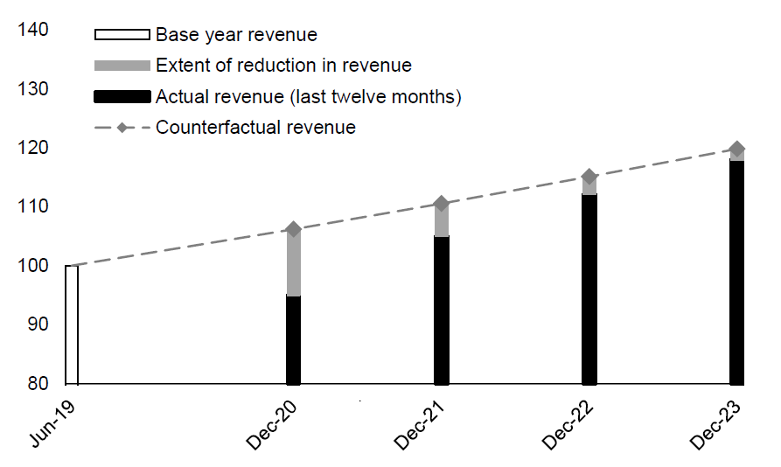
Revenue replacement calculation
From the Interim Final Rule (p. 59):
The small gray area is what can be used for revenue replacement
Notes:
Treasury’s Interim Final Rule gives recipients broad latitude to use funds for the provision of government services to the extent of reduction in revenue. While calculation of lost revenue begins with the recipient’s revenue in the last full fiscal year prior to the COVID-19 public health emergency and includes the 12-month period ending December 31, 2020, use of funds for government services must be forward looking for costs incurred by the recipient after March 3, 2021.
Recipients may use funds to cover costs incurred for eligible projects planned or started prior to March 3, 2021, provided that the project costs covered by the funds were incurred after March 3,2021.

Slide 27
Revenue replacement calculation
Annual revenues from 2016-2019 calculated as of December 31 in allowable categories.
Calculation of growth from year to year.
Comparison to the higher of the allowable growth of 4.1% or the past 3 year growth rate.
If actual growth in revenues is more, revenue replacement is zero!
DO NOT USE FISCAL YEAR!
Notes:
As of right now it is unclear if you can use your fiscal year-end date or if you’ll be required to use December 31
Should use audited data if available, but no requirement if not available as long as unaudited data is reliable and substantially accurate

Slide 28
Revenue replacement calculation
 | NOT INCLUDED | INCLUDED
Federal transfers (direct or passthroughs) | IFR Page 50
Intergovernmental transfers (from or to government) | US Census Bureau guidance
Utilities and Mass Transit Revenues | US Census Bureau Guidance
Refunds and error corrections | IFR page 49
Debt issuance proceeds | IFR page 49
Liquor Store Revenues | US Census Bureau Guidance
All other general revenues (taxes, program revenues etc., if they support public services) |  | YES
Fees charged |  | YES
Use government-wide revenues, including component units!

Slide 29
Revenue replacement
Funds cannot be used for:
Direct pension contributions
Exception: if employee grant eligible, employer’s share of ongoing, normal contributions OK
Tax reductions
Debt service
“Rainy Day” / Stabilization funds
Funds can be used for:
Government services including directly providing aid to Citizens
Pay as you go capital projects / maintenance
Cybersecurity, health, K-12, Police, Fire, Public Safety
Based on IFR pp. 53-54

Slide 30
Core eligible uses – state and local
Respond to public health emergency and its negative economic impacts.
Premium pay for eligible workers that provide essential work during the pandemic.
Pay for government services to the extent of reduced general revenues due to COVID-19.
Specific uses for water, sewer, broadband.

Slide 31
Water, sewer, broadband infrastructure and reporting
Water / Sewer – aligns with States’ Revolving Funds (Clean water / drinking water SRFs – CFDA 66.458, 66.468)
Others may be named in future FAQs.
If state has SRF – use it to potentially leverage funds.
Broadband
Enhancing service to 100MBS download / upload, unless impracticable due to terrain, geography, cost.
Can be used to support internet access and literacy.
Can be used for eligible projects planned or started prior to March 3, 2021, provided the project costs covered by FRF award fund were incurred after March 3, 2021.

Slide 32
Some Frequently Asked questions – separating fact from fiction

Slide 33
Eligibility and ALLOWABLE uSES
FICTION | FACT
If the cost was allowable under CRF, it is allowable under FRF. | Not necessarily. Eligibility of public health and safety payroll are different, and expenses related to the issuance of TANs are not an eligible use. (FAQ 2.2)
The IFR doesn’t list my government’s potential use of funds relating to COVID-19 or negative economic impacts. I guess we can’t use ARPA funds. | Not necessarily. The IFR contains a non-exclusive list of programs or services that MAY be funded. It contains the framework for evaluating other potential uses. (FAQ 2.3)
My County has to use our funds exclusively for County costs and projects. | Wrong. The County may provide funds directly to households in the community as long as the County substantiates the household has experienced a negative economic impact from the pandemic. (FAQ 2.6)
The IFR talks a lot about travel, tourism and hospitality. We don’t have a lot of this activity in our County, so we can’t really assist industries in our County. | Wrong. The County may provide funds to other industries provided they can support their assessment of how the businesses in the industry were negatively impacted by the pandemic. (FAQ 2.10)

Slide 34
Eligibility and ALLOWABLE uSES
FICTION | FACT
My County cannot use the funds for general workforce development. | Not necessarily. If the County can demonstrate it is directly addressing a negative impact of COVID-19, you can use the funds for job training for the unemployed (FAQ 2.8) and other back to work incentives to reduce unemployment. (FAQ 2.13)
In order to provide assistance or aid to low-or moderate-income households in our community, the County would have to demonstrate that each individual household experienced a negative impact. We don’t have the resources to do that so we can’t use the funds for that purpose. | Wrong. The IFR allows the County to demonstrate a negative economic impact on a population or group and to provide assistances to the individuals or business within that group and only needs to demonstrate that the household or business is within the population or group. (FAQ 2.17)

Slide 35
Premium pay
FICTION | FACT
Essential workers are only those in public safety and public health. | Wrong. Essential workers are those in critical sections who regularly perform in-person work, interact with others at work, or physically handle items handled by others: education, childcare, transportation, sanitation, grocery and food production. (FAQ 5.1)
My County can only provide premium pay to essential County workers. | Wrong. The County can provide assistance to third-party employers of essential workers. (FAQ 5.2)
My County can only pay premium pay for work performed after March 3, 2021. | Wrong. The County is encouraged to consider providing premium pay retroactively for work performed during the pandemic. (FAQ 5.3)

Slide 36
Revenue loss calculation
FICTION | FACT
My County identified a reduction in revenue. It’s free money from ARPA! | Not quite. There is broad latitude, but cannot use funds on debt service, rainy day funds (or other reserves), settlements and judgments and direct pension deposits (FAQ 3.8)
The revenue calculation is required to use audited data. | Wrong. There’s no requirement for the data to be audited if not available. (FAQ 3.10)
The revenue calculation needs to be done on a full accrual basis of accounting. | Wrong. It may be on the cash, accrual or modified accrual basis as long as it is consistent. (FAQ 3.12)

Slide 37
OTHER Eligible uses
FICTION | FACT
We have to get approval from the State or Treasury for any water/sewer projects using ARPA funds. | Wrong. Prior approval is not required; however, the County needs to make sure the intended project and uses of funds align with eligible projects listed in the Federal and State drinking water or clean water revolving fund. (FAQs 6.1 and 6.7)
There’s no way my water, sewer or broadband project will be complete by December 31, 2024 – I guess we can’t go forward. | Wrong. US Treasury only requires recipients to obligate funds by that date. The period of performance will run until 12/31/26. (FAQ 6.2)
There’s no funds in ARPA for cybersecurity. | Wrong. Cybersecurity is an allowable cost for ARPA, along with expanding broadband and digital literacy (FAQ 6.6)

Slide 38
OTHER Eligible uses – arpa funds
FICTION | FACT
My County cannot use funds to assist with any costs or negative economic impact incurred before March 3, 2021. | Wrong. The “incurred before March 3, 2021” only applies to what was incurred by the County. The County can use the funds to assist households and businesses with costs incurred by the household or business prior to March 3, 2021. (FAQ 4.7)
My County is constructing an asset from ARPA funds. It needs to be deeded over to the federal government on December 31, 2024. | Wrong. Like other federal programs, if the use was allowable, the asset may be retained. If disposed, program provisions apply (FAQ 10.1)
Since my County is receiving ARPA funds in advance, interest on the funds is owed to the federal treasury. | Wrong. The funds are exempt from the Cash Management Improvement Act (FAQ 10.3)

Slide 39
infrastructure
Treasury FAQ 4.2
May recipients use funds to invest in infrastructure other than water, sewer, and broadband projects (e.g. roads, public facilities)?
Under 602(c)(1)(C) or 603(c)(1)(C), recipients may use funds for maintenance of infrastructure or pay-go spending for building of new infrastructure as part of the general provision of government services, to the extent of the estimated reduction in revenue due to the public health emergency.
Under 602(c)(1)(A) or 603(c)(1)(A), a general infrastructure project typically would not be considered a response to the public health emergency and its negative economic impacts unless the project responds to a specific pandemic-related public health need (e.g., investments in facilities for the delivery of vaccines) or a specific negative economic impact of the pandemic (e.g., affordable housing in a Qualified Census Tract).

Slide 40
infrastructure
Treasury FAQ 4.6
How do I know if a specific use is eligible? [5/27] Fiscal Recovery Funds must be used in one of the four eligible use categories specified in the American Rescue Plan Act and implemented in the Interim Final Rule:
To respond to the public health emergency or its negative economic impacts, including assistance to households, small businesses, and nonprofits, or aid to impacted industries such as tourism, travel, and hospitality;
To respond to workers performing essential work during the COVID-19 public health emergency by providing premium pay to eligible workers;
For the provision of government services to the extent of the reduction in revenue due to the COVID–19 public health emergency relative to revenues collected in the most recent full fiscal year prior to the emergency; and
To make necessary investments in water, sewer, or broadband infrastructure.

Slide 41
infrastructure
Treasury FAQ 4.10
May recipients fund a project with both ARP funds and other sources of funding (e.g., blending, braiding, or other pairing funding sources), including in conjunction with financing provided through a debt issuance? [7/14]
Cost sharing or matching funds are not required under CSFRF/CLFRF. Funds may be used in conjunction with other funding sources, provided that the costs are eligible costs under each source program and are compliant with all other related statutory and regulatory requirements and policies. The recipient must comply with applicable reporting requirements for all sources of funds supporting the CSFRF/CLFRF projects, and with any requirements and restrictions on the use of funds from the supplemental funding sources and the CSFRF/CLFRF program.
Notes:
Note that in this FAQ, CSFRF/CLFRF funds could not be used to fund the entirety of a water infrastructure project that was partially, although not entirely, an eligible use under Treasury’s Interim Final Rule. However, the recipient could use CSFRF/CLFRF funds only for a smaller component project that does constitute an eligible use, while using other funds for the remaining portions of the larger planned water infrastructure project that do not constitute an eligible use. In this case, the “project” under this program would be only the eligible use component of the larger project.

Slide 42
infrastructure
Hypotheticals
Water, Sewer and Broadband infrastructure project
Funding of a public infrastructure project with ARPA and bond proceeds
Remodel of existing facilities with ARPA
Entities pool funds for projects
Fund existing planned / in-process infrastructure project
Notes:
Decision Tree:
Is the infrastructure project specifically allowed in the IFR?
Does the entirety of the project fit within an allowable use?
Can the project be bifurcated?
Has the entity experienced revenue loss?
Treasury FAQs
NACo FAQs
IAC FAQs
Wait for Final Rule

Slide 43
HOW EIDE BAILLY CAN HELP YOU

Slide 44
ADVISORY SERVICES
ARPA presents an opportunity to reshape governments (within boundaries of allowable costs).
Cyber-resiliency and Cybersecurity
Citizen engagement for uses of ARPA funds:
Surveys
Community outreach
Strategic thinking/planning:
Review of entire federal grant lifecycle at government: enhancing internal controls and reporting
Establishing regional roundtables for sharing of services (encouraged by ARPA)
Notes:
Shoring up systems
Penetration testing
Training
Network design
Outsourcing

Slide 45
QUESTIONS?

