Slide 1
Alberto Gonzalez
DMV Administrator

Slide 2
GEM & Technology Update
GEM Vehicles Update
Since March, improvements have continued every 3 weeks
Improved transaction times across the state
Major New Functionality Added
QR Code usage
502- Dealer Purchase New Vehicle Registration
Fleet Inventory
Dealer Services Enhancements
GEM Drivers Enhancements
Release of Liability On-Line

Slide 3
GEM & Technology Update
What’s Next For GEM/Technology
Authorized Providers (Dealer’s Senate Bill 1102)
502-Dealer Purchased Recreational Vehicles
502-Dealer Purchased Vehicle with Plate Transfer
Increased On-Line/Mobile Alternatives vs In-Person
Continued System Enhancements Across GEM
Quick Scan Bar Code for Counties and ITD
New Equipment for Counties (PCs, Scanners, Barcode Scanners)
Updating The Automated Driver’s License Testing Software
RFP for the Driver’s License Print Service Provider

Slide 4
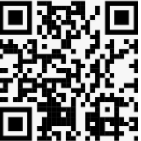
Service Delivery Evolving
Needs are changing
Customers want options to meet their needs
Reduced costs to customers
Improved timelines (24-48 hrs)
Improved lobby wait times
Standard work across the state including any door policy
20%
20%
1%
Est 45% of titles
59%

Slide 5
Service Delivery Evolving
Online
We are on pace to exceed 1 Million online transactions this year (in 2016 we had just over 260,000)
QR code trial went great, looking to go statewide
E-502 option launched and over 4,500 registered new car online. 75% completed transaction – Assuming 25% needed plate transfer which is coming

Slide 6
Service Delivery Evolving
Authorized parties
Up to 10 providers will be allowed in Idaho. We expect at least one in place by end of year.
Agreements (business and technical) are being finalized and are using national best practices
Many vendors already providing other services to dealers
Assumption is 80-90% take rate or about 300,000 customers annually

Slide 7
Service Delivery Evolving
Traditional services
There will always be a need, but we anticipate a reduced need over time
Many folks prefer to mail in or walk-in for their transactions
Funding impacts are inevitable
Need to plan to right-size staff at county and state level once revenue impact is known

Slide 8
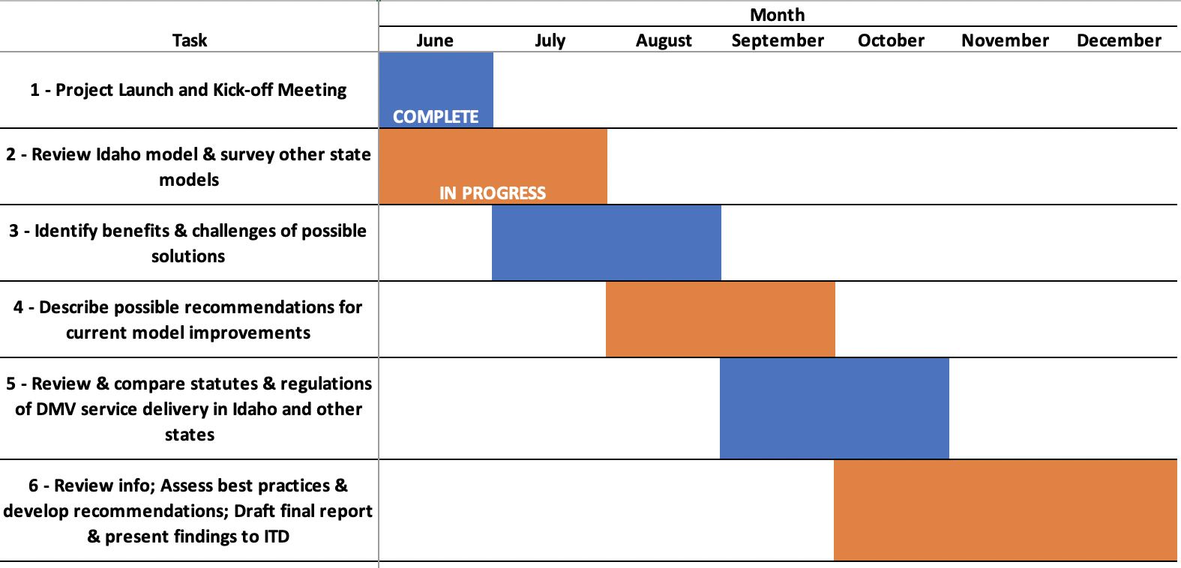
Service Delivery Model Study FHWA Funds (Transportation Research Board)

Slide 9
Brian Goeke
DMV Policy Manager

Slide 10
Transitional Funding Options for Counties to Reduce $ Impact
ITD, Several Assessors, the Association, and the Governor's Office met on Aug 17th and discussed the below options:
 | ITD Proposed |  |  |  |  | Assessor Proposed
SERVICE | A | B | C | D | SERVICE | E
ITD On-Line Renewal | $0.00 | $0.00 | $0.00 | $0.00 | ITD On-Line Renewal | $2.00
ITD Mail-In Renewal | $0 | $2.00 | $2.00 | $2.00 | ITD Mail-In Renewal | $4.00
County In-Person Reg | County Admin | County Admin | County Admin | County Admin | County In-Person Reg | County Admin
County Dealer Title | $0 Centralized at ITD | $0 Centralized at ITD | $0 Centralized at ITD | $3 | County Dealer Title | $3
ITD Dealer Title | $0 | $0 | $3 | $3 | ITD Dealer Title | $3
3rd Party Title | $0 | $3 | $3 | $3 | 3rd Party Title | $3

Slide 11
Transitional Funding Option Analysis
13 Counties have an Admin Fee under $4
Introducing another set of fees ($2/$4) is problematic
The Vendor Bill will eliminate the need for ITD to pursue Dealer Title Centralization
Postage needs to be included in the discussion if online and mail are centralized
ITD needed to provide a longer runway for Assessors to plan for impacts.
SERVICE | E
ITD On-Line Renewal | $2.00
ITD Mail-In Renewal | $4.00
County In-Person Reg | County Admin
County Dealer Title | $3
ITD Dealer Title | $3
3rd Party Title | $3
Our analysis led to 5 areas of consideration: Online Renewals, Mail In Renewals, Vendor Processed Titles, Postage, and the Implementation Timeline

Slide 12
Transitional Funding Option for Counties to Plan for $ Impact
Online and Mail In Renewal Processing will be centralized, as this is the most efficient and cost effective process for taxpayers
All Current Postage Fees will be frozen, and eventually eliminated, as centralization and plate-on-demand will eliminate the need for counties to mail plates and stickers to customers
FY22 (Oct 21 – Sept 22)​ | FY23 (Oct 22 – Sept 23)​ | FY24 (Oct 23 – Sept 24)​
Online Admin Fee​ Mail In Admin Fee​ Vendor Title Portion​ Postage​ | Online Admin Fee​ Mail In Admin Fee​ Vendor Title Portion​ Postage​ | Online Admin Fee​ Mail In Admin Fee​ Vendor Title Portion​ Postage​

Slide 13
Understanding the Impact
FY22 (Oct 21 – Sept 22)​ | FY23 (Oct 22 – Sept 23)​ | FY24 (Oct 23 – Sept 24)​
Online Admin Fee​ Mail In Admin Fee​ Vendor Title Portion​ Postage​ | Online Admin Fee​ Mail In Admin Fee​ Vendor Title Portion​ Postage​ | Online Admin Fee​ Mail In Admin Fee​ Vendor Title Portion​ Postage​
This process will not introduce any new fees.
The numbers that you are seeing at based on the last 3 months of transactions, extrapolated out over a year. Mail In numbers were assumed at 20%.
The impact difference between counties varies greatly, the highest monetary impacts will be felt by the larger counties. However it is likely a 30% to 40% revenue decrease from DMV transactions for all counties by the end of FY24.
The number in the right column (FY24) is in addition to the center column (FY23)
This impact assumes the Admins Fees remain the same.
At the end of FY24, the compensation counties receive for transactions will be consistent with transactions being performed in the office.

Slide 14
Questions?

