Slide 1
Law Enforcement Liability
IACC Conference
Coeur d’Alene
June 10, 2021

Slide 2
Chad Sarmento
Law Enforcement Risk Manager
23 Years Idaho Law Enforcement
Patrol Commander
Jail Commander
Police Officers Standards Training (POST) Instructor

Slide 3
Law Enforcement – A Risky Venture
Use of Force
High Speed Driving
Civil Rights
Criminal & Gangs
Mental Illness
Drug Abuse
Medical Conditions
Innocent Bystander

Slide 4
Law Enforcement Liability Risk (Exposures)
In Custody Jail Deaths
Deliberate indifference
Civil Rights Violations
Inmate access while in custody
Medical access for both new & pre-existing problems
Rights from illegal search & seizures
Including stopping & individual by use of firearm
Lack of Policies/Training for Personnel
Emergency medical procedures
Responding to an unconscious suspect/inmate
Excessive Use of Force
Lack of policies or properly trained personnel
Vehicle Accidents
Pursuits
Lack of ongoing driver’s training
Lack of policy regarding high-risk pursuits
General driving accidents
Employment/Promotion Decisions
To include disciplinary procedures provided by county
Discrimination/Harassment/Retaliation

Slide 5
But At What Cost?
Pursuit & Emergency Vehicle Response:
$3.9 Million - Police chase injured 3 pedestrians
3 teenagers injured when struck by stolen vehicle eluding police pursuit
Jail Death / Lack of Medical Care
$8.3 Million - Wrongful death Of inmate in county jail
After four years of litigation Alameda County & Corizon Health, Inc. ended a wrongful death civil rights case by agreeing to pay $8.3 million.

Slide 6
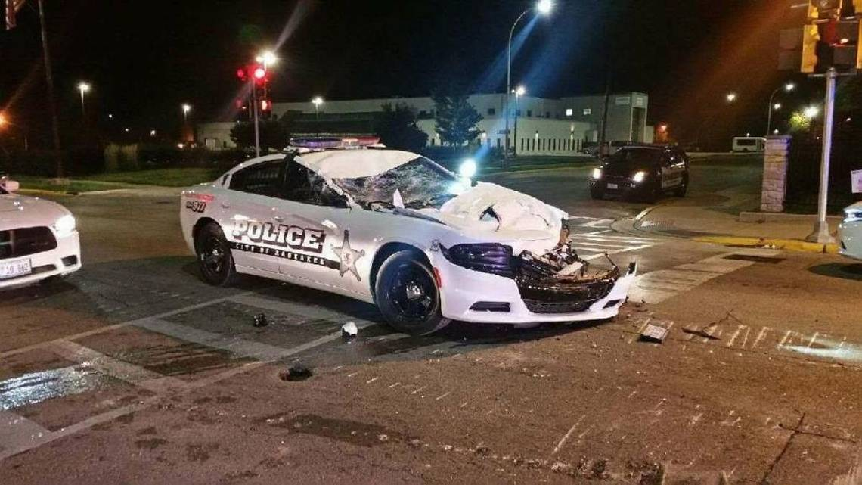
What are we doing to Help with risk?
In 2019, introduced Law Enforcement Risk Management Program
Designated person to work on high-risk areas
Point of contact with your law enforcement leadership
Developer/organizer for ongoing liability issues

Slide 7
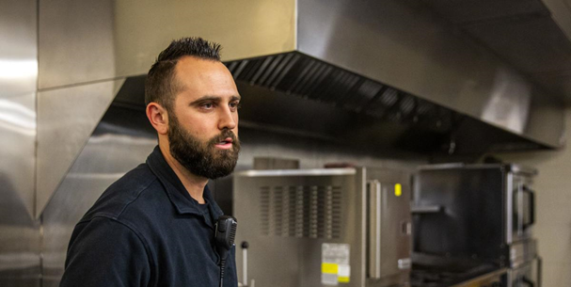
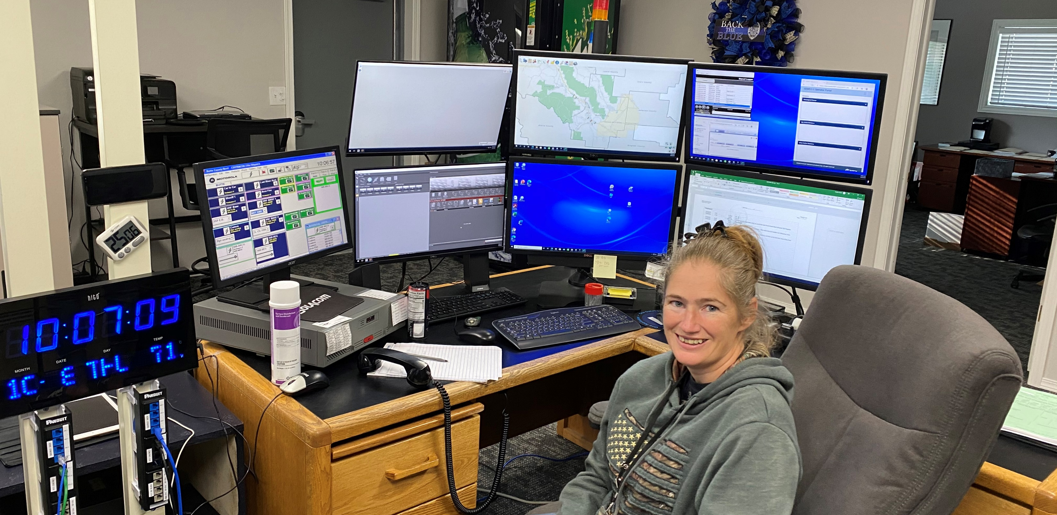
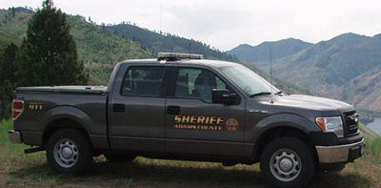
Idaho Laws Requiring You To Have Law Enforcement
Idaho Code 31-2202 – Sheriff Duties
Preserve peace
Take charge
Keep county jail & prisoners
Serve processes, notices, & maintain records

Slide 8
Idaho Laws Requiring You To Have Law Enforcement
Idaho Code 20-601
Jails kept by Sheriff
Must provide medical care, food & shelter
Must provide transportation
If no jail, housing arrangements must be made
Boise, Camas, Franklin, Lincoln, Minidoka, Oneida, Teton

Slide 9
Law Enforcement Liability
Patrol
Detention

Slide 10
Patrol Claims
Use of Emergency Vehicle
Responding to calls
High speed pursuit
Use of lights & siren
Policy & procedure violation
Arrest Procedure
Excessive use of force
Unreasonable search seizure
No probable cause

Slide 11
Patrol Risk Management Tool
Training
Emergency vehicle use
Use of Force
Physical control techniques
Less-lethal options
K9 deployment
Communication
De-escalation
Cultural awareness

Slide 12
Patrol Risk Management Tool
Policy & Procedure Review
Updated Patrol Policy
Training on that Policy

Slide 13
Detention Claim Areas
Excessive use of Force
Inmate Management
Medical care
Lack of/or inadequate
Wrongful Death
Suicide/mental illness
Medical condition
Search
Provisions made
Availability to practice

Slide 14
Detention Risk Management Tools
Training
Use of Force
Inmate Well Being Checks
Medical Intervention
Contract & Insurance Review
Medical Provider
Dental Provider
Food Services
Other Law Enforcement Agencies

Slide 15
Detention Risk Management Tools Continued
Policies & Procedures
Updated?
Training?
Medical Care Provider
On-site?
Available?
Suicide Prevention Measures
Are Idaho’s legally mandated jail mental health procedures being done?
Strip Search Policy & Procedures
Where do they happen, & are they legal?
Cross-Gender Searches

Slide 16
Continuing Risk Exposures
Overcrowding
Increased violence
Classification & separation

Slide 17
Continuing Risk Exposures
Lack of Detention Deputies
Inmate well-being hampered
Using inappropriate staff for facilities

Slide 18
Continuing Risk Exposures
Medical Provider
Access
Responsive
Insurance

Slide 19
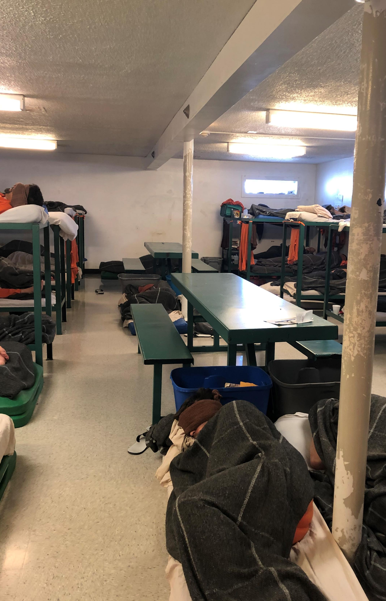
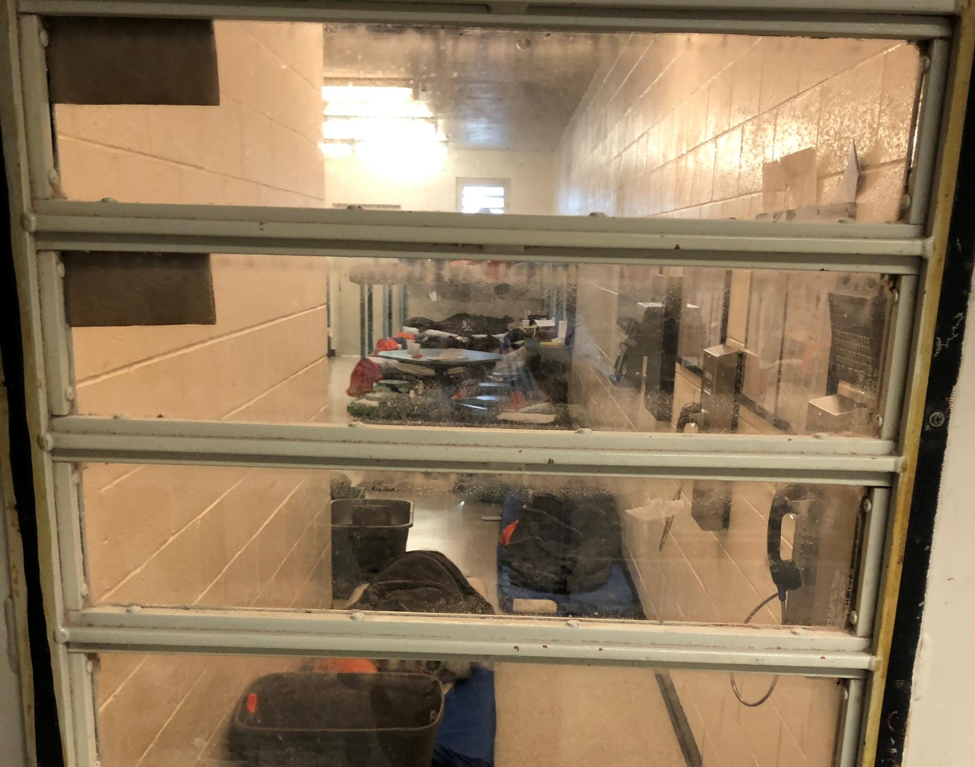
Continuing Risk Exposures
Facilities
Deterioration
Fire Safety

Slide 20
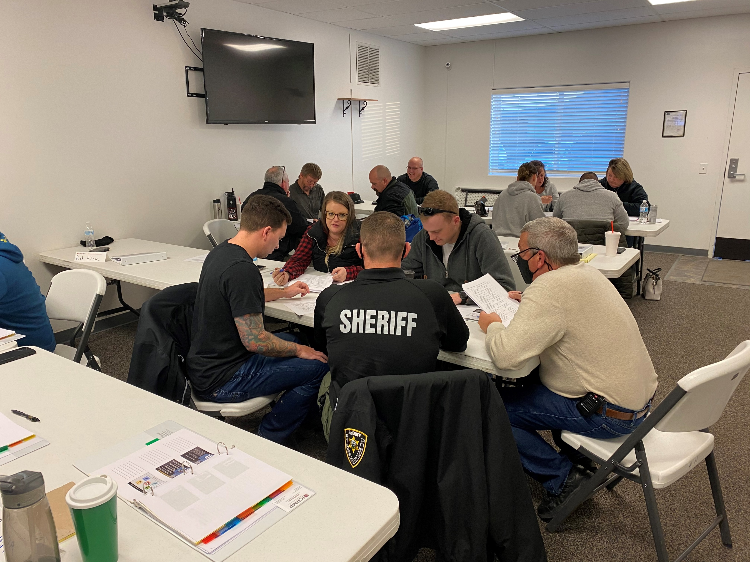
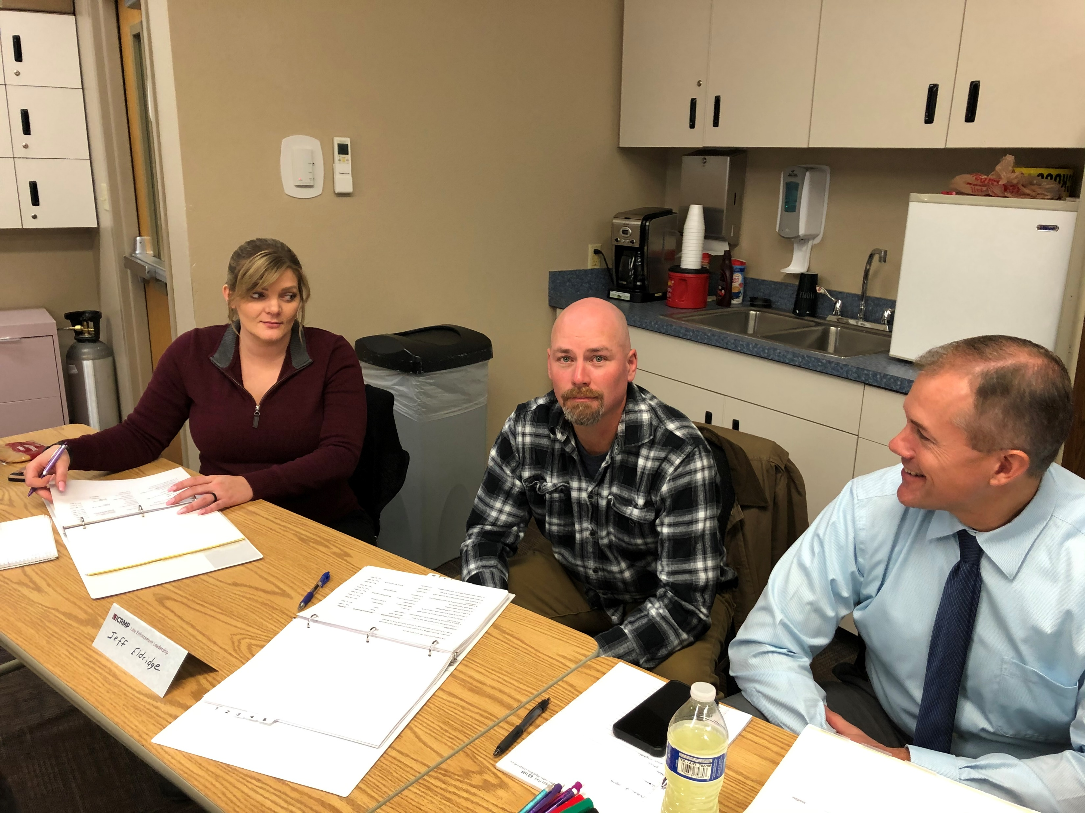
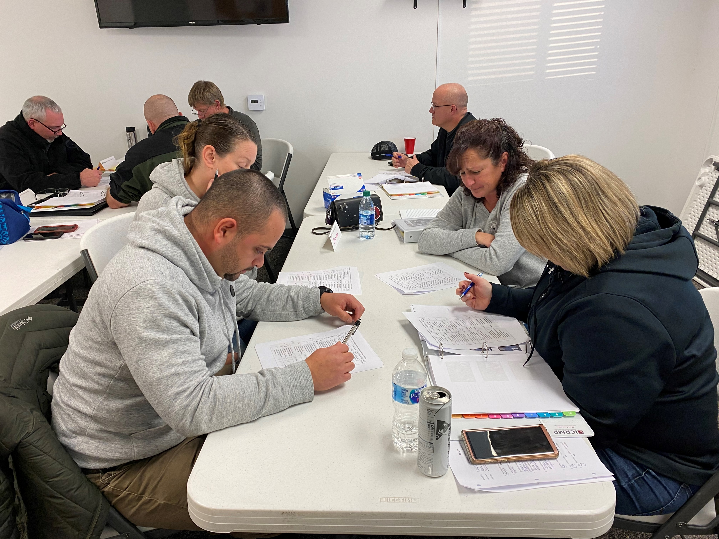
Getting & Using Information
Visiting your agency
Working with law enforcement & their stakeholders
Seeing first-hand success & struggles
Forming achievable improvement plans
Reducing risk through training

Slide 21
Thank You
Chad Sarmento
Law Enforcement Risk Manager
208-246-8203
csarmento@icrmp.org

