Slide 1
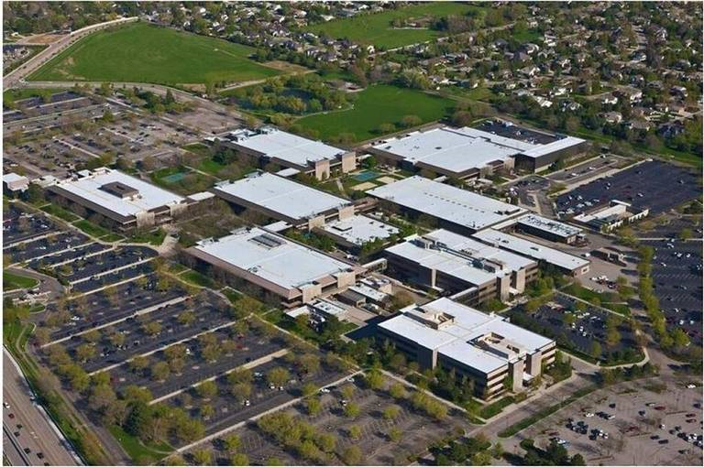
WELCOME TO
IDAHO STATE TAX COMMISSION’S
2021 BUDGET AND LEVY TRAINING

Slide 2
Your Instructors Today are
Alan Dornfest: Property Tax Policy Bureau Chief
Phone: (208) 334-7742
Fax: (208) 334-7844
E-Mail: alan.dornfest@tax.idaho.gov
Archie Keeton III : Research Analyst, Senior
Phone: (208) 334-7541
Fax: (208) 334-7629
E-mail:archie.keetonIII@tax.idaho.gov

Slide 3
Session Goals
Review new and existing laws that may affect property tax revenue for taxing districts
Understand limits on property tax revenue
Understand preliminary levy rates (HB-389)
Understand how to use forms to certify budgets
  Where to get forms
  Where to get necessary information
  What documentation to provide

Slide 4
Session Limitations
Focus is on revenue, not expenditure
  State Tax Commission (STC) does not oversee or govern expenditures
  Expenditure questions go to:
      Associations of like districts
      County (Idaho Association of Counties)
      City (Association of Idaho Cities)
      Highway Districts (Idaho Association of Highway Districts)
      Fire Districts
      Independent auditors
      Legal advisors
  Carry over authority varies
Assume compliance with budget hearing and other publication requirements (until challenged).

Slide 5
Taxing District General
Budget and Levy Responsibilities
Notify each county clerk of budget hearing date and location.
    Written notification required. (I.C. §63-802A - due April 30 each year)
Comply with LSO Registry Requirements.
Provide required advertisements for budget hearing, if required, dates, location, times, and publication of proposed budget
If forgone amount is to be used in budget must have a public hearing and define, by resolution, how much and for what purpose.
Dec 31, 2021 is the deadline for forgone accrual for the subsequent year
Certify budget to county commissioners
  Make sure that you sign your L-2 form before submitting it to the county
  Due to county by 9-9-2021,
  Request a 7 working day extension from the county new due date 9-20-2021,
  School emergency fund due before 9-13-2021.

Slide 6
Property Tax Budget
Hearing Notification
I.C. §63-802A. NOTICE OF BUDGET HEARING.
Not later than April 30 of each year, each taxing district shall set and notify* the county clerk of the date and location set for the budget hearing of the district. If no budget hearing is required by law, the county clerk shall be so notified.
…a taxing district that fails to comply with subsection (1) of this section shall be prohibited from including in its budget any budget increase otherwise permitted by either subsection (1)(a) or (1)(e) of section 63-802, Idaho Code.
If a taxing district wishes to change the time and location of such budget hearing as stated on the assessment notice, it shall publish such change of time and location in advance of such hearing as provided by law.
(Prohibits property tax budget increases from 3%, new construction, annexation, recaptured forgone, and generating additional forgone.)
* Written notification required (Rule 805.01).
Tax Commission’s web address for rules:
http://adminrules.idaho.gov/rules/current/35/350103.pdf

Slide 7
  https://tax.idaho.gov/forms/EIS00320_03-26-2018.pdf Here is a link to a list of districts and governing statutes.

Slide 8
Local Governing Entities Central Registry
(LSO contact: Shelley Sheridan – 208-334-4832 – registry@lso.idaho.gov for questions)
Requires local entities, including all taxing and special districts except school districts, to register with the state registry. This includes urban renewal districts and entities that charge fees.
Account information to be updated annually by December 1st. (prior year information)
Entities requiring audit (expenditures exceeding $150,000) must upload the audit within 9 months of the year-end date.
  If unable to meet this deadline, contact LSO.
  September 1st LSO notifies counties and STC of noncompliant entities.
Penalties for noncompliance
    Frozen p-tax
    Withheld sales tax (Currently have 33 non-compliant districts including 7 cities)
    Counties may charge fees.

Slide 9
County’s Roles
Assessor:
1. Provides locally assessed property value information to county clerk.
2. Develops new construction roll
County Clerk:
1. Provides value & tax information to Taxing Districts
2. Provides information to County Commissioners
3. Provides information to STC
  4. Distributes tax receipts and other revenue to districts
County Commissioners:
1. Set levy rate
2. Approve property tax portion of budget
3. Submit levy & approved budget to STC
(9-20-2021 or 9-27-2021 with extension)

Slide 10
State Tax Commission Roles
Review and approve levy rates and property tax portion of budget to ensure limits not exceeded (10-27-2021)
Determine and apportion operating property values*
  Preliminary values in July
  State Board of Equalization finalizes by 4th Monday in August
  Final values in September (9-7-2021)
Provide technical support & assistance; develops administrative rules
Map boundaries of each taxing district and urban renewal revenue allocation areas
Distribute sales tax revenue sharing and property tax replacement dollars
Calculate gross earnings tax and notify counties of amounts for solar, wind, geothermal, electrical and natural gas co-ops.
* - Flood Control, Watershed, Herd, Levee, Infrastructure, and most Fire districts do not receive operating property values.

Slide 11

What Year is it Anyway?
Throughout this presentation, when we refer to a calendar year, we are referring to the year in which your property tax budget is being certified.
Now which year am I supposed to use?
2021 or FY2022

Slide 12
Basic Property Tax
Total budget minus non property tax revenue equals property tax (p-tax) budget.
Levy Rate computed by dividing the p-tax budget by the net taxable value of district. Levy rate goes out to 9 decimal places.
$100,000 P-Tax
$ 100,000,000 Net Taxable Value
= 0.001

Slide 13
Computing Your Maximum
Non-Exempt Property Tax
Highest non-exempt p-tax budget of the immediate prior 3 years plus 3% increase.
Add any solar farm tax received from the immediate prior year (doesn’t get 3% increase). Affects Ada, Elmore, Owyhee, Power, and joint counties/districts.
New construction roll amounts must be multiplied by the preliminary levy rate to generate budget increase of new construction.
90% of the annexation value must be multiplied by the annexation preliminary levy rate to generate budget increase of annexation.
Sum of all above equals maximum non-exempt p-tax budget; cannot exceed the 8% cap (not what can be levied).
Minus p-tax replacement revenue received, revenue received from Solar Farm tax, and recoveries (from July 1, 2020 thru June 30, 2021).
Plus budgeted forgone.( up to 1% or 3% with a capital project)

Slide 14
Property Tax Replacements
These are added back to determine the highest of the last 3 years and are included in the 3% increase.
Replacement Amounts
Agricultural Equipment Replacement – amount unchanged since 2006.
Personal Property Reimbursement – fixed at 2013 amount unless corrected.
Recovered/Recaptured amounts received by district July 1, 2019 through June 30, 2020
Recovered Homeowner’s Exemption – Improperly claimed H/E.
Recaptured QIE - Property tax exemption in lieu of Investment Tax Credit (QIE)
Recovered personal property reimbursement – Improperly granted PP Exemption if for years after 2013.
Recovery of erroneous provisional property tax exemption per I.C.§ 63-1305C.

Slide 15
Property Tax Replacements
These are NOT added back to determine the highest of the last 3 years or given a 3% increase.
The immediate prior year solar farm tax is added to your budget authority.
Replacement amount not included in 3% increase computation but added back to compute maximum property tax capacity.
Revenue received from Solar Farm Tax received 7-1-2019 through 6-30-2020.

Slide 16
Forgone Amount
(not applicable to School Districts)
Amount of a previously allowable increase in non-exempt property tax portion of budget that was not taken.
Example:
After certifying in 2020, the highest non-exempt property tax budget of last 3 years was $100,000.
No new construction or annexation;
No replacement monies;
$100,000 X 3% = $3,000 = $103,000 max. for 2021;
District certifies $102,000 in 2020
forgone amount available in 2021 = $1,000
Never expires and once taken, becomes part of base for future 3% calculations.
A more detailed explanation is provided with example calculations in the appendix.
16

Slide 17
Forgone Amount without Budget Increase
(not applicable to School Districts)
If a taxing district elects to not take any budget increase they may take as much forgone as they have available provided, they do not exceed any levy limits. (3%,new construction, or annexation)
When using this provision, the district can not elect to reserve any of the budget increases otherwise allowed as forgone.
This provision of forgone is not subject to the 8% cap.
17

Slide 18

Forgone Amount and Capital Projects
(not applicable to School Districts)
If the taxing district has a capital project, they may use up to 3% of forgone. (3% total over the lesser of their max budget or 8% cap)
This must be tracked annually for all years of the Capital project and then subtracted from the taxing districts p-tax budget after completion with notification to the Idaho State Tax Commission.
18

Slide 19
Forgone example with new changes
100,000 Highest of the last 3 yrs.
+3,000 3% increase
+2,000 New Construction
105,000
No capital project
1% of 105,000
106,050 Budget plus 1% of forgone
Capital project
3% of 105,000
108,150 Budget plus 3% forgone

Slide 20
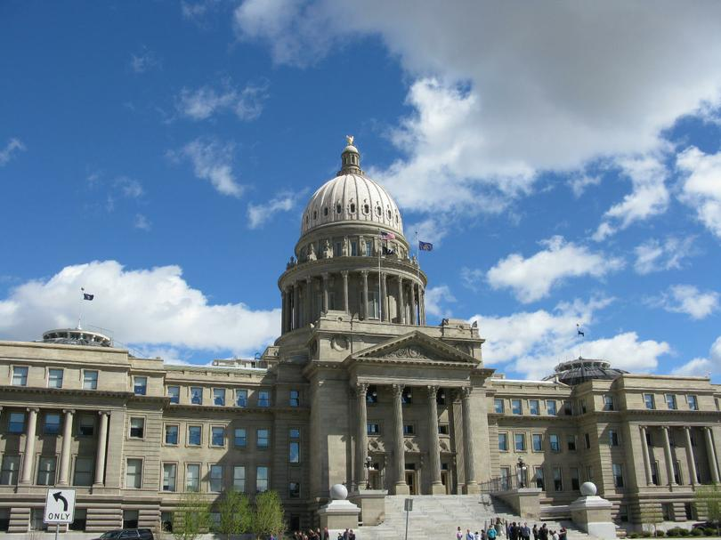
2020/2021 Legislation

Slide 21
(2020)HB-354 Reserved Forgone Amount
Amends I.C. §63-802(f);
Reserve all or part of current year’s forgone amount requires;
  Adoption of a resolution specifying the dollar amount to be reserved,
  The district must provide notice of intent to do so, and,
  Hold a public hearing which may be in conjunction with its annual budget hearing (if required).
  The resolution shall be adopted at the annual budget hearing if district has a budget hearing requirement.
If district doesn’t do a resolution the current year’s forgone amount can’t be recovered in a subsequent year.

Slide 22
HB-354 Reserved Forgone Amount
Current Year’s Forgone Amount options
  Resolution to reserve all or part of forgone
    Existing forgone increased
  Resolution to recover all or part of forgone
    Total existing forgone is reduced by amount recovered
  Do nothing
    Current year’s forgone may not be recovered and no new forgone will be accrued

Slide 23
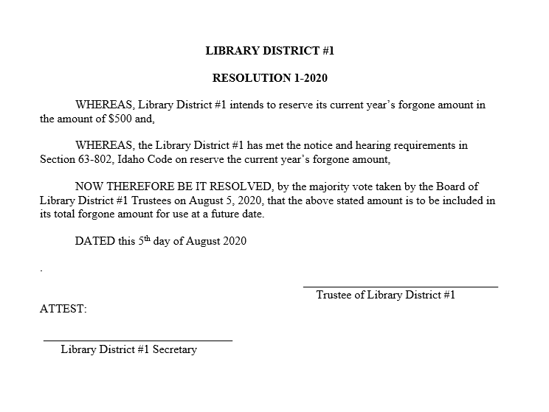
HB-354 Reserve Forgone Increase
Statute requires the resolution specify a dollar amount or property taxes being reserved.
Required to hold annual budget hearing | Not required to hold annual budget hearing.
Public hearing requirement to reserve forgone may be in conjunction with annual budget hearing. | Must hold a public hearing in order to adopt resolution to reserve current year’s forgone amount.

Slide 24
HB-408 City Sales Tax Distribution
Effective 7-1-2020
Amends I.C. §63-3638(10)
Combines the revenue share and base/excess distribution for cities into one distribution.
DOES NOT change County revenue share and base/excess distribution.
DOES NOT change Special Purpose Taxing District base/excess distribution.

Slide 25
(2020)HB-408 City Sales Tax Distribution
Effective 7-1-2020
1st Distribution using the new city formula is for quarter ending June 30, 2020.
Management Services is responsible for all distributions except the Special Purpose Taxing Districts.
Contact Craig Allison (208) 334-7552 for questions or concerns.

Slide 26
(2020)HB-587 – Highway District
Effective 7-1-2020
Amends I.C. §50-2908.
  RAA’s formed on or after, or expanded into a highway district as of 7/1/2020.
    Amount of taxes that would have been paid to the U/R agency is to be returned to the highway district. The U/R agency and the highway district may enter into an agreement for a different allocation based on the highway districts levy.
    If an agreement is entered into a signed copy to be sent to the County(s) clerk and the STC no later than September 1 of the year agreement takes affect.
    DOES NOT effect how levies are computed for highway districts.

Slide 27
HB-587 – Highway District
Effective 7-1-2020
Current Levy Calculation Process
Net Value (less increment) $100 million | P-Tax budget $100,000 | Levy Rate = 0.001
RAA Increment $ 500,000 | U/R agency (Increment x Levy) $ 500. | U/R Agency receives $ 500.
New Law
$500 is not sent to U/R agency but returned to the highway district. Unless there is a signed agreement on file indicating otherwise.

Slide 28
HB 389
2021 General | 2021 Budget and Levy
Homeowners Exemption up to $125,000 Site improvement exemption lost on completion of improvement Circuit Breaker brackets increased to a max of $1,500 | New construction rolls will include change of land use only when associated with a building New construction rolls will include 90% of the NC value (80% if an UR dissolves) and 90% of annexed value New construction budget capacity calculations are based on the preliminary levy rate. Sum of 3%,NC, and annexation < 8%
2022 General | 2022 Budget and Levy
Disqualified from Circuit Breaker if assessed home value is over 125% of the median Transient Personal Property exempt $250,000 Personal Property exemption (replacement money to be recalculated in 2022) | Discretionary subtraction from new construction for homeowner's exemption above $100,000 3rd Monday of November personal property amount by district is to be calculated

Slide 29

Property Taxes and the 3% Cap
Levy
Limit
Cap
Property Tax Budget
Cap

Slide 30
Property Tax Budget and Levy Limits Defined in Idaho Code
Property Tax Budget Limit - 3% Cap Pertains to “non-exempt” budget which excludes bonds and other voter approved levies.
Section 63-802, I.C. LIMITATION ON BUDGET REQUESTS -- LIMITATION ON TAX CHARGES -- EXCEPTIONS.
(1) No taxing district shall certify a budget request for an amount of property tax revenues to finance an annual budget that exceeds the greater of:…(3% language)
Tighter Constraint Prevails

Slide 31
Budget vs. Levy Limit
Scenario:
A taxing district’s statutory M&O levy limit is 0.0004. Its maximum, non-exempt property tax potential budget is $55,000 and its total net taxable market value is $125 million.
Budget Not Allowed
Because levy limit exceeded
Budget Allowed
Because levy limit not exceeded
Rollback = $5,000
Levy limit can’t be exceeded without express statutory authority.

Slide 32


Computing Your Maximum
Non-Exempt Property Tax Budget

Slide 33
Example: Computing 3% Portion of Increase
Year | 2018 | 2019 | 2020
Total levied non-exempt p-tax budget | 124,389 | 130,678 | 136,218
Agricultural Equipment Replacement Money | 28 | 28 | 28
Personal Property Replacement Money | 1,318 | 1,318 | 1,318
*Recovered Homeowner’s Exemption | 110 | 0 | 0
Total Property Tax Replacement monies | 1,456 | 1,346 | 1,346
Total levied non-exempt property tax budget plus property tax replacements | 125,845 | 132,024 | 137,564
Computation of 3% increase:
$ 137,564 $ 137,564
X 0.03 + 4,127
$ 4,127 $ 141,691 (total plus 3% increase)
* = Total received by district between July 1st thru June 30th each year.

Slide 34
New Construction Roll
Idaho Code §63-301A & §63-802 & Rule 802
Includes 90% of taxable property first on tax roll in 2021:
  1. New structures and newly occupied residences.
  2. Additions or alterations to existing non-residential structures.
  3. Installation of new or used manufactured housing that did not previously exist within the county.
  4. Change of land use classification (i.e. agricultural to commercial; if structure included under HB-389).
  5. Newly taxable as a result of loss of inventory exemption (63-602W).
  6. Improvements or installation of equipment used in conjunction with generation of electricity.
  7. Prior eligible new construction identified and reported to county assessor.
    (5 Year look back limit)
  Property, otherwise qualifying, now taxable because of rescinding of provisional exemption.
  80% Increase in increment value of dissolved (or de-annexed portion) of Revenue Allocation Area (RAA) – increase measured in comparison to Dec. 2006 increment value.
    a. Excludes new construction in RAAs within Urban Renewal Districts during life of RAA.

Slide 35
Deductions Made To New Construction Roll I.C. §63-301A(1)(f)
When previous new construction roll included property but,
  Board of Tax Appeals (BTA) or District Court ordered lower values
  Double or erroneous assessments discovered
  Land use changed to lower value category
  Value lower due to site improvement exemption
Could produce net negative new construction values
HB 389 – Applies a discretionary subtraction of homeowners exemption that exceed $100,000 (effective 2022)

Slide 36
HB 389- New Construction
Preliminary levies for NC budget capacity
Highest of the last 3 years
Add in up to 3% as usual
Divide result by July 2021 equalized value + 2020 operating property.
1,000,000
X
3%
30,000
Then,
400,000,000+470,000
1,030,000/400,470,000
.00257198
Preliminary levy
Can be multiplied by 90% 2021 NC value

Slide 37
HB 389- Property Tax cont.
Total increase for 2021: 3%, new construction, and annexation can NOT exceed 8%.
Forgone can increase your budget by an additional 1% unless for a capital project.
Forgone can increase budget up to 3% for a capital project.

Slide 38
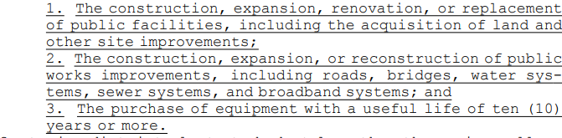
HB 389- Property Tax cont.
What is a capital project???
Once the capital project has completed the additional forgone must be subtracted from the budget.

Slide 39
Preliminary Levy Rate Calculator
Enter the highest non-exempt from the last 3 years as referenced from the max budget and forgone worksheet.
Enter prior year’s operating property and the amount of the 3% the district. (cannot exceed 3%)
Enter current equalized locally assessed value year net taxable for your district (Do not reduce this amount; may include sub-roll)
Enter the annexation net taxable locally assessed value if applicable

Slide 40
Preliminary Levy Rate Calculator
Once all information is added there will be either one or two preliminary levy rates generated. (two if you have an annexation)
Please note that cell (Q) has the highest non-exempt P-tax budget prior to subtracting replacement dollars.
This is the highest possible budget the district could have at the 8% cap; this may not be attainable depending on the highest of the last 3 years and other calculations.

Slide 41
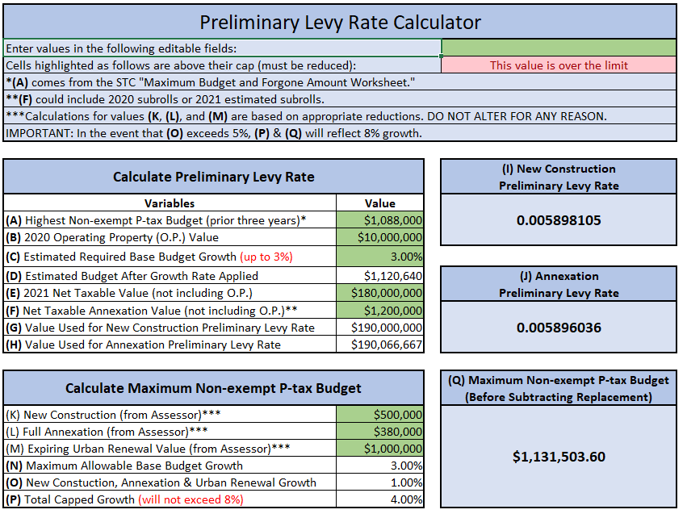
Preliminary Levy Rate Calculator

Slide 42
Example: New Construction Roll
2021 Preliminary Levy Rate = .005898105
2021 new construction Roll Value = $ 4,722,800
Multiply the 2021 new construction roll value
by the 2021 Preliminary levy rate:
$ 4,722,800
X 0.005898105
$ 27,855 additional budget allowance
(above 3% increase)

Slide 43
Annexation Example
2021 annexation preliminary levy rate = 0.005896036
2021 annexation* value = $ 525,750
90% = $ 473,175
Multiply the 2021 annexation value by the 2021
preliminary levy rate:
$ 473,175
X 0.005896036
$ 2,790 additional budget allowance
(above 3% increase)
* Stated annexation value includes taxable real, personal and operating property values provided district levies against all taxable property. (real and personal at 90%)

Slide 44
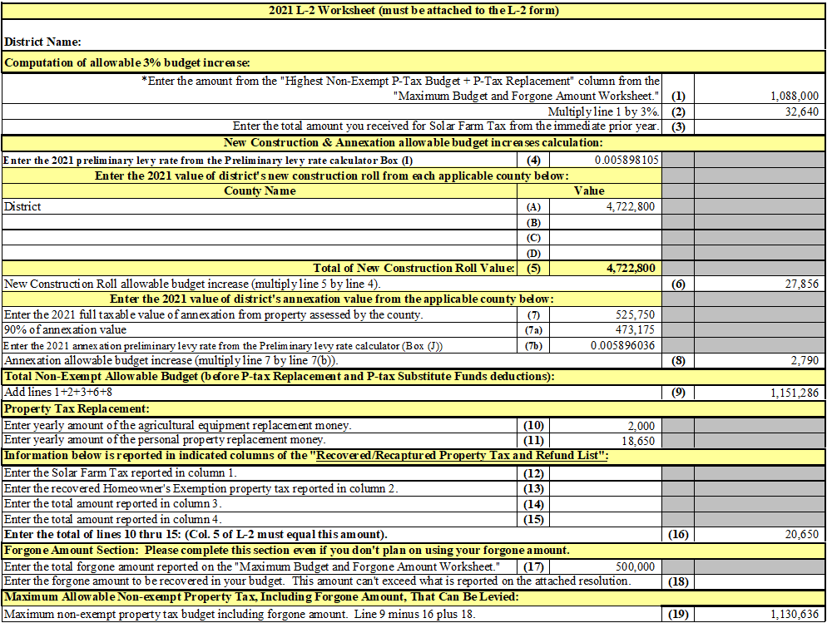

Slide 45
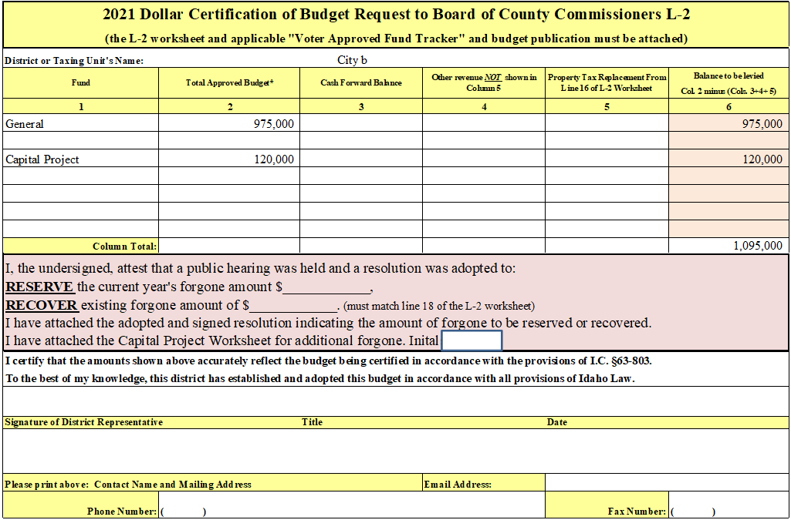
New L-2 Form due to
HB-354 – Reserved Forgone Amount and HB-389
If budgeting forgone or reserving forgone must complete this section and attach a signed resolution.
For 3% forgone increases

Slide 46
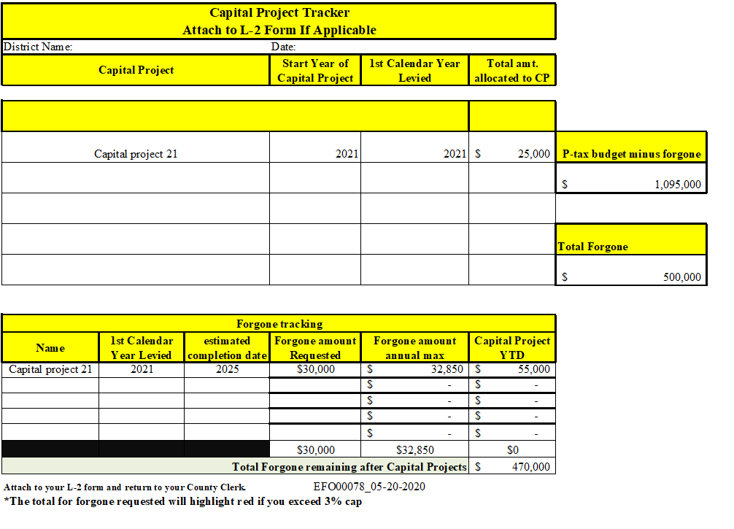

Slide 47
When Is All This Information Available?
Information available from the county clerk:
I.C. §63-802 property tax information is currently available and is on the STC’s web page. Look for the “Maximum Budget and Forgone Amount Worksheet” (This no longer provides prior year levies, use the preliminary levy rate calculator)
New Construction Roll Value – 4th Monday in July
Taxable value (locally assessed current year, prior year actual or estimated sub roll, and prior year operating property) 1st Monday in August
Annexation Values:
Real and personal (locally assessed) – 1st Monday August
Operating property (assessed by STC) – 1st Monday September
https://tax.idaho.gov/forms/EFO00131_05-05-2021.pdf

Slide 48
Non-School Funds Exempt From
3% Annual Increase Cap I.C. §63-802
Fund | Description
Temporary Override | All taxing districts have authority. 2 year maximum duration; requires simple majority to pass. Total of fund and override levy rate can’t exceed the fund’s levy limit.
Permanent Override | All taxing districts have authority. Most need a 2/3 majority to pass. Qualifying cities have additional version that requires only 60% voter approval to pass. Total of fund and override levy rate can’t exceed the fund’s levy limit.
Bond | Refer to authorizing statute for specific requirement, but all require 2/3 majority voter approval.
Plant Facilities | Available to Library and Community Colleges as well as schools. See I.C. §33-804 for details.

Slide 49
School District Funds Exempt From
3% Annual Increase Cap I.C. §63-802
Fund | Statute
Temporary Supplemental | I.C. §33-802(3)
Permanent Supplemental | I.C. §33-802(5)
Emergency | I.C. §33-805\63-805
Judgment | I.C. §33-802(1)
Tuition: Eligible Schools #92, 383, and 394 | I.C. §33-1408
Cooperative Service Agency (COSA) | I.C. §33-317(2): 2/3 voter approval 10 yr. limit.
State Authorized Plant Facilities | I.C. §33-909 (levied by county in area of school district)
Plant Facilities | I.C. §33-804: 10 year limit.
Safe Schools Plant Facilities | I.C. §33-804A: 20 year limit.
COSA Plant Facilities | I.C. §33-317A
Budget Stabilization: Eligible Schools # 61, 92, 394, and 421 | I.C. §33-802(2): Each has set maximum property tax budget.
Judgment | Refunds related to value appeals (ex. Board of Tax Appeals) See I.C. §63-1305 for details.

Slide 50
Property Tax Forms

Slide 51
List of Property Tax Related Forms
  2020 Dollar Certification of Budget Request to Board of County Commissioners L-2. (L-2 for short)
  L-2 Worksheet (must be attached to the L-2 form)
  Maximum Budget and Forgone Amount Worksheet
  Voter Approved Fund Tracker (as required)
  Capital Projects Tracker (as required)
  All L-2 related forms at this web address: https://tax.idaho.gov/search-formspublications.cfm?ch=bl&t=pt

Slide 52
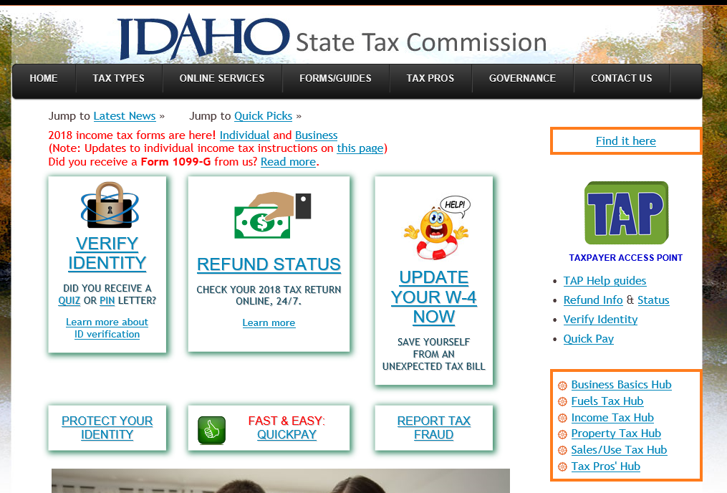
State Tax Commission’s Web Page: tax.idaho.gov
To find the Budget and Levy forms
Click on the “Property Tax Hub”

Slide 53
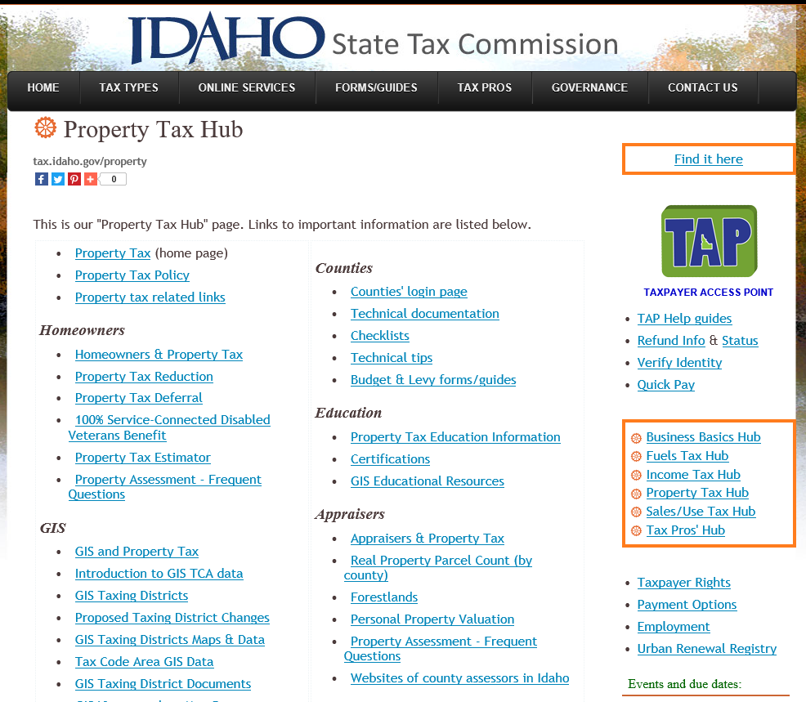
Select “Budget & Levy forms/guides”

Slide 54
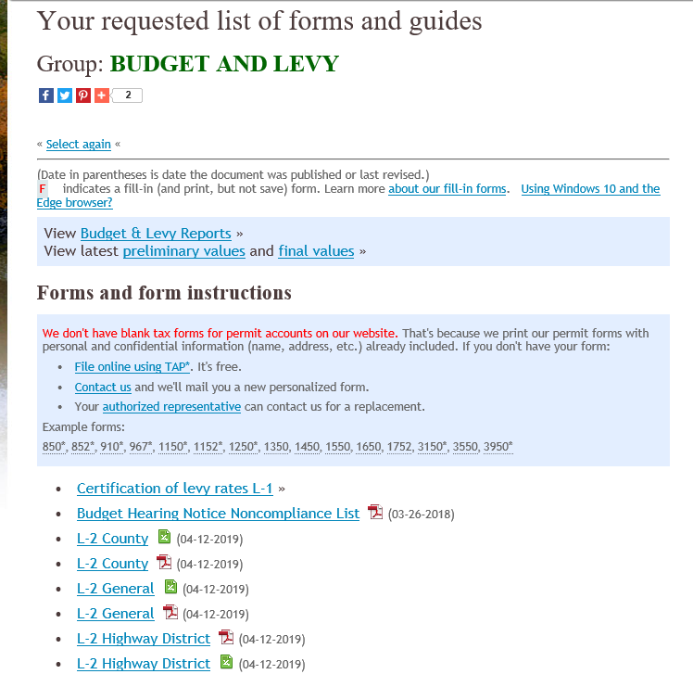
To find Agricultural and/or Personal Property replacement report select “Budget & Levy Reports”.
L-2s, Maximum Budget and Forgone worksheets located here.

Slide 55
Other L-2s
On the web page there are 5 different type of L-2s. They are as follows:
  County – for county use only
  Hospital – has spot for initialing if public hearing held.
  Highway – identifies fund shared with city(s)
  School – L-2 worksheet has hypo levy for tort computation
  Generic – used by district not listed above.
  GPSGI – used for one time relief last year.

Slide 56
Rule 803
L-2 submitted to each county MUST be signed.
Unless otherwise provided for in Idaho Code, budget requests for the property tax funded portions of the budget can not exceed the amount published in the notice of budget hearing, if a budget hearing notice is required.
The levy approved by the STC can not exceed the levy computed using the amount shown in the notice of budget hearing.
Subtract all replacement monies on the L-2 worksheet.

Slide 57
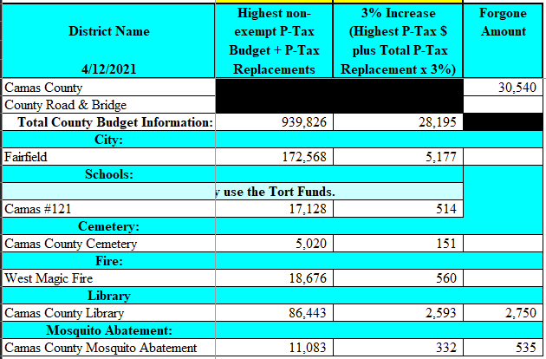
Maximum Budget and Forgone Amount Worksheet
Line 1 of L-2 Worksheet
Line 2 of L-2 Worksheet
Part 1 of 2 Parts
Line 17 of L-2 Worksheet

Slide 58
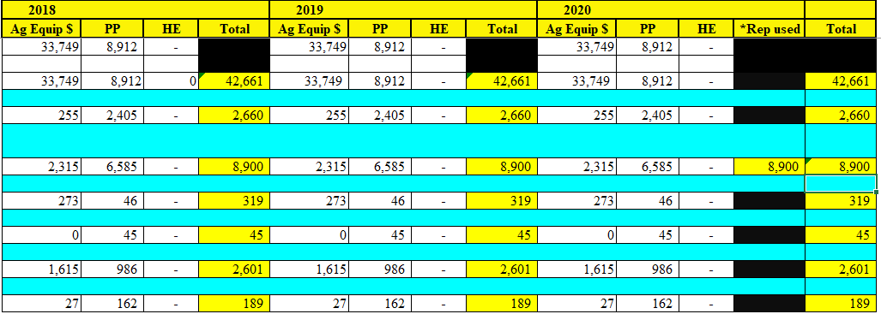
Maximum Budget and Forgone Amount Worksheet
The amounts listed above are added to the appropriate year’s non-exempt p-tax to determine the highest of the last 3 years amount.
Part 2 of 2 Parts

Slide 59
Non-School Voter Approved Fund Tracker
If the current year’s request is < or > 20% of prior year’s amount a “Yes” will pop up in the “Explanation Required” column.

Slide 60
School Voter Approved Fund Tracker
If the current year’s request is < or > 20% of prior year’s amount a “Yes” will pop up in the “Explanation Required” column.

Slide 61
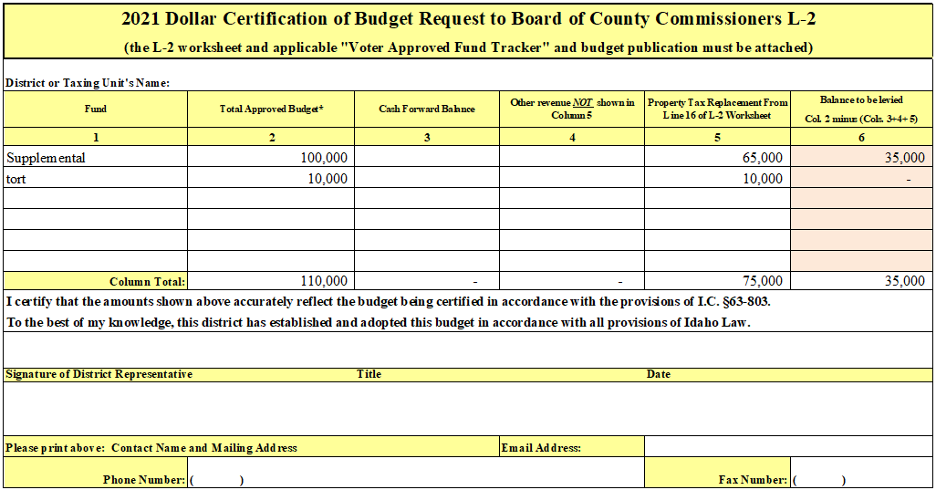
School District L-2

Slide 62
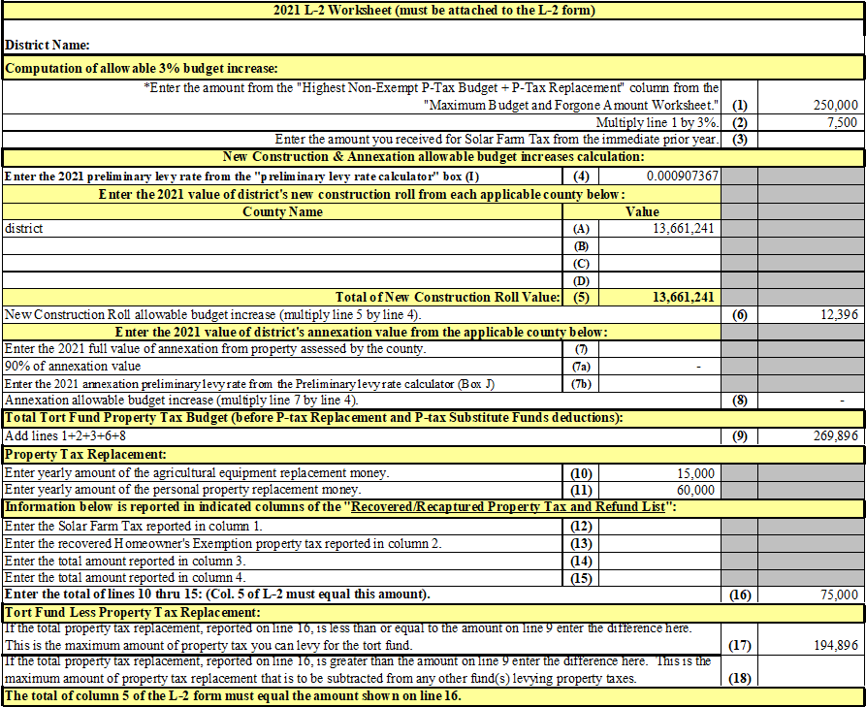

Slide 63
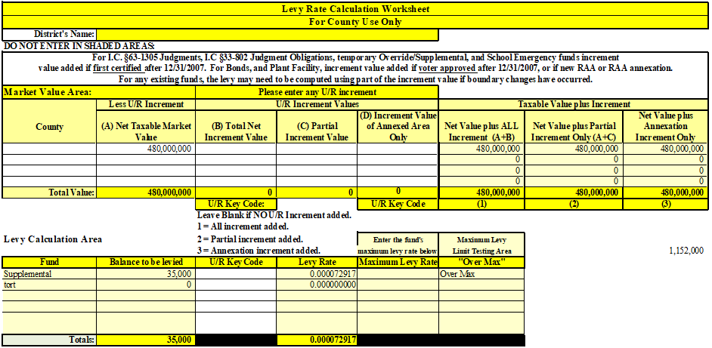
L-2 Worksheet
How do I determine when to include increment for levy calculations?

Slide 64
District Formation or Alterations
General Document Requirements:
  An ordinance, order, or resolution must:
    Be recorded with the County Clerk, filed with the County Assessor, and signed by the appropriate authoritative official
    Include a legal description describing the boundary of the formation or alteration
    Include a legible map that matches the legal description and clearly identifies the boundary of the formation or alteration
    Provide current contact information for the taxing district
Important Dates and Deadlines:
  A hard-copy must be filed with the Idaho State Tax Commission within 30 days of the effective date of formation or alteration, but no later than January 10th of the effective year.
  The ordinance, order, or resolution must be signed by December 31st to be reflected in the changes for the next effective year.
Mail hard-copies to: Idaho State Tax Commission, Attn: GIS Department, P.O. Box 36, Boise, ID 83722-0410.
Email: gis@tax.idaho.gov Phone: 208-334-7750
For more information, please visit the link “How to Submit an Annexation” on the ISTC GIS/ Cartography website: https://tax.idaho.gov/gis/
Reference: Idaho Statute 63-215, Idaho Administrative Rule 35.01.03 Section 225

Slide 65
Election to Create a New Taxing District
Section I.C. §63-802C
County clerk where proposed taxing district is to be shall:
  Mail notice of election to all residences or residents who are eligible to vote.
  Notice to be mailed not less than 14 days prior to day of election.
    Shall state with specificity purpose of election
    Date of election
    Polling places
    Time the polls will be open
    Aggregate amount of taxes that will be raised in the proposed district and the increase that will occur per $100,000 of taxable value of property, above any exemptions, of residential property, commercial property, industrial property, land actively devoted to agriculture and operating property.
  County clerk may bill the proposed taxing district for replacement of costs of administering this section.
Compliance with this section shall satisfy any notice or publication requirement as may be provided by law.

Slide 66
Changing Name of Taxing District
I.C. §67-2321
  Governing body of a taxing district must follow publication and hearing rules.
  Certified copy of the resolution must be filed with the State Tax Commission and with the county recorder of each county in which the jurisdiction is situated.

Slide 67
What to Send with L-2s
The signed 2021 L-2 form with all pertinent information.
The 2021 L-2 worksheet.
Voter approved fund tracker if applicable
  If a new voter approved fund (first time levied), a copy of the ballot and canvass of the vote required.
Newly formed recreation district - copy of formation petition showing voter approved levy limit.
If budget includes any forgone amount, a copy of resolution is required by I.C. §63-802 (1)(e).
Plus any other information requested by the county (i.e. copy of published budget notice).
Capital project worksheet (if applicable)

