Slide 1
Idaho Association of County Recorders and Clerks Election Conference
Chief Judge Manual Presentation
By: Amanda Rogerson & Sunrise Ayers

Slide 2
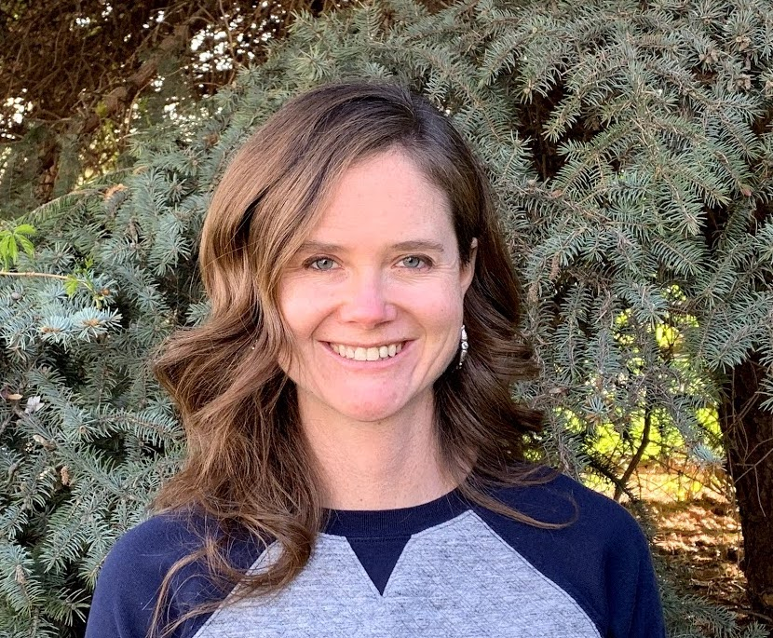
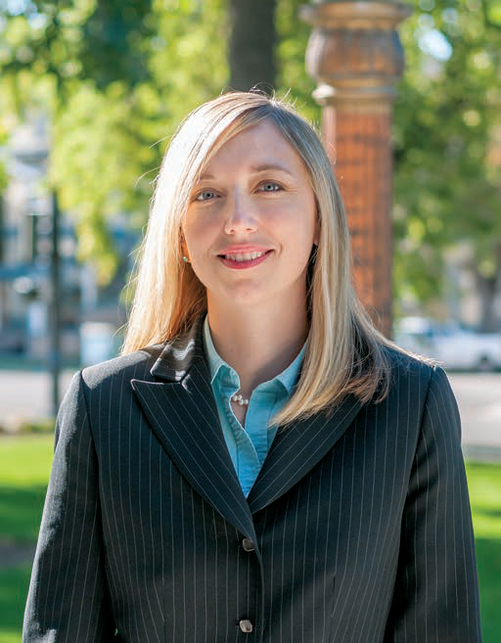
Amanda Rogerson
Amanda.Rogerson@gmail.com
Sunrise Ayers
sunrisecox@yahoo.com

Slide 3
Idaho Academy of leadership for lawyers
A leadership training program for lawyers from across the State of Idaho
Mission: to promote diversity and inspire the development of leadership within the legal profession
https://isb.idaho.gov/member-services/programs-resources/iall/
IALL Reading List:
  Dare to Lead, Brené Brown
  Give and Take, Adam Grant
  Emotional Intelligence 2.0, Travis Bradberry and Jean Greaves
  Gallup CliftonStrengths Assessment
    https://www.gallup.com/cliftonstrengths/en/252137/home.aspx

Slide 4
Legacy project
Each Idaho Academy of Leadership for Lawyers participant must complete a legacy project to benefit their local legal community and/or their community as a whole.
To view past legacy projects: https://isb.idaho.gov/wp-content/uploads/Legacy-Project-Master-List.pdf

Slide 5
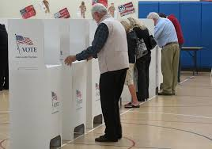
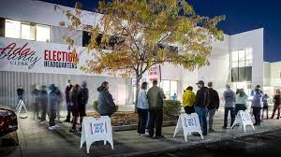
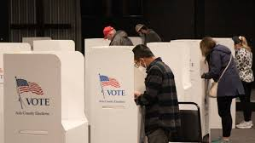
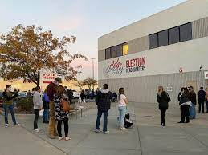
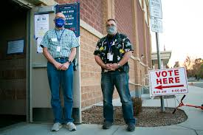
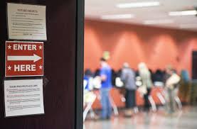
Chief Judge Experience

Slide 6
Chief Judge Manual

Slide 7
Amanda Rogerson
Amanda.Rogerson@gmail.com
Sunrise Ayers
sunrisecox@yahoo.com

