Slide 1
Elections 101
By Phil McGrane, Ada County Clerk
Notes:
© Copyright PresentationGo.com – The free PowerPoint library

Slide 2
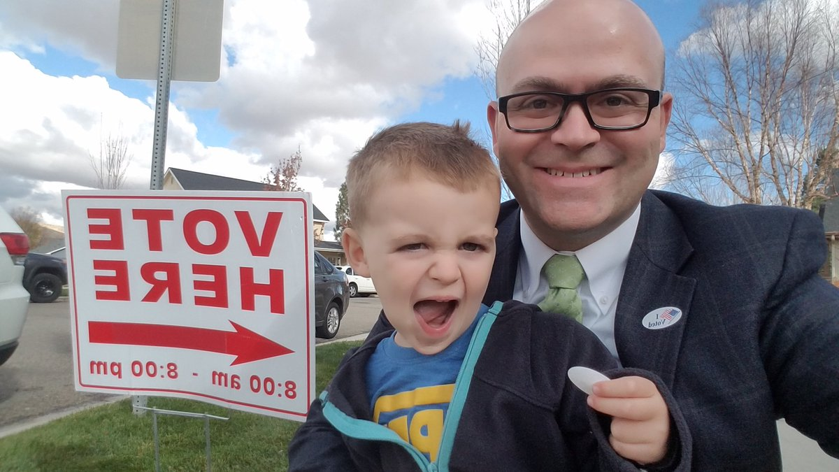
Agenda
Made in the U.S.A A Quick(ish) History
An Idaho Look
DREs, Provisional Ballots, and other election stuff
Phil & Andy McGrane Voting
Notes:
© Copyright PresentationGo.com – The free PowerPoint library

Slide 4
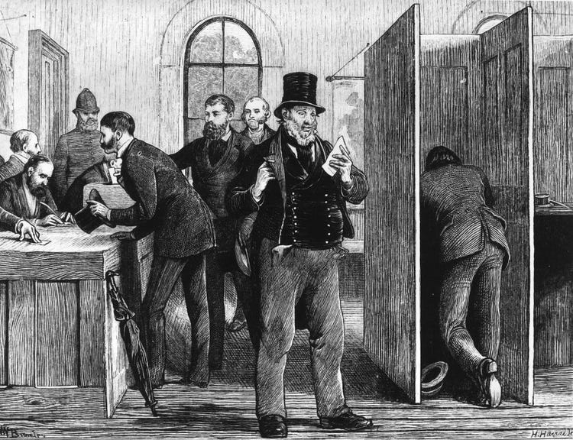
Where do we start
U.S. Constitution, Article I Section 4
“The times, places and manner of holding elections for Senators and Representatives, shall be prescribed in each state by the legislature thereof; but the Congress may at any time by law make or alter such regulations.”

Slide 5
A Quick Run Through History
1788 U.S. Constitution Ratified – Christian, white, property owning, men over 21 can vote.
1845 Election Day Set – Congress sets the first Tuesday following the first Monday as Election Day
1856 – All white men could vote
1870 Fifteenth Amendment – cannot deny voting based upon race, color, or prior servitude

Slide 6
A Quick Run Through History
1896 Idaho Recognizes Women’s Right to Vote
1900ish – Primary Elections adopted
1920 Nineteenth Amendment – Women have the right to vote
1964 24th Amendment – No poll taxes
1965 Voting Rights Act – aimed to prevent restrictive voting practices, introduces preclearance

Slide 7
A Quick Run Through History
1971 26th Amendment – 18 year old's can vote
1971 Federal Election Campaign Act
1975 Languages added to Voting Rights Act
1982 Disabilities added to Voting Rights Act
1986 UOCAVA – Federal Overseas Voting Protected
1993 National Voter Registration Act – Motor Voter law, Same Day Registration States Exempt

Slide 8
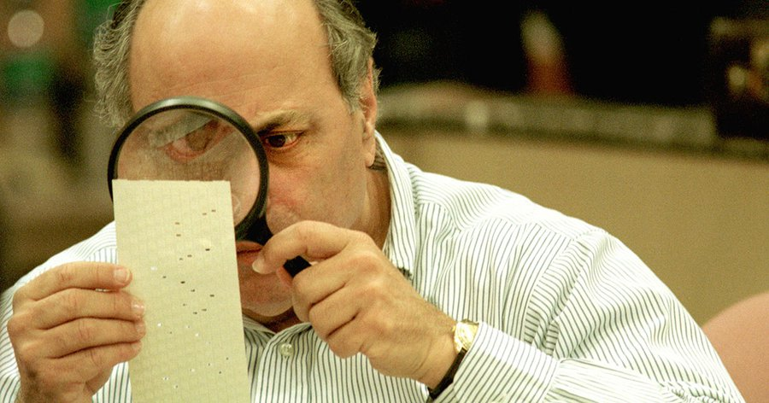
A Quick Run Through History
2000 Bush v. Gore…

Slide 9
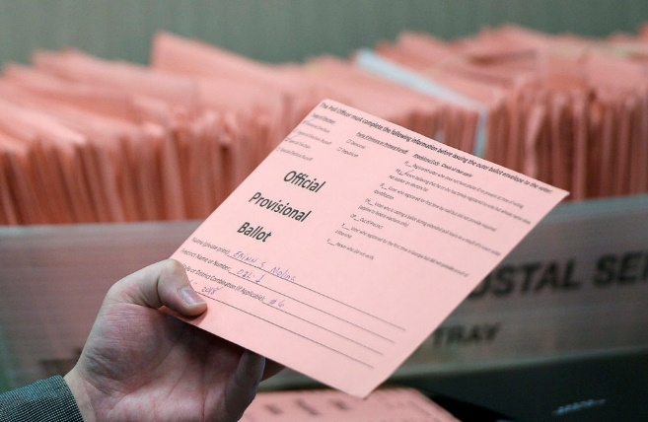
A Quick Run Through History
2002 Help America Vote Act (HAVA) – Statewide voter registration system, new election equipment, provisional ballots, accessible voting for the disabled
2009 MOVE Act – Military & Overseas Voter Empowerment Act (UOCAVA 2.0)
Next…???

Slide 10
Home Sweet Home

Slide 11
Key Idaho Law Changes
Let’s Start with HAVA… – Statewide voter registration system, new election equipment, accessible voting for the disabled
2009 Election Consolidation – the Clerk is now in charge
2010 Voter ID & Affidavit
2011 Close Primary – Idaho GOP v. Ysursa & the 1st Amendment

Slide 12
Other Elections Stuff…
Notes:
© Copyright PresentationGo.com – The free PowerPoint library

Slide 13
Idaho Statewide Voter Registration System
Notes:
© Copyright PresentationGo.com – The free PowerPoint library

Slide 14
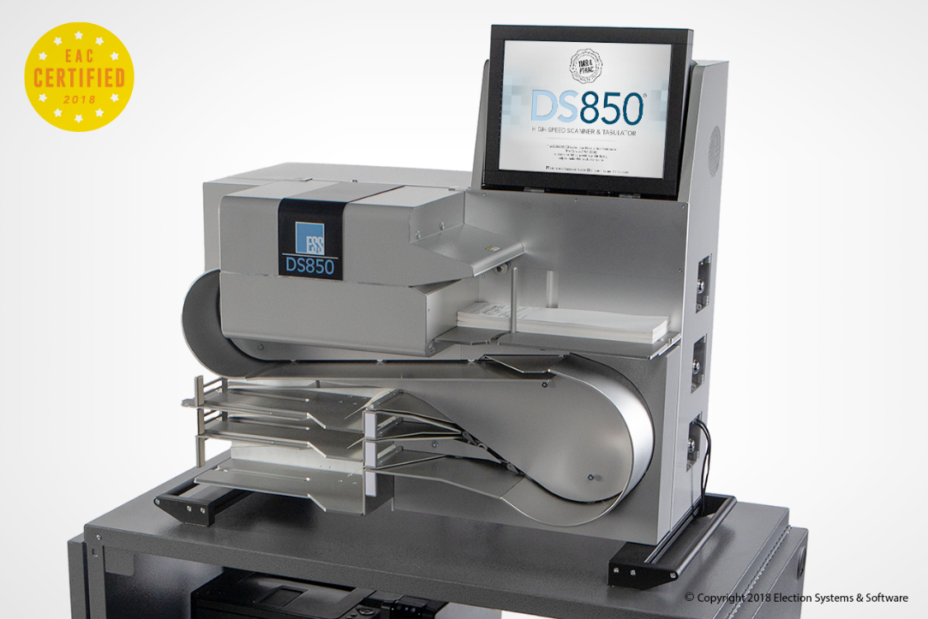
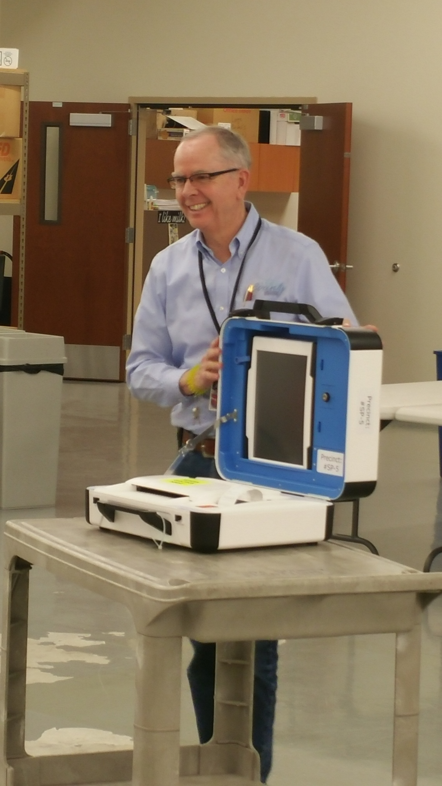
Elections Equipment
Optical/Digital Scan
Notes:
© Copyright PresentationGo.com – The free PowerPoint library

Slide 15
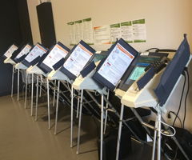
Elections Equipment
DRE – Direct-Recording Electronic Voting Machine
Notes:
© Copyright PresentationGo.com – The free PowerPoint library

Slide 16
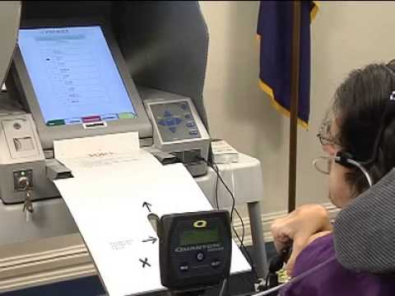
Elections Equipment
BMD – Ballot Marking Device
Notes:
© Copyright PresentationGo.com – The free PowerPoint library

Slide 17
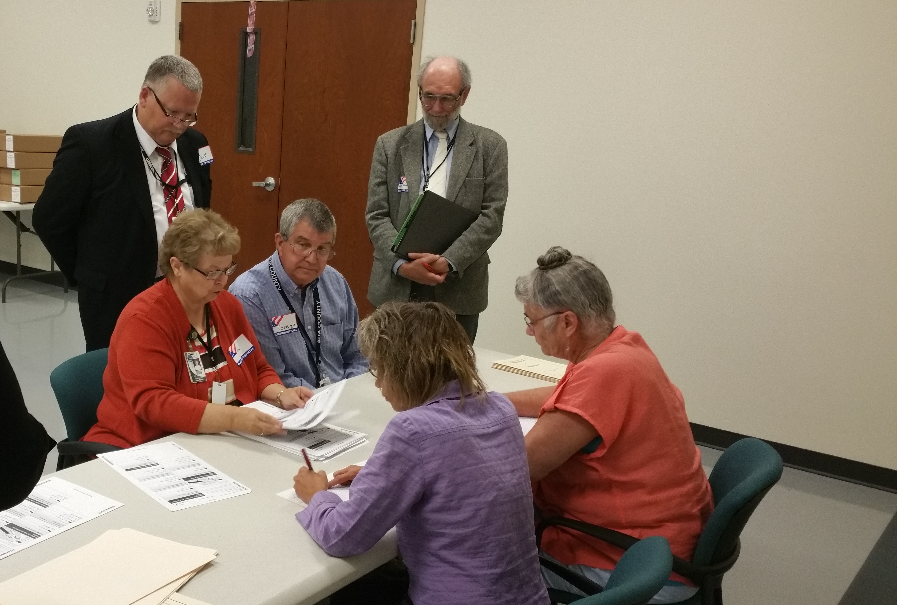
Elections Equipment
Hand Count
Notes:
© Copyright PresentationGo.com – The free PowerPoint library

Slide 18
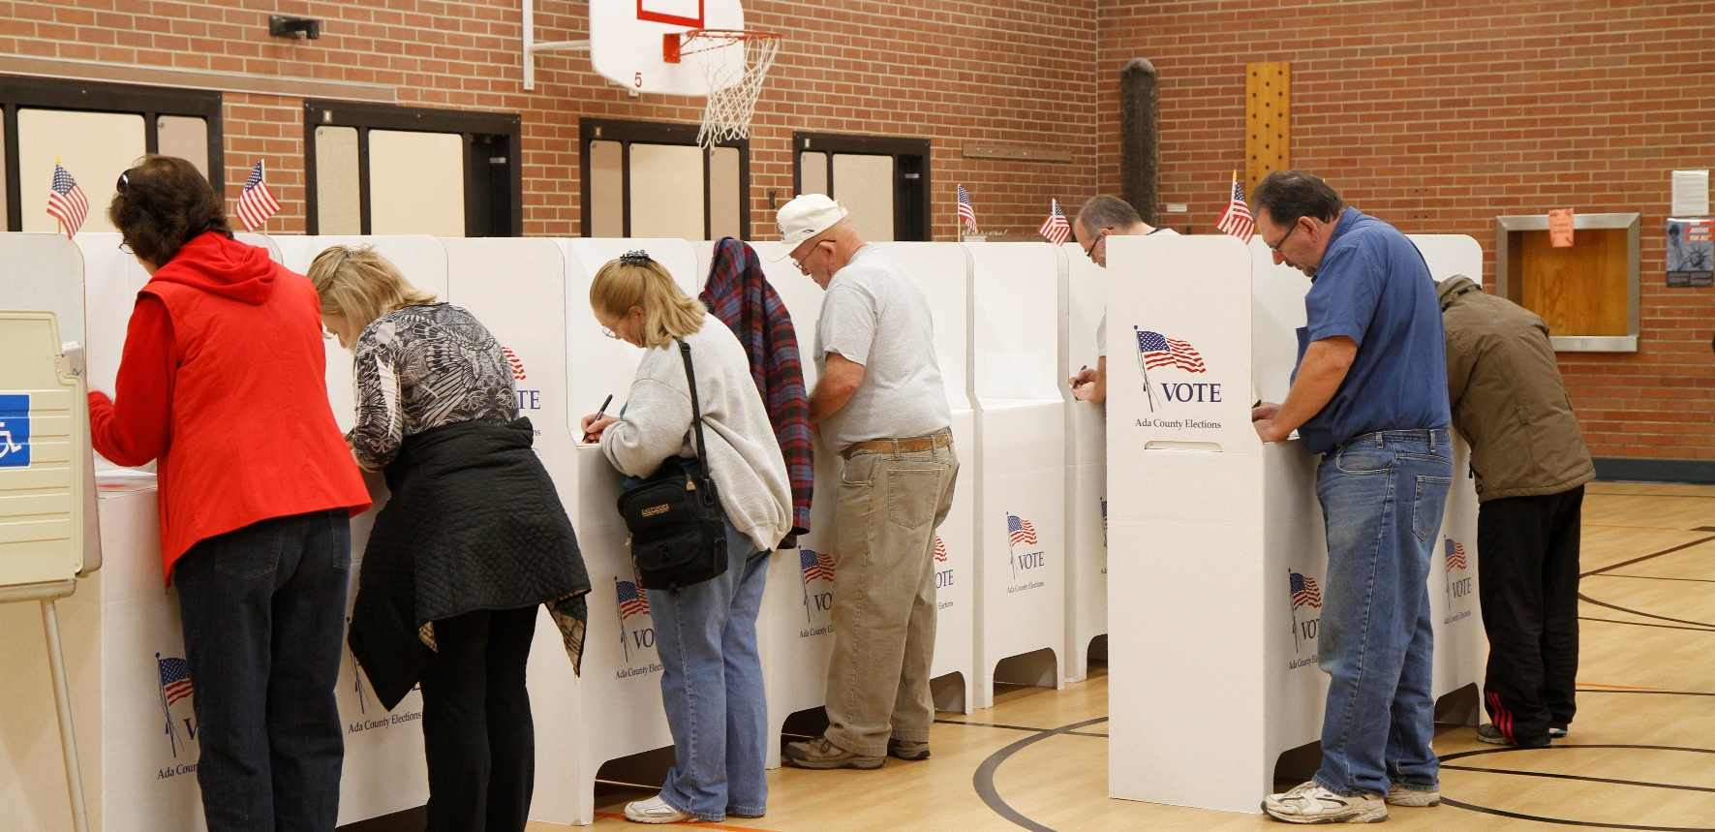
Event Planning
Notes:
© Copyright PresentationGo.com – The free PowerPoint library

Slide 19
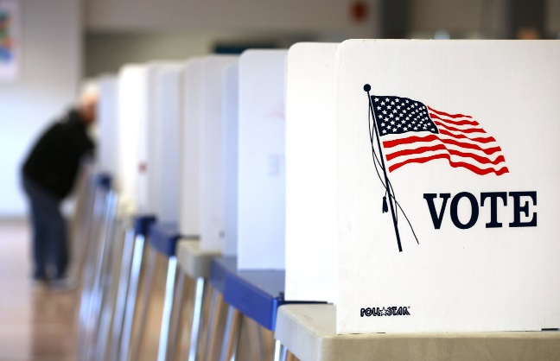
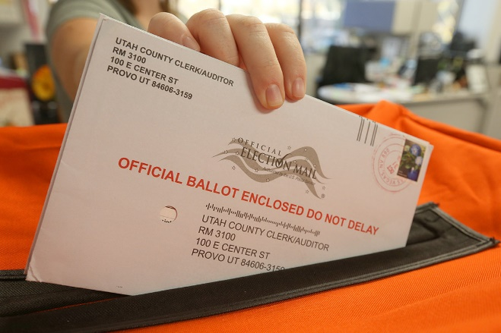
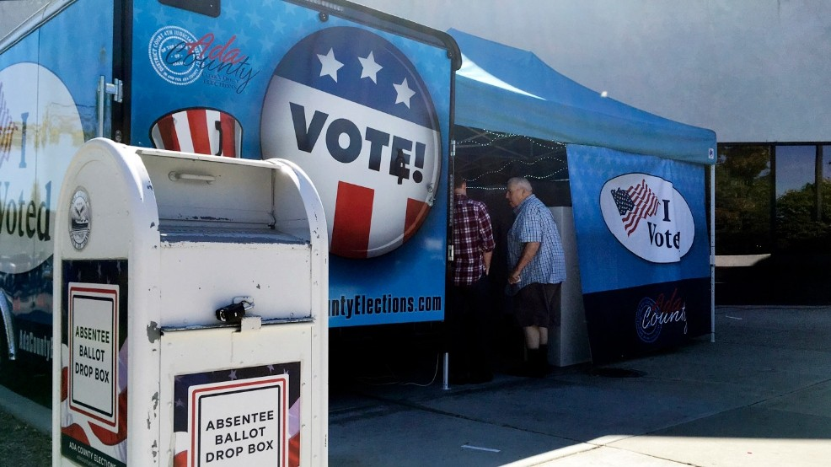
Background
Forms of Voting
Polling Places
Vote by Mail/Absentee
Early Voting
Notes:
© Copyright PresentationGo.com – The free PowerPoint library

Slide 20
Notes:
© Copyright PresentationGo.com – The free PowerPoint library

Slide 21
Questions?
Notes:
© Copyright PresentationGo.com – The free PowerPoint library

Slide 22
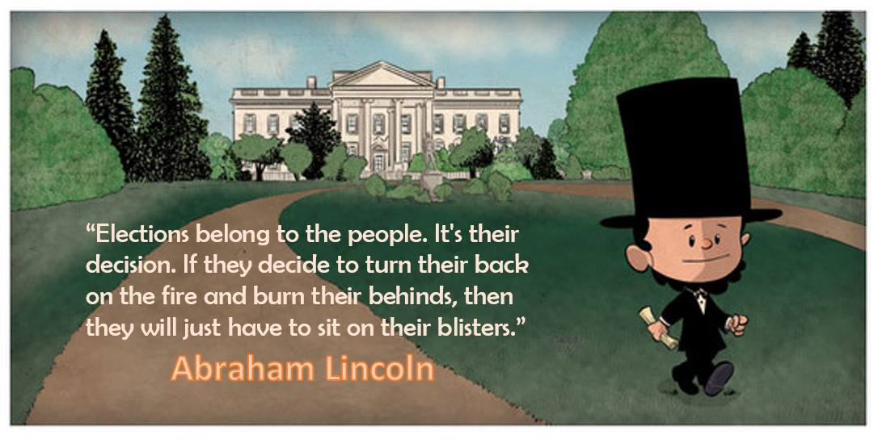
Notes:
© Copyright PresentationGo.com – The free PowerPoint library

Slide 23
Contact
Phil McGrane Ada County Clerk www.AdaCountyElections.com (208) 287-6860 elections@adacounty.id.gov
Notes:
© Copyright PresentationGo.com – The free PowerPoint library

