Slide 1
Law Enforcement Liability Webinar
January 27, 2021

Slide 2
presenters
Tim Osborne Executive Director
Chad Sarmento Law Enforcement Risk Manager

Slide 3
Goals of webinar
Law Enforcement Liability
Types of Claims
Risk Management
Continuing Exposure Areas

Slide 4
County liability exposures
Cyber Liability
Network Breach
General Liability
Personal Injury or Property Damage
Auto Liability
Snow Plowing/Road Work
Employment Liability
Discrimination/Harassment/Retaliation

Slide 5
Law enforcement is risky
Use of Force
High Speed
Civil Rights
Criminals & Gangs
Mental Illness
Drug Abuse
Medical Issues
Innocent Bystander
Use of Force
High Speed Driving
Civil Rights
Criminals and Gangs
Mental Illness
Drug Abuse
Medical Conditions
Innocent Bystander

Slide 6
And expensive
3.9 Million Settlement For Police Chase That Injured Three Pedestrians
A settlement totaling $3.9 million has been reached on behalf of three teenagers who were injured when they were struck by a stolen vehicle that was eluding a police pursuit.

Slide 7
$8.3 Million for jail death
After over four years of litigation Alameda County and Corizon Health, Inc. have ended a wrongful death civil rights case by agreeing to pay $8.3 million dollars

Slide 8
Idaho is not immune
Plaintiff Counsel
Numerous Claims in Lawsuit
Years to investigate and litigate
State and Federal Claims
Federal Civil Rights Claims (Section1983)
Legal Fees Component

Slide 9
Societal change
Increased Documentation
Video or Pictures
Cultural Shift
Driven Narrative
Inflammatory
Increased Damage Awards

Slide 10
Realizing this changing exposure
Jail Risk Management Assessment
Fremont, Madison, Bonneville, Twin Falls, Canyon, Ada, Kootenai, Boundary, Benewah
In 2019, Dedicated Law Enforcement Risk Manager
Extensive Idaho law enforcement experience
Develop partnership with law enforcement officials
Assess risk and implement mitigation efforts
Provide relevant and engaging training
POST certified training at no cost to members

Slide 11
Chad Sarmento ICRMP Law enforcement risk manager
22 Years in Idaho law enforcement
Patrol Commander
65 Unit patrol department
Jail Commander
Two separate detention centers
525 bed facility
1126 bed facility
Police Officers Standards Training (POST) Instructor

Slide 12
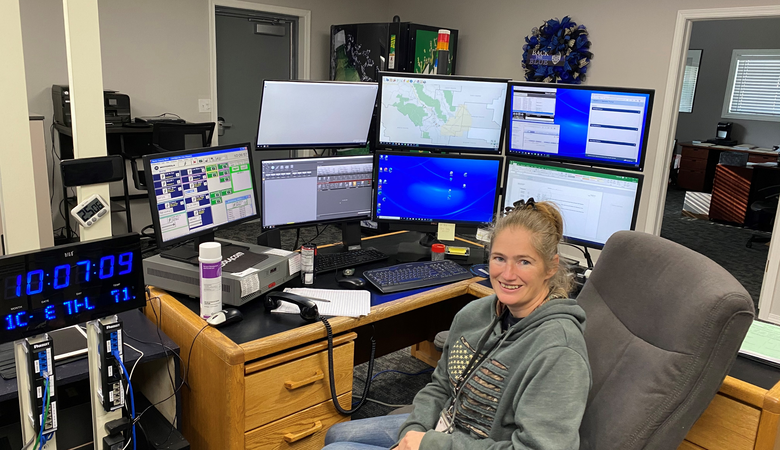
Idaho laws requiring you to have law enforcement
Idaho Code 31-2202
Duties of a Sheriff
Preserve the peace
Take charge and keep the county jail and prisoners
Serve all processes, notices, and maintain records

Slide 13
Idaho laws requiring you to have law enforcement
Idaho Code 20-601
Jails are to be kept by the Sheriff
Must provide medical care, food and shelter
Must provide transportation
If no jail, housing arrangements must be made
Boise, Camas, Franklin, Lincoln, Minidoka, Oneida, Teton

Slide 14
Law enforcement liability
Patrol
Detention

Slide 15
Patrol claims
Use of Emergency Vehicle
Responding to calls
High Speed Pursuit
Use of Lights and Siren
Policy and Procedure Violation
Arrest Procedure
Excessive use of force
Unreasonable Search Seizure
No Probable Cause

Slide 16
Patrol risk management tool
Training
Emergency vehicle use
Use of Force
Less-lethal options
K9 deployment
Communication
De-escalation
Cultural awareness

Slide 17
Patrol risk management tool
Policy and Procedure Review
Updated Patrol Policy
Training on that Policy

Slide 18
Detention claim Areas
Excessive use of Force
Inmate Management
Medical care
Lack of/or inadequate
Wrongful Death
Suicide/Mental Illness
Medical Condition
Search
Provisions made
Availability to practice

Slide 19
Detention risk management tools
Training
Use of Force
Inmate Well Being Checks
Medical Intervention
Contract and Insurance Review
Medical Provider
Dental Provider
Food Services
Other Law Enforcement Agencies

Slide 20
Detention risk management tools continued
Policies & Procedures
Updated?
Training?
Medical Care Provider
On-site?
Availability
Suicide Prevention Measures
Are Idaho’s legally mandated jail mental health procedures being done?
Strip Search Policy and Procedures
Where do they happen, and are they legal?
Cross-Gender Searches

Slide 21
Continuing risk exposures
Lack of Detention Deputies
Inmate well-being hampered
Using inappropriate staff for facilities

Slide 22
Continuing risk exposures
Overcrowding
Increased violence
Inmate classification and separation

Slide 23
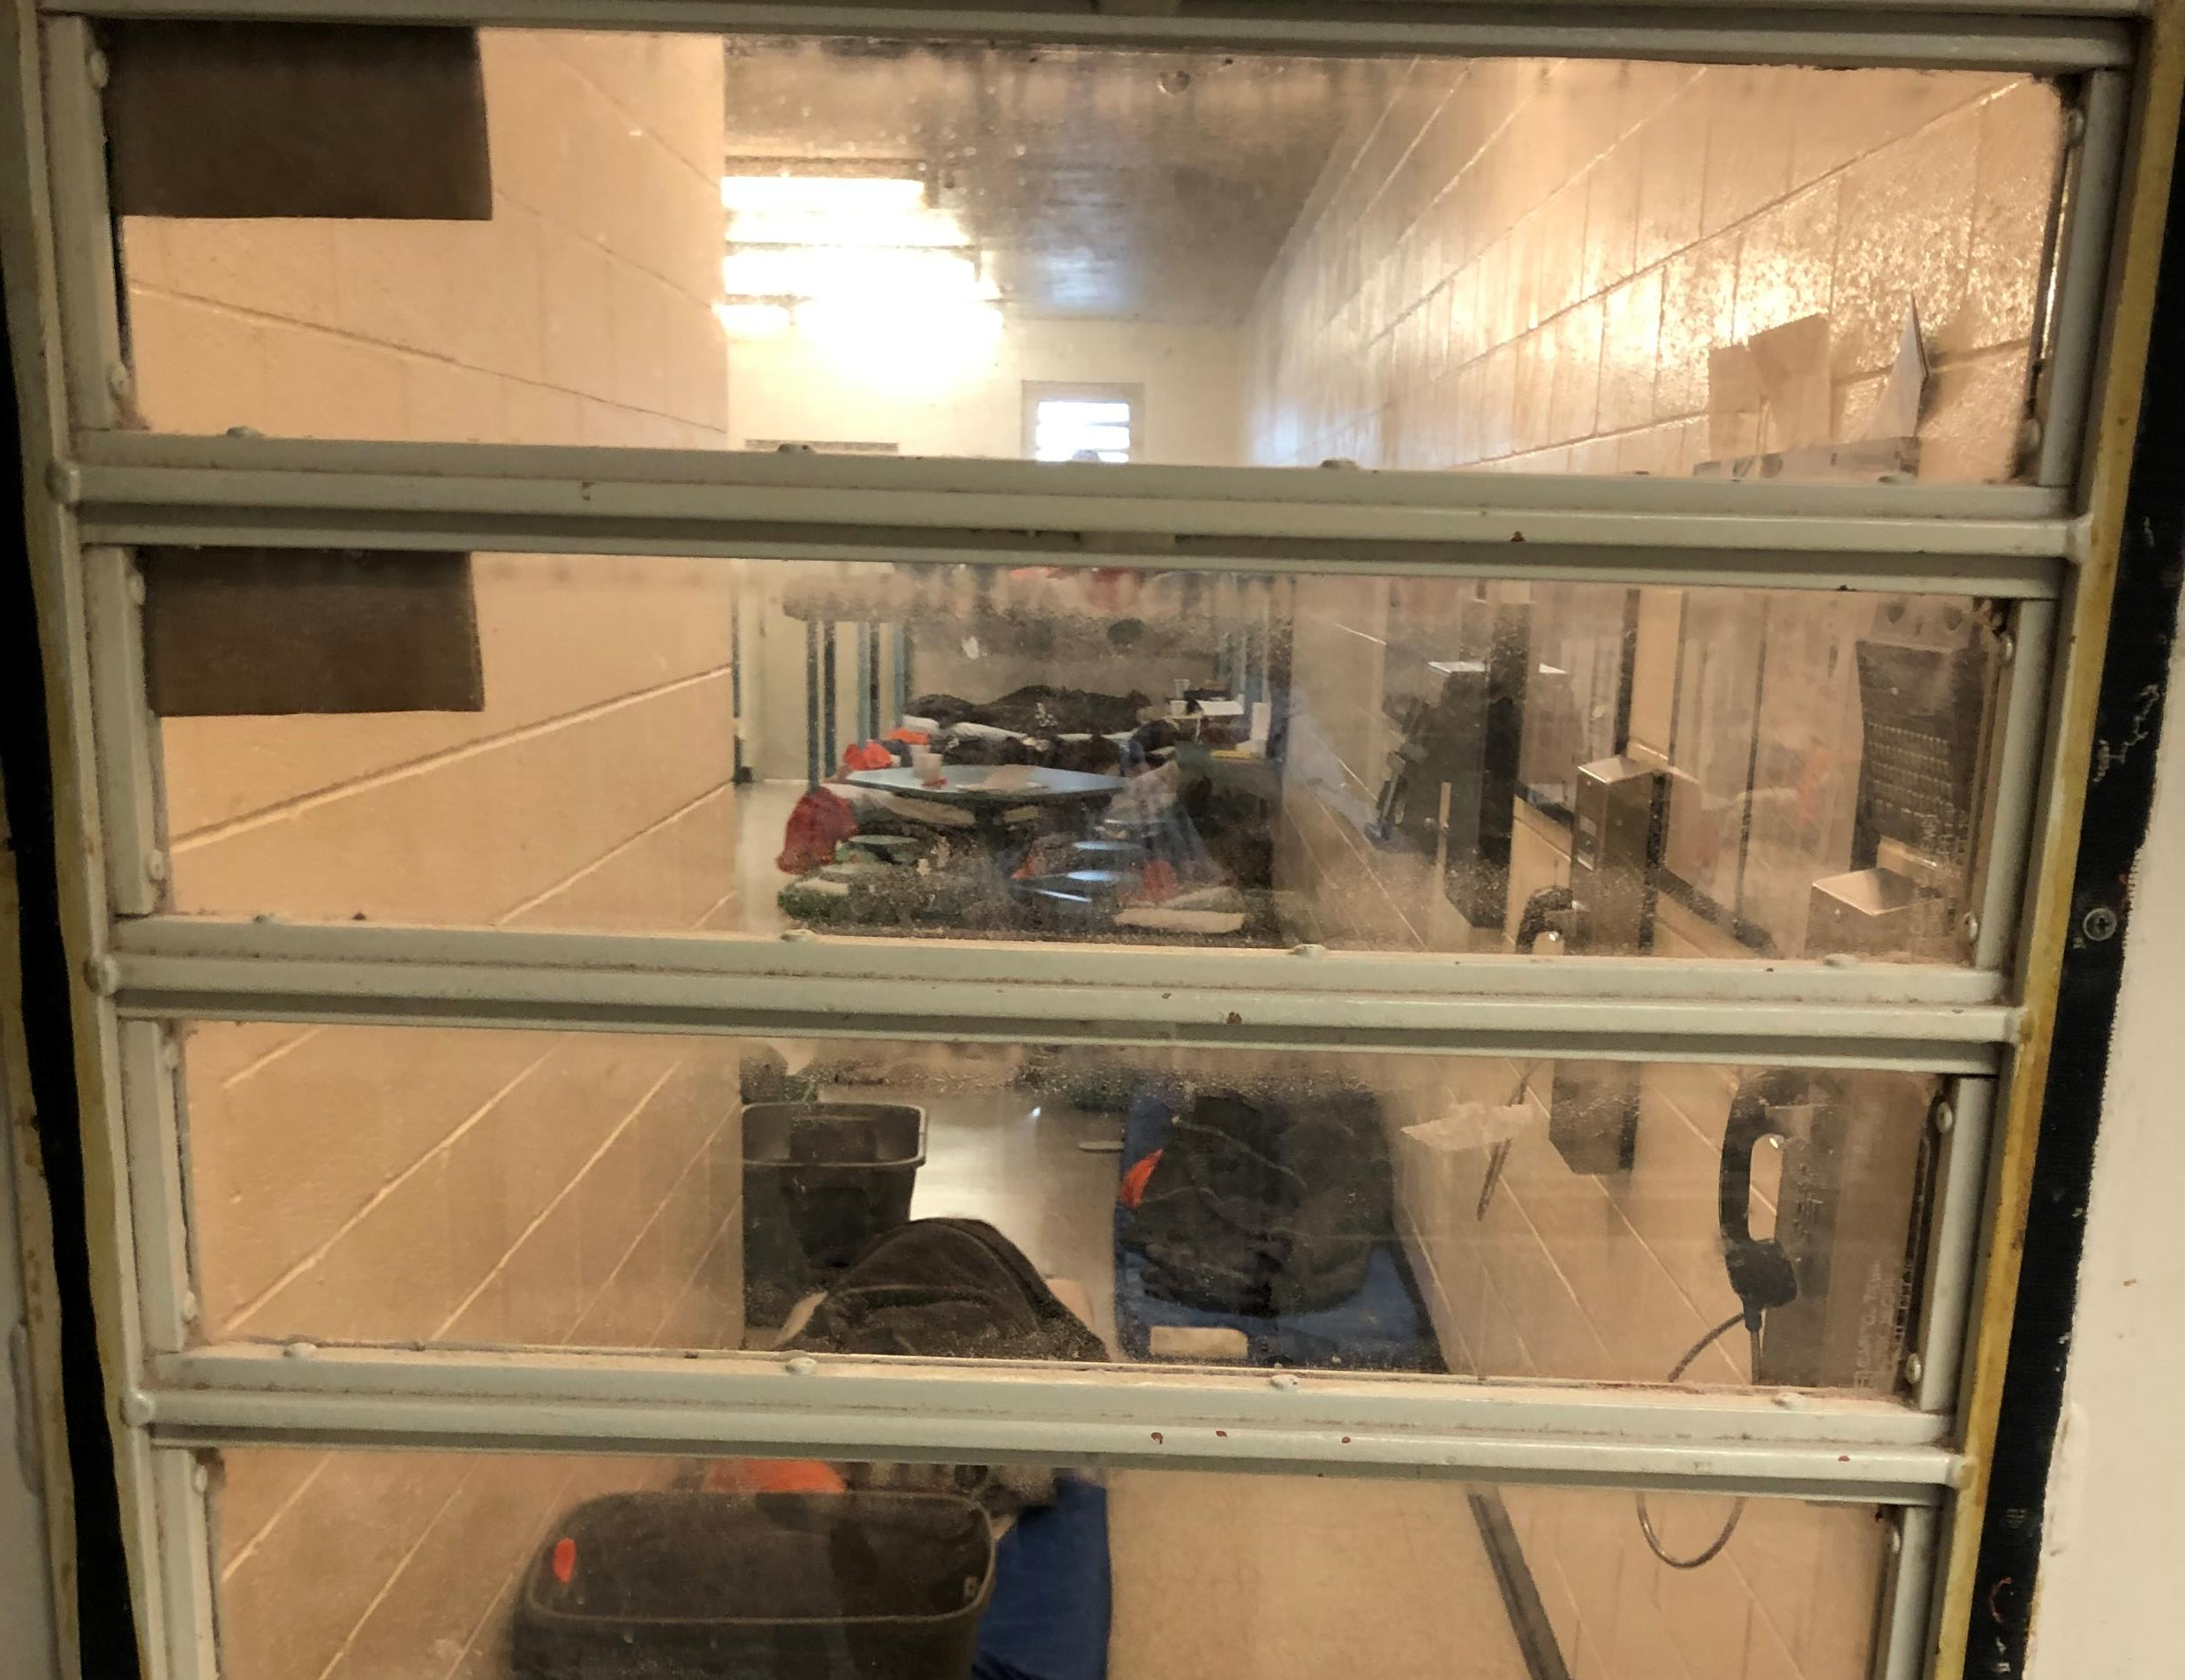
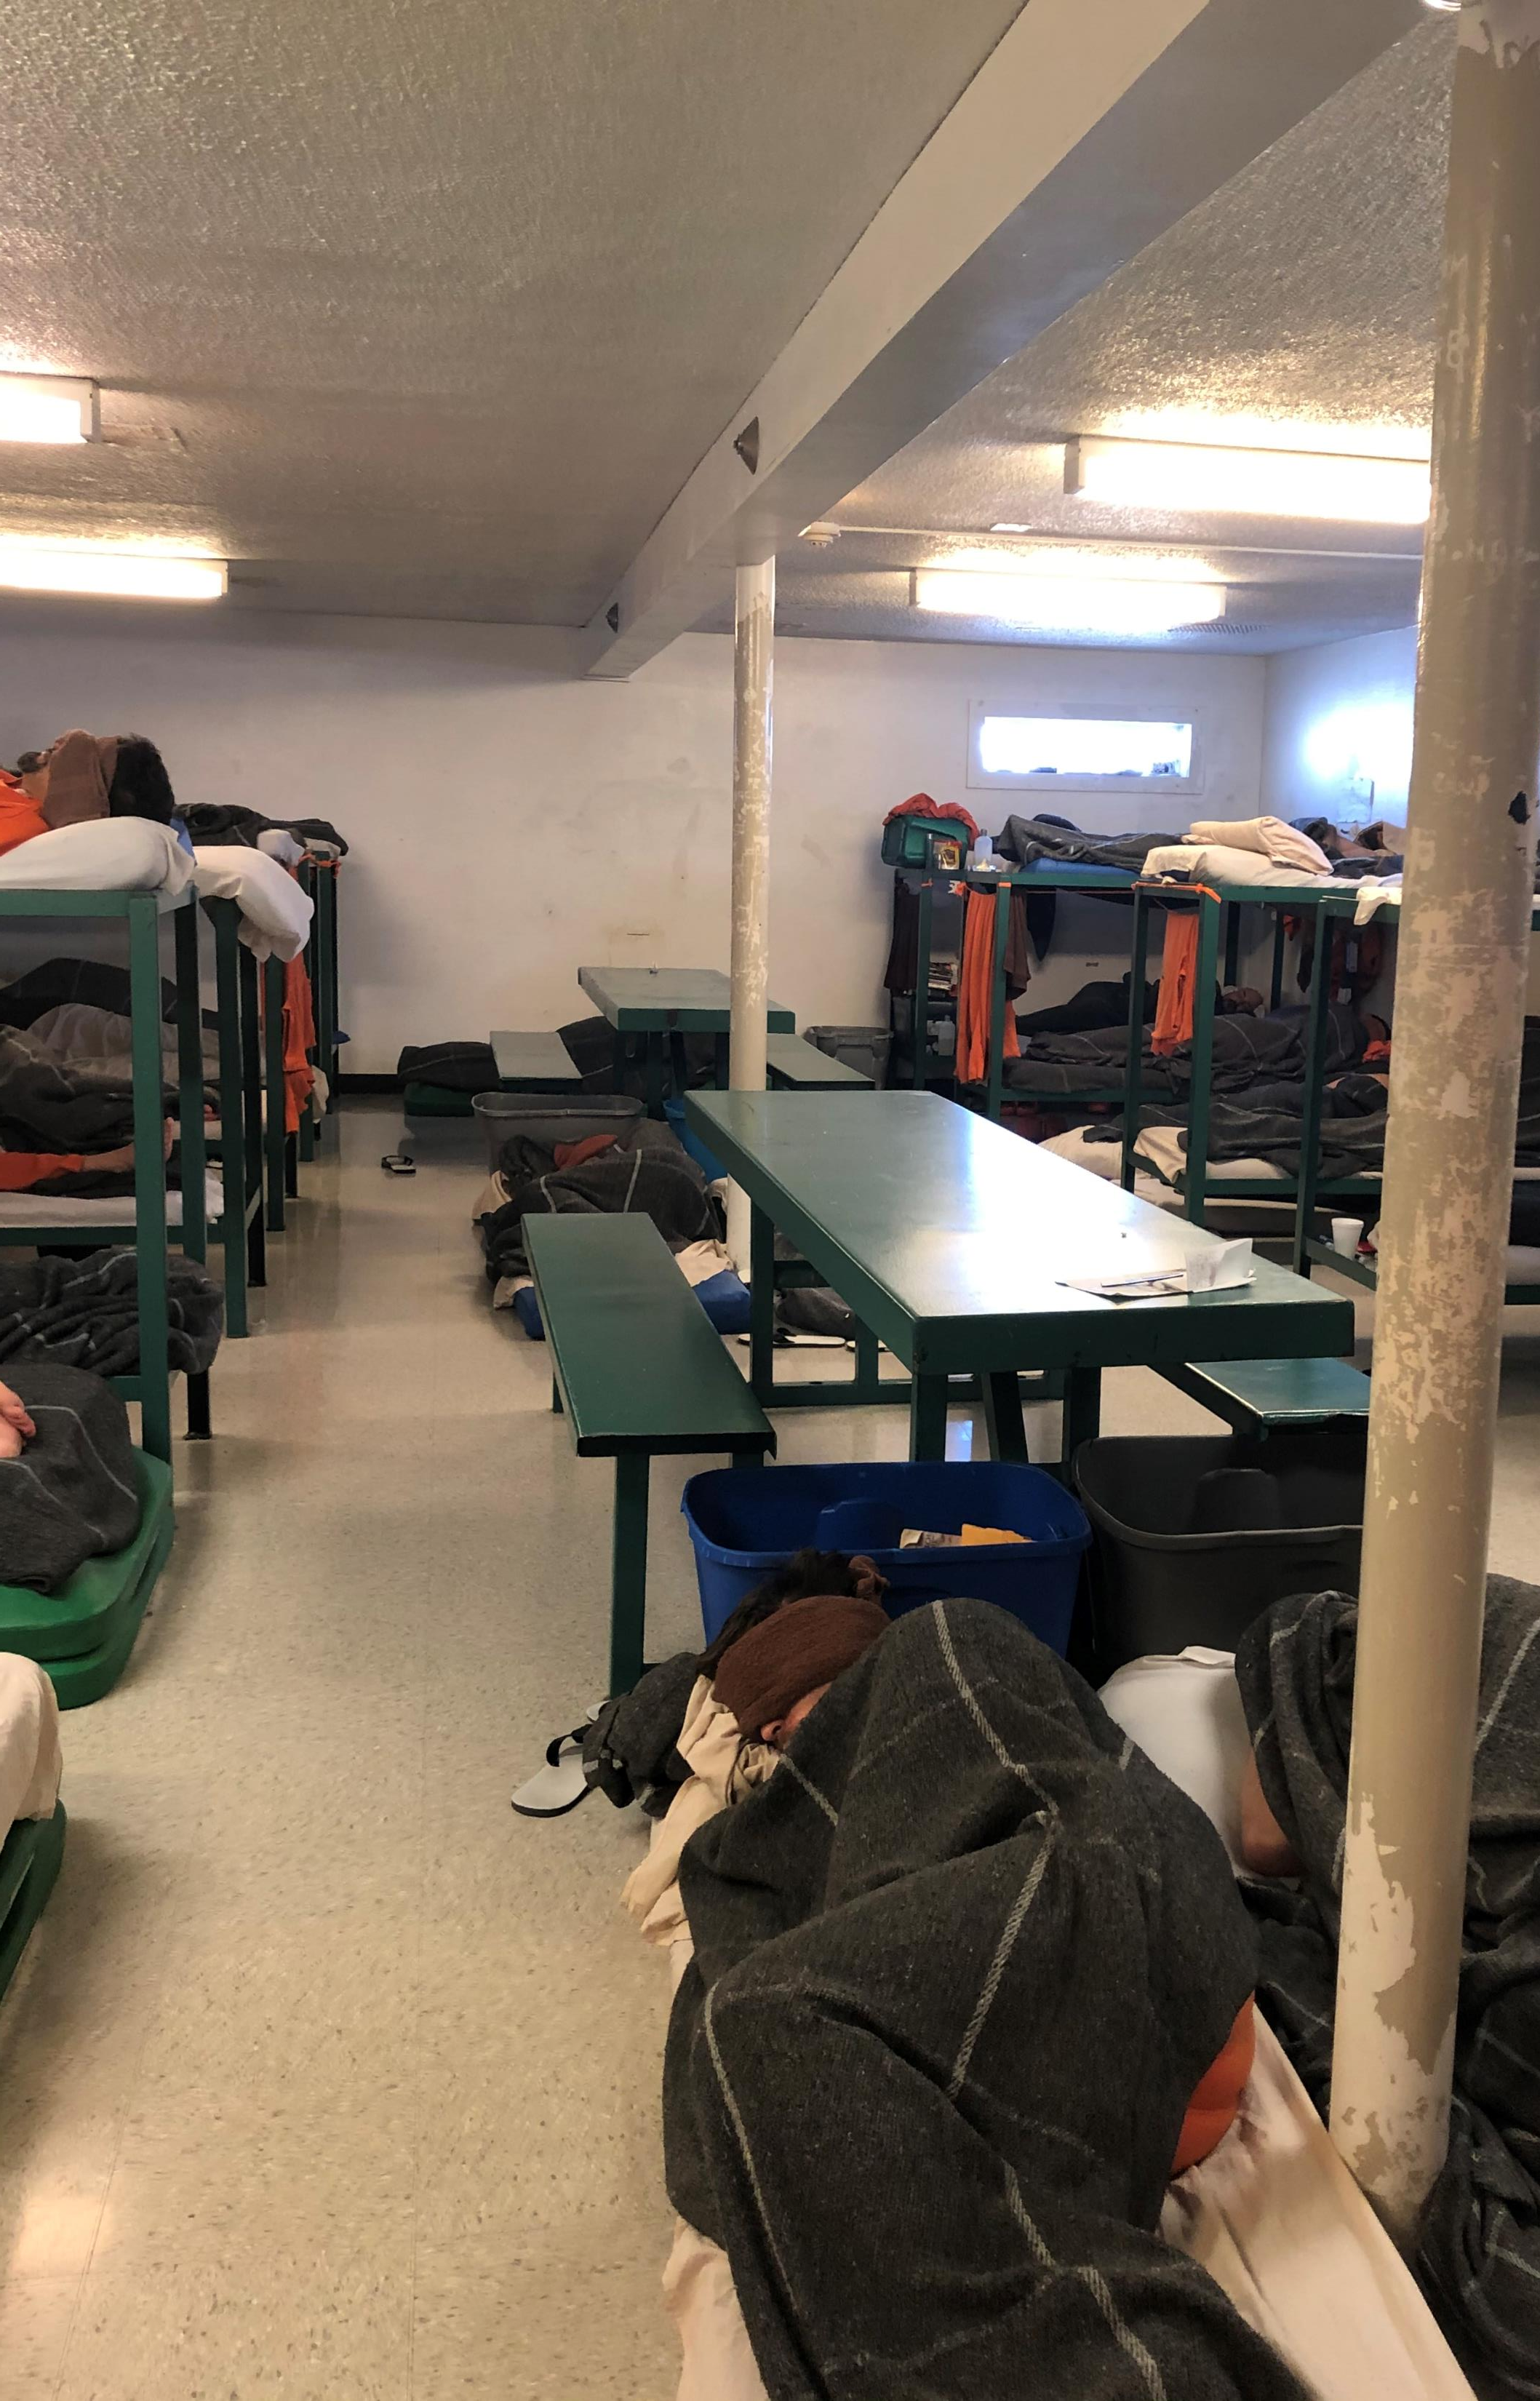
Continuing risk exposures
Facilities
Deterioration
Fire Safety

Slide 24
Continuing risk exposures
Medical
Provider
Access
Responsiveness
Insurance

Slide 25
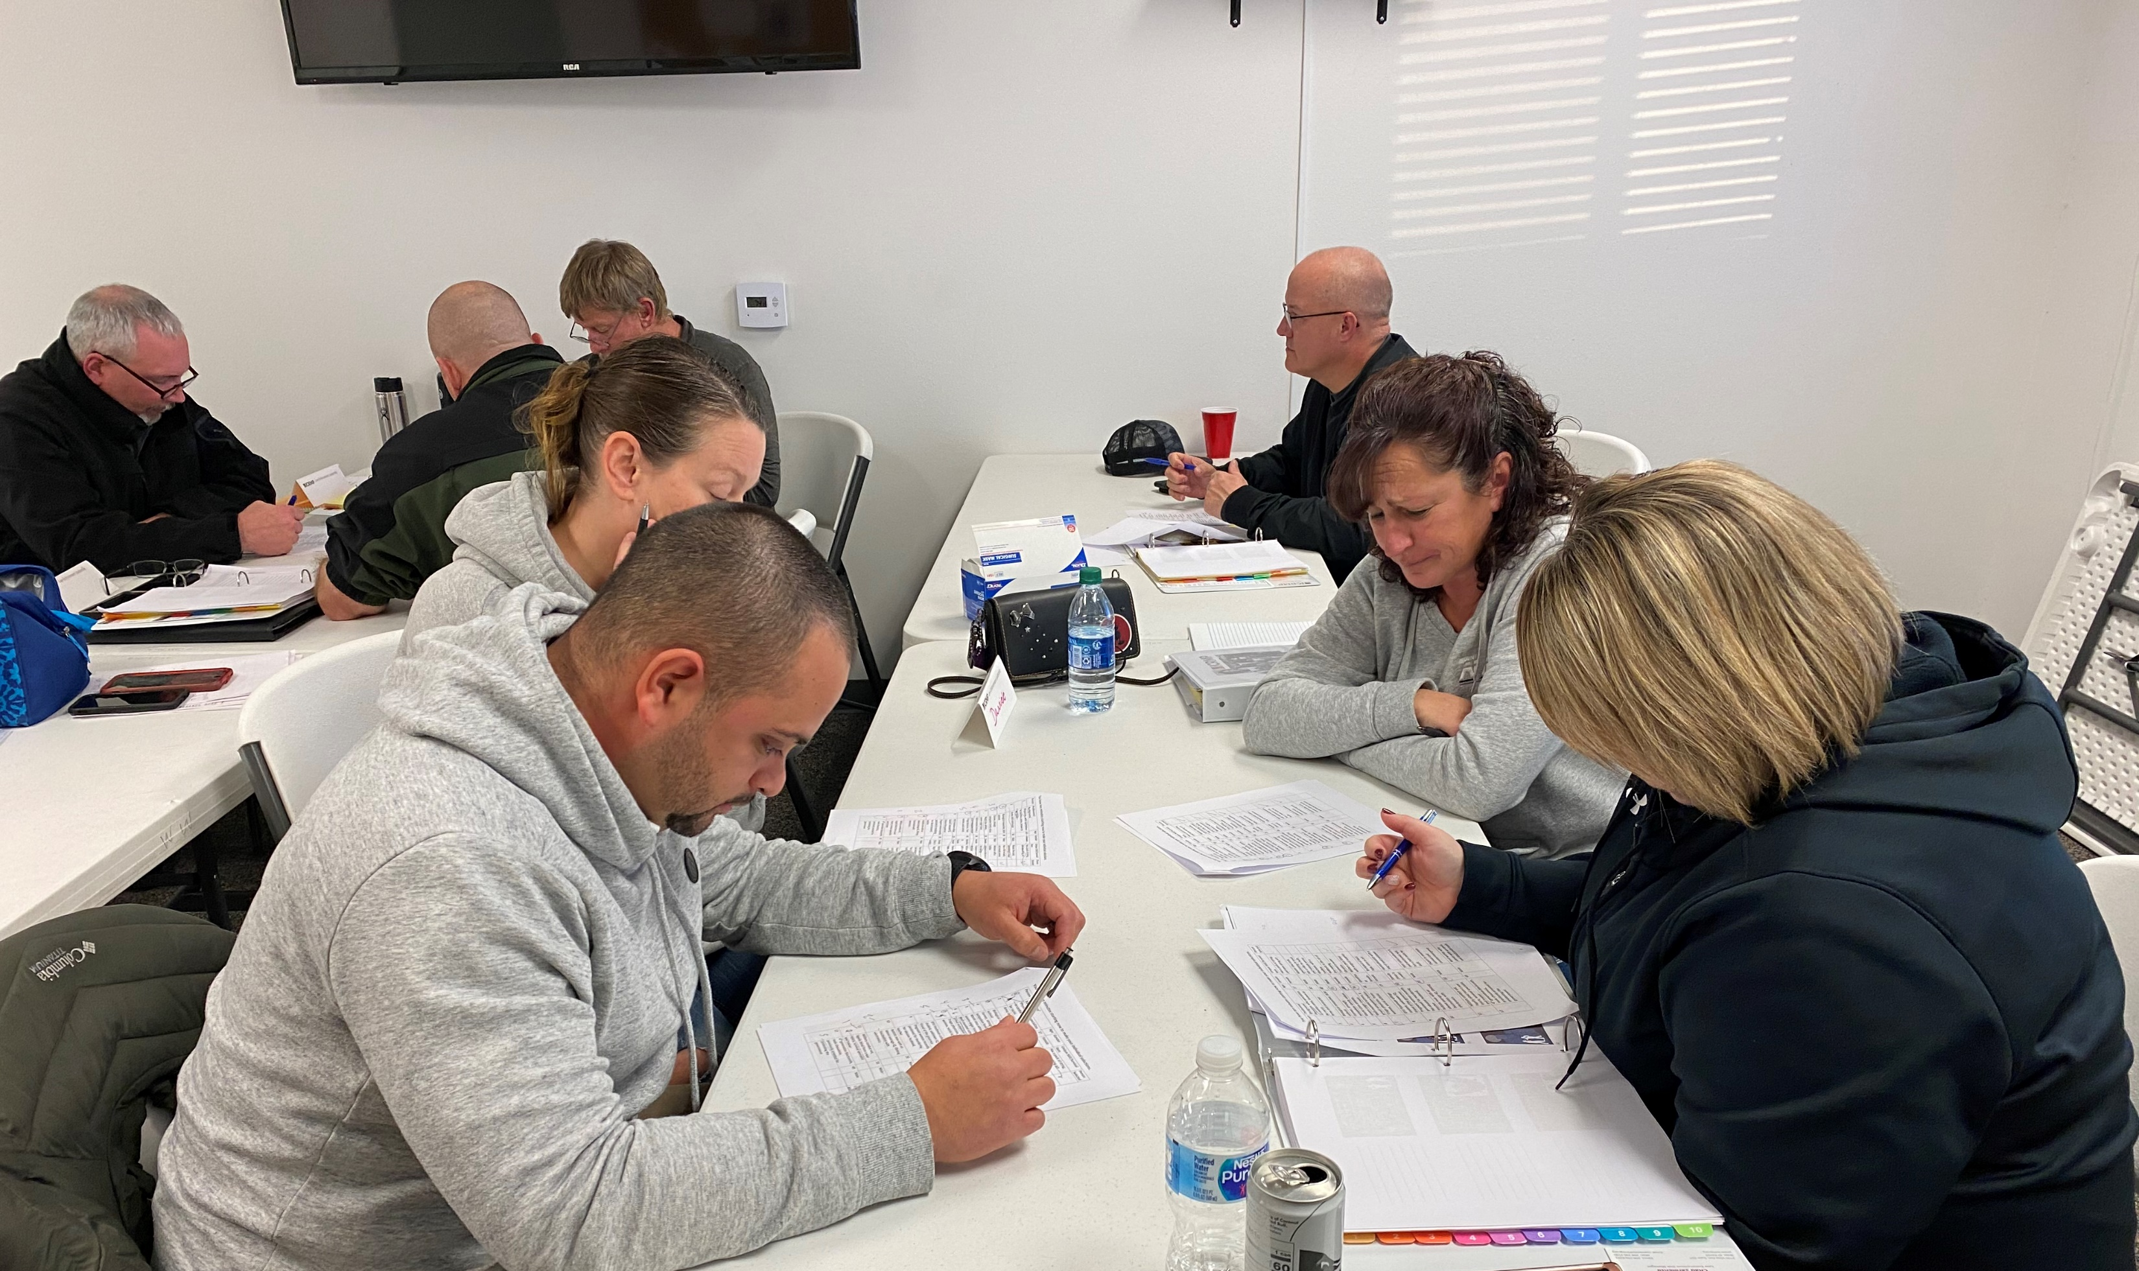
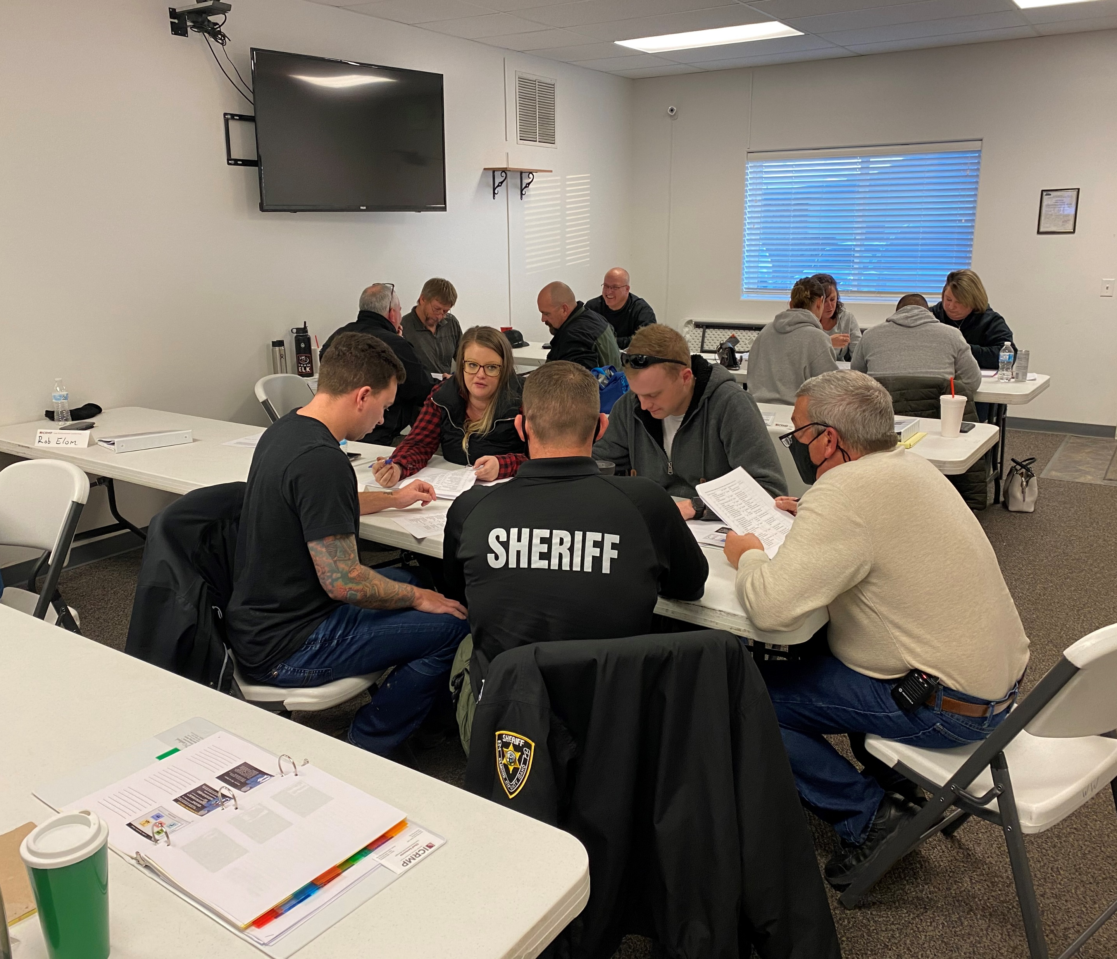
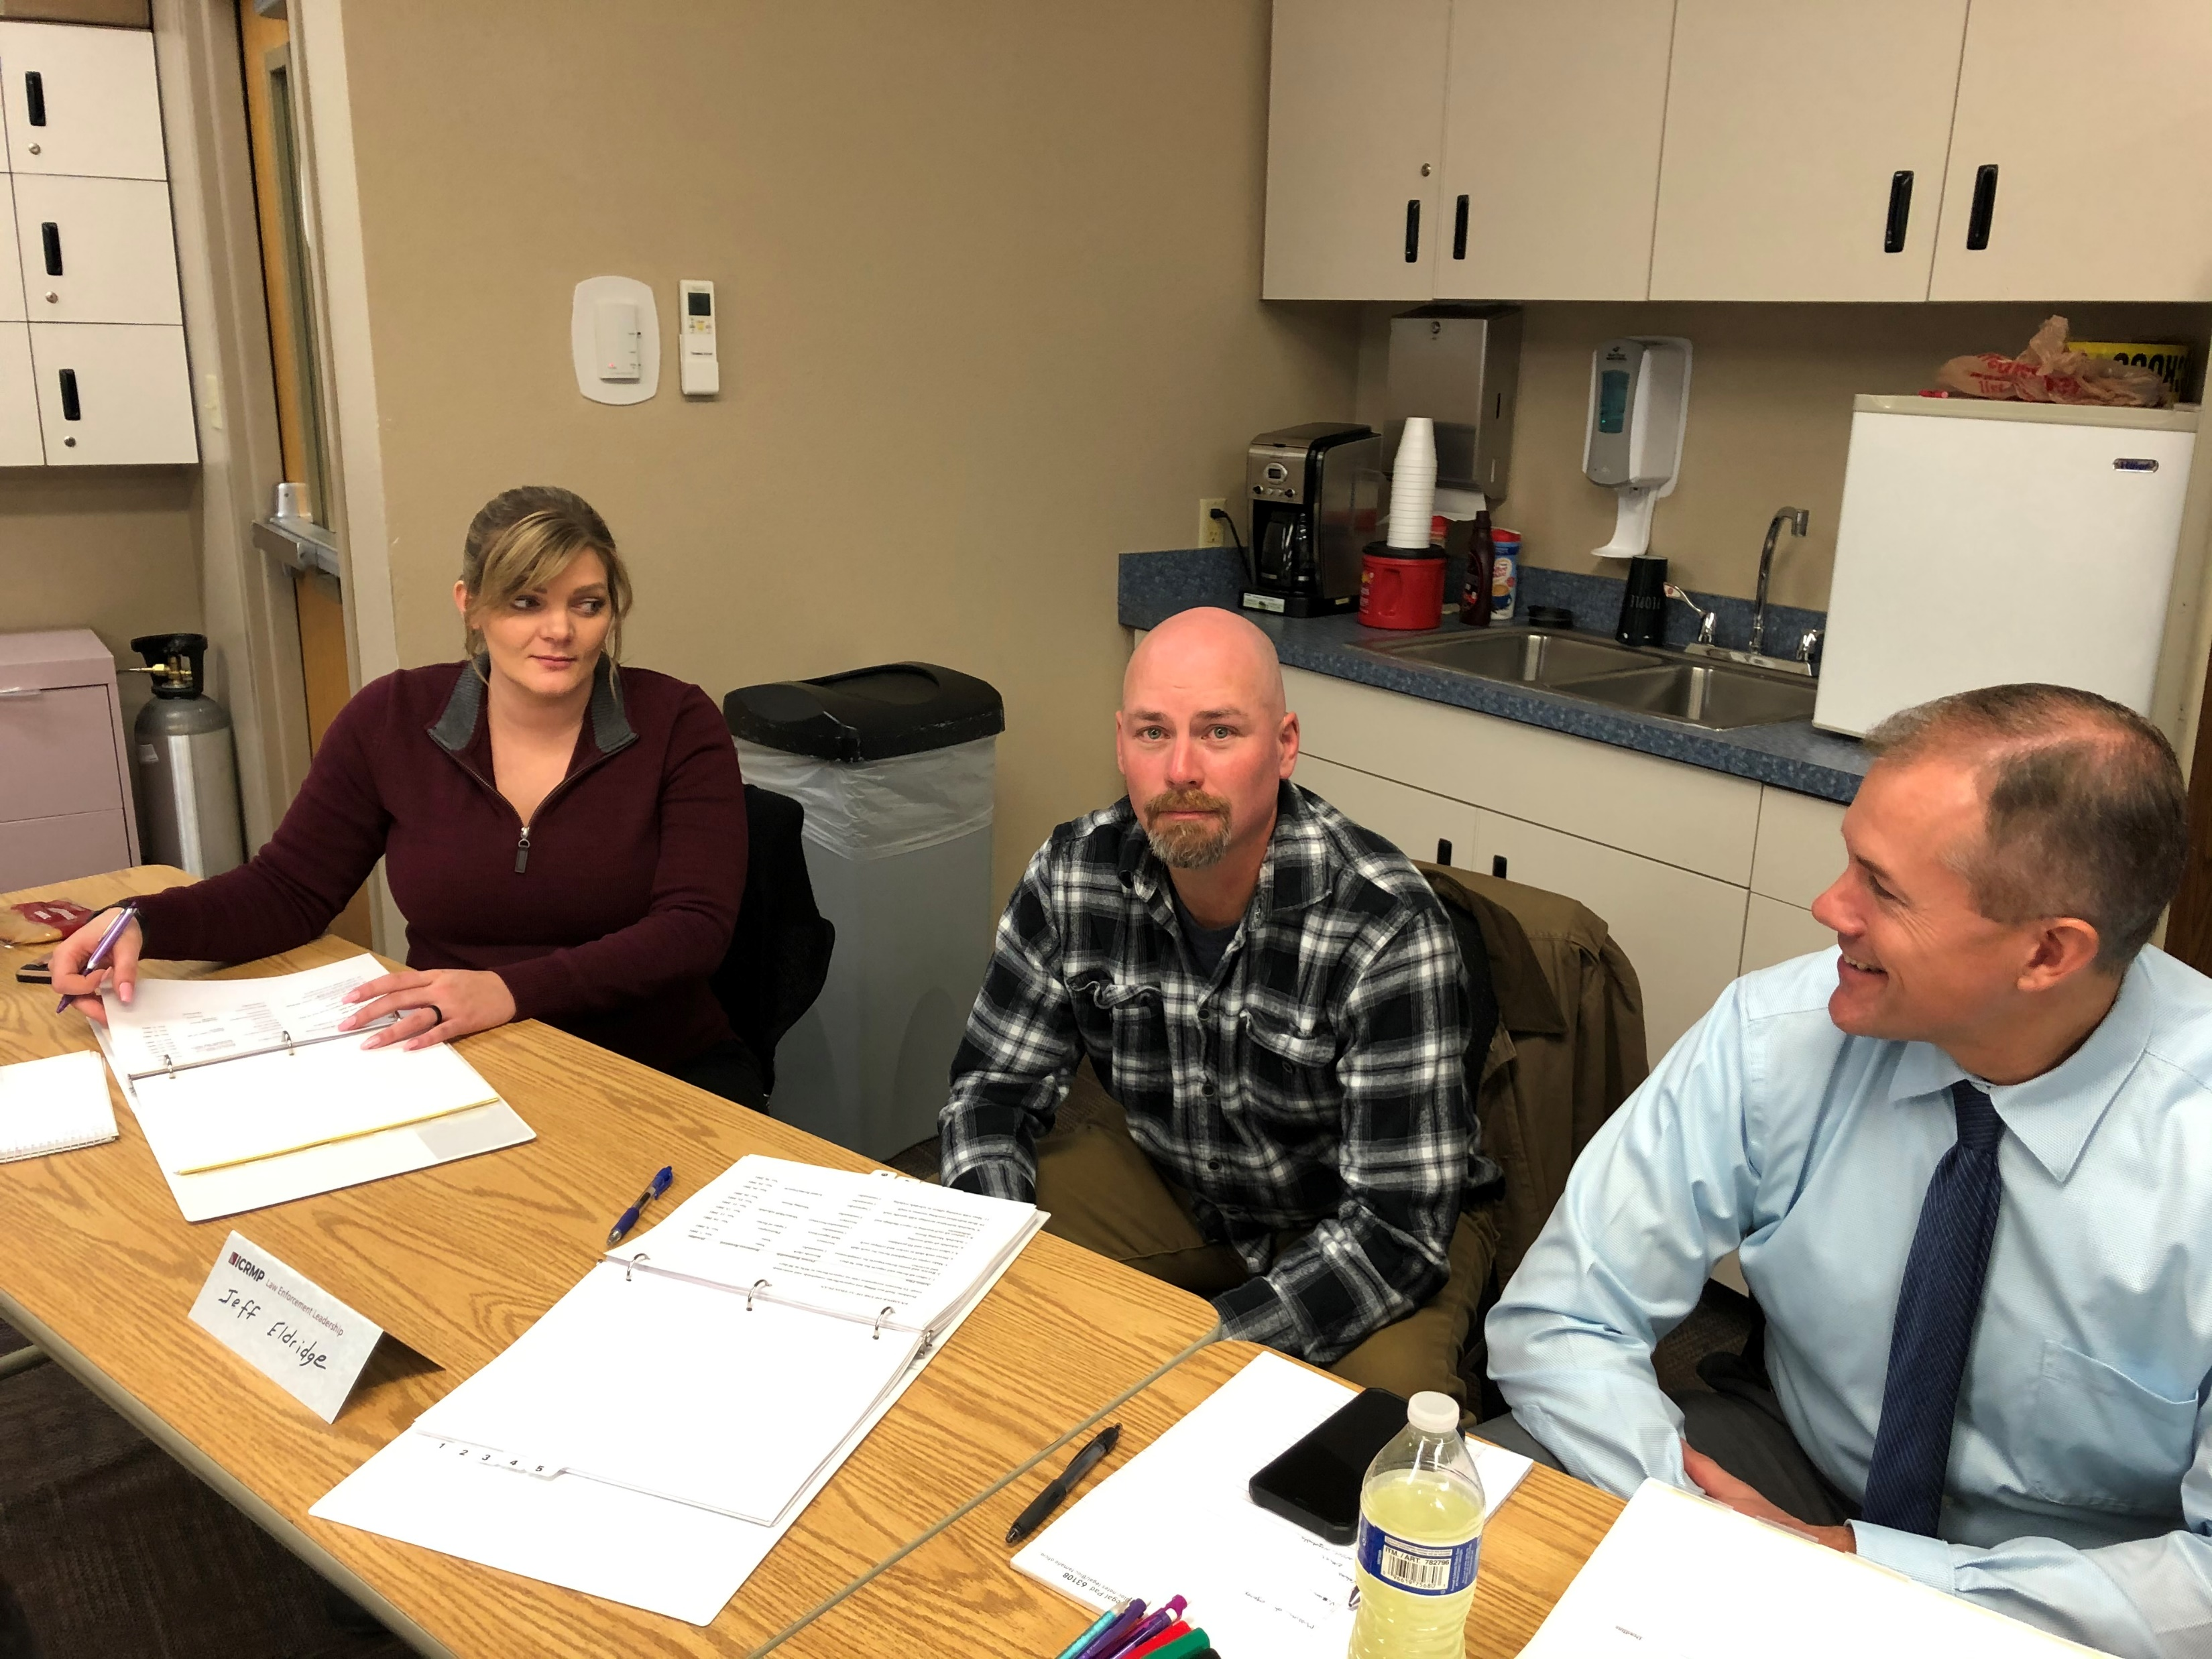
Getting and using the information
Visiting your agency
Working with both law enforcement and their stakeholders
Seeing first-hand the success and struggles
Forming achievable improvement plans
Reducing the risk through training

Slide 26
Questions? We are here to help

