Slide 1
Notes:
Thank you for joining us today for this IAC Webinar: Welcome to Online Meetings, Education and Networking! I’m Shari Fernandez, IAC Event Coordinator. I am joined by Sara Westbrook, IAC Director of Policy; and Kristin Cundiff IAC Director of Operations.

Slide 2
THANK YOU TO OUR CORPORATE PARTNERS:
Notes:
Before we begin we’d like to thank our Corporate Partners: ICRMP, Gem Plan, Blue Cross of Idaho and Western States CAT. We greatly appreciate their year-round support of IAC.

Slide 3
THE ”NEW NORMAL”
Online Meetings
Webinars
Virtual Conferences
Networking
Notes:
Like all of you, at IAC we have been adjusting to the ”new normal” of online meetings, webinars, virtual conferences and networking. It’s been a learning experience for all of us. Some meetings have gone better than others….

Slide 4
We’ve all been here….
Notes:
I’m sure we’ve all participated in at least one meeting like this…. [Play Video] We can laugh about it because it’s true! But, virtual is the new normal so we all need to be able to make the best of it – which is what we’re going to try to help you do today.

Slide 5
Webinar
Provide education or training to a large group
Interaction with audience is minimal
Most often audience is in listen-only mode
IAC delivers webinars via GoToWebinar
Notes:
First of all there are different types of online experiences and they are each a bit different. A webinar, like what we’re doing right here is different from an online meeting. The purpose of a webinar is to provide education or training to a group. It can be a small group or a really large group. Generally, there is minimal interaction between the audience and the presenters. Also generally, the audience is in listen-only mode. GoToWebinar – the platform we are currently using -- is what IAC has chosen for providing webinars.

Slide 6
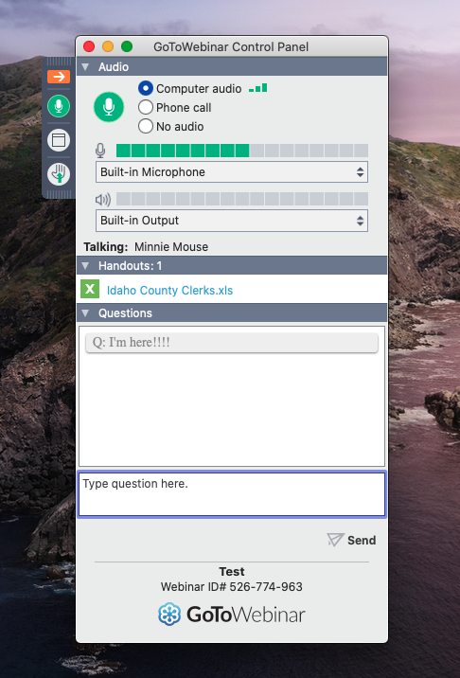
GoToWebinar Features
The GoToWebinar Control Panel gives you the ability to:
Raise your hand
Type a question
Mute/Un-mute your microphone
Notes:
There are several features available to you as an attendee on the GoToWebinar Control Panel. If you click the hand icon, it signals to the presenter that you have a question. You also have the ability to type a question in the question box. The presenter will see the question and can either verbally answer it or type out a response. Additionally, the microphone button allows you to mute/un-mute yourself. It is important to note that not all webinars will give you the ability to unmute yourself. Especially, in large webinars, in order to control the noise, you will enter the webinar in listen-only mode. With that said, let’s take a moment to play with the buttons…..

Slide 7
GoToWebinar: Test Drive
Questions?
Notes:
You should now all have the ability to un-mute yourself. Feel free to do so if you would like to ask a question or make a comment. You can raise your hand – you can also put your hand down, by clicking the icon again, once your question has been answered. If everyone is ready to move on we’ll talk about virtual meetings.

Slide 8
Virtual Meeting
Replaces an in-person meeting or conference call
Collaborative discussion
Hosted on Zoom, Google Hangouts or GoToMeeting
Notes:
(KRISTIN) As I mentioned before virtual meetings are different than webinars as the purpose of an online meeting is to replace an in-person meeting or a conference call. Ideally, all participants are on camera and can have a collaborative discussion. IAC has hosted meetings on several different platforms including, Zoom, Google Hangouts and GoToMeeting. Virtual meetings can be tricky because you have to be aware of a lot more details than you would just walking into your conference room for a team meeting.

Slide 9
How to be a good online meeting participant….
10 Tips for professional online meetings:
Notes:
(Sara) With that said, we’ve compiled a list of 10 tips for professional online meetings. Please note, we have personally done, or experienced, ALL of the things on this list. The goal is not to call people out, but to help you become the best online participant you can! Let’s get rolling with Tip #1!

Slide 10
Tip #1: Be ready for your close-up!
Be (fully and) appropriately dressed for the meeting.
Notes:
[SHARI] If you’re in an online meeting – hopefully, you’re on camera so you can interact with all your colleagues! However, Be ready for your close-up…. And that means be fully and appropriately dressed. To illustrate this point we have a short video from an ACTUAL online meeting. [PLAY VIDEO]. So, at very least, please wear pants.

Slide 11
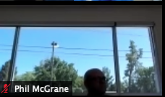
Tip #2: Lighting is critical!
Make sure you have good lighting – in front of your face
Sit facing a window
If you are lit from behind you will be a shadow floating in your screen
Notes:
[KRISTIN] Where you’re sitting in relation to the light in your space makes a huge difference! If I take my laptop and turn the camera towards the windows, I immediately become a shadow. It can be as simple as moving your device 90 degrees to get better lighting. If you don’t have a window in your workspace, you might look into a desktop lamp. Alternatively, almost all of the online meeting platforms have an app that you can download to a phone or tablet. Since many desktop computers don’t have a camera built in, using a mobile device is a great alternative since you can move to where the lighting is best for you.

Slide 12
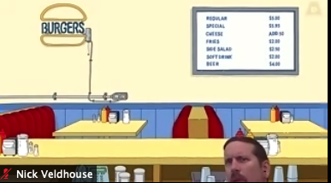
Tip #3: Camera angle is important!
Avoid nostrils and foreheads
Position your camera at eye-level, or slightly above
Fill the frame….like a TV anchorperson
Notes:
[SARA] Take a moment to be sure that you are filling out the video frame. This will help you feel more comfortable and confident. A good rule of of thumb is to fill 2/3rds of the screen. Also, in order to optimize your camera position, don’t hesitate to raise your camera to a more pleasing angle. Simply adding a few stacked books under your laptop or tablet could be just the ticket. (Example of extreme closeup and awkward angles.)

Slide 13
Tip #4: “Check, 1, 2…”
Test your audio ahead of time.
Use headphones, ear buds or a head-set to reduce feedback and echo.
Notes:
[SHARI] Just like in-person meetings you have to be able to hear what’s going on. But like a conference call you don’t want feedback or background noise to get in the way. Headphones -- and they can be the same ones that came with your phone, they don’t have to be fancy – will go a long way toward improving your audio quality. [example of sound without headphones and with headphones plugged in].

Slide 14
Tip #5: The mute button is your friend
If you are not talking be sure to mute your microphone.
Notes:
[KRISTIN] in pretty much all platforms the microphone button looks the same – although the color might be different. It is best practice to have your microphone muted when you are not speaking… just in case. [Shari’s alarm will go off. Sara has someone come talk to her, etc. ]

Slide 15
Tip #6: Less (in the background) is more
Avoid cluttered surfaces, distracting art, and kids and pets
Use a virtual background
Notes:
[SHARI] Home offices – that were sometimes bedrooms, family rooms or dining room tables made it hard to avoid distracting backgrounds. But, less is definitely more when it comes to your virtual meeting settings. You want colleagues to pay attention to what you are saying and not what might be going on behind you. In Zoom, you have the ability to create a virtual background that will cloak your physical space…. and possibly your bun or ponytail, if you happen to have one. We’ll come back to this later!

Slide 16
Tip #7: Be punctual… just like in person
Get online a couple of minutes before the meeting/webinar starts
Notes:
[KRISTIN] Just like in-person meetings it can be very awkward to do a quick re-cap to catch-up latecomers to a meeting. Getting online a few minutes early also lets you make sure your connection, video and sound are all working correctly. This is especially important if you plan to be a panelist or speaker. Don’t feel shy about asking the meeting or webinar host if you can get on ten minutes early to check your sound and camera. Most online meetings and webinars have a function that allows the meeting host to start in a practice mode.

Slide 17
Tip #8: Rustling papers, typing, clicking your pen?
Refer back to tip 5… If you aren’t muted everyone will hear what you’re doing.
If you aren’t muted, it can be distracting to your colleagues.
Notes:
[SARA] We are all really busy – but sometimes when we are trying to multi-task it can be distracting to our colleagues and detract from the topic at hand. Be sure you’re muted to avoid distractions. Also, don’t be offended if the organizer mutes you. Sometimes you don’t even realize your microphone is picking up the sound. I’ve been on calls where I thought I was muted and while waiting for the meeting to start I was rapidly typing up an email when I heard from the meeting organizer, “Will whomever is typing on their computer please mute your microphone?” Oops! It happens, just try your hardest not to let it happen to you.

Slide 18
Tip #9: Save snacks, or your lunch, for later
Watching you eat is very distracting.
If your microphone is not muted, listening to you eat is VERY distracting.
Notes:
[SHARI] We’ve all got to eat. Maybe a meeting ran long and now you’re on this online meeting and you’re starving. We have been there, and we get it! But we really don’t want to watch you eat your lunch. And, if it’s a noisy food – like chips – we really don’t want to listen to it either. Never fear, there is a simple solution. Mute your microphone and turn off your video. You’re still participating, and we won’t be offended.

Slide 19
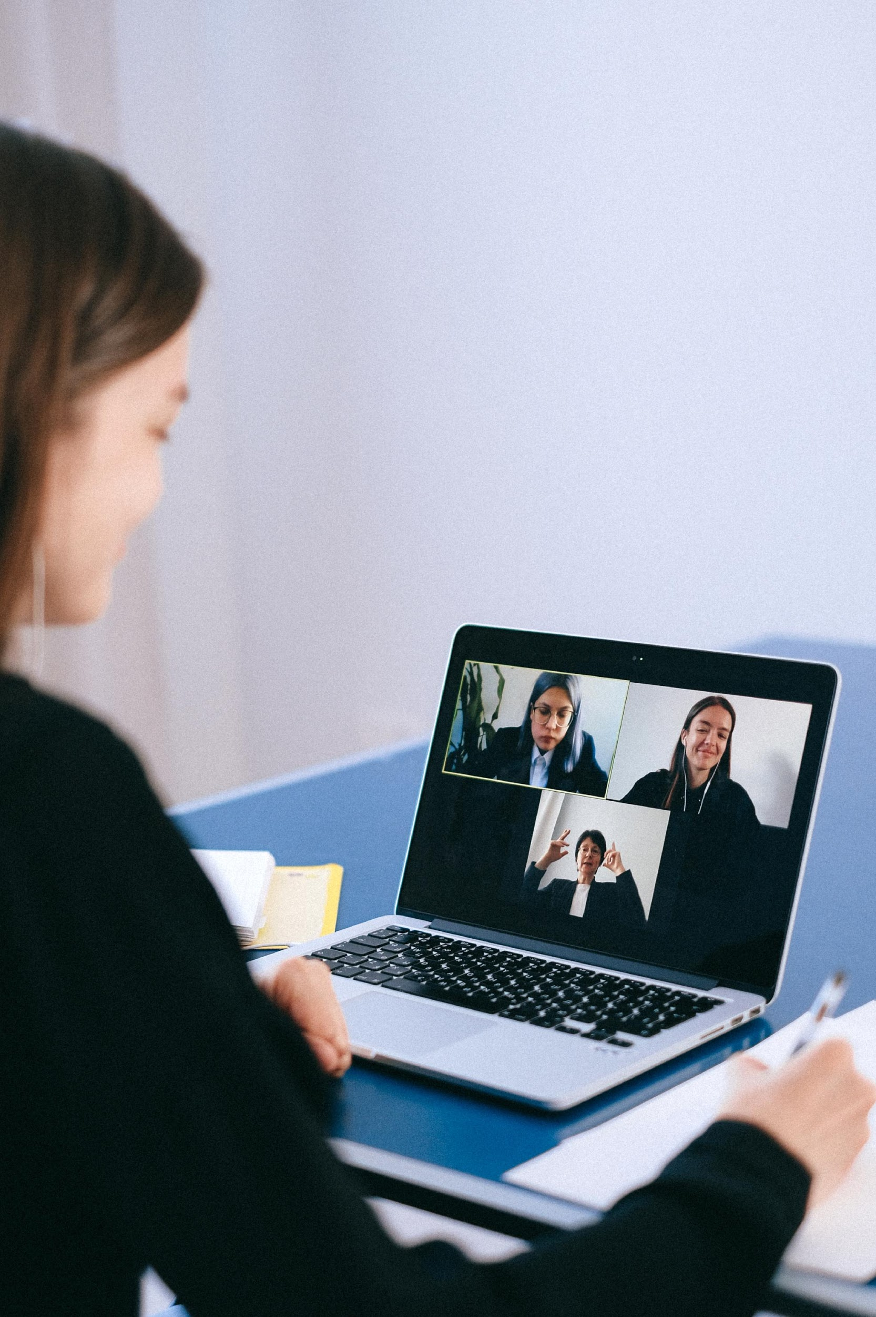
Tip #10: Be present
Be sure to focus your attention to the meeting at hand.
Your colleagues can see you….
Notes:
[KRISTIN] Treat your online meetings as if they were in-person. We get that there are a million emails piling in your in-box and it’s very easy to listen to the meeting and crank out a few responses at the same time….. Don’t forget that you can turn off your camera for a few moments if you need to help a customer or talk to a colleague. Or if you are working at home - talk to a family member! It will be less distracting to others if you have your camera turned off while people are wandering in and out of the frame.

Slide 20
QUESTIONS?
Notes:
[SHARI] That’s it for our top ten tip list… there are probably things we’ve omitted, but this hopefully got you thinking about your online meeting presence. Are there any questions before we move on?

Slide 21
TEST DRIVE TIME….

Slide 22
Test Drive: Zoom
Join us in a Zoom Meeting!
You will find the meeting link in the chat box.
Notes:
[SHARI] We’re going to jump over to Zoom. Kristin is putting the link to the Zoom meeting in the question box. Please use the link to join us for a Zoom test drive. The GoToWebinar will be ending when we switch over to Zoom. See you there!

