Slide 1
Impact of State Mandates on County Governments
Presented by Amanda Bartlett and Lauren Bailey

Slide 2
A requirement or restriction that one government places on another.
2

Slide 3
Our report focused on counties.
Which state mandates are the most burdensome?
What factors help or impede counties?
What strategies are used to manage burdensome mandates?
3

Slide 4
Methodology
Problem identification
Problem confirmation
Exploratory data analysis
4

Slide 5
What state mandates present the greatest problems?
Judicial services
Health and welfare
Public safety
General government
Tax and expenditure limits
Sanitation
Road & bridge
Federal
5

Slide 6
What state mandates present the greatest problems?
Judicial services
Health and welfare
Public safety
General government
Tax and expenditure limits
Sanitation
Road & bridge
Federal
6

Slide 7
6 themes describe when mandates become problematic.
7
7

Slide 8
Technology issues create tension between counties and the state.
8

Slide 9
New or rapidly changing mandates affect the uncertainty of funding.
9

Slide 10
Public defense spending in state fiscal year 2017
10

Slide 11
$4.2 million
State grant dollars
Public defense spending in state fiscal year 2017
11

Slide 12
Rising costs, increasing demand for services, and a lack of revenue increases counties’ liability.
12

Slide 13
Compliance becomes more difficult when oversight changes hands from one agency or level of government to another.
13

Slide 14
Problems are exacerbated when two different mandates interact.
14

Slide 15
Changes in federal or state policy impact counties’ ability to implement mandates.
15

Slide 16
County spending for indigent medical services
$20.7 million
$17.1 million
2018
2017
County fiscal year
16

Slide 17
Survey responses indicated poor collaboration between counties and the state.
County commissioners who responded to our survey:
66%
Disagreed that the Legislature did a good job seeking input.
Disagreed that state agencies were responsive to counties’ concerns.
17

Slide 18
“We try and provide positive input regarding the establishment of policies and rules, and laws; however, we find that many times our concerns are not heard or given due consideration as to what the final outcome might be when these policies, rules and laws are implemented.”
-County commissioner
18

Slide 19
Poor collaboration between counties and the state has left county officials feeling like a special interest group rather than a strategic partner.
19

Slide 20
Recommendation
We recommend that policymakers consider the items on the checklist as they draft new legislation or rules that affect mandates to counties.
20

Slide 21
Source of problems:
80% not enough revenue
20% new or increased requirements
80%
21

Slide 22
Insufficient revenue was the most consistently reported cause of mandate problems.
County commissioners who responded to our survey:
70%
67%
Mandates usually or always lead to financial problems
County revenue was rarely or never adequate
State revenue was rarely or never adequate
22

Slide 23
Property taxes are the largest source of county revenue.
County fiscal year 2018
Property taxes
Other
Cash forward
Property tax replacement
44%
41%
14%
1%
23

Slide 24
The property tax budget cap and levy limits constrained property tax revenue in 29 of 44 counties.
County fiscal year 2018
24

Slide 25
15 counties were constrained by the budget cap.
County fiscal year 2018
Total amount of property taxes budgeted cannot increase by more than
from the largest budget of the
previous three years.
3%
25
Notes:
THis limit is set by IC 62-803. In 1991 the budget cap was repealed and replaced by the truth in taxation “Truth in Taxation” statutes enacted, requiring special ads informing public about any tax rate increases increase not calculated using newly annexed property or voter approved levies
Budget cap was reestablisned in 1995 when truth in taxation was repealed.

Slide 26
15 counties were constrained by the budget cap.
County fiscal year 2018
New construction and forgone increases
are added the maximum allowable property tax budget after the budget cap is calculated.
26
Notes:
THis limit is set by IC 62-803. In 1991 the budget cap was repealed and replaced by the truth in taxation “Truth in Taxation” statutes enacted, requiring special ads informing public about any tax rate increases increase not calculated using newly annexed property or voter approved levies
Budget cap was reestablisned in 1995 when truth in taxation was repealed.

Slide 27
15 counties were constrained by the budget cap.
County fiscal year 2018
These counties budgeted the maximum amount of property taxes available.
27

Slide 28
Counties constrained by the budget cap had no available forgone increases.
Median available forgone increases in county fiscal year 2018
$490,294
$20
All others (29 counties)
(15 counties)
28

Slide 29
14 counties were constrained by the current expense levy limit.
County fiscal year 2018
Statute restricts the use and amount of budgeted property taxes
29

Slide 30
14 counties were constrained by the current expense levy limit.
County fiscal year 2018
Current expense fund:
The county general fund
Budgeted by all counties
42% of county property taxes are budgeted in this fund
30

Slide 31
Counties constrained by the current expense levy limit did not have levy room to reach the maximum amount of property taxes available.
Median percent of current expense levy used in county fiscal year 2018
$490,294
93%
76%
57%
Levy limit constrained (14 counties)
Budget cap constrained (15 counties)
Not constrained (15 counties)
31

Slide 32
Counties constrained by the current expense levy limit budgeted less new construction property taxes.
Median new construction property taxes in county fiscal year 2018
$490,294
$86,411
$48,045
$18,599
Levy limit constrained (14 counties)
Budget cap constrained (15 counties)
Not constrained (15 counties)
32

Slide 33
Counties can decide which levies to use.
Of the 14 counties constrained by the current expense levy limit:
District court
14
Charity and indigent
12
Justice
10
33

Slide 34
Counties may relieve some pressure on the current expense by using all available levies.
Of the 14 counties constrained by the current expense levy limit:
District court
14
Charity and indigent
12
Justice
10
34

Slide 35
7 counties using the justice fund were at 97% of the justice fund levy limit.
Of the 14 counties constrained by the current expense levy limit:
District court
14
Charity and indigent
12
Justice
7
10

Slide 36
15 counties were not constrained.
County fiscal year 2018
Budget cap
Levy limit
Not constrained

Slide 37
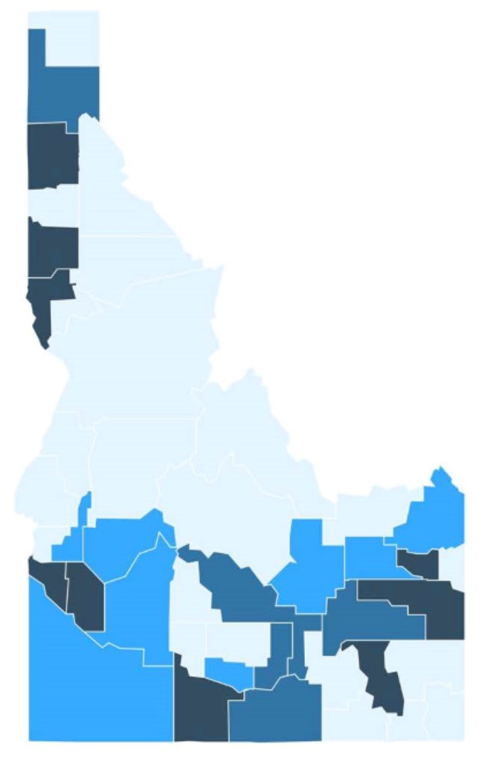
Urban contains a city with at least 20,000 residents (9)
Percentage of constrained counties
Rural center contains a city with 7,500–20,000 residents (5)
Commuting sends at least 25% of working residents to an urban county (8)
Open rural remaining counties (22)
37

Slide 38
Rural counties were more likely to be constrained.
Percentage of constrained counties
40%
75%
77%
Urban (9 counties)
Rural center
(5 counties)
Commuting
(8 counties)
Open rural
(22 counties)
38

Slide 39
Policy options for future analysis.
Percentage of responding county commissioners who indicated the following changes would be effective:
Measure fiscal stress in counties
58%
Review formulas for revenue sharing
57%
Allow counties to levy a local option tax
52%
Increase statutory levy limits
51%
Review statutorily set fees
45%
Increase the 3 percent budget cap
41%
Allow a simple majority bond
36%
Adjust property tax exemptions
22%
39
Eliminate individual statutory levy limits
21%

Slide 40
Recommendation
We recommend that more analysis be conducted on the effect of tax and expenditure limitations and revenue sharing formulas on counties.
40

