Slide 1
Working together to Achieve The Promise Of Quality Public Defense
Idaho State Public Defense Commission
Update to the Idaho Association of Counties
June 6, 2018
Notes:
In our adversarial system of criminal justice with government quite properly spending vast sums of money to establish machinery to try defendants accused of crime you need procedural and substantive safeguards designed to assure fair trails before impartial tribunals in which defendants stand equal before the law. This noble ideal cannot be realized if the poor man charged with crime has to face his accuser without a lawyer to assist him. – Gideon v. Wainwright
Not only a lawyer, but an effective lawyer who can provide constitutionally adequate representation to each and every client, not just a select few.

Slide 2
Mission of the Public Defense Commission
Indigent defense system improvements
Financial and technical assistance
Indigent Defense Standards
Current
Upcoming
Notes:
Road map for my presentation today.
Highlight the improvements that you have made to your indigent defense delivery systems like providing attorneys at initial appearance and decreasing workloads
Provided over $4 million in funding to the counties and technical assistance through Regional Coordinators; What can we do for you? Step-by-step guide to compliance and how we can help you!
Go over the standards we have created and the ones we will be creating this year. It is important to note that these standards are FIRST and FOREMOST to ensure the constitutional representation of indigent defendants – i.e. meeting the requirements of the U.S. and Idaho Constitutions. Second, we must maintain a collaborative relationship in which we assess how much compliance with these constitutional requirements are going to cost. With that information, we can make a financially supportive budget request to the Idaho legislature each year.

Slide 3
Why?
NLADA Report – 2010
ACLU lawsuit: Tucker et. al., v. State of Idaho
Guided by the U.S. and Idaho Constitutions
Guided by Idaho Code and Court Rules
Molding national standards to fit Idaho
Notes:
Entities like the American Bar Association, National Association of Criminal Defense Lawyers, National Legal Aid and Defender Association – created standards for public defenders as well as public defense systems.
NLADA report: Studied 7 counties: Ada, Blaine, Bonneville, Canyon, Kootenai, Nez Perce and Power. Idaho is deficient in several areas including excessive caseloads, flat-fee contracts, lack of investigation, lack of training and failure to provide attorneys at initial appearance
We found similar deficiencies in other counties over the last couple years.
Idaho is NOT alone.
In fact, there are lawsuits in every type of system: statewide, county based and hybrid systems. CONCLUSION: no oversight or no ability to enforce standards.
ACLU lawsuit – alleges the same deficiencies as the NLADA report; 4 defendants in 8 counties; and it is now a class-action lawsuit meaning that the ACLU is challenging the systemic provision of public defense services, not just individual cases or counties.
Tracy Tucker – Not represented at his initial appearance; in jail for 3 months, met with his attorney for total of 20 minutes over that time (two of those times were in court)
Jason Sharp - not represented at his initial appearance; in jail for 2 weeks – in fear of losing his job. Lack of communication with attorney.
Naomi Morley – was told she would have to pay for an expert herself; attorney had an excessive caseload and couldn’t devote time to her case; lack of communication with attorney
Jeremy Payne – not represented at his initial appearance; in jail for 5 months awaiting trial; lack of communication with attorney; no investigation into his case
CLASS CERTIFICATION: “all indigent persons who are now or who will be under formal charge before a state court in Idaho of having committed any offense, the penalty for which includes the possibility of confinement, incarceration, imprisonment, or detention in a correction facility (regardless of whether actually imposed) and who are unable to provide for the full payment of an attorney and all other necessary expenses of representation in defending against the charge.”
Sixth Amendment; Art. I, Sect. 13 and Public Defense Act. Idaho has provided right to counsel since it was a Territory (1863)
The Sixth and Fifth Amendments to the United States Constitution:
Sixth A guarantees an attorney, paid for at public expense, is provided for indigent persons charged with ANY crime that has a possible jail sentence. Not only are attorneys guaranteed, but the EFFECTIVE assistance of counsel is guaranteed.
Idaho has extended this right to capital post-conviction defendants, appeals, parents facing the termination of their parental rights, juvenile defendants regardless of their parent’s ability to pay, and children involved in child protection cases.
So – why the PDC?
No uniformity in local indigent defense systems
No consistent standards regarding training and experience
No state funding or oversight
No reporting on budget performance
POSSIBLE TOPIC – Pros and cons of the different systems

Slide 4
Mission
Improving indigent defense services
Ensuring that constitutional safeguards are met
Collect data
Support compliance with standards
Provide training
Notes:
The Idaho Public Defense Commission is committed to improving the delivery of trial-level indigent defense services by serving the Counties and Indigent Defense Providers of Idaho. We strive to ensure that the safeguards of the 6thAmendment to the United States Constitution and Article I, Sect. 13 of the State Constitution are met. We will collect data, support compliance with standards, provide training, and administer grants to achieve fair and just representation of the accused. In the words of Thomas Jefferson, “The price of freedom is eternal vigilance.”
How do we ensure that indigent defendants receive constitutionally adequate services? And why?
Meet minimum standards. ALL of the PDC standards are supported by research and input from stakeholders. Also supported by years of experience in public defense. ABA, NACDL, NLADA, NAPD and other State standards. What works; what doesn’t
2) You cannot improve what you cannot measure. Data collection helps answer the most basic of queries – how are things going?
1. What resources exist, and are they adequate? Basic resources that can be expressed through data include overall funding, expenditures, staff size and composition, and attorney experience level. These data should be considered in context with other important resources that speak to capacity, such as training, office equipment and tools of the trade, such as on-line legal research.
2. Attorney activities: what work is performed? Case-related work activities include client contact, legal research, motion practice, investigation and in-court advocacy. Again, measurements of these case-related activities can be considered in context with non-case-related activities, such as training and professional development.
3. Client outcomes: what do you do for your clients? Basic client outcomes include case disposition (guilt or acquittal/dismissal) while more nuanced understandings consider life outcomes, client satisfaction, or whether clients plead to charges less severe than originally charged.
Financial assistance – supporting compliance.
Technical assistance and legal training for lawyers

Slide 5
Highlighting Your Work – Public Defense Improvements
Defending attorneys at first appearance
Confidential meeting space for defending attorneys
Reducing workloads
Increasing pay for defending attorneys
Resources for defending attorneys
Technology Upgrades
Notes:
Hiring a defending attorney to handle first appearances
Purchasing video conferencing equipment for first appearances; upgrading current systems.
Remodeling private meeting space; soundproofing meeting rooms (esp. in jail)
Workloads: additional attorneys; social workers; administrative assistants, investigators
Resources: Investigators, experts, immigration consultation, westlaw access (or other online research tools), CLEs and training, travel expenses
Technology upgrades: computers, case management software, software to review evidence, WiFi for PDs in courthouses

Slide 6
Financial and Technical Assistance
Notes:
Compliance; Compliant? – Looking to the future. Indigent defense financial assistance

Slide 7
Indigent Defense Grants
Uses of FY2018 IDG
Compliance Proposals
Notes:
What were they used IDG funds for? What will they be used for?
What kind of compliance proposals did we see?
What are the statutory requirements? Define compliance proposal.
Usage of funds: attorneys, social workers, investigators, legal secretaries, PD assistant at courthouse
IT support
Increased salaries and compensation to retain qualified attorneys
First appearances: supplying a full-time attorney; purchasing video equipment
PD conference room
Immigration attorney for consultations
Transcripts ordered by the PD
Conflict attorney fees that have been increasing
Travel (Utah to meet clients; to county seat for a rural county)
Legal software for time tracking, accountability, legal research; case management software
Health insurance
Polygraph for Defense counsel in preparation for case; evaluations
Resources materials for attorney like a field sobriety test manual
Bar fees
CLE and training
Office supplies – furniture; better equipment
IDG Accounting and Compliance Proposals – Let’s take a look at Ada County (groan …..)

Slide 8
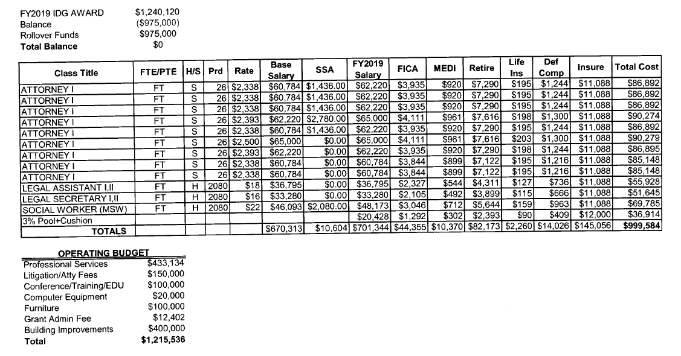
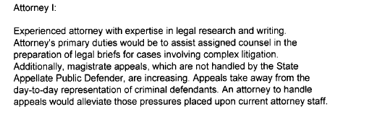
Compliance Proposal

Slide 9
Indigent Defense Grants
Uses of FY2018 IDG
Compliance Proposals
Statistics
Notes:
How much of the IDGs were used at the time of grant application?
Statistics from the FY2019 Grant Applications
At time of applications: $4,207,599.61 disbursed.
$2,076,908.68 used (May 1 is halfway through the year)
$2,130,690.93 remaining
Anticipate about $1,000,000 remaining, but most of that is from one county who has a remodeling project on the horizon that will use up all of that money.
PDC anticipates more funds will be needed as workload standard is implemented.
Funding in context
IDE: FY2017 $35,071,969.72
Counties: $30,691,559.97
State (not including SAPD): $4,380,409.75 (12.5%)
ELF FY2017 approved: approx. $250,000
ELF FY2017 disbursed: $126,988.24 in 2017 and $48,619.90 in 2018 that had been encumbered
FY2018 Anticipated Expenditures –
Counties: $33,046,154.40
State: $4,207,599.61 – plus ELF ($359,799.89 approved; only $33,029 disbursed. Some closed without any monies paid out = $75,320.30.) and training ($110,000+)
FY2019 IDG Max: $4,452,560.41
FY2020 IDG Max if statute remains same: $4,751,763.54
FY2019 ELF approved (including remaining balance from FY2018 ELF awards): $284,500
The future:
Future increases of state funding will only come in response to county leaders making the case: -indigent defense grant accounting
-County needs for compliance
-Communicating with legislators
TWO very important pieces of data collection:
IDG applications: compliance proposals and indigent defense expenditure reports
Annual Reports of defending attorneys
Workload study will give us some data

Slide 10
Step-by-Step Guide to Compliance
Assessing Compliance
Notes:
We aren’t qualified to do this. We’re not lawyers. We don’t have time for this.
Ask your Regional Coordinators. Snapshot of an Annual Review.
Ask your public defender’s.
Things you should of which you should be aware:
Budget for FY2019 and your Local Share
PDC strives to make this process collaborative and constructive, rather than punitive. It is in county and State interest that state resources (as limited as they are currently) are used in the most efficient and effective manner.
How PDC has helped you:
helped counties define their needs when requesting grant funds.
Assisted counties in locating and reaching out to video conferencing services for first appearance.
Met with local attorneys and regional stakeholders, elected officials on looking at new methods of providing defense services (regional office stuff)
Generated ideas for providing CLEs to the local attorneys
Assisted attorneys with completing ELF applications which saves the counties a lot of money because then they don’t have to pay for the expense
counties and attorneys in “troubleshooting” issues regarding standards compliance;
counties in reviewing budgets and assessing “budget format”;
been available at the “beck and call” of stakeholders for emergency meetings.
Assisted counties with posting job announcements for PDs

Slide 11
Step-by-Step Guide to Compliance
Compliance
Non-Compliance
Enforcement date: March 31
Barriers
OMG! The PDC has designated a deficiency for our county?!?! What does this mean? What do we do?
Notes:
Walk through the what it means to be in compliance.
Being out of compliance is not the end of the world ….
Enforcement date – doesn’t mean you shouldn’t comply before then. Doesn’t mean you are in compliance with current standards until that date ….

Slide 12
Step-by-Step Guide to Financial Assistance
Tracking the IDG
Plan to meet Standards
What is “Local Share?”
What is “Cost Analysis?”
What if the IDG is not enough?
Notes:
Tracking the IDG: line item or Restricted Fund.
The PDC must know how that money was spent and on what. This is extremely important data. We must be able to tell the legislature how it was spent – they will not appropriate funds without knowing that information.
How much should we budget?
Local Share + Cost Analysis.
County A:
Local Share for FY2019 –
Preceding 5 years: 2014, 2015, 2016, 2017, 2018
First 3 years of IDE: $188,975; $220,545; $185,501
MEDIAN: $188,975
County A – must maintain $188,975. FY2018 – expecting to spend $299,653.
FY2019 – Grant eligible – 15% = $28,346

Slide 13
Indigent Defense Standards
Idaho’s Principles of an Indigent Defense Delivery System
Enforceable Standards
Current Standards
Standards in creation
The future Standards
Notes:
HANDOUTS

Slide 14
Negotiated Rulemaking
Town Hall Meetings
Negotiated Rulemaking Meetings
Participation Deadline: August 10, 2018
Public Hearings
Comments Deadline: Nov. 3, 2018

Slide 15
Other upcoming items …
New Commission members
Prosecutor’s role in public defense
The term “grant”
Cap on IDG amounts expires
Case Management Software

Slide 16
Kimberly J. Simmons
Executive Director
Idaho State Public Defense Commission
816 West Bannock St., Suite 201
Boise, ID 83702
(208) 332-1736 – office
(208) 869-3124 – mobile
Kimberly.Simmons@pdc.Idaho.gov

Slide 17
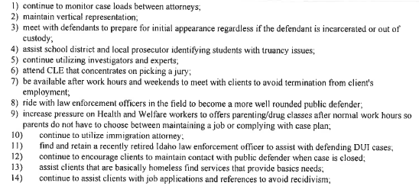
Compliance Proposal – Example 2

Slide 18
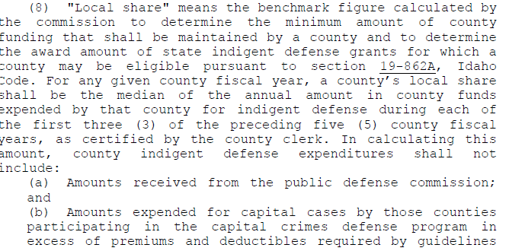
Notes:
Training for defending attorneys
Operating costs for defending attorneys
Experts, investigations, transcripts, witness fees, evaluations (even if ordered by the court – but for indigent defendants only)
Premiums and deductibles for CCDF
Salaries, compensation for defending attorneys
NOT included: witness fees for prosecution; jury fees; prosecutor costs; IDG funds

Slide 19
Local Share vs. County Expenditures
Local Share
County Expenditures
(FY2017): $24,026,316.50
(FY2018): $25,691,553.62
(FY2019): $27,850,188.85
(FY2020): $30,021,678.77
$30,691,559.97
$33,046,154.40 (Anticipated)
Setting your budgets ….
If calculation stays the same …

Slide 21
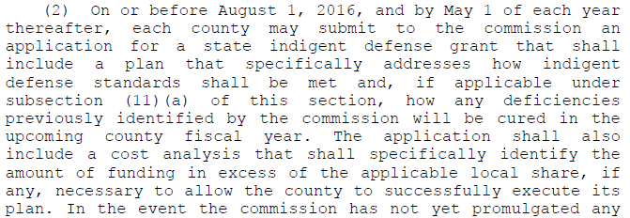
Idaho Code § 19-862A: Compliance – Indigent Defense Grants

Slide 22
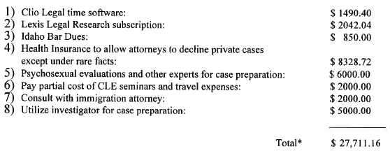
What’s missing?

Slide 23
Setting up the Cost Analysis
The Local Share is $184,950.00.
The maximum eligible IDG award is $27,742.50.
To provide adequate public defense services that ensure constitutional representation, County will need a total of $228, 211.26.
In excess of its Local Share, County will need $43,261.26.
The Cost Analysis for County should include a detailed description of the need for the $43,261.26, not just the maximum eligible amount of the IDG.

