Slide 1
Why a Weed Superintendent
Idaho Association of Commissioners and Clerks
June 7th, 2017
Jeremey Varley
Vice-Chair IAWCS
Lemhi County Weed Superintendent

Slide 2
Idaho Association of Weed Control Superintendents
Mission Statement: Empowering our professional county weed superintendents with the best available resources to enhance statewide collaboration for invasive plant management.
Established in 1982

Slide 3
Idaho Association of Weed Control Superintendents
Exchange information
Provide education
Training
Promote cooperation

Slide 4
IAWCS Board of Directors 2017
Chairman- Terry Lee, Camas County
Vice-Chairman- Jeremey Varley, Lemhi County
Secretary/Treasurer-Bonnie Davis, Washington County
Past President- Bryce Fowler, Freemont County
Region Representatives
Bill Hargrave, Kootenai County
Chip Haight, Lewis County
Steve Anderson, Valley County
Kali Sherrill, Twin Falls County
Aaron Hull, Franklin County
Jeffrey Petingil, Bonneville County
Webmaster- Jeremey Varley, Lemhi County

Slide 5
IAWCS Membership
Of the 42 weed Superintendents 41 are members.

Slide 6
Weeds 101
What is this ?
Notes:
What is it?
Is it Noxious?

Slide 7
Weeds 101
What is this ?

Slide 8
Weeds 101
What is this ?

Slide 9
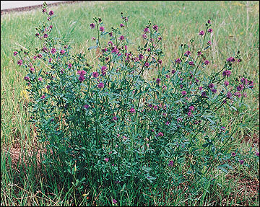
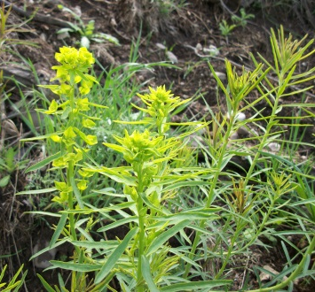
Weeds 101
Dandelion
Alfalfa
Leafy spurge

Slide 10
Weeds 101
So how do weeds become noxious?

Slide 11
Noxious Weed- An invasive weed that is injurious to agricultural or horticultural crops, natural habitats or ecosystems, humans or animals and has been designated by a control authority.

Slide 12
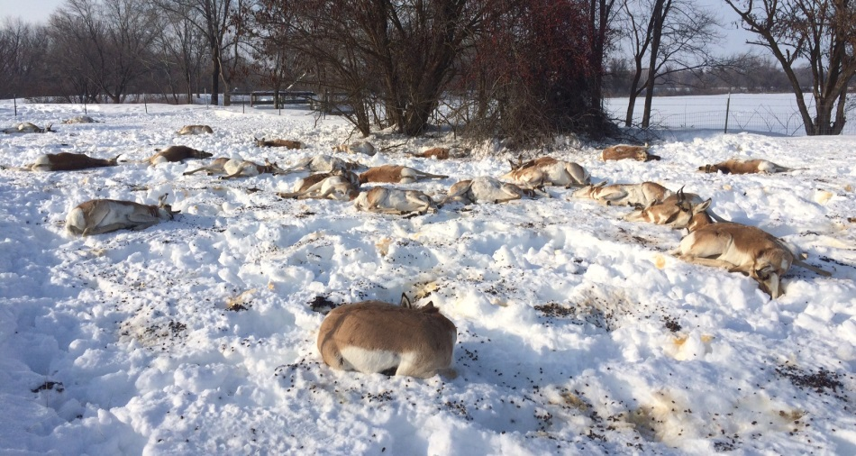

Slide 13
What makes Idaho Noxious Weeds So Bad?
Roughly 8 million acres of Idaho lands are infested with noxious weeds*
If left undeterred noxious weeds can spread at a rate of 3,200 acres annually**
The expansion of noxious weeds leads to a negative impact on plant diversity, wildlife habitat and health, watershed health, recreation, tourism, human life and property value.

Slide 14
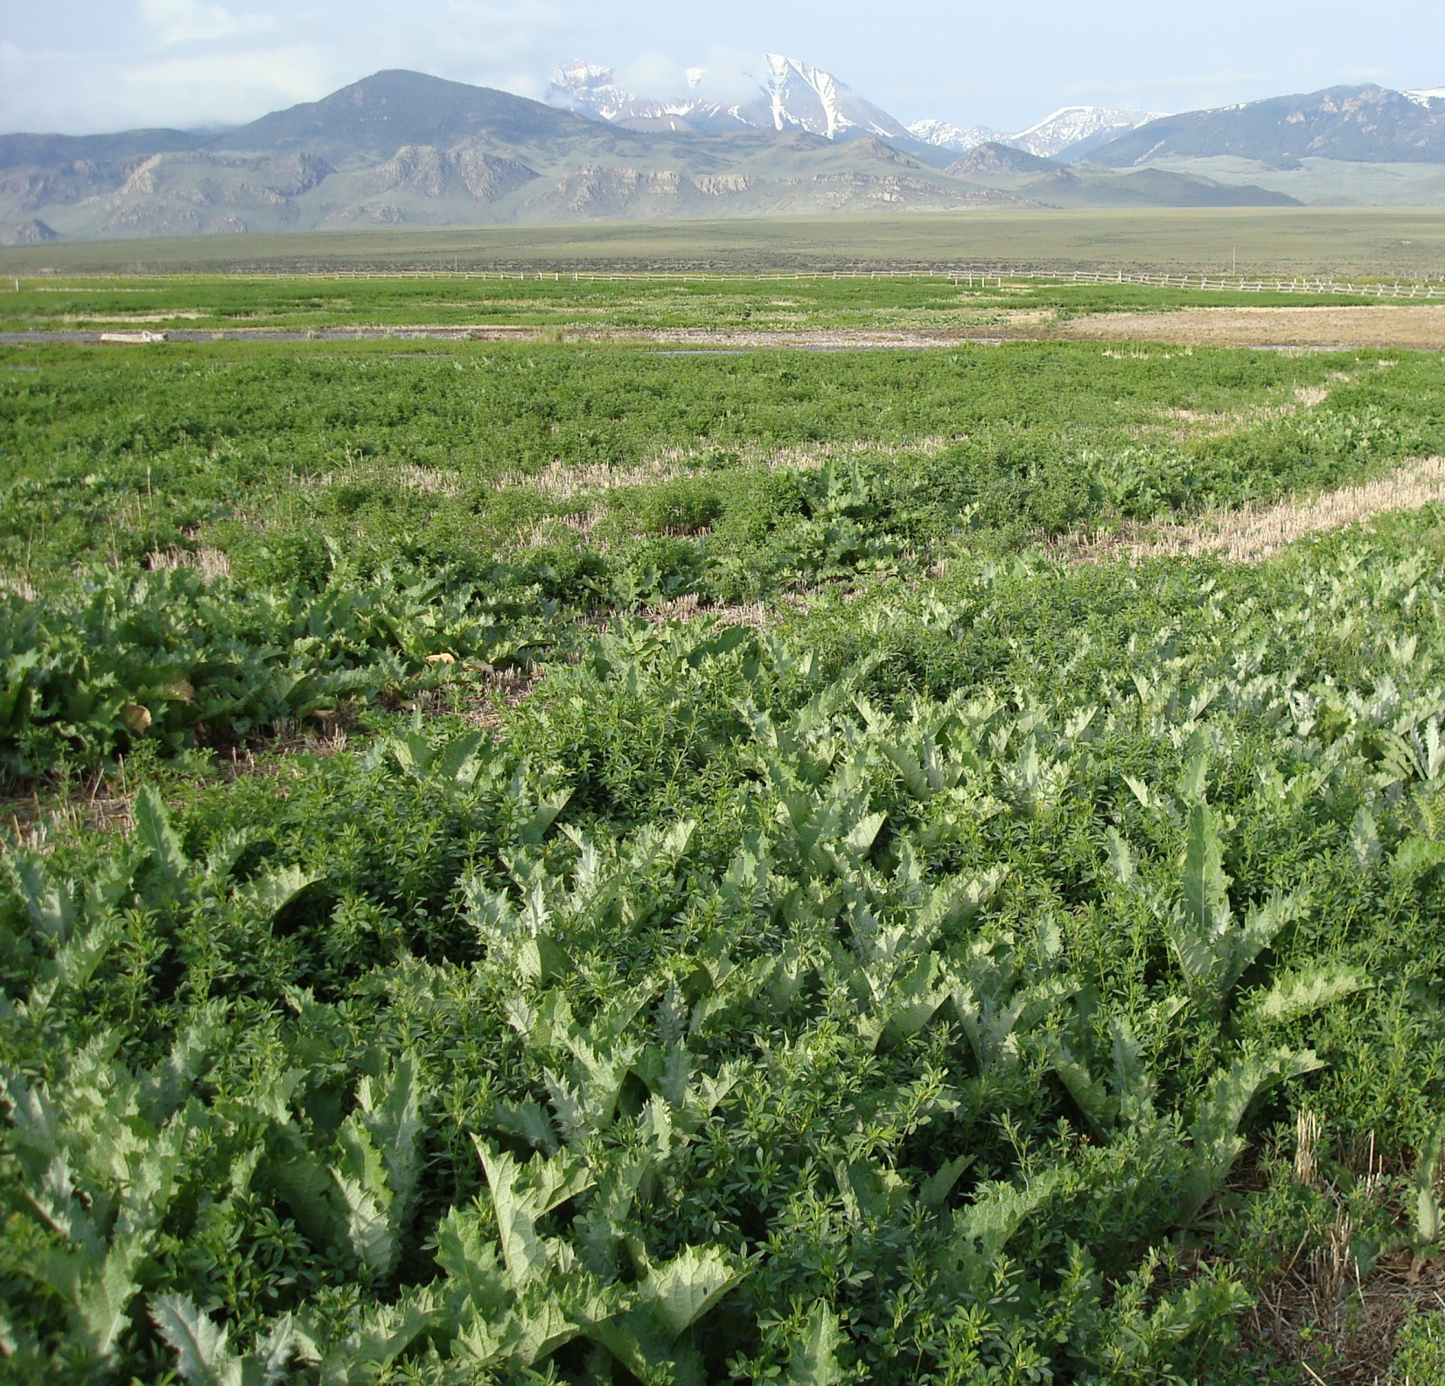
What Makes Idaho Noxious Weeds So Bad?
Nationally the estimated annual loss of productivity due to Noxious weeds is $7.4 Billion
Idaho’s estimated loss of productivity is $300,000,000.00
The $300 million is likely a low estimate based
on indirect negative impacts
Source: Idaho Strategic Plan for
Managing Noxious and Invasive Weeds (10/2005)

Slide 15
Noxious Weed Law
Idaho Noxious Weed law was first put into place in 1981
Tittle 22- Agriculture and Horticulture
Chapter 24-Noxious weeds
“It is the purpose of this chapter to define noxious weeds; legal requirements, duties and responsibilities of persons; and to provide the statutory and financial means for the control of noxious weeds, wherever such noxious weeds occur in this state”

Slide 16
County Duties
Your County in relation to noxious weeds as per the Idaho Noxious Weed law is responsible for the following: (22-2405)
Establish and maintain a coordinated noxious weed program
Employ a County Weed Superintendent
Qualified to detect and treat noxious weeds
Direct access to county commissioners
Provide operation and educational funds for county superintendent
Initiate cooperative agreements with other agencies or counties for control of noxious weeds

Slide 17
County Powers
22-2406
Can quarantine lands with noxious weeds
Stop movement of Noxious weed infested items
Implement enforcement action
Levy taxable properties for funding
Use noxious weed fund which may be revolving , only for noxious weed purposes

Slide 18
County Powers
(2) The county weed superintendent is authorized to:
(a) Enter upon all lands within the county where there are noxious weeds to ascertain conditions, if a reasonable attempt has been made to contact the landowner and where possible the operator of the land prior to entry and there is probable cause for entry; and
(b) Stipulate items as requiring treatment to prevent dissemination of noxious weeds, in accordance with the applicable regulations.

Slide 19
Tittle 22- Agriculture and Horticulture Chapter 24- Noxious Weeds
22-2407. LANDOWNER AND CITIZEN DUTIES.
It shall be the duty and responsibility of all landowners to control noxious weeds on their land and property,
The cost of controlling noxious weeds shall be the obligation of the landowner.
Noxious weed control must be for prevention, eradication, rehabilitation, control or containment efforts.
Notes:
Don’t explain to much this is just a verbatim statement of what the law says

Slide 20
Tittle 22- Agriculture and Horticulture Chapter 24- Noxious Weeds
22-2409- PENALTIES FOR VIOLATIONS
(2)Any person who violates or fails to comply with any provisions of this chapter or any rules promulgated hereunder may be assessed a civil penalty by the control authority of not more than $10,000.00 for each offense
Notes:
The main point of this slide is to let them understand that this law has the ability to effect them financially should they not comply

Slide 21
What does the noxious weed Law mean to you
Notes:
Go into this section assuring them that you will talk about how we can help but this is the black and white version of the law

Slide 22
So Why A Weed Superintendent
Every County is different, every weed control program is different.
It is not one size fits all.
Do you know how many Idaho listed noxious weed species there are?
67 Listed Species
4 Prohibited Genera

Slide 23
Idaho Noxious Weeds
Black henbane
Bohemian knotweed
Brazilian elodea
Buffalobur
Canada thistle
Common crupina
Common/eurpean frogbit
Common reed
Curlyleaf pondweed
Dalmation toadflax
Diffuse knapweed
Dyer’s woad
Eurasian watermilfoil
Fanwort
Feathered mosquito fern
Field bindweed
Flowering rush
Giant hogweed
Giant knotweed
Giant salvinia
Hoary alyssum
Houndstongue
Hydrilla
Japanese knotweed
Johnsongrass
Jointed goatgrass
Leafy spurge
Matgrass
Meadow knapweed
Mediterranean sage
Milium
Musk thistle
Orange hawkweed
Oxeye daisy
Parrotfeather milfoil
Perennial pepperweed
Perennial sowthistle
Plumeless thistle
Poison hemlock
Policeman’s helmet
Puncturevine
Purple loosestrife
Rush skeletonweed
Russian knapweed
Saltcedar
Scotch broom
Scotch thistle
Small bugloss
Spotted knapweed
Squarrose knapweed
Syrian beancaper
Tall hawkweed
Tansy ragwort
Variable-leaf milfoil
Vipers bugloss
Water chestnut
White bryony
Whitetop
Yellow devil hawkweed
Yellow flag iris
Yellow floating heart
Yellow hawkweed
Yellow starthistle
Yellow toadflax
Purple starthistle
Iberian starthistle
Prohibited
Cytisus
Genista
Spartium
Chameacytisus

Slide 24
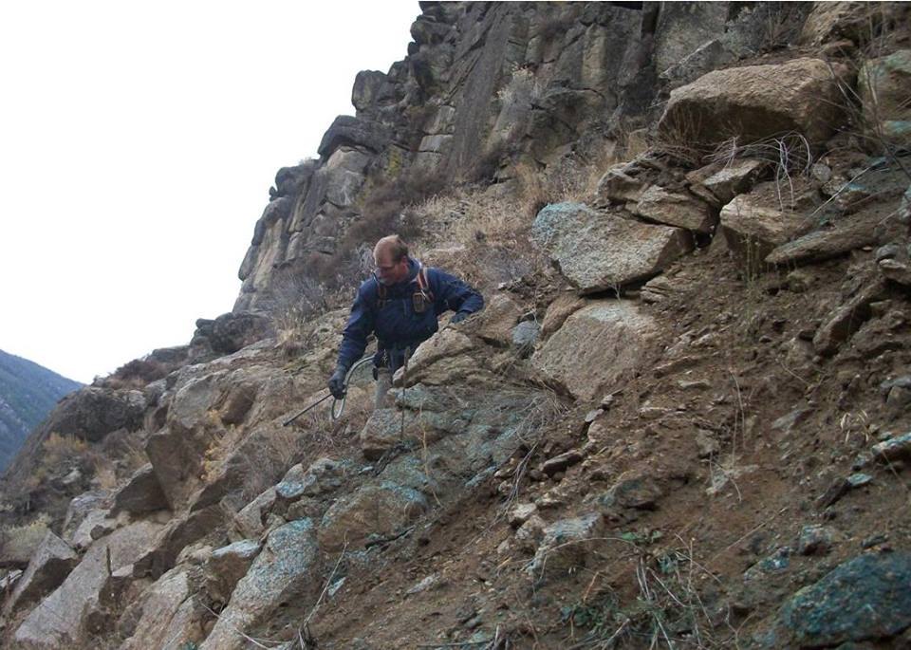
Who is your Weed Sup.
Do you know who they are?
Have you met with them?
How often do you meet with them?
What weed control programs are they running?
What challenges are they facing?
Do you support them?
“When dealing with Invasive Species,
our failures are obvious, our successes
are Invisible!” Dr. Rich Old

Slide 25
Who is your Weed Sup.
IF you don’t know who they are visit www.iawcs.org County Contacts
Then take the opportunity to meet them.

Slide 26
Weed Control Programs
Remember this is not one size fits all
Citizen cost share programs
Equipment rentals
Weed management plans
Consultations
Education and outreach
Although chemically treating weeds is a large portion of our responsibilities being a weed superintendent is more than just spraying

Slide 27
More than just spraying
Building Relationships/Trust with general public
Making individualized recommendations
Writing and carrying out Grants/Agreements
Reporting
Budgeting
Enforcing
Record Keeping
GIS database management
Utilizing new technology
Just to name a few
Notes:
We are professionals from the government and we are here to help

Slide 28
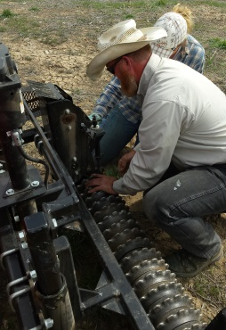
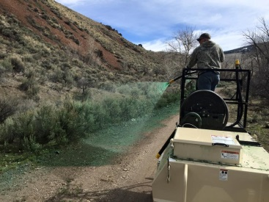
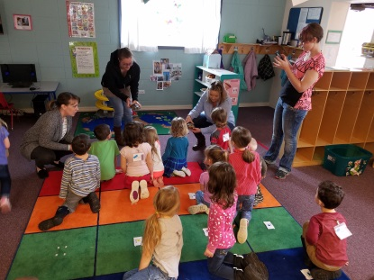
Using all the tools
Integrated Pest Management
Education
Prevention
Eradication, Control, or Contain
Chemical
Biological
Cultural
Mechanical
Legal
Site Rehabilitation
Inventory
Best $ Spent

Slide 29
Challenges
Natural Challenges: Weather, Terrain, etc.
Federal, State, and Local regulations
EPA NPDES
Sage Grouse initiatives
Idaho Pesticide and Chemigation Law
Worker Protection
Intra Agency Communications
Budgeting
Full time vs Part time
Crew Management
Knowing what is best…
Private Landowners
Commissioners

Slide 30
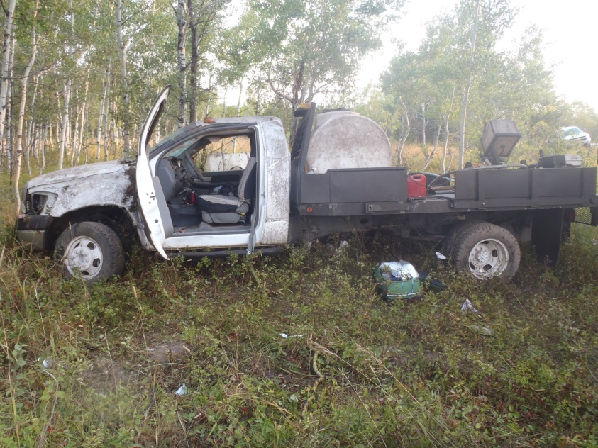
Support
Don’t wait until it is too late

Slide 31
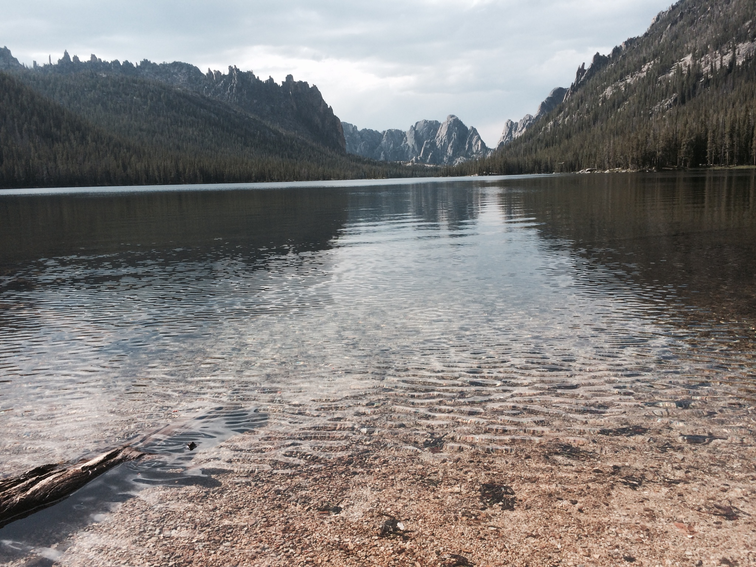
Jeremey Varley
IAWCS Vice-Chairman
Lemhi Noxious Weed Superintendent
weeds@lemhicountyidaho.org
(208)742-1660
(208)993-0950

