Slide 1

L-2 and Related Property Tax Forms

Slide 2
List of Property Tax Related Forms
  2017 Dollar Certification of Budget Request to Board of County Commissioners L-2. (L-2 for short)
  L-2 Worksheet (must be attached to the L-2 form)
  Maximum Budget and Forgone Amount Worksheet
  Voter Approved Fund Tracker (as required)
  All L-2 related forms at this web address:
  https://tax.idaho.gov/search-formspublications.cfm?ch=bl&t=pt

Slide 3
Property Tax Budget and Levy Limits Defined in Idaho Code
Property Tax Budget Limit - 3% Cap Pertains to “non-exempt” budget which excludes bonds and other voter approved levies.
Section 63-802, I.C. LIMITATION ON BUDGET REQUESTS -- LIMITATION ON TAX CHARGES -- EXCEPTIONS.
(1) No taxing district shall certify a budget request for an amount of property tax revenues to finance an annual budget that exceeds the greater of:…(3% language)
Tighter Constraint Prevails

Slide 4
Budget vs. Levy Limit
Scenario:
A taxing district’s statutory M&O levy limit is 0.0004. Its maximum, non-exempt property tax potential budget is $55,000 and its total net taxable market value is $125 million.
Budget Not Allowed
Because levy limit exceeded
Budget Allowed
Because levy limit not exceeded
Rollback = $5,000
Levy limit can’t be exceeded without express statutory authority.

Slide 5
Computing Your Maximum
Non-Exempt Property Tax
Highest non-exempt p-tax budget of the immediate prior 3 years (including applicable p-tax replacement money) increased by 3%.
New construction and/or annexation current year’s value multiplied by the immediate prior year’s total non-exempt levy rate.
Sum of all above equals total non-exempt p-tax budget (not necessarily what can be levied).
Minus any current year’s p-tax replacement revenue received.
  New 2017 revenue received from Solar Farms treated as p-tax replacement.
Plus budgeted forgone amount less disclaimed amount.
Results in maximum non-exempt property tax that can be levied.

Slide 6
Property Tax Replacement
Amounts to be deducted each year
Agricultural Equipment Replacement – amount unchanged since 2006.
Personal Property Reimbursement – fixed at 2013 amount unless corrected.
Amounts Received as of June 30th to be deducted in year received
Recovered Homeowner’s Exemption – Improperly claimed H/E.
Recaptured QIE - Property tax exemption in lieu of Investment Tax Credit (QIE)
Recovered personal property reimbursement – Improperly granted PP Exemption if for years after 2013.
Revenue received from Solar Farm Tax (does not receive 3% increase in following year)
Property Tax Relief Fund – Local Option Sales Tax – Nez Perce County Only
Total of all of the above items are to be subtracted when computing your maximum allowable non-exempt property tax budget.
However, for the purposes of computing the highest of the last 3 years and forgone amounts you add them back except for solar farm tax. Solar farm tax is added back to compute a maximum but does NOT receive a 3% increase.
See additional information in the appendix.

Slide 7
Example: Computing 3% Portion of Increase
Year | 2014 | 2015 | 2016
Total levied non-exempt p-tax budget | 124,389 | 130,678 | 136,218
Agricultural Equipment Replacement Money | 28 | 28 | 28
Personal Property Replacement Money | 1,318 | 1,318 | 1,318
*Recovered Homeowner’s Exemption | 110 | 0 | 0
Total Property Tax Replacement monies | 1,456 | 1,346 | 1,346
Total levied non-exempt property tax budget plus property tax replacements | 125,845 | 132,024 | 137,564
Computation of 3% increase:
$ 137,564 $ 137,564
X 0.03 + 4,127
$ 4,127 $ 141,691 (total plus 3% increase)
* = Total collected between July 1st thru June 30th each year.

Slide 8
Example: New Construction Roll
2016 total non-exempt levy rate = 0.000334145
(does not include bonds etc.)
2017 new construction Roll Value = $ 4,722,800
Multiply the 2017 new construction roll value
by the 2016 non-exempt levy rate:
$ 4,722,800
X 0.000334145
$ 1,578 additional budget allowance
(above 3% increase)
(qualifying new construction first taxable or allowable in 2016)

Slide 9
New Construction Roll
Idaho Code §63-301A & §63-802 & Rule 802
Includes taxable property first on tax roll in 2017:
  1. New structures and newly occupied residences.
  2. Additions or alterations to existing non-residential structures.
  3. Installation of new or used manufactured housing that did not previously exist within the county.
  4. Change of land use classification (i.e. agricultural to commercial).
  5. Newly taxable as a result of loss of inventory exemption (63-602W).
  6. Improvements or installation of equipment used in conjunction with generation of electricity.
  7. Increase in increment value of dissolved (or deannexed portion) of Revenue Allocation Area (RAA) – increase measured in comparison to Dec. 2006 increment value.
    a. Excludes new construction in RAAs within Urban Renewal Districts during life of RAA.
    b. Excludes change of land use classification in RAAs-never recaptured.
  Prior eligible new construction identified and reported to county assessor.
    (5 Year look back limit)
A new construction value will be available for each district by late July, but is subject to correction until first Monday in September.

Slide 10
Deductions Made To New Construction Roll I.C. §63-301A(1)(f)
When previous new construction roll included property but,
  Board of Tax Appeals (BTA) or District Court ordered lower values
  Double or erroneous assessments discovered
  Land use changed to lower value category
  Value lower due to site improvement exemption
Could produce net negative new construction values

Slide 11
Annexation Example
2016 total non-exempt levy rate = 0.000334145
(does not include bonds etc.)
2017 annexation* value = $ 525,750
(annexation occurred between 1/1/2016 and 12/31/2016)
Multiply the 2017 annexation value by the 2016
non-exempt levy rate:
$ 525,750
X 0.000334145
$ 176 additional budget allowance
(above 3% increase)
* Stated annexation value includes taxable real, personal and operating property values provided district levies against all taxable property.

Slide 12
This form has changed since last year.

Slide 13
Report figures from column 1 and 7 only on the L-2 Worksheet.

Slide 14
Maximum Budget and Forgone Amount Worksheet
Line 1 of L-2 Worksheet
Line 2 of L-2 Worksheet
Line 5 of L-2 Worksheet
Part 1 of 2 Parts
Line 16A of L-2 Worksheet

Slide 15
Maximum Budget and Forgone Amount Worksheet
The amounts listed above are added to the appropriate year’s non-exempt p-tax to determine the highest of the last 3 years amount.
Part 2 of 2 Parts

Slide 16
Funds Exempt From
3% Annual Increase Cap I.C. §63-802
Bond | Refer to authorizing statute for specific requirements, but all require 2/3 majority voter approval.
Temporary Override | All taxing districts have authority. 2 years maximum duration; requires simple majority to pass. Total of fund and override levy can’t exceed the fund’s levy limit.
Permanent Override | All taxing districts have authority. Most need a 2/3 majority to pass. Qualifying cities have additional version that requires only 60% voter approval to pass. Total of fund and override levy can’t exceed the fund’s levy limit.
I.C. §63-1305 Judgment | Assessed value appeals: relates to any Court or Board of Tax Appeals valuation decisions.
Plant Facilities | Available to school, library, and community colleges. See I.C. §33-804 for details.

Slide 17
Must Be Signed
Please fill in contact information completely.

Slide 18
Rule 803
L-2 submitted to each county MUST be signed.
Unless otherwise provided for in Idaho Code, budget requests for the property tax funded portions of the budget can not exceed the amount published in the notice of budget hearing, if a budget hearing notice is required.
The levy approved by the STC can not exceed the levy computed using the amount shown in the notice of budget hearing.
Subtract all replacement monies on the L-2 worksheet (except for Boise Charter School district).

Slide 19
May include negative values.

Slide 20
If the current year’s request is < or > 20% of prior year’s amount a “Yes” will pop up in the “Explanation Required” column.

Slide 21
What to Send with L-2s
The signed 2017 L-2 form with all pertinent information.
The 2017 L-2 worksheet.
Voter approved fund tracker if applicable
  If new voter approved fund (first time levied), copy of the ballot and canvass of the vote required.
Newly formed recreation district - copy of formation petition showing voter approved levy limit.
If budget includes any forgone amount, a copy of resolution is required by I.C. §63-802 (1)(e).
If disclaiming forgone increase, a copy of disclaiming resolution is required by I.C. §63-802 (1)(f).
Plus any other information requested by the county (i.e. copy of published budget notice).

Slide 22
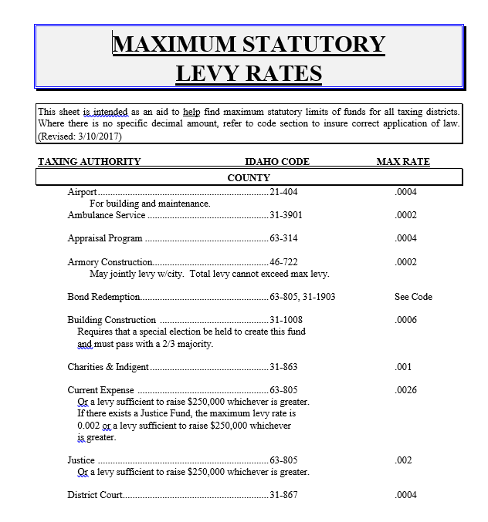
Funds that have the authority to levy property taxes.

Slide 23
Amount of Forgone Increase
Idaho Code §63-802(1)(e)
x

Slide 24
Forgone Amount
(not applicable to School Districts)
Amount of a previously allowable increase in non-exempt property tax portion of budget that was not taken (certified to be levied).
Never expires and once taken, becomes part of base for future 3% calculations.
24

Slide 25
Forgone Amount Calculation Scenario 1
2017 total approved non-exempt property tax budget (sum of non-exempt funds column 6 and total column 5 of L-2 form): | $ 505,000
Maximum allowable 2017 non-exempt property tax budget (line 9 of the L-2 worksheet): | $ 508,573
Highest approved (2014, 2015, 2016) non-exempt property tax budget for the last 3 years (line 1 of the L-2 worksheet): | $ 451,880
Computation
$ 508,573 | Maximum non-exempt p-tax budget
<$505,000> | Approved 2017 non-exempt budget
$ 3,573 | Forgone amount available in 2018.
In this example the total 2017 approved non-exempt property tax budget, including all property tax replacement monies ($505,000), is greater than the highest property tax budget of the immediate prior 3 years ($451,880). In this example you would simply subtract the maximum allowable non-exempt p-tax budget from the total approved non-exempt p-tax budget, including all property tax replacement monies.
xi

Slide 26
Forgone Amount Calculation Scenario 2
2017 total approved non-exempt property tax budget (sum of non-exempt funds from column 5 and 6 of L-2 form): | $ 400,000
Maximum allowable 2017 non-exempt property tax budget (line 9 of the L-2 worksheet): | $ 508,573
Highest approved (2014, 2015, 2016) non-exempt property tax budget for the last 3 years (line 1 of the L-2 worksheet): | $ 451,880
Computation
$ 508,573 | Maximum non-exempt p-tax budget.
<$451,880> | Highest of the Last 3 Years Budget.
$ 56,693 | forgone amount available in 2018.
In this example the total 2017 approved non-exempt property tax budget, including all property tax replacement monies ($400,000), is less than the highest property tax budget of the immediate prior 3 years ($451,880). In this example you would subtract the maximum allowable non-exempt p-tax budget from the highest property tax budget of the immediate prior 3 years from line 1 of the L-2 worksheet.
xii

Slide 27
Using Forgone Amount
Requirements
Must provide notice of intent to use forgone
Hold a public hearing (could be during budget hearing)
Certify by resolution:
  Amount of forgone to be used
  Specific purpose for using forgone.
Copy of resolution to be filed with L-2 submitted to county clerk.

Slide 28
HB-207 Disclaim Forgone Increase
Allows taxing district to disclaim all or a portion of its current year’s increase in its forgone amount.
  (allowable amount subject to be disclaimed has been posted on the STC web.)
District must provide notice of its intent to do so and hold a public hearing, which may be in conjunction with its annual budget hearing.
Once forgone has been disclaimed there is no recovery of that amount. All records will reflect the new reduced forgone balance.
May be done for property tax budget to be certified in September 2017.

Slide 29
HB-207 Disclaim Forgone Increase
Temporary Rule 803:
  Resolution must state:
    Amount to be disclaimed, and
    Must be submitted to each board of county commissioners the district is located along with the L-2 form.
  Board of County Commissioners must attach a copy of the resolution to be submitted to the State Tax Commission along with the L-2 form.

Slide 30
HB-207 Disclaim Forgone Increase
Sample Resolution
Required to hold annual budget hearing | Not required to hold annual budget hearing.
Public hearing requirement to disclaim forgone may be in conjunction with annual budget hearing. | Must hold a public hearing in order to adopt resolution to disclaim forgone.

Slide 31
Amounts Eligible for Disclaiming Report on Web
Reflects only the increase of forgone amount from 2015 – 2016

Slide 32
Property Tax Forms and Related Information on STC’s Web Page

Slide 33
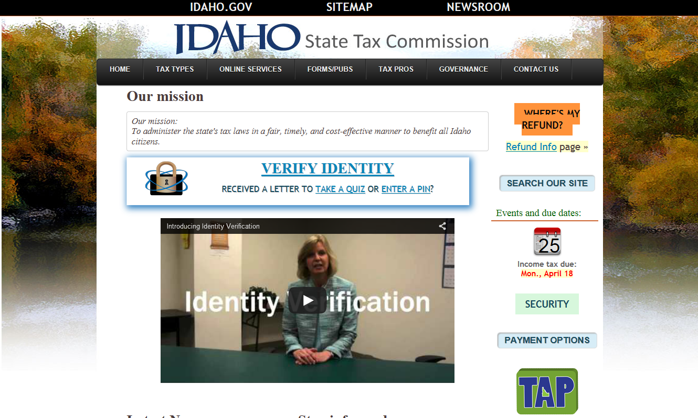
State Tax Commission’s Web Page: tax.idaho.gov
To find the Budget and Levy forms
Click on the “Forms/Pubs” button.

Slide 34
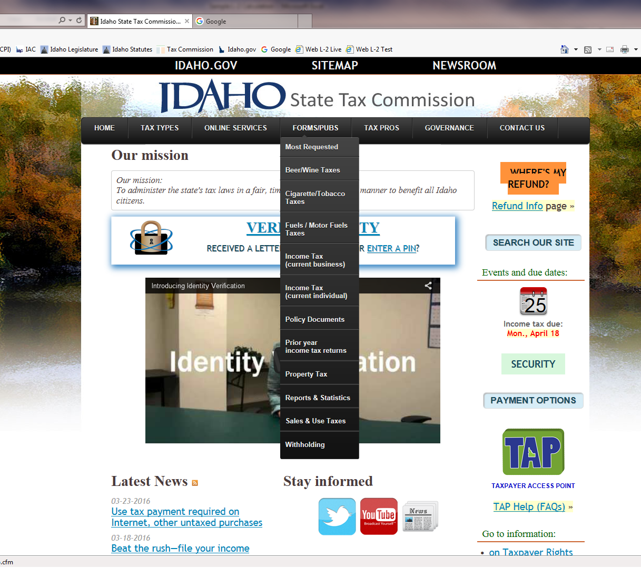
Select “Property Tax”

Slide 35
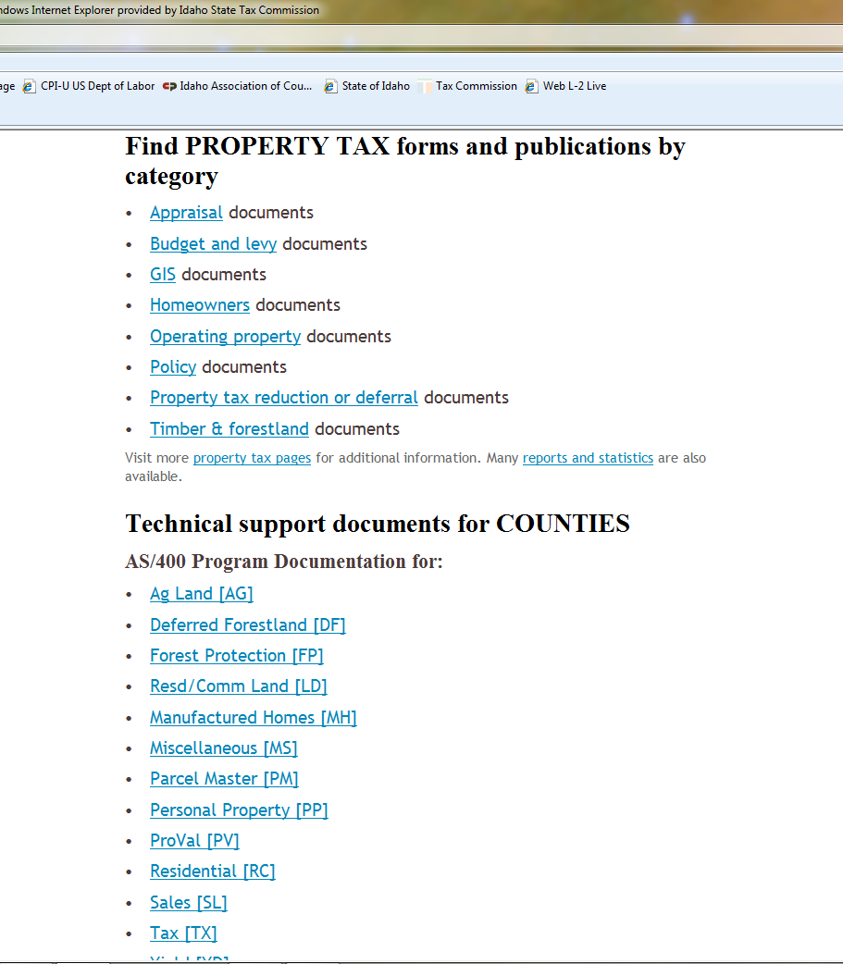
Select “Budget and Levy” documents

Slide 36
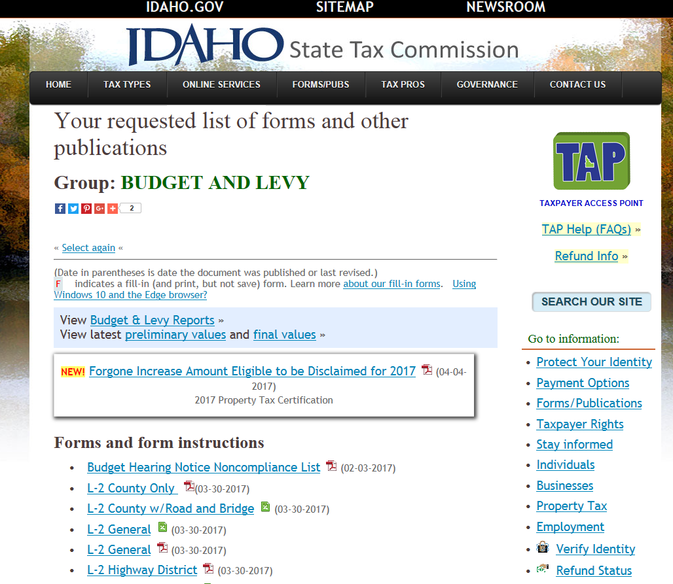
Agricultural Equipment and Personal Property replacement amounts are posted here. Also a link for operating property values.
Here are all of the L-2s
PDF- Print and fill in by hand.
Excel – Save on your computer and fill in.
Other - Maximum Budget and Forgone Amount worksheets, and the Maximum Levy Rate list.

Slide 37
State Tax Commission Urban Renewal Registry and Attestation
All requirements have been met for calendar year 2017.
For 2018 and each year:
  On or before December 1 U/R agency shall submit plans. I.C. §50-5913(2).
Attestation Requirements:
  Before the 1st Monday in June U/R agency attests to change or no change to plan. I.C. §50-2903A(1)(a).

Slide 38
Effect of Boundary Changes or District Consolidation on Existing Bonds
Territory Withdrawn From District
Fire District: (I.C. §31-1437) | Shall continue to be subject to taxation for the payment of the principal of and interest on any indebtedness.
Cities: (I.C. §50-225) | Such alteration shall not relieve any territory excluded from the limits of a city from its liability on account of any outstanding bonded or other indebtedness of such city.
Consolidation of District
Library: (I.C. §33-2710(4)) | Existing bonded debt of any district or districts shall not become the obligation of the consolidated library district. The debt shall remain an obligation of the property which incurred the indebtedness.
Hospital: (I.C. §39-1356) | Existing bonded debt of any district or districts shall not become the obligation of the consolidated hospital district.
School: (I.C. §33-311) | The debt or debts shall remain an obligation of the property within the districts proposing the consolidation.
iii

Slide 39
Example of City/Highway
I.C. §40-801(1)(a) Split Computation
This example multiplies the 40-801(1)(a) fund’s levy rate by the city’s net taxable Value and divides the result by 2.
This is the estimated amount that will be distributed to the city from the total property tax collection of the fund only.
Copies of this spreadsheet are available upon request.
Note: The highway district should certify $298,024 for its property tax budget. It will receive $49,947 less.
xxix

Slide 40
Highway/City Fund Sharing
Idaho Code §40-801(1)(a) states that any levy made shall be proportionately apportioned (50% of this fund’s levy applied to taxable property within cities in the districts) to all cities within the highway district boundary.
  On the L-2 show the entire amount: DO NOT deduct the amount anticipated for the cities.
No other property tax fund is shared with the cities (special levy 0.00084, tort etc.).
If the highway district certifies a levy as “M&O” or “General” it is assumed to be I.C. §40-801(1)(a) levy and revenue is split with the cities in the district.
xxviii

Slide 41
Highway and Roads Legislation
SB-1206
Does not effect the amount of sales tax you receive.
Transportation distribution calculated after revenue sharing percentage applied.
Amended I.C. §63-3638:
  Adds new subsection 16: 1% of sales tax to be distributed to the transportation expansion and congestion mitigation program.

Slide 42
Urban Renewal
Levy Setting

Slide 43
Funds Subject to HB-470 Provisions
  Temporary Override
  63-1305 Judgment
  School temporary Supplemental
  State Authorized Plant Facilities
  EXCEPT for Bonds all of the U/R increment is to be added when computing levy rates.
Notes:
Any newly approved fund(s) all increment added.
Bond and Plant Facilities long terms require thought process.

Slide 44
Information Required
When was the RAA established?
Has there been an annexation done by the RAA? If so when?
When was the election for the bond and/or Plant Facilities fund?
The answer to the above questions determine whether or not to add increment value to the net taxable value when computing levy rates.

Slide 45
Bonds When to Add Increment?

