Slide 1
Medical Indigency Appeal Hearings:
Creating a Record
June 11, 2019
Canyon County Prosecuting Attorney – Civil Division
Dan Blocksom

Slide 2
WARNING
I’m not your attorney.
Today’s presentation and materials are not intended as legal advice.
Today’s presentation and materials are not an exhaustive review of every possible situation.
CONSULT AN ATTORNEY for advice specific to your situation.

Slide 3
Intro: What am I supposed to be doing?

Slide 4
Today’s objective
To learn how to build a strong record for judicial review.

Slide 5
Today’s agenda
Eligibility criteria
Roles at a hearing
The judge’s perspective
Tips to avoid being overturned
Issue-spotting practice

Slide 6
Today’s handout
Front – takeaways from today
Back – case summary sheet

Slide 7
Eligibility criteria: The Big Three
1. Residency / obligated county
Six months in the last five years
30 days prior to incident

Slide 8
Eligibility criteria: The Big Three
2. Medical indigency
The patient’s ability to pay off the bill within 60 months, given his “income” and “expenses”

Slide 9
Eligibility criteria: The Big Three
3. Medically necessary

Slide 10
Eligibility criteria: The Minutiae
Timing of application
Complete application,
complete information*
*County has additional hurdles to clear to prevail on a denial on these grounds.
In the weeds

Slide 11
Roles at the hearing
Clerk:
To serve as the neutral investigator of the case
To present evidence to the Board
Applicant (hospital or patient):
To present evidence to the Board
Board:
To determine the facts
To apply the law to the facts
To build a record

Slide 12
The judge’s perspective
QUALITY OF EVIDENCE
Corroboration
Conflict
Credibility
Level 2
EVIDENCE
Sworn testimony
Exhibits, documentation, records
Pictures, videos
Level 1

Slide 13
The judge’s perspective (cont’d)
Reasons why a court will overturn the Board’s decision:
Violated the law.
Exceeded the Board’s authority.
Was based on unlawful procedure.
Was not based on the record or was not reasonable.*
*This is the most likely in the MI hearing context.

Slide 14
Tips to avoid being overturned
Review the materials.
Ask questions.
Explain the reasoning for your decision.
Consider setting out for Clerk’s Office to follow-up.

Slide 15
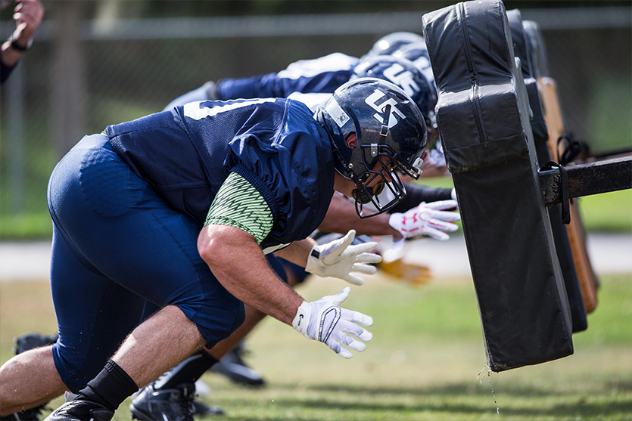
Issue-spotting practice

Slide 16
Hypo #1: Sally, age 50, single
Bill: $27k appendicitis ($450/month).
Income: $9/hr for 20 hours a week = $780/month.
Expenses:
$3000/month worth of expenses (utilities, food, car insurance, gas), but no documentation.
Sally lives with her boyfriend, and two adult children.
Medical review: All medical services were emergent and necessary.
Residency: The application says that Sally lived in the county for the last three years.
The Clerk’s office sent a rent verification form to Sally’s landlord, no response.

Slide 17
Hypo #2: Bob, 37, married but separated
Bill: $60k broken ankle ($1,000/month).
Part A: stabilization, cost $10k ($166/month).
Part B: surgery a month later, cost $50k ($833/month).
Income: $15/hr for 40hrs/wk = $2,600/month.
Expenses:
Wife and two minor child live across town.
Pays $1,500/month towards his wife’s expenses.
Didn’t list any expenses other than his wife’s expenses.
Medical review:
Part A was medically necessary and emergent.
Part B should have been on a 10-day prior app.
Residency: Bob is a county resident.

