Slide 1
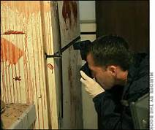
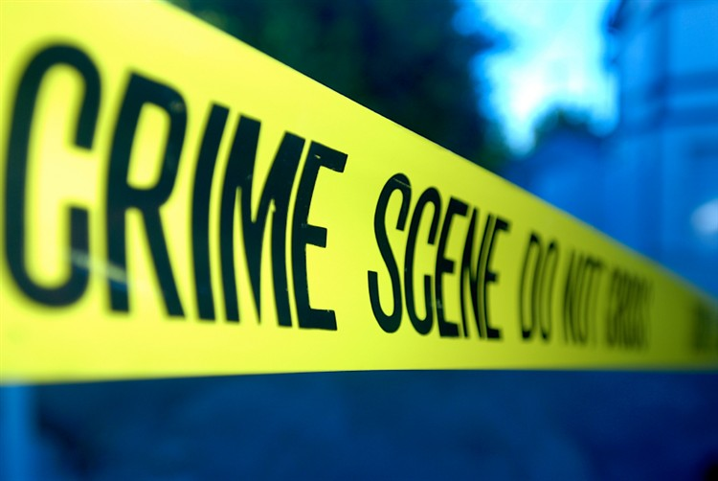
Crime Scene Photography Workshop February 8-9, 2018 Idaho State Coroner's Spring Conference Sharon L. Plotkin M.S. CCSI Certified Crime Scene Investigator

Slide 2
Purpose of this two-day workshop
To introduce the many challenges facing coroners, crime scene and law enforcement personnel in documenting crime scenes through photographic techniques and how to overcome these challenges.
Scene photography and working in low lit situations will be addressed. Power point lectures and many hands on practicums' will be provided to all those attending in order to achieve these objectives.

Slide 3
Objectives for this workshop
How to work with available light
Camera operations
Crime scene photography to include overall, midrange and close up photographs
Depth of field
Back lighting
Distortion
Oblique lighting photography
Night photography
Painting with light

Slide 4
Schedule Day One February 8, 2018 8:00 AM- 5:00 PM
Documenting crime scenes with photography
Standard Operating Procedures and Admissibility of photographs into court
How to work with available light
Camera settings

Slide 5
Schedule Day Two February 9, 2018, 12:00 PM- 9:00 PM Advanced photographic techniques
Impression/ evidence photography
Oblique lighting (impression evidence)
Photographic techniques including backlighting and depth of field
Night scene photography
Painting with light

Slide 6
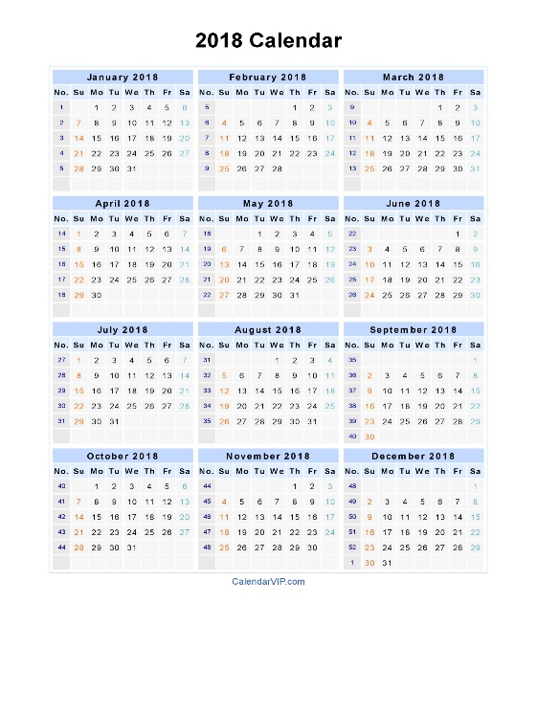
Day One

Slide 7
The Value of Crime Scene Photography
Photography is a valuable tool for recording crime scenes & explaining evidence to others
Photos communicate more about crimes scenes & the appearance of evidence than a written report.
Notes:
7

Slide 8
Recording the crime scene
The opportunity to permanently record the scene in its original state must not be lost. Such records will not only be useful during the subsequent investigation, but are also required for presentation at the trial in order to document the condition of the crime scene and delineate the location of the physical evidence. Photography, sketches, video taping and note taking are methods for crime scene recording.

Slide 9
Photography- the most important prerequisite for photographing a crime scene is for it to be in its original, unaltered state. Unless there is an injured party involved, objects must not be moved until they have been photographed from all necessary angles. Each crime scene should be photographed as completely as possible, which means that all areas should be included where the crime actually occurred and all adjacent areas where important acts may have occurred, immediately before or after the commission of the crime.
Ensures the integrity of the scene and to prove evidence existed on the scene.
Evidence pictures or video may verify witness statements: gives credibility to responding officers and may refresh the officer’s memory later.

Slide 10
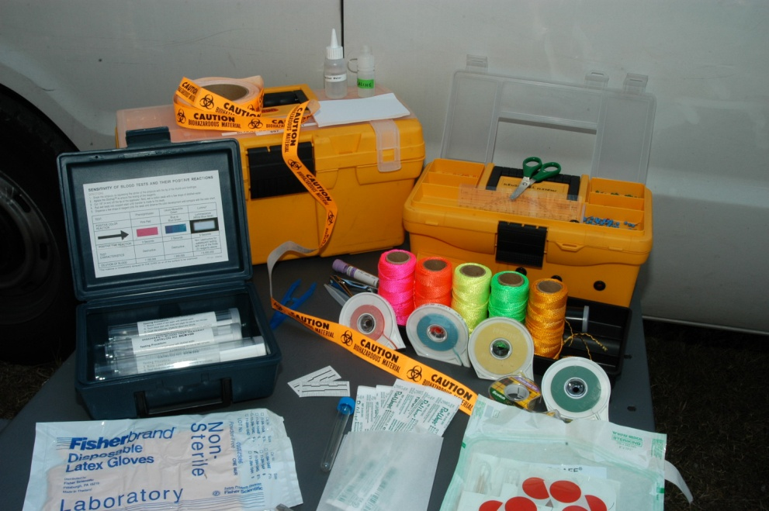
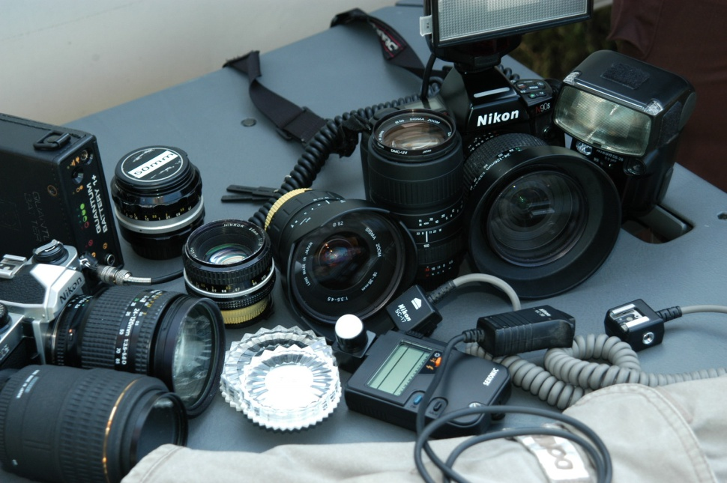
The role of the crime scene investigator is to identify, document, collect, preserve and reconstruct series of events that have occurred on crime scenes ranging from burglary to homicides and contact police shootings.
For blood or shooting reconstruction
Photography, sketching, report writing

Slide 11
Admissibility of Photographs in Court
3 points of qualification:
Object pictured must be material or relevant to point in issue
Content of photograph must not appeal to emotions or tend to prejudice court or jury
Photograph must be free from distortion & not misrepresent the scene or object it purports to reproduce

Slide 12
Standard Operating Procedure (SOP) for digital photography
It is important to have an SOP in place.
The SOP is a set of guidelines for those utilizing it to go by. It is not a one size fits all.
Crime scenes are dynamic and constantly changing and different so it is important to remember this when writing your SOP.
Some sections should be written to be purposefully vague. This allows for autonomy and adaptability when photographing crime scenes and prevents personnel from violating the particular sections of the SOP.

Slide 13
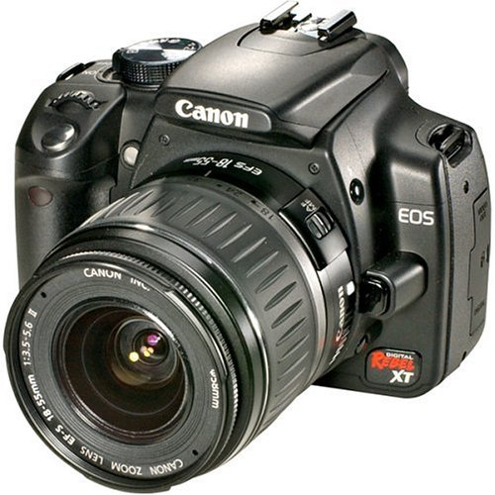
Digital cameras

Slide 14
Scene Photography

Slide 15
Overview photographs of the entire scene and surrounding area, including entry and exit points must be taken from various angles. If the crime took place indoors, the entire room should be photographed to show each wall area. Rooms adjacent to the actual crime site must also be photographed the same way. If the crime scene includes a body, photographs must be taken to show the body’s position and location relative to the entire scene.

Slide 16
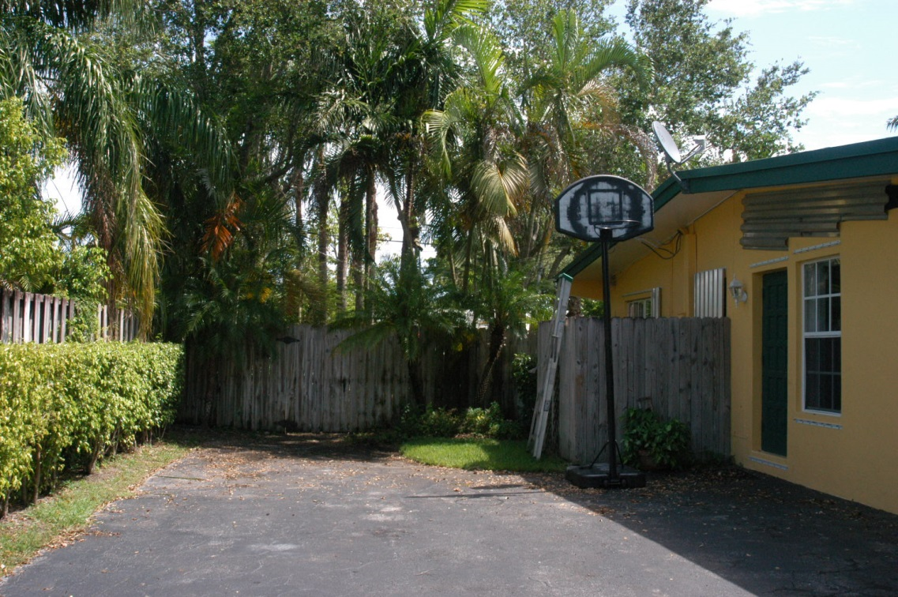
Overall photography of scenes- all sides of a location, access areas

Slide 17
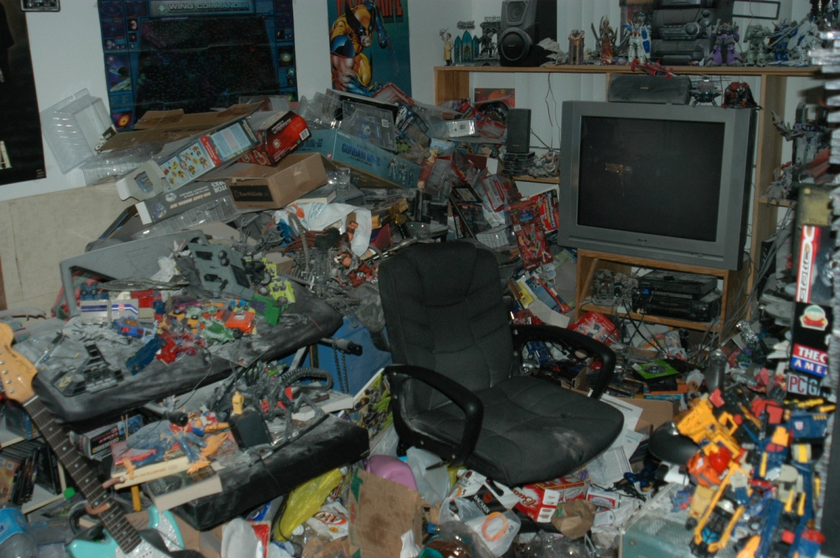

Slide 18
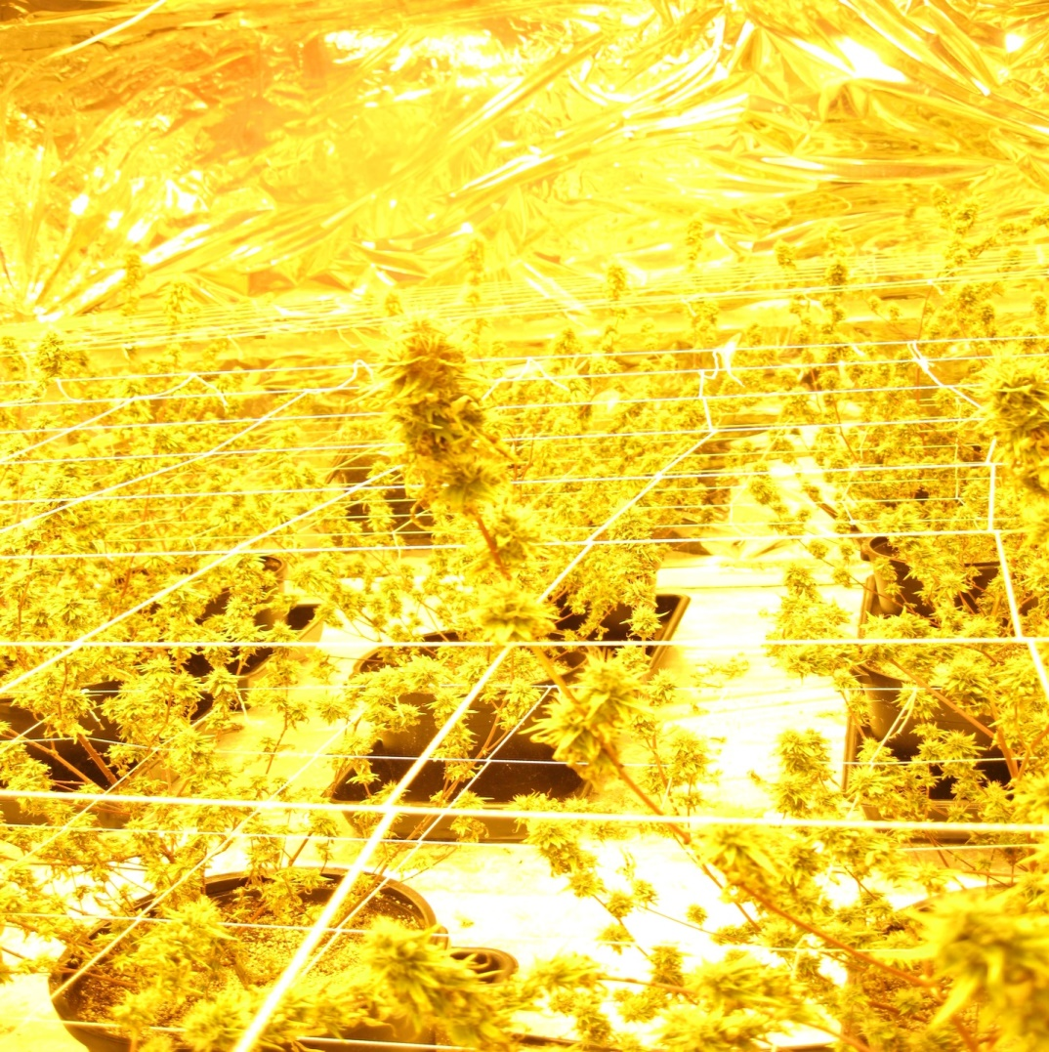

Slide 19
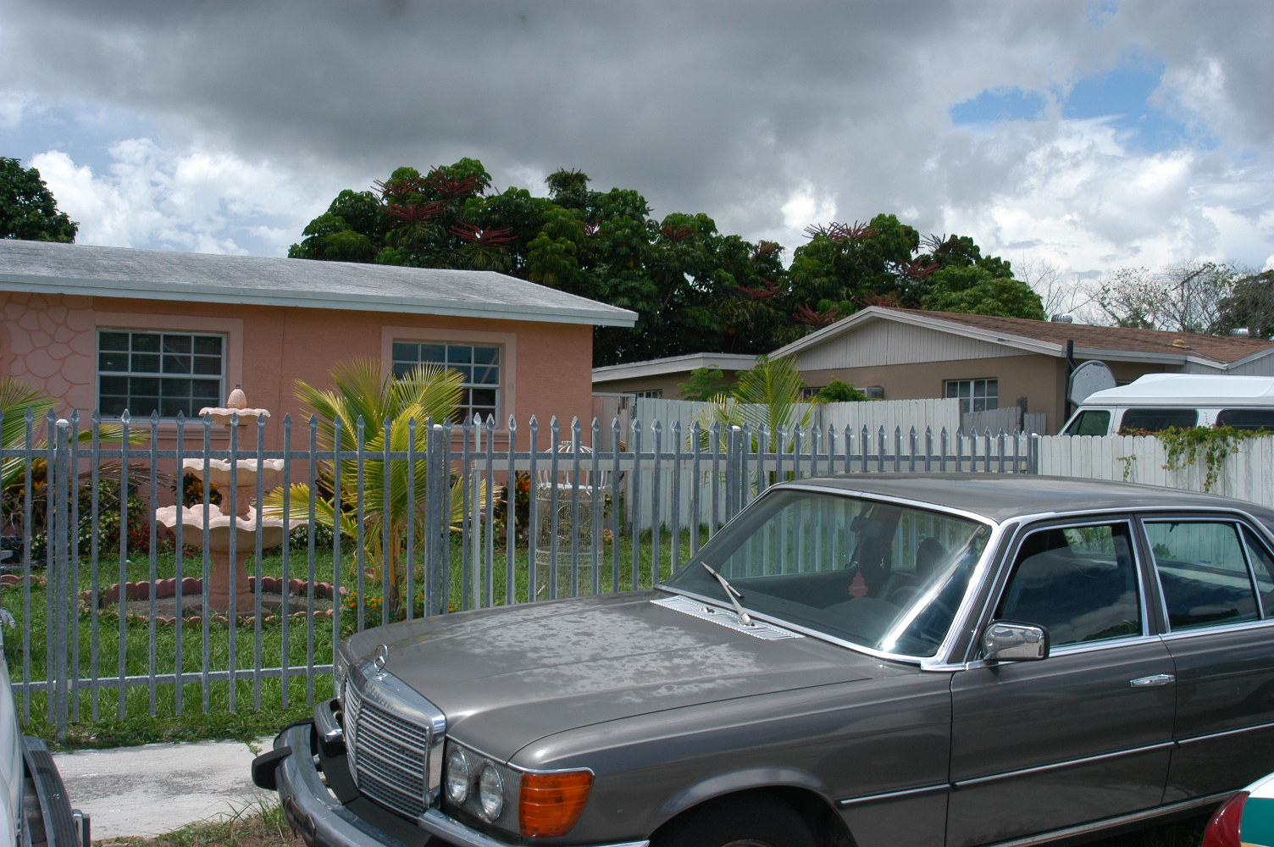

Slide 20
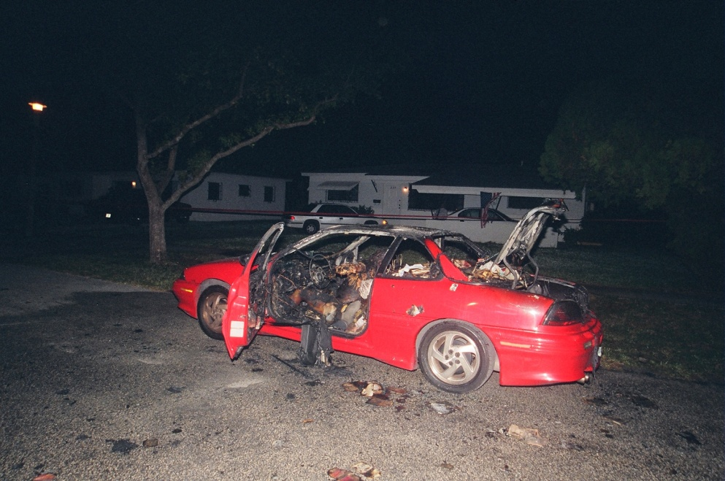

Slide 21
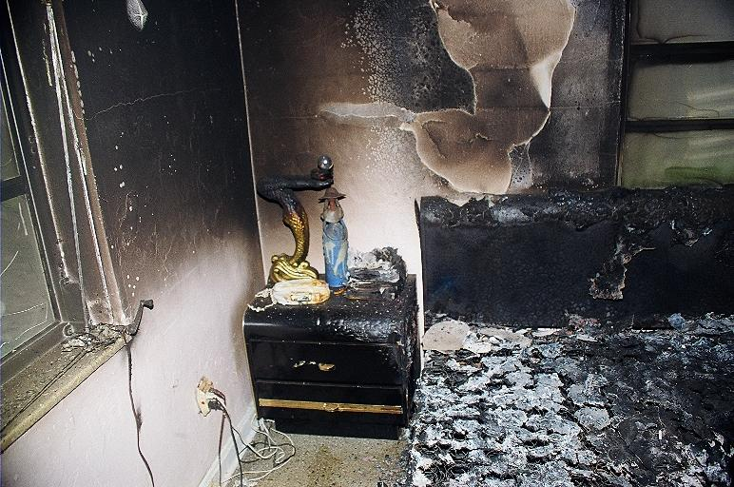
Arson scenes

Slide 24
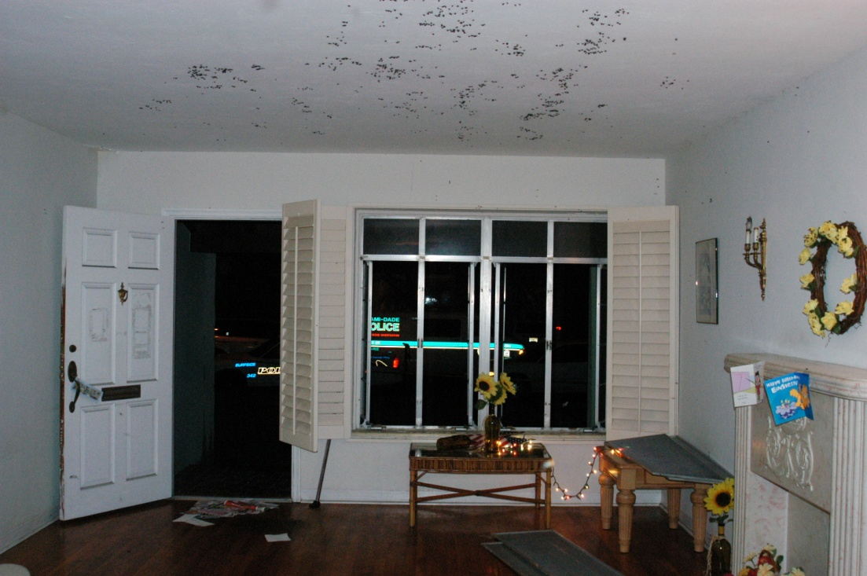

Slide 25
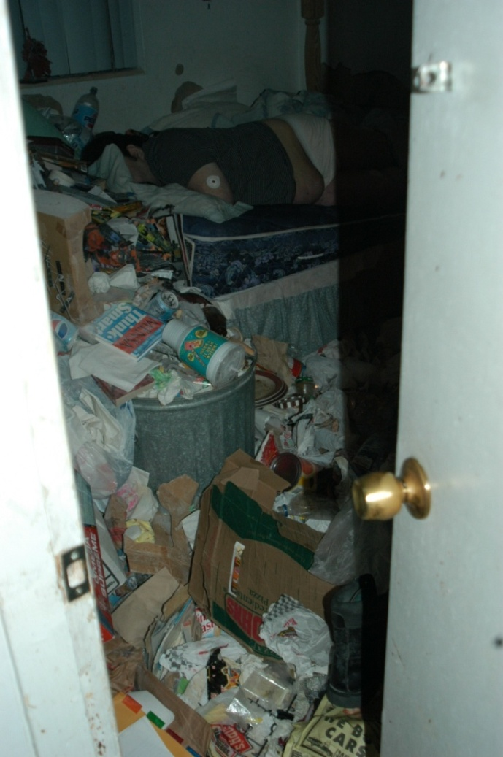
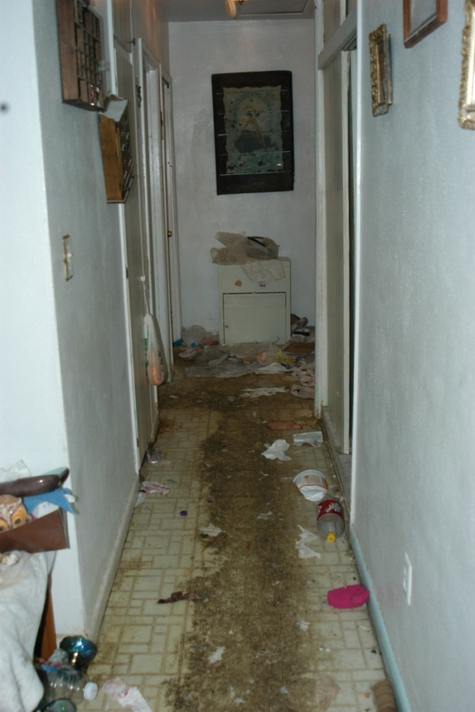
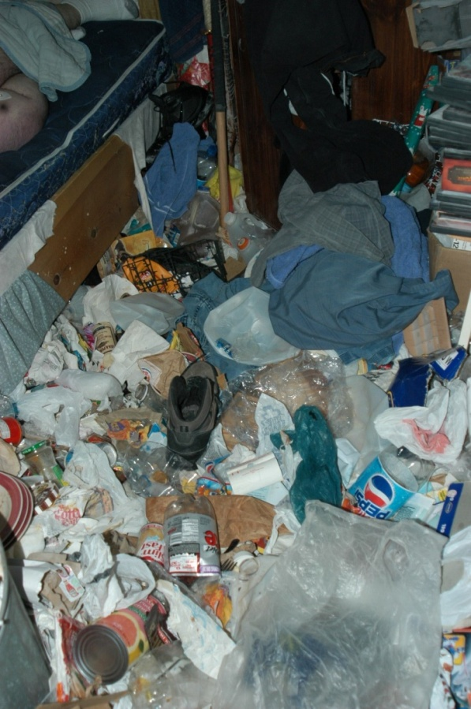

Slide 26
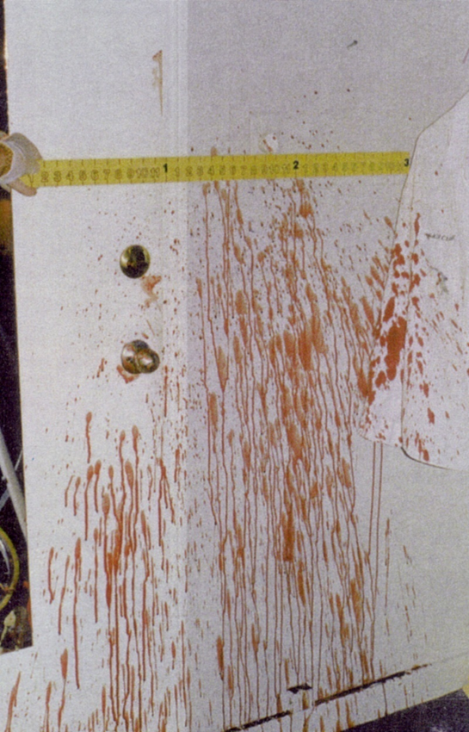

Slide 27
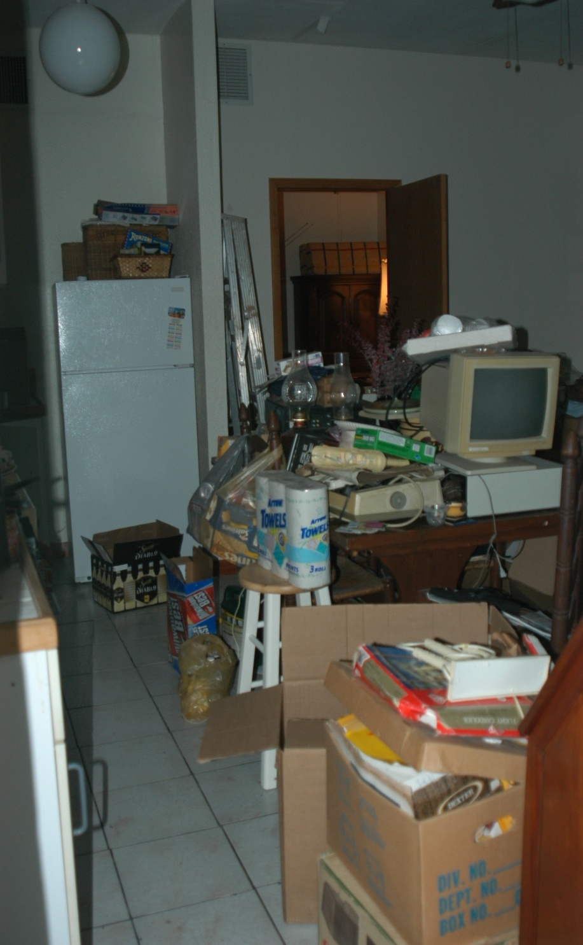
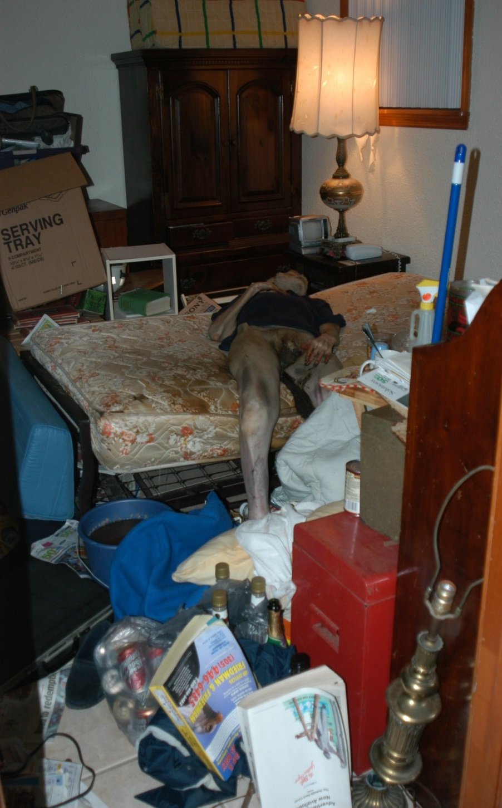

Slide 28
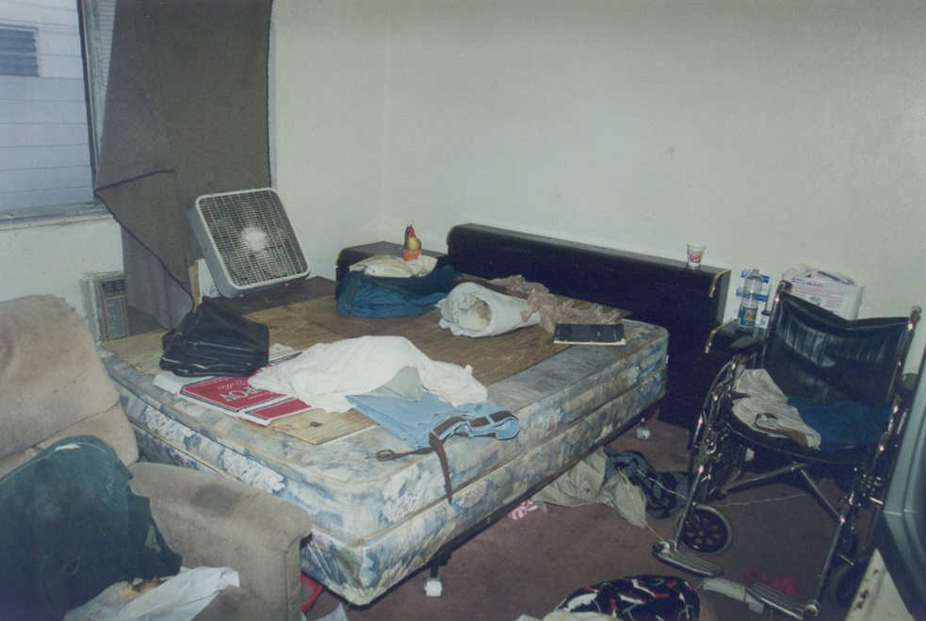

Slide 29
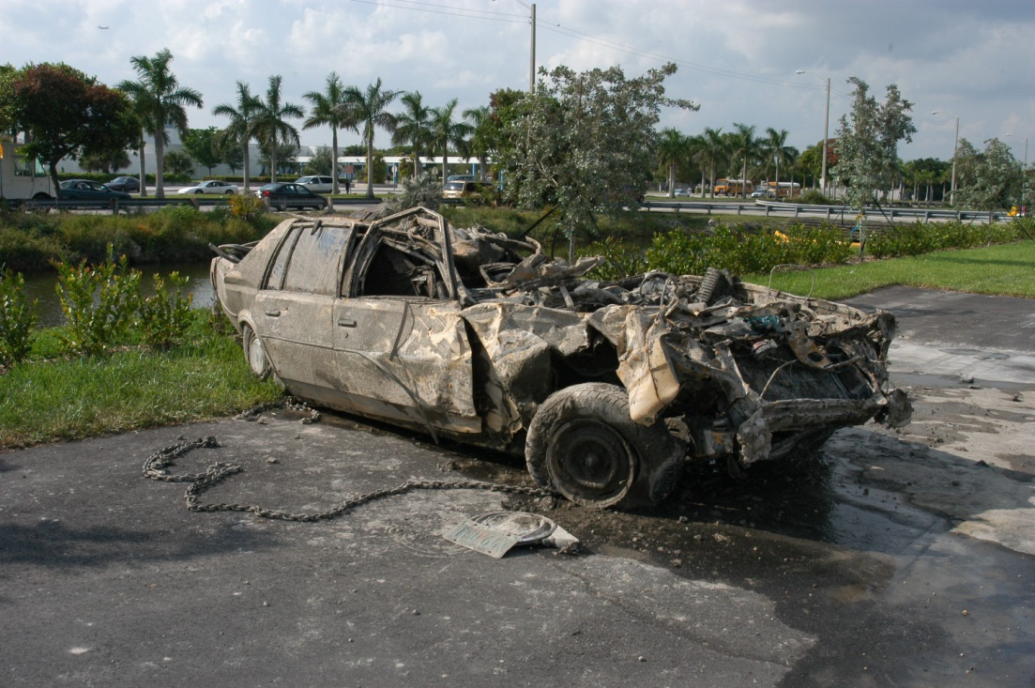

Slide 30
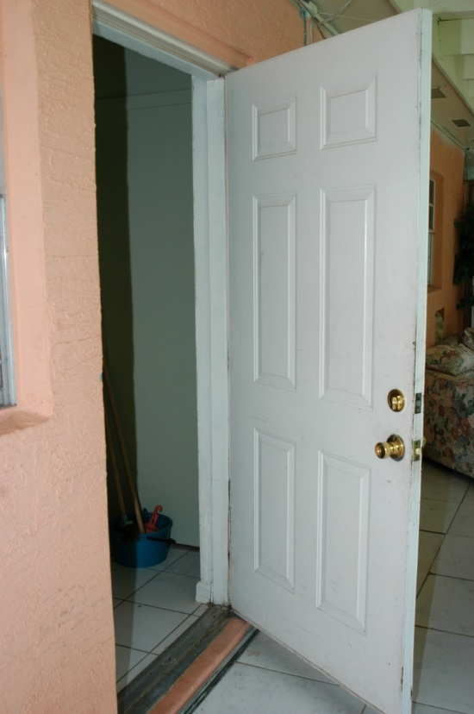
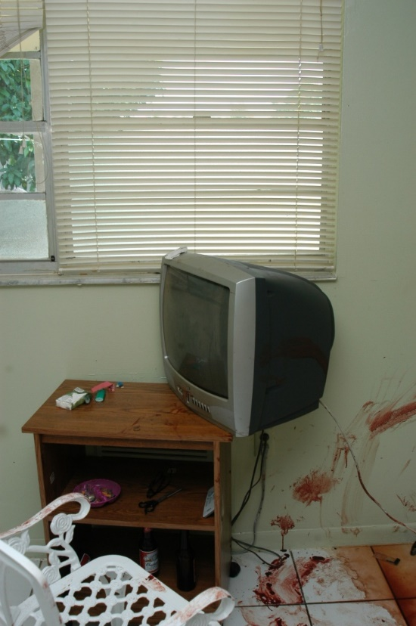

Slide 31
Midrange or evidence establishing. Used to depict where items are on crime scenes but the details of those objects is not known yet.

Slide 32
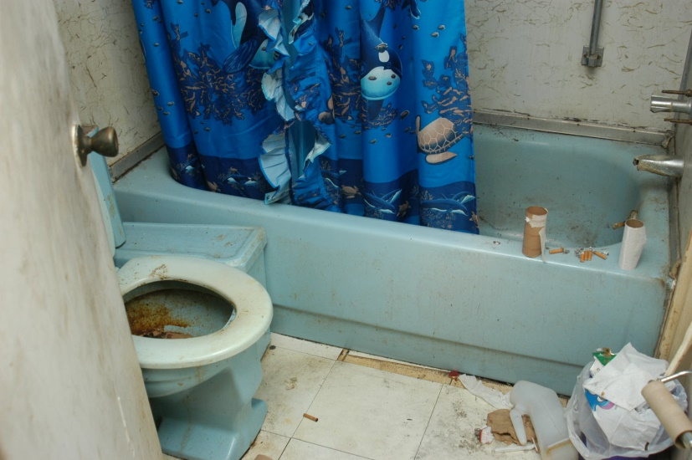
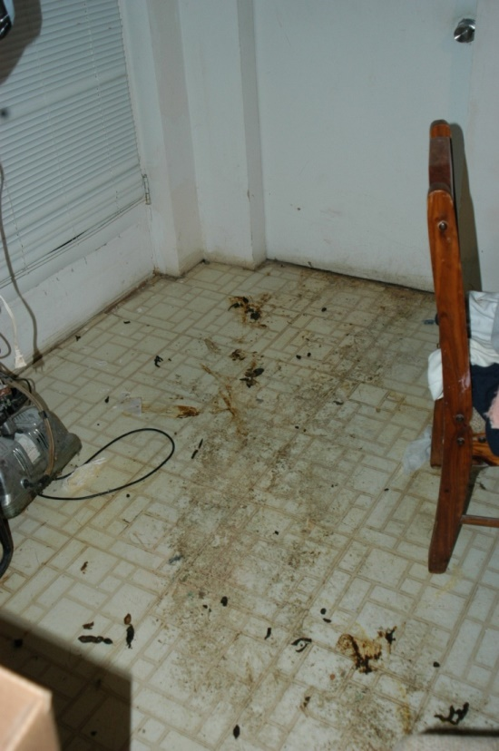
Midrange photography

Slide 33
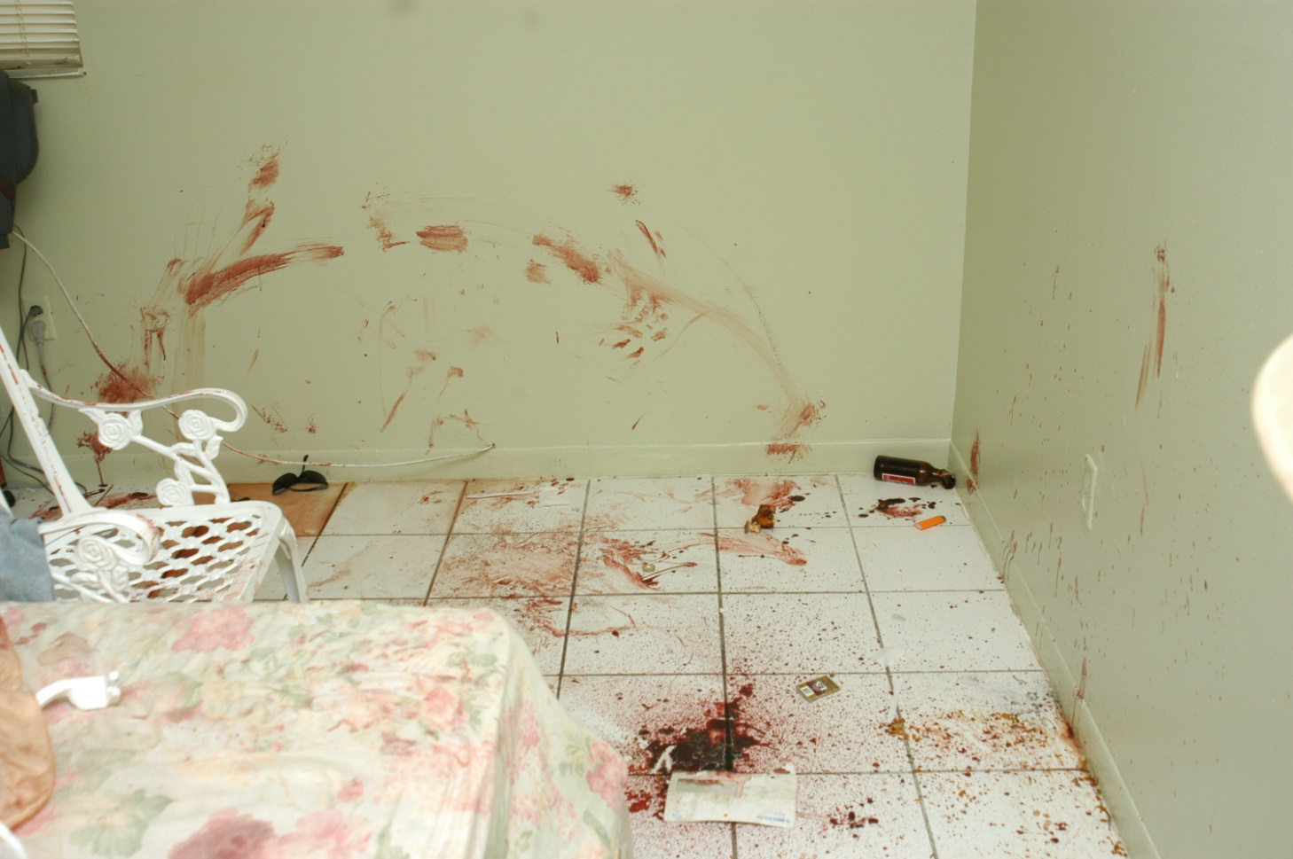

Slide 34
Pharmaceuticals

Slide 35
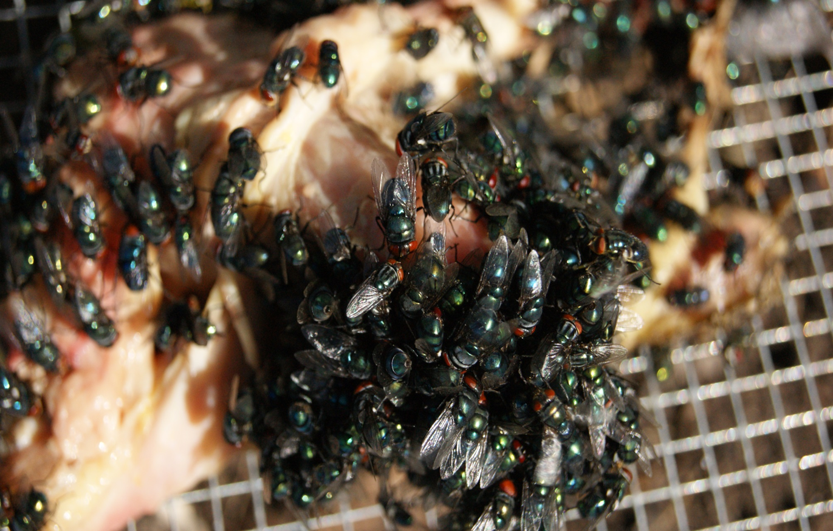

Slide 36
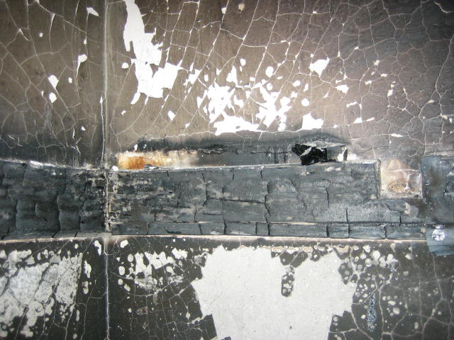

Slide 38
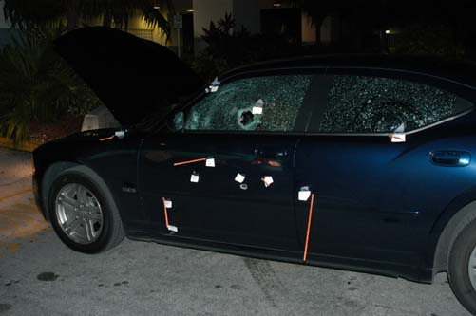

Slide 39
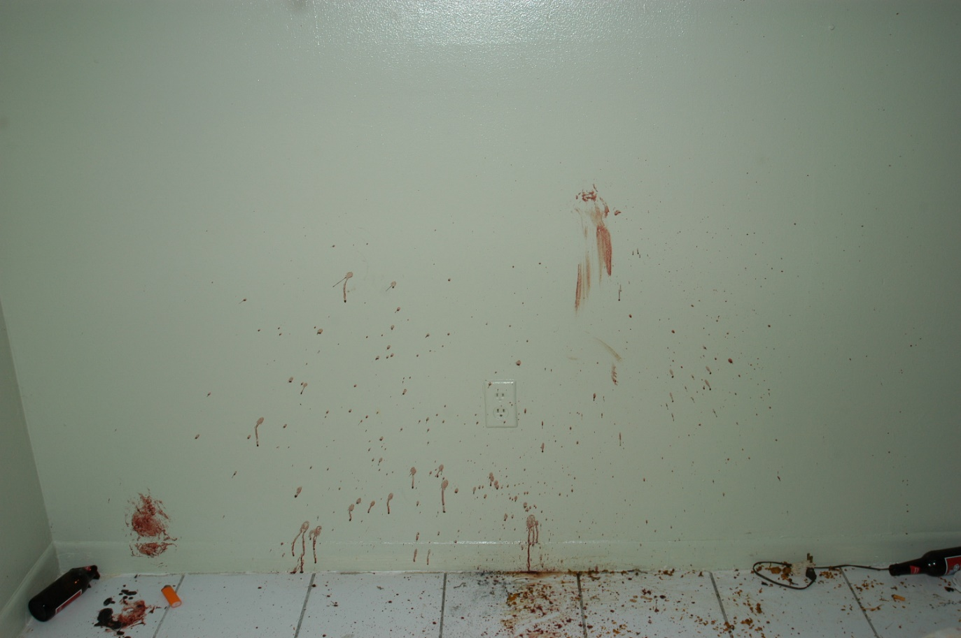

Slide 41
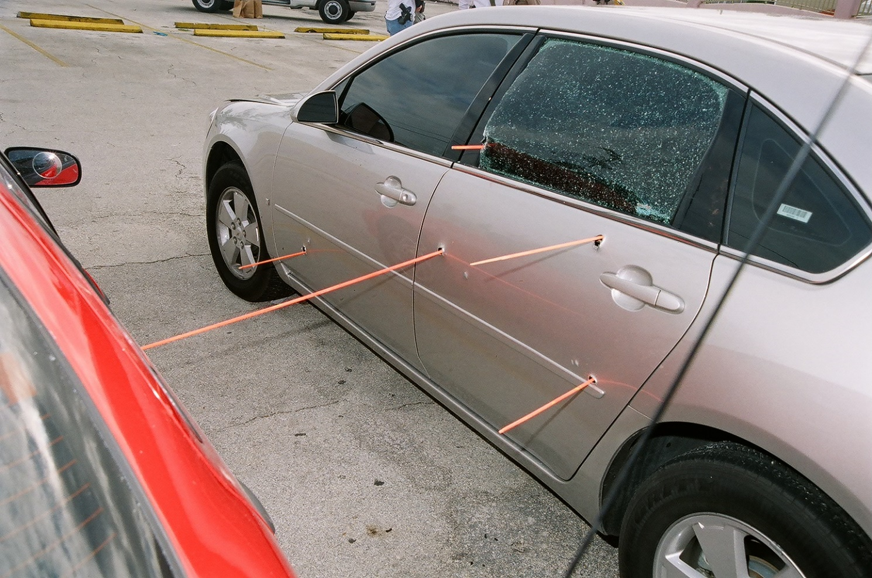

Slide 42
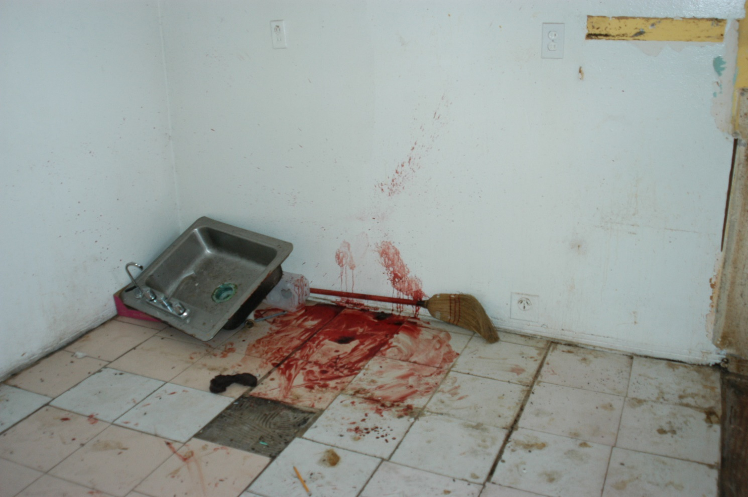

Slide 43
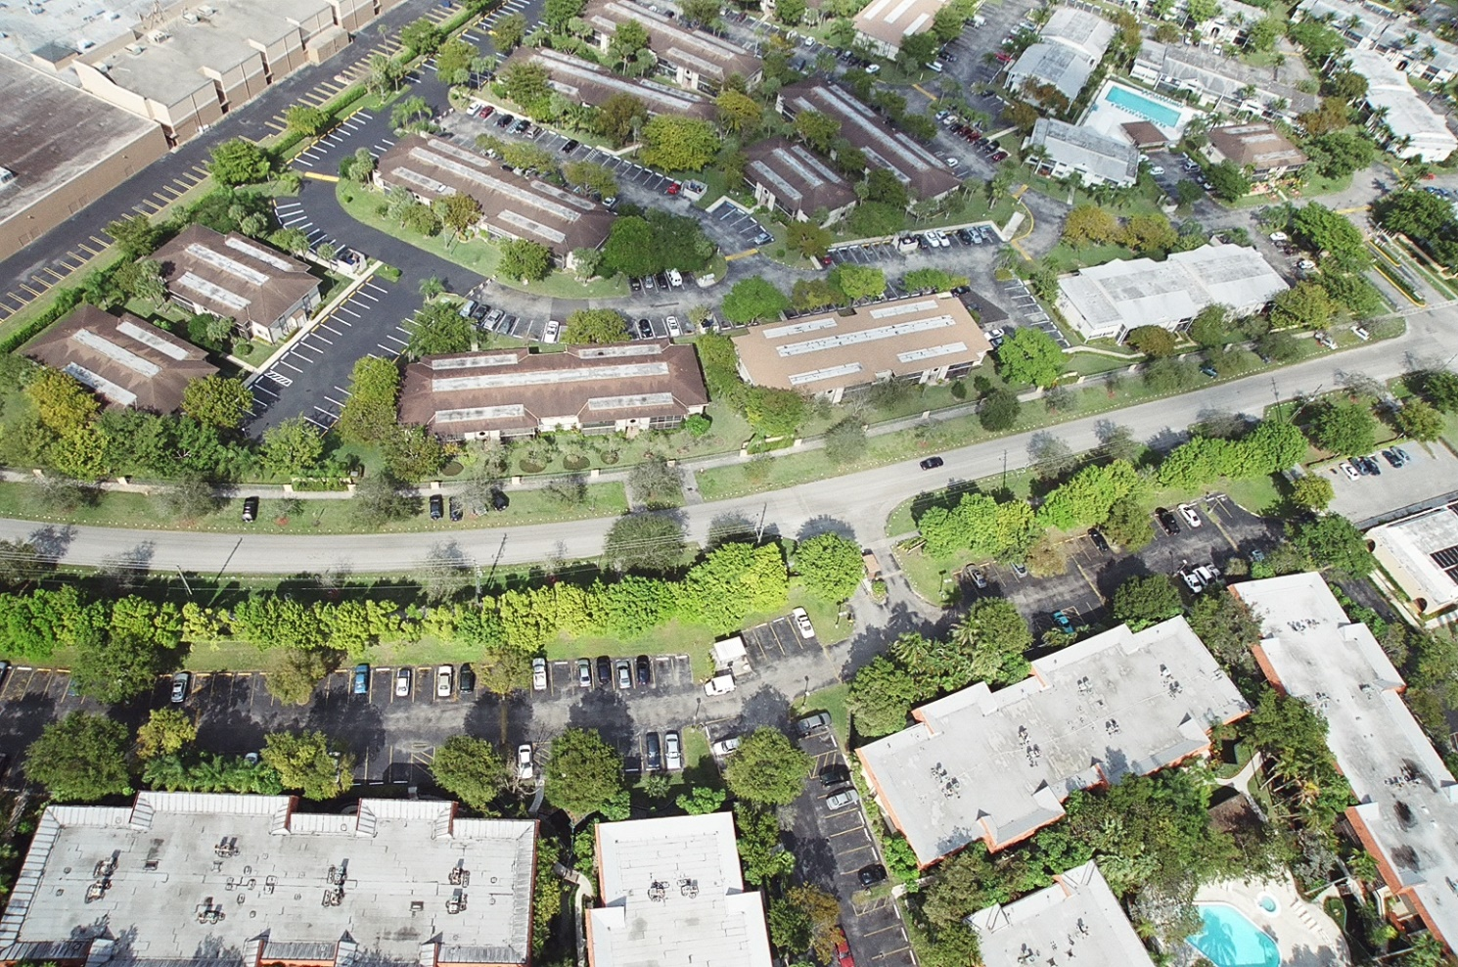
Aerial photography

Slide 44
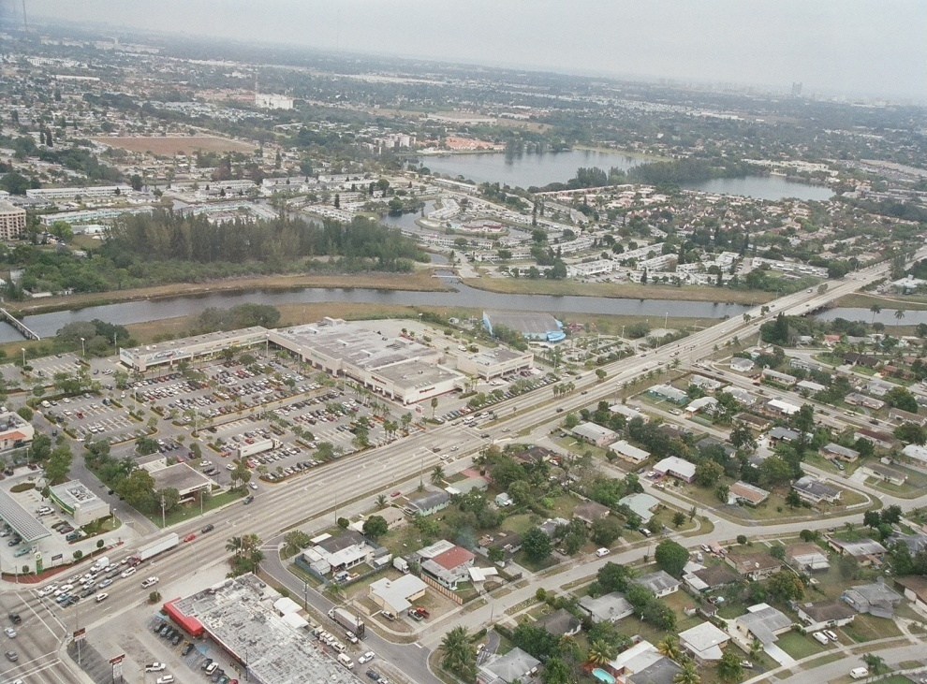
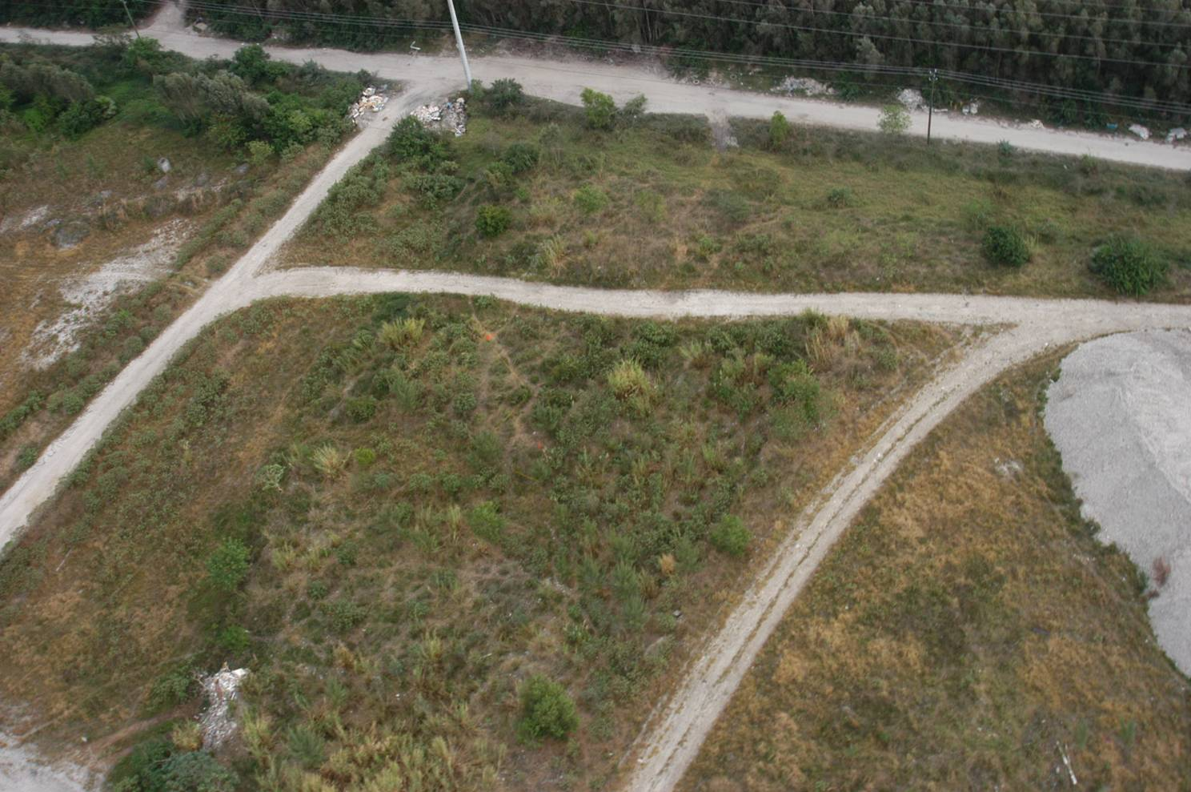

Slide 45
Close up photography- used to depict specific evidence on the scene.

Slide 46
Close up photographs depicting injuries and weapons lying near the body are also necessary. After the body is removed from the scene, the surface beneath the body should be photographed. As items of physical evidence are discovered, they are photographed to show their position and location relative to the entire scene. Close up photographs should then be taken to record the details of the object itself. When the size of an item is important, a ruler or other measuring scale may be placed near the object and included in the photograph as a point of reference.

Slide 47
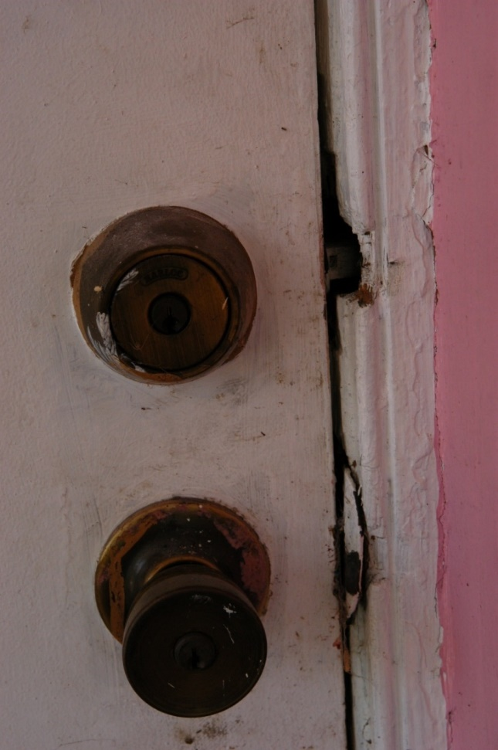

Slide 49
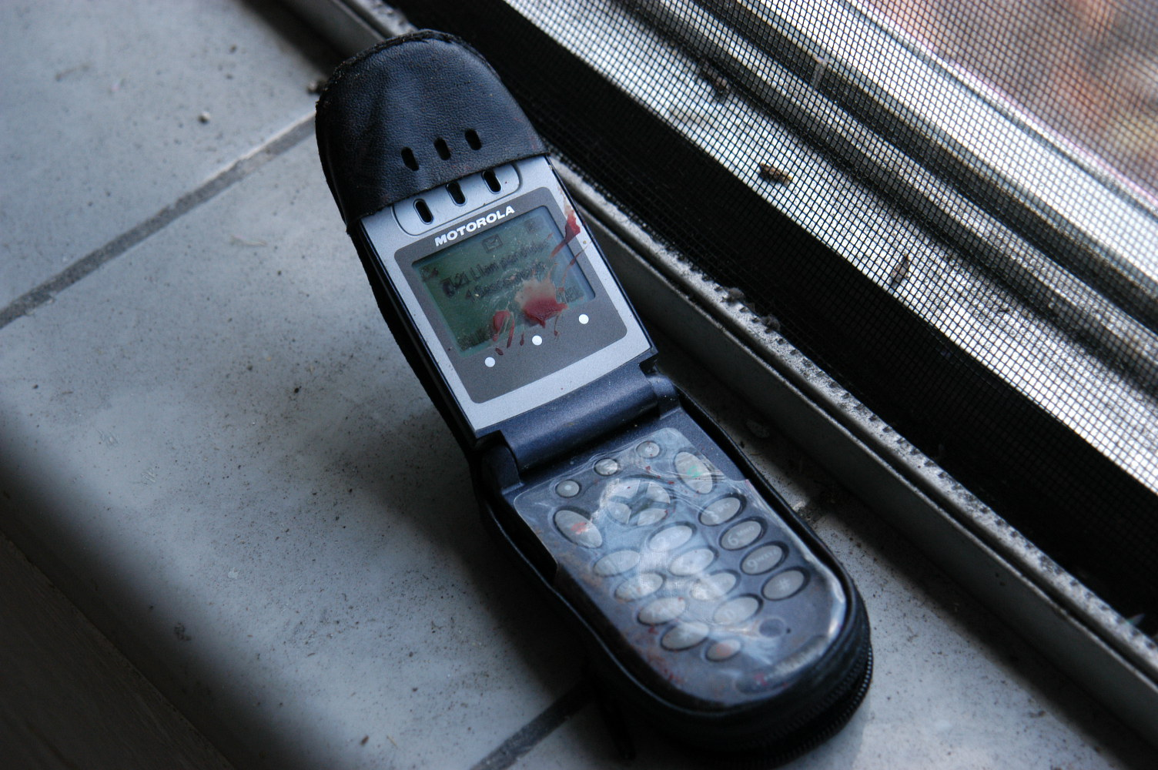

Slide 50
Injury documentation

Slide 51
Evidence

Slide 52
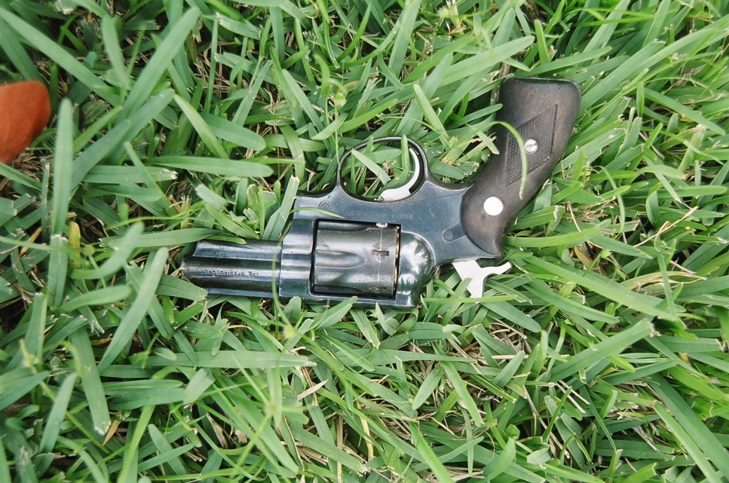

Slide 53
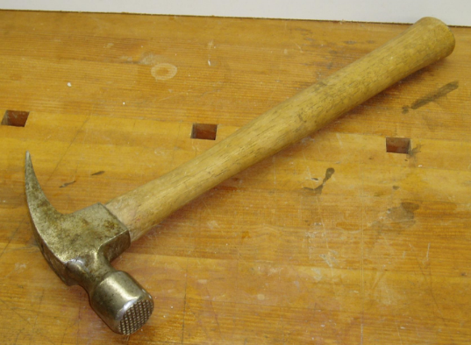
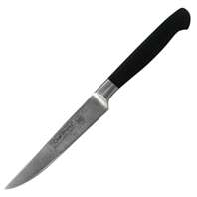
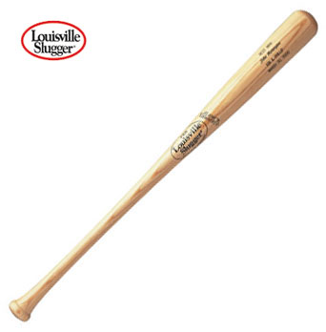
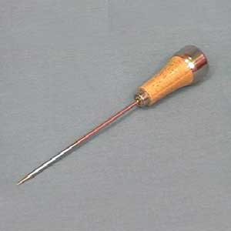

Slide 55
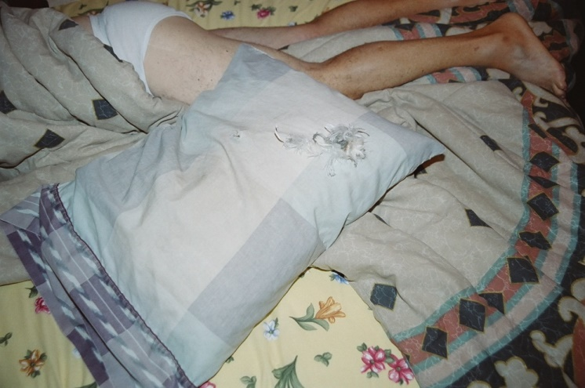
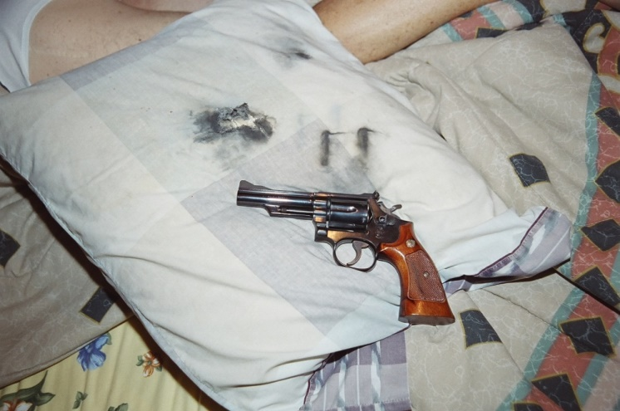
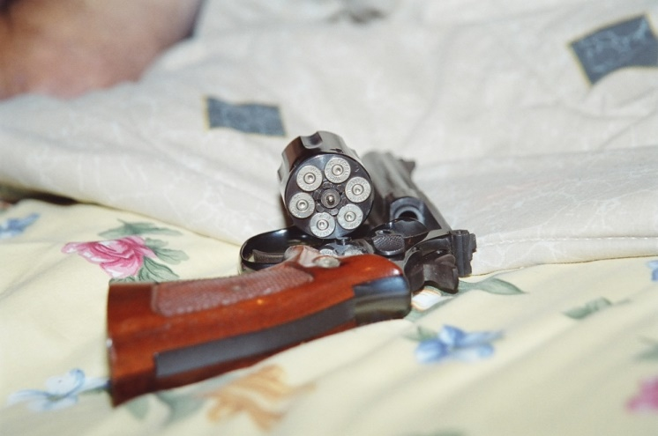

Slide 56
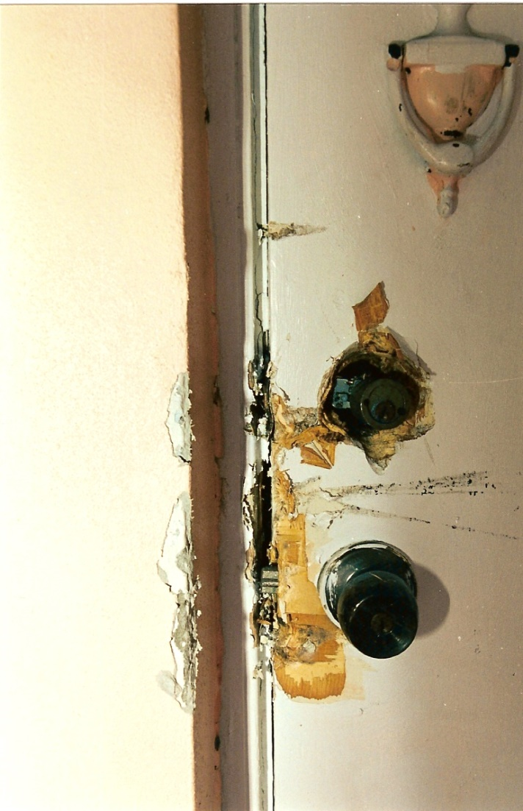

Slide 57
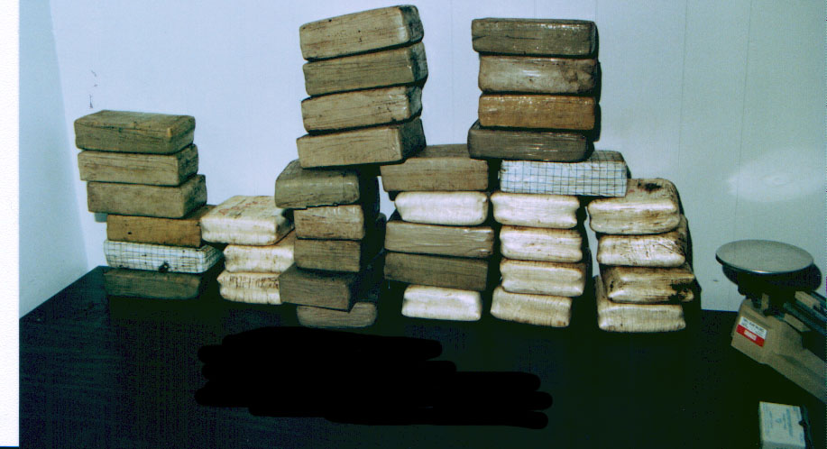

Slide 58
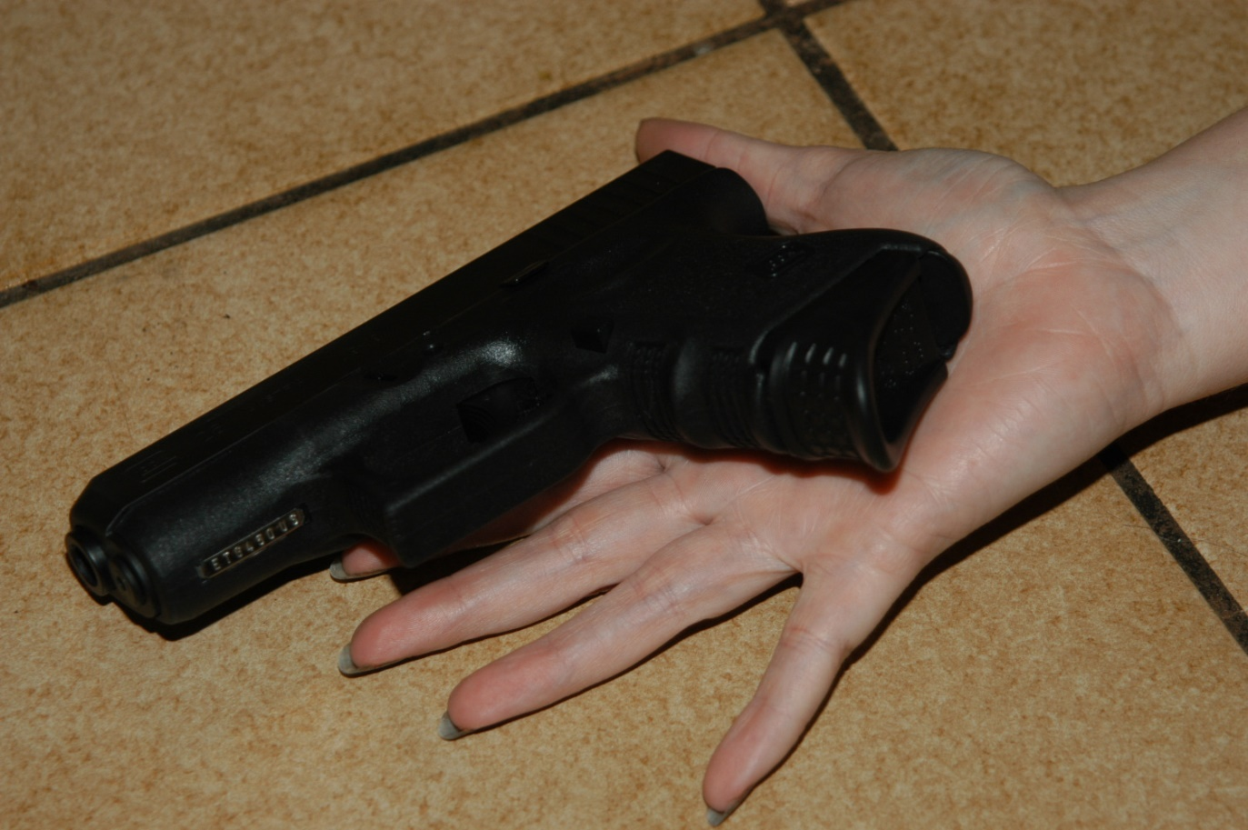

Slide 59
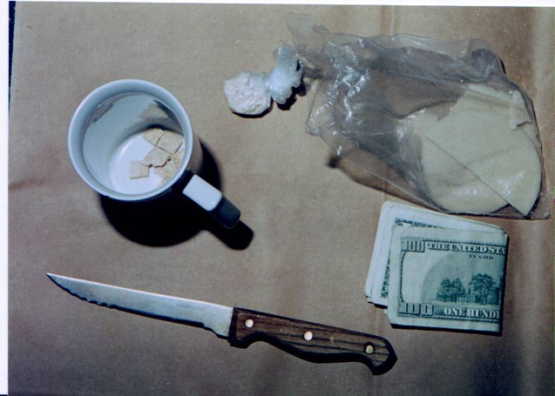

Slide 60
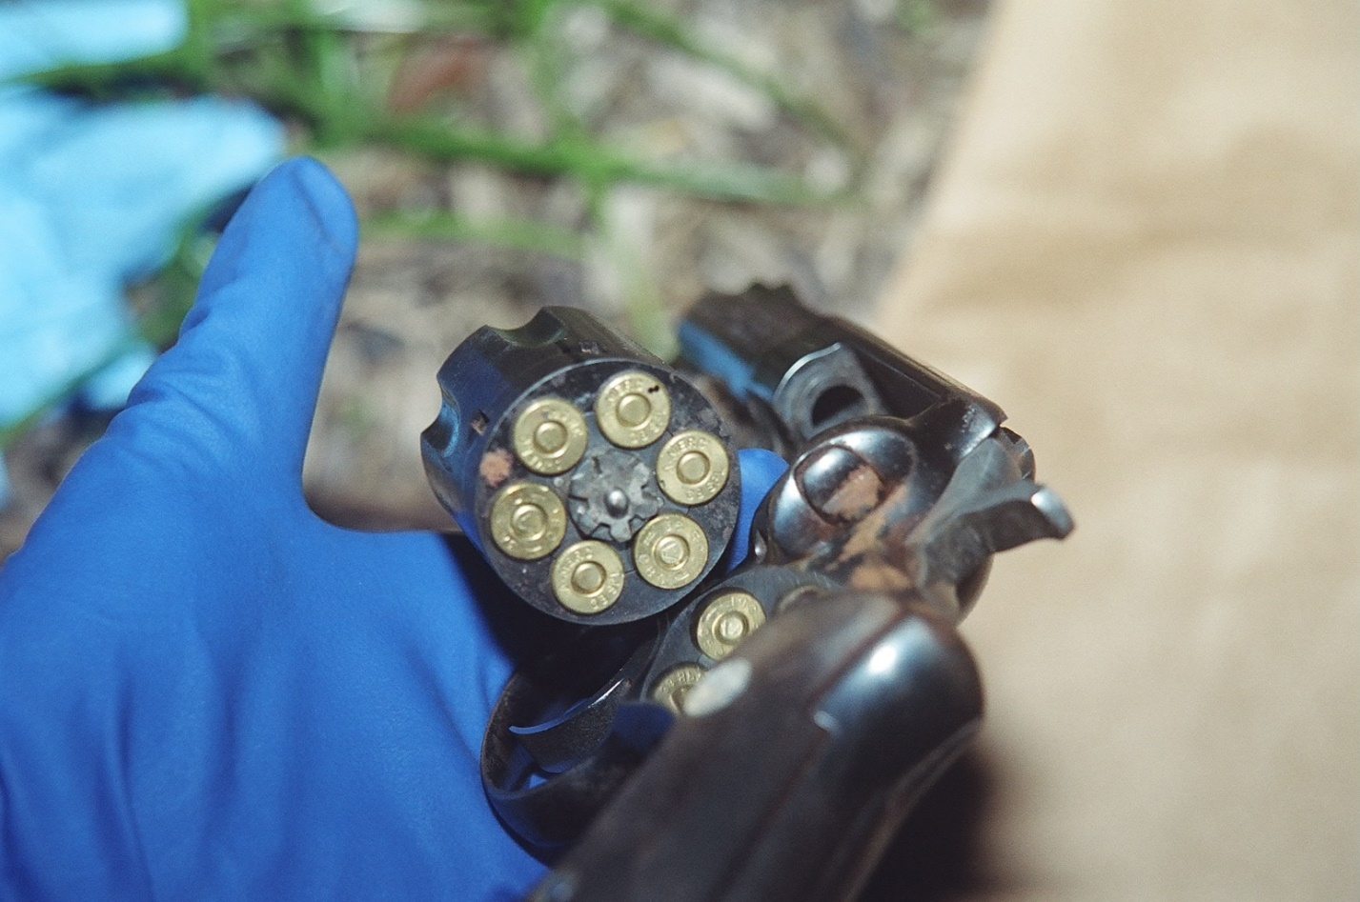

Slide 64
So what is wrong with these?

Slide 74
A quick note on photography… Admissibility of photographs in court
3 points of qualification:
Object pictured must be material or relevant to point in issue
Content of photograph must not appeal to emotions or tend to prejudice court or jury
Photograph must be free from distortion & not misrepresent the scene or object it purports to reproduce

Slide 75
The first 2 points of qualification are not the crime scene photographer’s responsibility
The 3rd point relates directly to the crime scene photographer
All crime scene photos must be true & accurate representations of the crime scene or evidence

Slide 76
Close up photographs depicting injuries and weapons lying near the body are also necessary. After the body is removed from the scene, the surface beneath the body should be photographed. As items of physical evidence are discovered, they are photographed to show their position and location relative to the entire scene. Close up photographs should then be taken to record the details of the object itself. When the size of an item is important, a ruler or other measuring scale may be placed near the object and included in the photograph as a point of reference.

Slide 77
Reasons to use ambient (natural light) when photographing scenes or people.
Natural light is always a preferred lighting source.
Your flash can only travel so far and scenes can be longer than your flash distance.
Equipment failure.
The photographer takes the picture not the camera.
You control how you want to take the photograph and the best settings to do so.
Can pick up a second job photographing weddings and bar mitzvahs.

Slide 78
How to work with light
Shutter speeds are seen as fractions (ex. 500 is 1/500 of a second) and is compared to a curtain. The less light you want into the camera the faster you want this shutter speed. 250 is slower than 500 which allows in more light. The human hand can only hold the camera steady at 1/50th of a second. So any shutter speed slower than that (1/40 or slower) a tripod should be used.

Slide 79
ISO ( International Standards Organization). The higher this number the more light that comes in range is 80- 16,000 or higher. The higher the ISO the more noise or grainy the picture.

Slide 80
Aperture (also called FStops) or opening of the lens (diaphram) is like the dilating of the retinas in the eye. The more open the retina the more light that comes in. The range is F2.8- 22. The higher the number the smaller the opening (F2.8 is wide open whereas F22 is closed down).
Note- the lower the FStop number the less depth of field you will get.
The FStop number is also affected by the focal length of your lens (you will see this number change as you zoom in and out with your lens).

Slide 81
Bryan Peterson has written a book titled Understanding Exposure which is a highly recommended read if you’re wanting to venture out of the Auto mode on your digital camera and experiment with it’s manual settings.
In it Bryan illustrates the three main elements that need to be considered when playing around with exposure by calling them ‘the exposure triangle’.
Each of the three aspects of the triangle relate to light and how it enters and interacts with the camera.
The three elements are:
ISO – the measure of a digital camera sensor’s sensitivity to light
Aperture – the size of the opening in the lens when a picture is taken
Shutter Speed – the amount of time that the shutter is open
It is at the intersection of these three elements that an image’s exposure is worked out.
Most importantly – a change in one of the elements will impact the others. This means that you can never really isolate just one of the elements alone but always need to have the others in the back of your mind.

Slide 82
The Window
Imagine your camera is like a window with shutters that open and close.
Aperture is the size of the window. If it’s bigger more light gets through and the room is brighter.
Shutter Speed is the amount of time that the shutters of the window are open. The longer you leave them open the more that comes in.
Now imagine that you’re inside the room and are wearing sunglasses (hopefully this isn’t too much of a stretch). Your eyes become desensitized to the light that comes in (it’s like a low ISO).
There are a number of ways of increasing the amount of light in the room (or at least how much it seems that there is. You could increase the time that the shutters are open (decrease shutter speed), you could increase the size of the window (increase aperture) or you could take off your sunglasses (make the ISO larger).
The faster the shutter speed the less light allowed in.
http://www.digital-photography-school.com/learning-exposure-in-digital-photography#ixzz1iLDMYFKP

Slide 83
ISO 400 FSTOP 3.5 shutter 50

Slide 84
ISO 600 FSTOP 3.5 Shutter 50

Slide 85
ISO 3200 FSTOP 3.5 Shutter 50

Slide 86
Downtown Miami on Thursday Night ISO 1250 FSTOP 3. 5 shutter 10

Slide 87
ISO 2500 FSTOP 3.5 shutter 2 seconds

Slide 88
Courtesy of The Cayman Police photography class

Slide 89
ISO 2500 FSTOP 3.5 shutter 30
The higher your ISO the more color your sky gets from the city lights which may sometimes look unnatural and gets more grainy (noise).

Slide 90
Depth of field
Depth of field is determined by several factors: Aperture/F-Stop
Lens Subject Distance
Depth of field refers to the range of distance that appears acceptably sharp. It varies depending on camera type, aperture and focusing distance, although print size and viewing distance can also influence our perception of depth of field.
The depth of field does not abruptly change from sharp to unsharp, but instead occurs as a gradual transition. In fact, everything immediately in front of or in back of the focusing distance begins to lose sharpness.
Much like lens strength, subject distance, plays a big part in determining the possible size of depth of field. The closer you are to your focal point, or subject, the less depth of field is possible.
Controlling depth of field
aperture and focal distance are the two main factors that determine how big the circle of confusion will be on your camera's sensor. Larger apertures (smaller F-stop number) and closer focusing distances produce a shallower depth of field.
http://www.cambridgeincolour.com/tutorials/depth-of-field.htm

Slide 91
The focal length of your lens plays a big part in determining the depth of field (DOF) for your images. The lens strength is a limiting factor for what your aperture can do. The higher the magnification factor, the smaller the depth of field will be, even with large F-Stop settings. Depth of Field Progression for a 70-300mm Lens 70mm = largest DOF
100mm = large DOF
200mm = small DOF
300mm = smallest DOF
http://photography.about.com/od/takingpictures/ss/DOF_3.htm

Slide 92
The depth of field shown in a photograph is the amount of area in the foreground and background of an object in focus that is also relatively in focus.
The smaller the aperture opening, the greater the depth of field will be. This means that higher f-number settings will yield higher depth of field.

Slide 93
https://encrypted-tbn0.gstatic.com/images?q=tbn:ANd9GcTOEtCZwMEq35lF7Bn5N0jDdAmDtp67nPI4OW6HiB8vmfKdXYVqiRbHXrKx

Slide 94
Other helpful tips
Exposure value (EV)
How To Use EV Compensation EV Compensation helps to fix this by telling the camera to expose at a higher or lower setting than it thinks is right. For very bright settings (like the snow or beach), set an EV value as a positive number (+1/3, +1 etc). For very dark scenes, choose a negative EV number.
http://www.digital-photo-secrets.com/tip/19/exposure-value/#sthash.NyEYbzzn.dpuf

Slide 95
http://cdn.digital-photo-secrets.com/images/ev-graysnow.jpg

Slide 96
White Balance
Light is seen in wavelengths of light. The visible spectrum of light is between 400 and 700 nanometers. Light also emits certain colors depending on the wavelength of light.
At its simplest – the reason we adjust white balance is to get the colors in your images as accurate as possible.
digital-photography-school.com/introduction-to-white-balance#sthash.dPGG0Gw5.dpuf

Slide 97
http://www2.estrellamountain.edu/faculty/farabee/BIOBK/spectrum.gif

Slide 98
http://photoaffiliates.com/wp-content/uploads/2013/07/White_balance_demonstration_688.jpg

Slide 99
Tips for taking good photographs
Let the pictures tell a story
Always take more than you think you need
Make sure the perspective, lighting, exposures are correct.
Use scales to depict size when necessary.

Slide 100
Day Two
Back lighting
Distortion
Impression/ evidence photography
Oblique lighting
Night Photography/
Painting with light

Slide 101
Backlighting
Back lighting is when there is light coming from behind your subject. If we do not compensate for this your subject will always be dark (if not using a flash).
It is important to remember if using natural light that you need the camera to read the light off of your subject and not what is behind them (example someone standing in front of a window). In essence you will have to overexpose the background to get the light reflecting off of the subject.

Slide 102
Oblique lighting
Used for bringing out the details of imprinted or indented evidence such as shoe wear, indented writing, head stamps on casings.

Slide 103
Oblique /side lighting This helps with bringing any impressed information (fills in the shadows)

Slide 104
Before an impression is moved or handled, it must be photographed (include a scale for measurement purposes) to show all the observable details of the impression.

Slide 105
Several shots should be taken directly over the impression (90 degrees prevents any distortion of the impression) as well as at various angles around the impression.

Slide 106
Use of flashlights for oblique (side) lighting

Slide 107
Tips for taking effective photographs using oblique lighting
Place camera on a tripod and have camera at a 90 degree angle (straight down) over the impression.
Use a scale or other measuring device to depict size. Be sure that scale is level with the impression.
Have a second person use either a flash light or a slave or attached flash unit and have them shoot the light source to the side of the impression. The key here is to throw light across the surface of the impression to bring out the impressed information.
Have person with the lighting move light source on all four sides of the impression while the photographer continues taking the same picture. This is called bracketing (same picture but a setting is changed).

Slide 111
www.pinterest.com

Slide 112
Possible shoe impression in soil

Slide 113
When using a flash here be sure to throw the light below the car. If not it will bounce off of the bumper and shadow out what is underneath the vehicle.
This is also known as fill flash.

Slide 114
Night photography/ painting with light
Painting with light allows for the photographer to use more than one light source to illuminate a dark area. These light sources can include light police, flashlights, spot lights and flash units. Examples where this may be needed could be a street scene at nightfall with multiple pieces of evidence are present
The light sources are mobile while the camera remains on one position.

Slide 115
Supplies needed:
Camera, tripod, long cable release cord, light sources (flash, flashlights), black cardboard to cover the lens while the shutter is open, extra batteries.

Slide 116
Hint
Putting glow in the dark tape around the legs of your tripod will help prevent you tripping over them while photographing in the dark. You can also hang a mini light down from the center of the tripod as well to help with this.

Slide 117
Prior planning will avoid further problems from arising during the shoot. Note area, ambient lighting available, evidence locations. Have lighting persons available to disperse light in preset locations.

Slide 118
Procedure
The cable release cord allows the shutter to be opened and closed without touching the camera (therefore preventing camera shake).
The angle of the view of the camera is that are in front of the camera which is seen by the lens.
Tripod- the camera must be mounted on a tripod. This is due to long shutter exposures. The human hand can only hold the camera for approximately 1/50th of a second. Any shutter speed slower than that will have camera shake resulting in blurry images.

Slide 119
Procedure
Step 1- place camera on a tripod
Step 2- attach cable release cord
Step 3- if your camera is set to manual focus, focus 1/3 of the way into the scene. With a wide focal length then F5.6 or F8 should give you enough depth of field. (8 would be better). Make sure to move focus from auto to manual once focus is set.
Set FStop based on the depth of field you are trying to obtain. The wider open the FStop (1.4, 2.8 ) the less Depth of Field you will gain. A good place to start can be F5.6 or 8.

Slide 120
Procedure continued
Keep in mind the smaller aperture you use, each stop you close down doubles the amount of time you need to be painting and exposing. So a 60 second exposure at f/5.6 becomes an 8 minute exposure at f/16!
White balance (WB) if you are using a flashlight then WB should be set to Tungsten. Utilizing a proper white balance prevents a color shift from occurring in the captured images. This will ensure that the color balance of the photographs is accurately depicted.
Set your ISO. The higher your ISO the more noise you create. Choose the lowest ISO possible. A good place to start is about ISO 200.

Slide 121
Procedure continued
Step 4- if only one person is doing this put the shutter on Bulb and keep open for 60 seconds. Then person #1 runs around lighting the scene with multiple flashes and then comes back and closes the shutter. If there is more than one person, Person #1 stays at the camera, opens the shutter, place black card over lens (do not touch the lens) and the second person runs around the scene lighting it up. Before the flash is fired, have the lighting person (person #2) yell back to camera person (person #1) to remove card covering the lens, flash goes off and card is placed over lens. Repeat lighting the scene as needed. When finished have person #1 close the shutter. Use a cable release cord to keep the shutter open as this prevents camera shake and be sure to secure camera strap as well.
The amount of times you flash will depend on how big of an area you are trying to light up.

Slide 122
Procedure continued
Hints: when using flash units keep flash from going back into the camera. Don’t put yourself between camera and light source (you will block the light), don’t aim into reflective sources such as mirrors, windows, etc). Standing behind objects such as cars and trees and flashing the light source will prevent this from occurring. Keep moving when dispensing light as this will prevent ghost images from showing up in your photographs. Dark clothing helps!

Slide 123
Inverse Square Law
When an object that is twice the distance from a point source of light will receive a quarter of the illumination. So what it means to us photographers is that if you move your subject from approximately 10 feet away to approximately 20 feet away, you will need four times the amount of light for the same exposure (double the distance means you are receiving ¼ of the light therefore four times the light needed).
(http://www.geofflawrence.com/inverse_square_law.html

Slide 124
Any questions????

Slide 125
Ready to try?????

Slide 126
Special thanks to Detective Ignacio Vila and Detective Christine Kruse for their contributions and for always being a part of the team!

Slide 127
Contact Information
Sharon L. Plotkin M.S. CCSI
Cell: 305-218-6949
Email: splotkin@mdc.edu
slplotkin@bellsouth.net

