Slide 2

University of Idaho
Extension 4-H…. Making the Best Better
Barbara D. Petty
Associate Dean / Director of Extension
Jim Lindstrom
4-H Director

Slide 3

Overview
Historical path
UI Extension and 4-H Today
Our Future

Slide 4
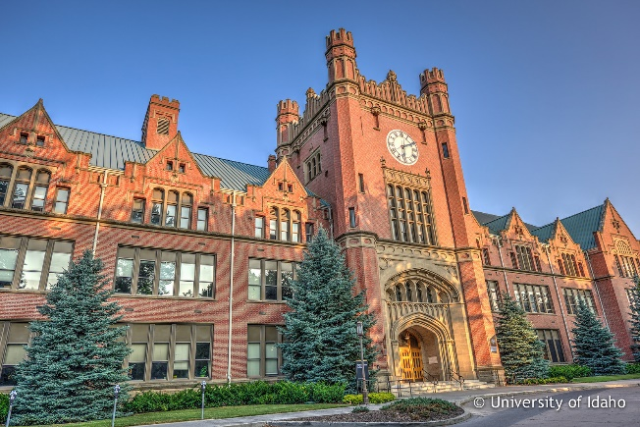
Why was Extension Created?
Morrill Act -1862
Hatch Act -1887
Smith-Lever Act – 1914
Idaho’s Extension Agents – 1913
College of Agricultural and Life Sciences

Slide 5
Extension Partnership
County
State
Federal

Slide 6
University of Idaho Extension
improves people’s lives by…
…engaging the University and our communities through research based education. Our areas of expertise are Agriculture, Community Development,
Family and Consumer Sciences,
Natural Resources and Youth Development.

Slide 7
Our Team

Slide 8
Statewide Presence
42 County Extension Offices
3 Indian Reservation Offices
9 Research and Extension Centers

Slide 9
Our Team
Faculty positions
  70 County Educator positions (3 vacant)
  15 Area Educator positions
  48 Specialists
  7.5 Administrators
60 Program Coordinators & Extension Associates

Slide 10
4-H Leadership - State Office
Leadership, Support and subject matter specialties.
Positive Youth Development, community collaborations
Volunteer Management, orientation, training, conflict resolution
Healthy Living
Project based science program
Citizenship, Teen Leadership, Military, International, conferences, trips

Slide 11
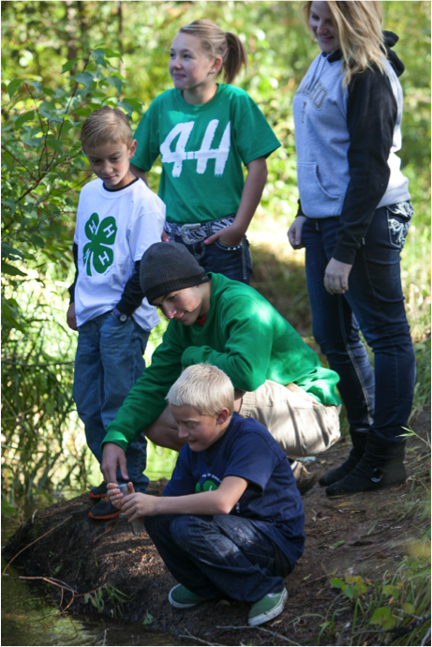
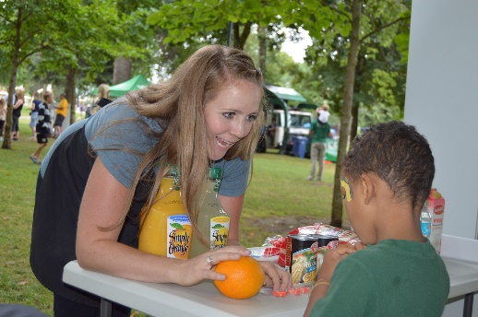
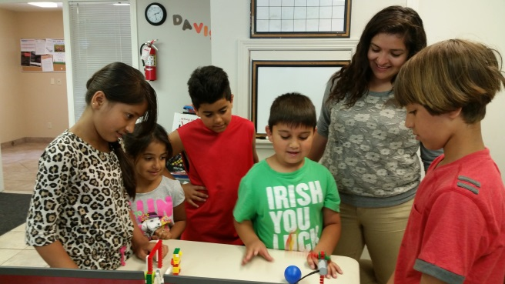
Local 4-H Personnel
Extension educators
4-H Program Coordinators
4-H Program Assistants
Temporary Help
Summer Interns

Slide 12

Basics of 4-H

Slide 13
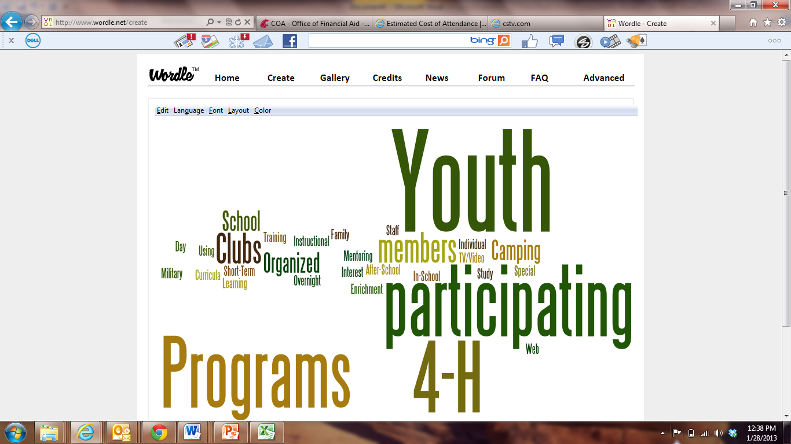


Slide 14
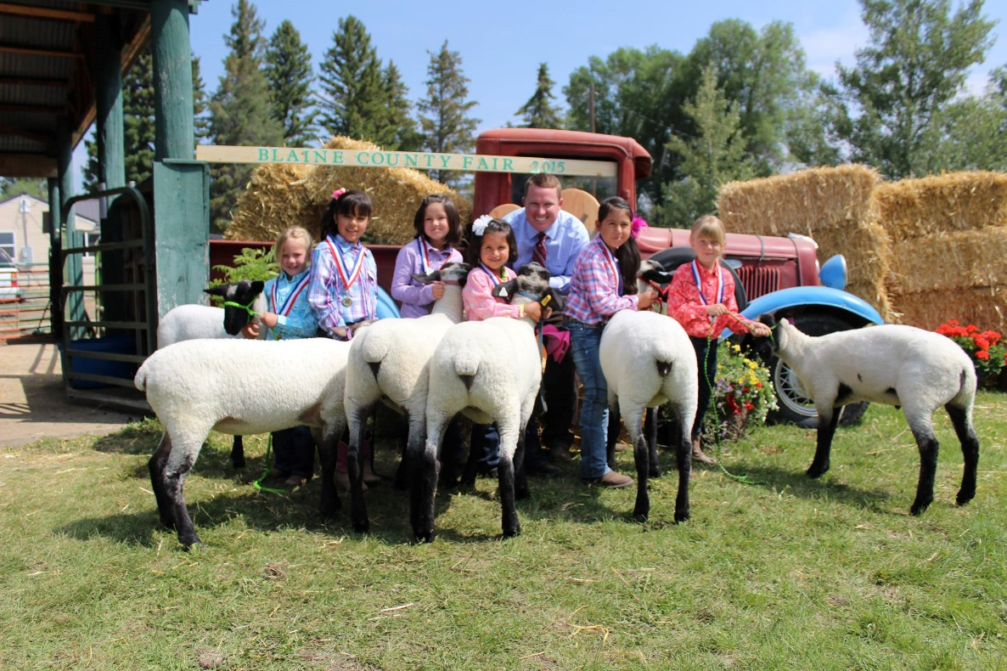
Snap shot of current program

Slide 15
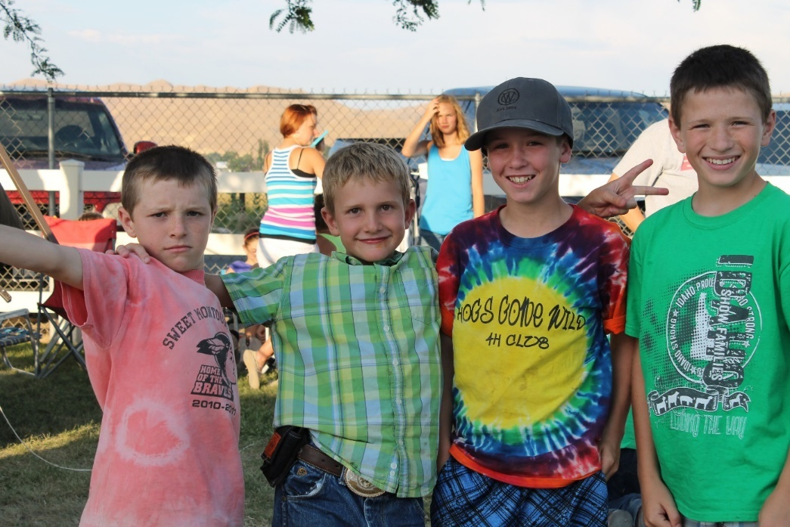
MISSION MANDATES
NATIONAL 4-H HEADQUARTERS
  Healthy living
  Citizenship
  Science

Slide 16
The Tufts 4-H Study of PYD:
3x more likely to CONTRIBUTE
2x more likely to pursue
SCIENCE
2x more likely
to go to COLLEGE
Less Likely
to be involved in risky behavior
Institute for Applied Research in Youth Development at Tufts University

Slide 17
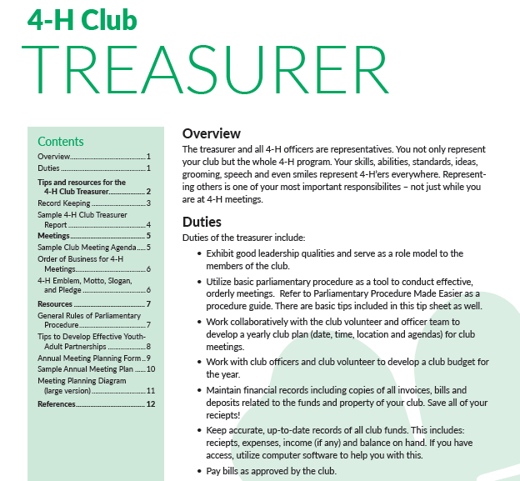
Finances
4-H Clubs
4-H County Volunteer Associations (Leaders' Council)
4-H Affiliates
County Accounts (UI Extension and County Partnerships)
UI Extension financial support

Slide 18
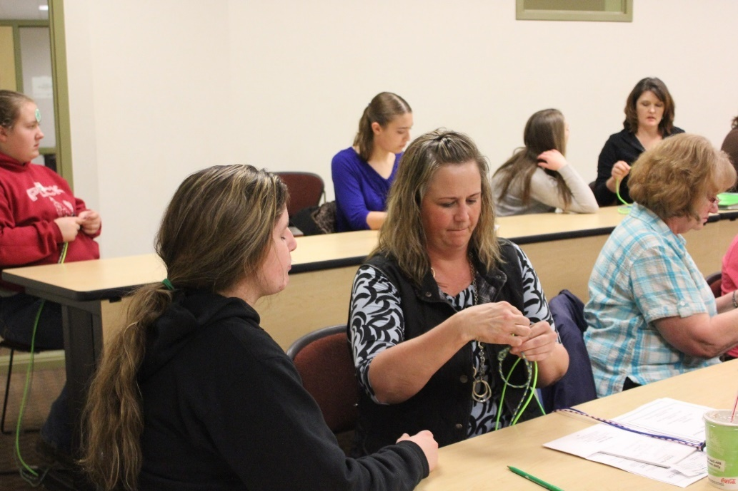
TRENDS
4-h volunteers
3200 Adult Volunteers
Background Check
Basics of Youth Development
Subject matter training
Passionate!

