Slide 1
Birth, Death, and Marriage Certificate Guidelines and Protocol
Dan Irwin, Field Coordinator
State of Idaho
Department of Health and Welfare
Division of Public Health
Bureau of Vital Records and Health Statistics

Slide 2
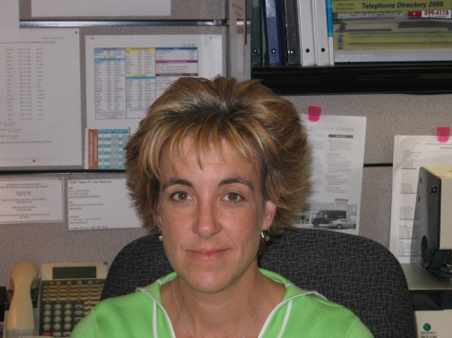
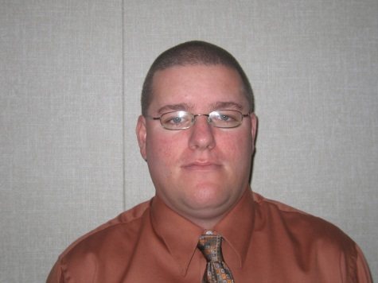
OVERVIEW OF VITAL RECORDS
The Bureau of Vital Records and Health Statistics is the Idaho State Agency charged with the duties of registering, storing, and providing copies of Vital Events for legal, health, and administrative purposes.
The Bureau of Vital Records and Health Statistics is oversaw by the State Registrar. There are 3 appointed Deputy State Registrars who assist in the completion of the duties.
STATE REGISTRAR James Aydelotte
DEPUTY STATE REGISTRAR Kathy Anderson
DEPUTY STATE REGISTRAR Jeremy Peterson
DEPUTY STATE REGISTRAR Dan Irwin

Slide 3
OVERVIEW OF VITAL RECORDS
To date, the Bureau has registered the following events for 2016:
Live Births
Deaths
Marriages
Divorces
22,190
13,303
13,603
6,804

Slide 4
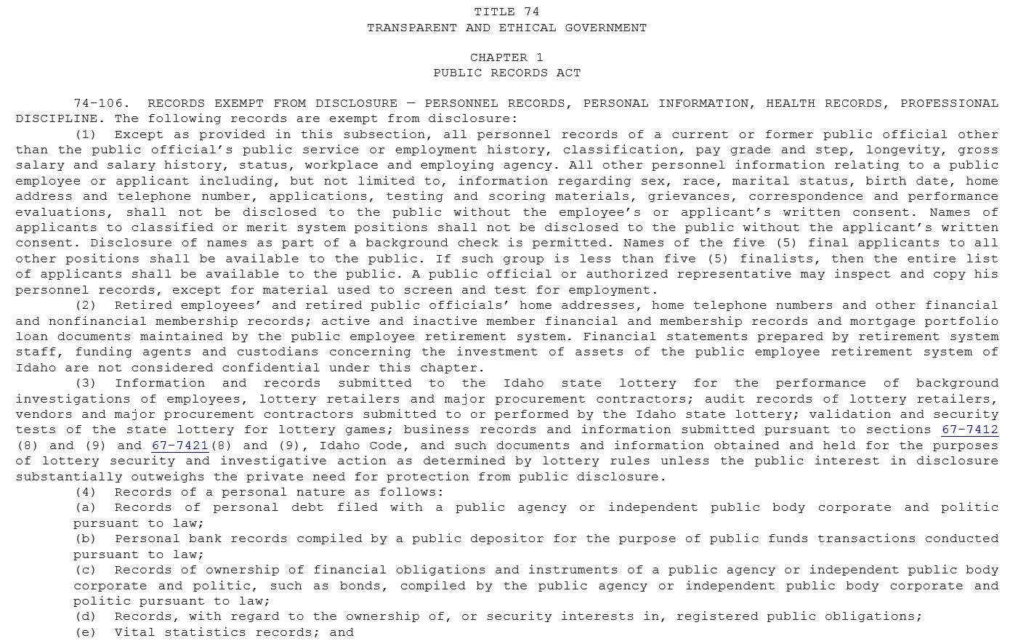
CONFIDENTIALITY AND DISCLOSURE
Vital Records are exempt from Public Records law IC§74-106(e).

Slide 5
CONFIDENTIALITY AND DISCLOSURE
Every record that is registered by our Bureau is subject to strict confidentiality and disclosure laws.
Certificates of Live Birth remain confidential for 100 years.
Certificates of Death, Marriage, and Divorce remain confidential for 50 years.
Records can only be released to persons who can provide evidence of a “Direct and Tangible Interest” in the record (e.g. Relative within the first degree or someone who is taking care of legal matters).

Slide 6
BIRTH CERTIFICATE
Legally confidential for 100 years
Contains a lot of Personally Identifiable Information (PII) and extremely sensitive medical information.
Filed directly with the Bureau of Vital Records
Should NOT be recorded at the County Level
Variation among States sometimes creates confusion of persons seeking to file record
Document that creates an “identity”.

Slide 7
DEATH CERTIFICATE
Legally confidential for 50 years
Contains a lot of Personally Identifiable Information (PII) and extremely sensitive medical information
Filed directly with the Bureau of Vital Records
Should NOT be recorded at the County Level***

Slide 8
DEATH CERTIFICATE
5 Types of Certified Copies
STANDARD CERTIFIED COPY
Issued by the Bureau of Vital Records
Most prevalent copy that is issued
Not a complete copy of the death record
Provides Cause and Manner of Death information
Contains all the required information for survivors to collect benefits (Life Insurance, VA Benefits, etc.)

Slide 9
DEATH CERTIFICATE
5 Types of Certified Copies
CERTIFIED LOCAL ISSUANCE PHOTOCOPY
Issued by Local Deputy State Registrars at 7 Public Health Districts
2nd most common copy that is issued
Complete copy of the death record
Provides Cause and Manner of Death information
Contains all the required information for survivors to collect benefits (Life Insurance, VA Benefits, etc.)

Slide 10
DEATH CERTIFICATE
5 Types of Certified Copies
CERTIFIED SHORT FORM COPY
Issued by the Bureau of Vital Records
Rarely requested or issued
Not a complete copy of the death record
Does not provide Cause and Manner of Death information
Contains sufficient information to complete most estate closing matters (Bank Account, Property Transfer, etc.)

Slide 11
DEATH CERTIFICATE
5 Types of Certified Copies
CERTIFIED PHOTOCOPY
Issued by Bureau of Vital Records
Infrequently requested, sometimes system limitations mandate production
Complete copy of the death record
Provides Cause and Manner of Death information
Contains all the required information for survivors to collect benefits (Life Insurance, VA Benefits, etc.)

Slide 12
DEATH CERTIFICATE
5 Types of Certified Copies
CERTIFIED SHORT FORM PHOTOCOPY
Issued by the Bureau of Vital Records
Rarely requested or issued
Not a complete copy of the death record
Does not provide Cause and Manner of Death information
Contains sufficient information to complete most estate closing matters (Bank Account, Property Transfer, etc.)

Slide 13
DEATH CERTIFICATE
WHAT IS THE LAW FOR PROPERTY TRANSFERS AND RECORDING CERTIFIED COPIES OF DEATH CERTIFICATES?

Slide 14
DEATH CERTIFICATE
IS AN AFFIDAVIT A PLAUSIBLE SOLUTION?
Utilized in Cassia County
Contains all the information necessary to locate record
Doesn’t violate confidentiality and disclosure requirements of Death Certificate
Does not provide Cause and Manner of Death information (i.e. No HIPPA implications)

Slide 15
DEATH CERTIFICATE
DOES THE LAW NEED TO BE AMENDED?
Recent legislation passed in the State of Oregon requires “short form” for property transfers
“Short Form” still contains Personally Identifiable Information (SSN, Parent’s Information)
Not all State’s have a “short form”
Challenge for Funeral Homes to explain the various types of death certificates and their purpose to the family

Slide 16
MARRIAGE CERTIFICATE
I.C. § 39-262 specifies that the Board of Health and Welfare will prescribe the form of the Marriage Certificate.
Standard certificate form was adopted on 10/21/2014
Parties select their own titles from Bride/Groom/Partner
Collects the person’s sex
Adds Maiden name to both parties of the marriage
Notice from State Registrar allowed for some transition time for counties to implement changes.
Currently there are multiple versions of the marriage certificate in use among the 44 counties
Bannock County is the only adoptee of the standard form

Slide 17
MARRIAGE CERTIFICATE
Common Problems to watch for:
Officiant doesn’t possess authority under I.C. § 39-262 to solemnize marriage
32-303. By whom solemnized. Marriage may be solemnized by any of the following Idaho officials: a current or retired justice of the supreme court, a current or retired court of appeals judge, a current or retired district judge, the current or a former governor, the current lieutenant governor, a current or retired magistrate of the district court, a current mayor or by any of the following: a current federal judge, a current tribal judge of an Idaho Indian tribe or other tribal official approved by an official act of an Idaho Indian tribe or priest or minister of the gospel of any denomination. To be a retired justice of the supreme court, court of appeals judge, district judge or magistrate judge of the district court, for the purpose of solemnizing marriages, a person shall have served in one (1) of those offices and shall be receiving a retirement benefit from either the judges retirement system or the public employee retirement system for service in the Idaho judiciary.

Slide 18
MARRIAGE CERTIFICATE
Common Problems to watch for:
Marriage occurred prior to the issuance of the marriage license
32-302. “All persons herein authorized to solemnize marriages must first require the presentation of the marriage license.”

Slide 19
MARRIAGE CERTIFICATE
Common Problems to watch for:
The parties to the marriage signed in the spot that should list the officiant’s name and title

Slide 20
MARRIAGE CERTIFICATE
Common Problems to watch for:
The officiant failed to sign the Certificate

Slide 21
MARRIAGE CERTIFICATE
Common Problems to watch for:
The Recorder failed to sign the Certificate.

Slide 22
MARRIAGE CERTIFICATE
Common Problems to watch for:
The wrong copy of the Certificate is Recorded.

