Slide 1

Are We Prepared?
Idaho Office of Emergency Management
Director Brad Richy

Slide 2
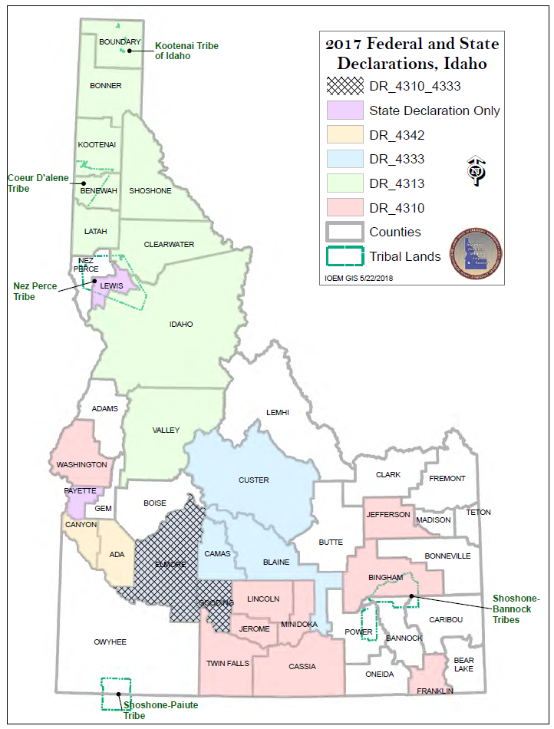
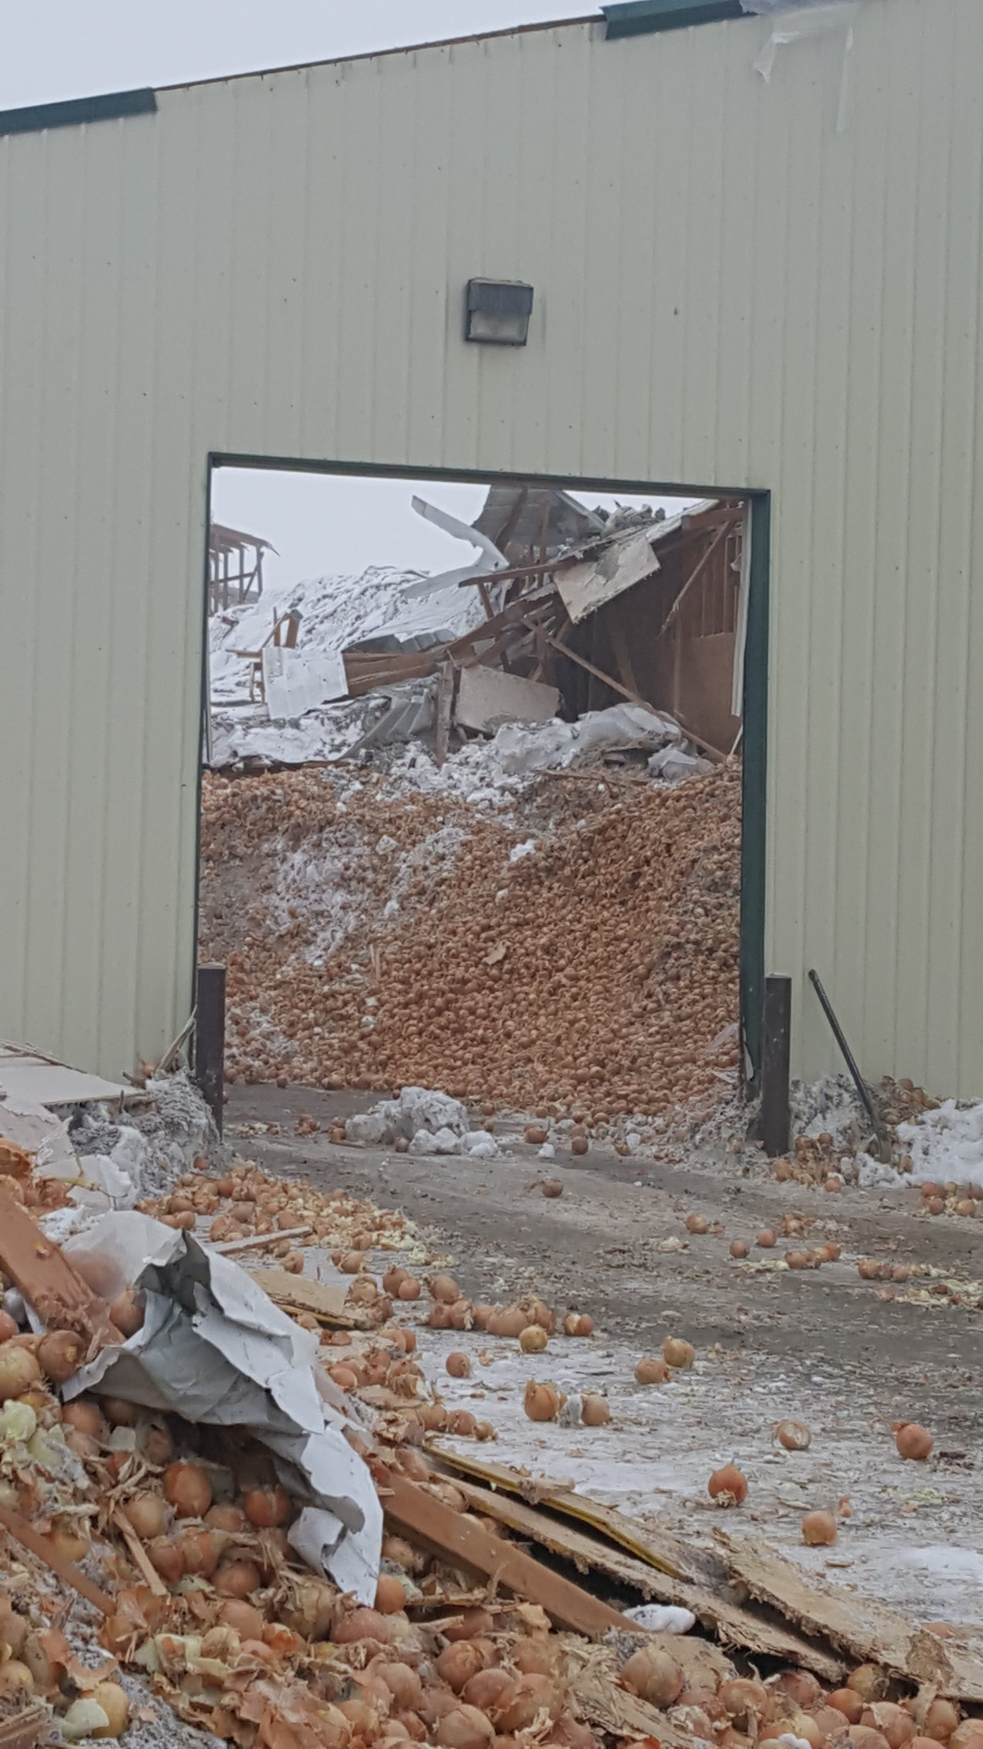
Impacts of 2017 Idaho Disasters
Federal Funded
325 Projects, estimated cost $29,000,000
State Emergency Relief Funded
Over 500 Projects, estimated cost $42,000,000

Slide 3
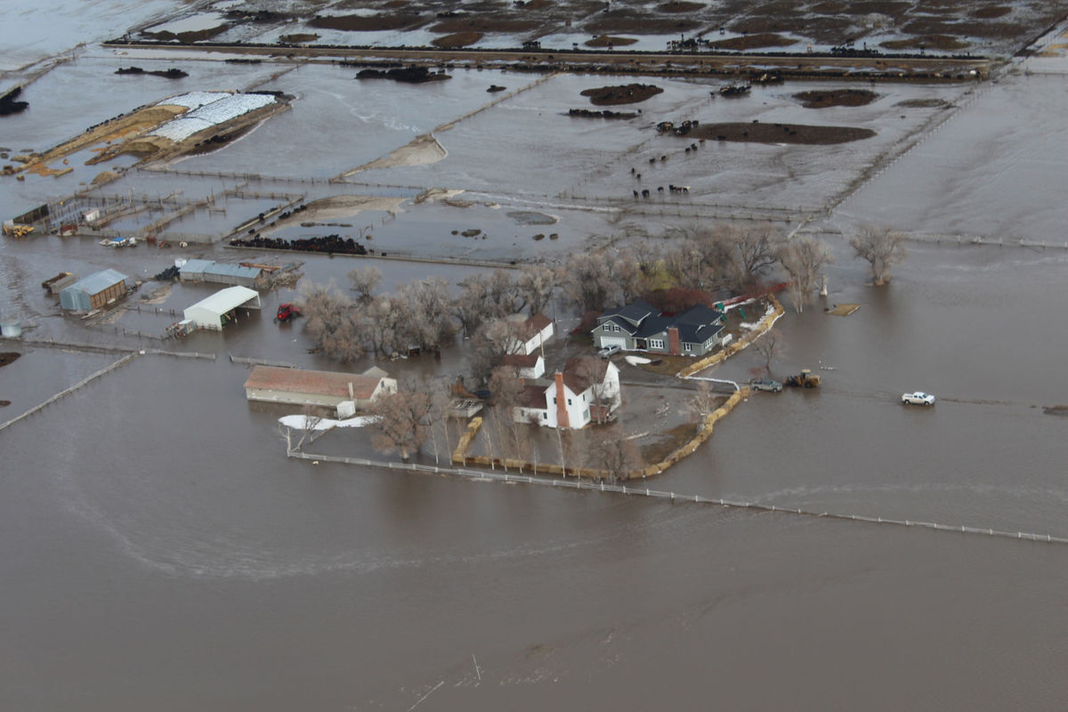
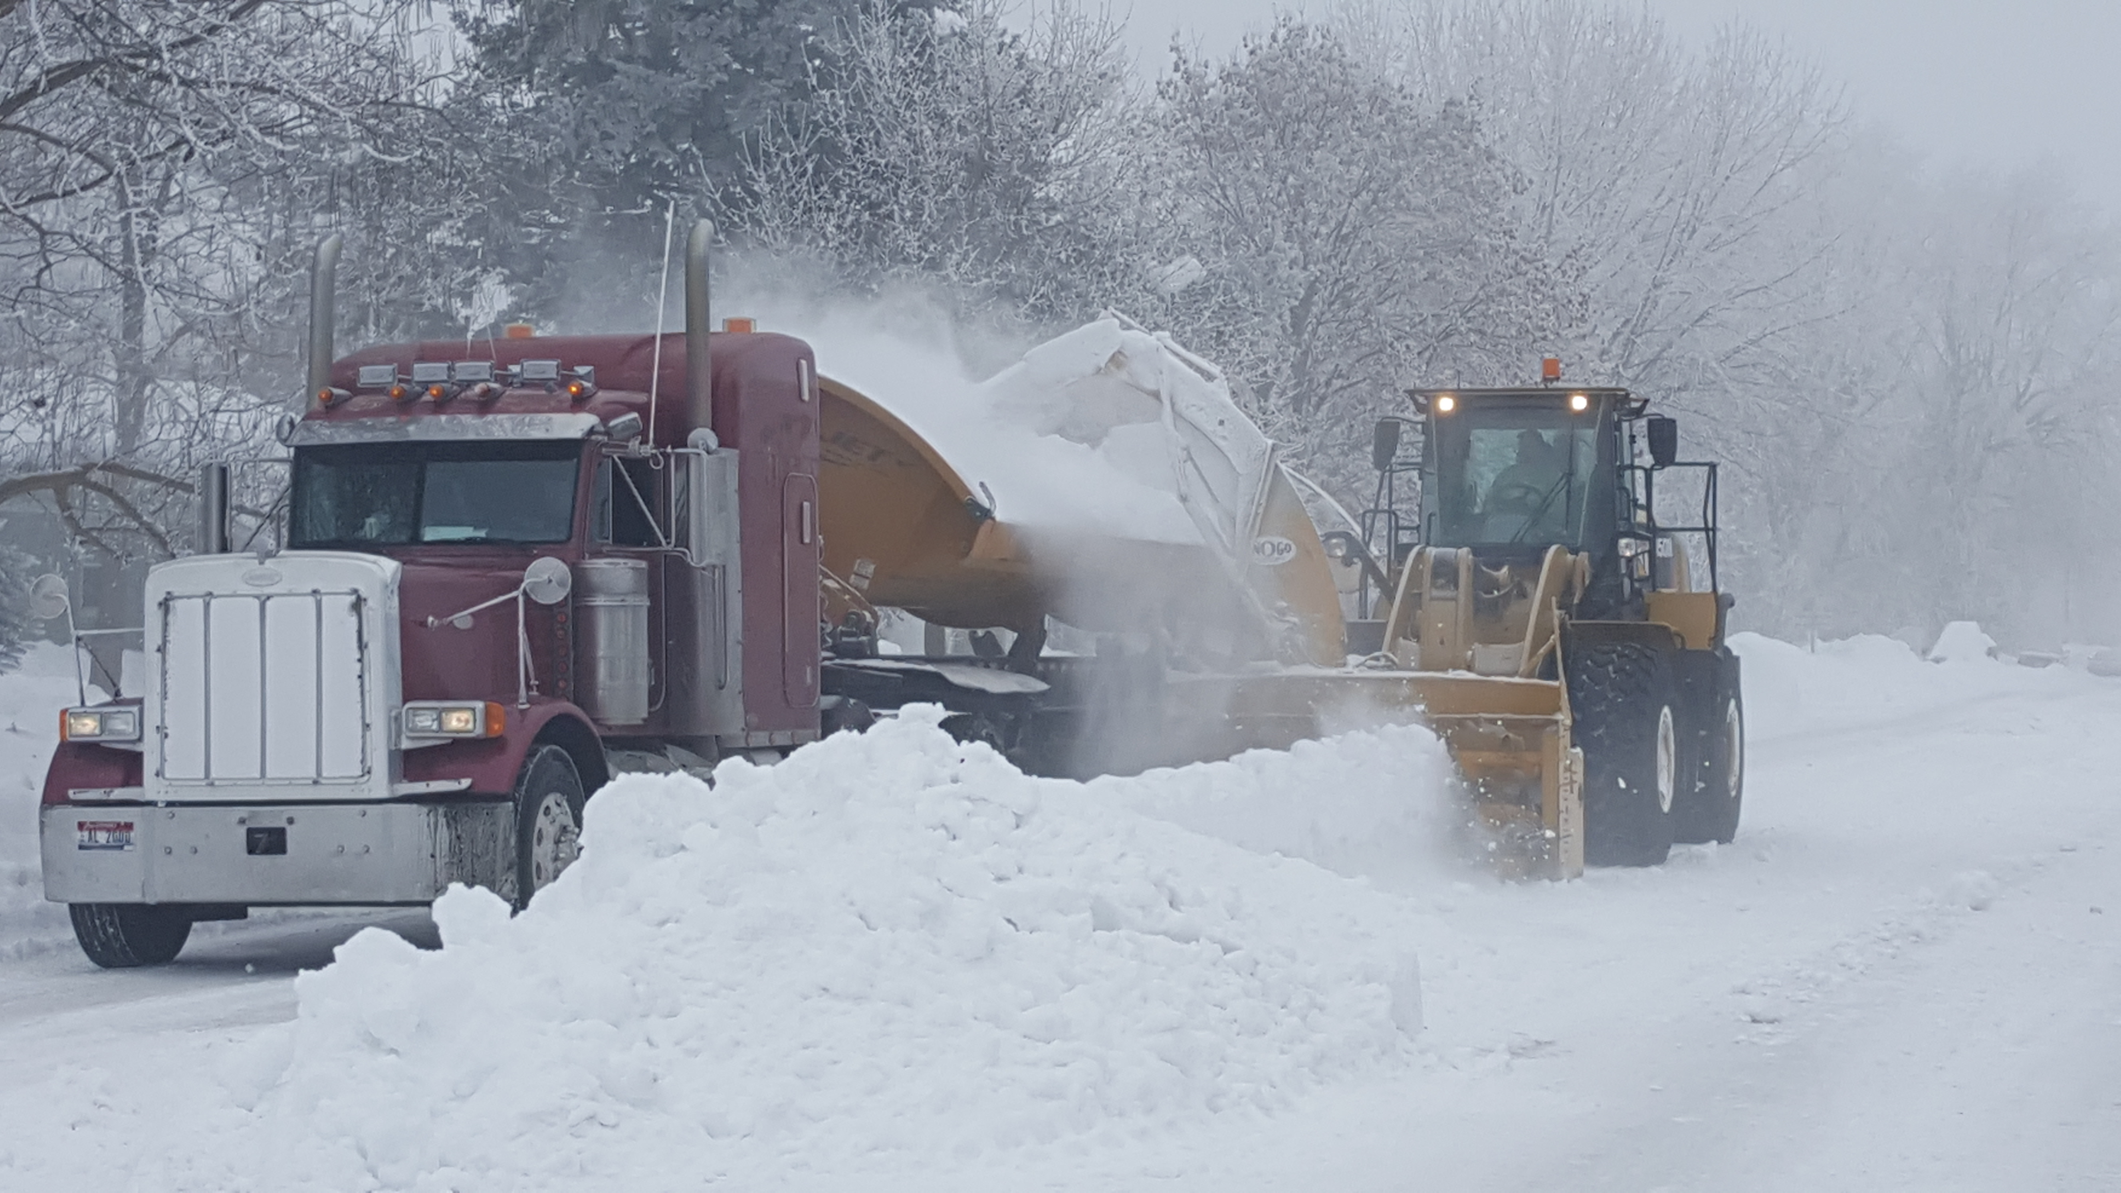
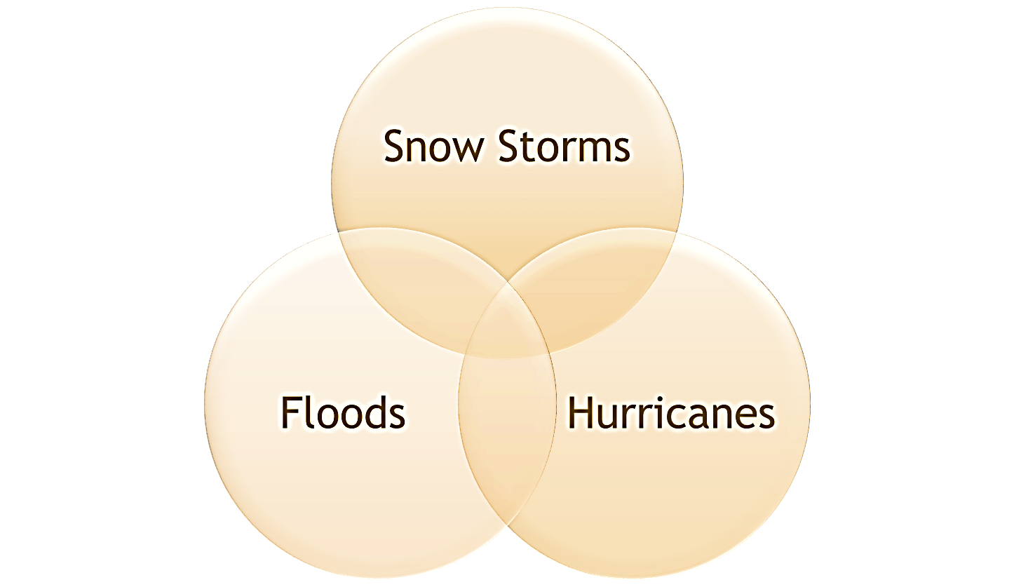
Impacts of 2017 Idaho Disasters

Slide 4
Impacts of 2017 Idaho Disasters
Power Outages
School closures
Limited access to necessary resources
Building collapses
Snowstorms
Road closures
Water contamination
Flooding
Road and bridge damage
Power Outages
Road closures
School closures

Slide 5
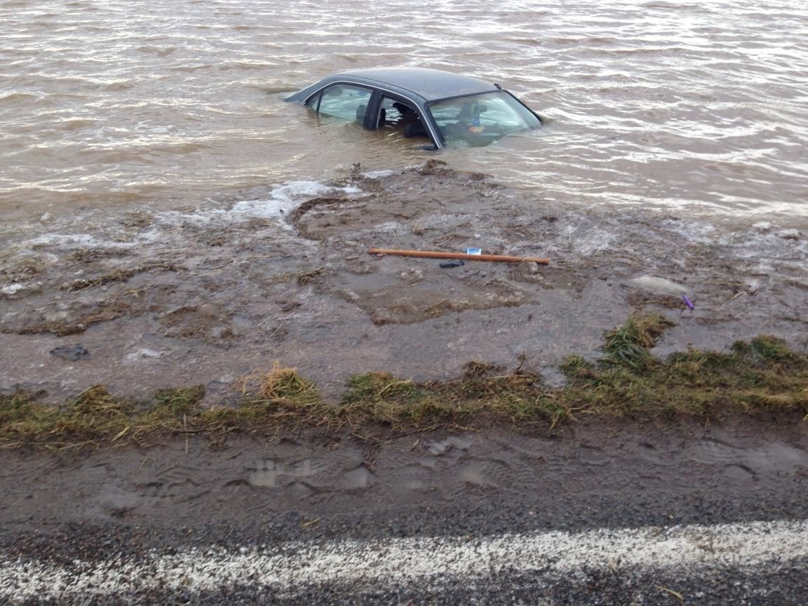
2017 Unprecedented Year
Storms, Fires, Floods, Heat = over $300 billion in damages
48 States Responding
32 Federal Agencies – all supporting:
  46.9 million people affected by Harvey, Irma, Maria and Wildfires – 15% of our population
    $9.6 billion NFIP claims for calendar year 2017
    2.4+ million home inspections completed
    4.8+ million hotel stays
    5.6+ million calls
    4.8+ million registrations
    2000+ contract actions

Slide 6
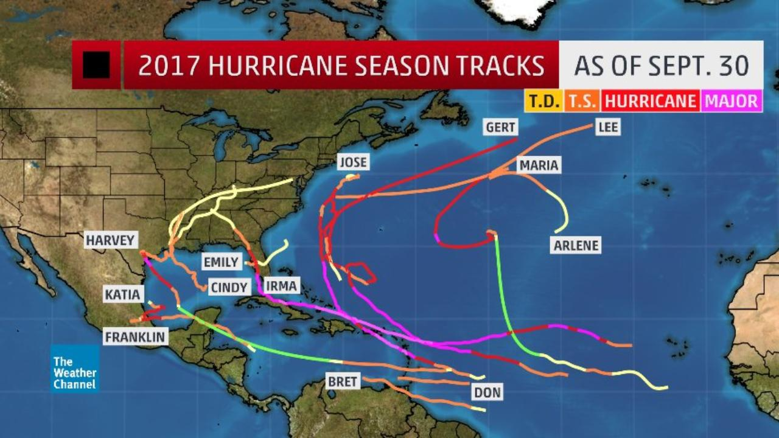
FEMA Challenges from 2017
FEMA sent nearly 100 employees to Idaho to help communities recovery from the snow and flood disasters. However, when bigger disasters hit, and lives were at stake, FEMA withdrew from Idaho and deployed all their assets to the hurricane devastated states.
FEMA by the Numbers
21,095 Staff
  Across 10 Geographic Regions
  Serving 54 States & Territories and 573 Tribes
  Managing a $14.9B (FY ‘18 budget)
$20B Spent in 2017
  On 59 Major Declarations
  16 Emergency Declarations
  62 FMAGs
  In 34 states and 4 Tribes
Today
  16 JFO’s
  Managing 32 Disasters in 14 States
  16 Fire FMAGs (FY 18)
  5 Million NFIP Policies with $1.3 Trillion Exposure (2/21)

Slide 7
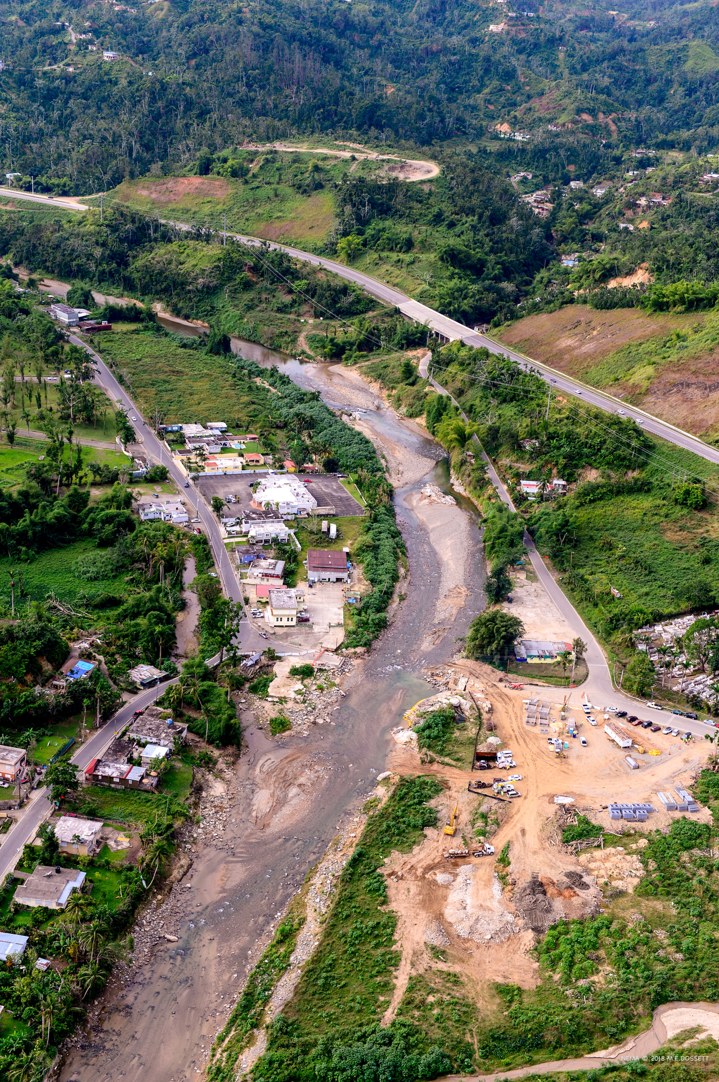
Is Your Community Prepared?
To be 100% without power and communications for an extended period of time?
To shelter evacuees for weeks or months?

Slide 8

Response and Recovery
When the “Whole Community” arrives to help, are you prepared?
  The Joint Field Office in Puerto Rico has 2000 FEMA workers.

Slide 9
Are You Prepared?
Consider the following initiatives to improve resiliency:
428 Mitigation
  How would your community take advantage of this funding?
Create a disaster reserve fund similar to a rainy day fund.
Ensure communications capabilities.
Develop a continuity program.
Build capabilities to meet the housing needs of large numbers of displaced individuals and families.
Take advantage of vendor-managed inventory and scalable standby contracts for staffing, commodities, and debris removal.

Slide 10
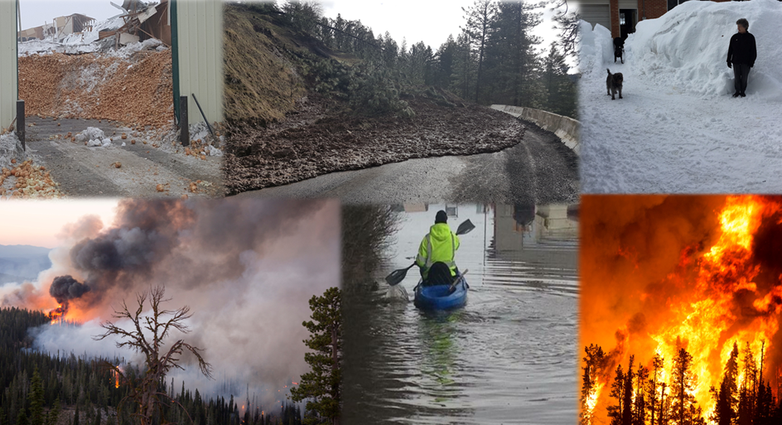
Are We Prepared?
Questions?

