Slide 1
FINANCE & BUDGET FUNDAMENTALS
For County Clerks
Practical Financial Insights for Everyday Financial Management
Tim Sturges | Director of Finance & Budget

Slide 2



TODAY'S ROADMAP
Three Ways to Think About Fiscal Health
Budgeting Fundamentals
Financial Policy
Putting It Into
for Non-Finance Officials
& Governance
Practice
Structural balance, reserves, revenue risk, and communicating the budget.
Why written policies matter; and building a long-term financial plan.
Your statutory calendar and a simple habit for mid-year monitoring.

Slide 3
01
Budgeting Fundamentals
for Non-Finance Officials
Four concepts that separate a budget that balances on paper from one that's actually healthy.

Slide 4
BUDGETING FUNDAMENTALS
“Balanced” Isn’t Automatically Healthy
STATUTORILY BALANCED
STRUCTURALLY BALANCED
Meets the legal requirement. Revenues equal appropriations on paper — the minimum bar.
Ongoing revenue covers ongoing expense. The real test of whether a budget is sustainable.
Run the test: Is recurring revenue covering recurring expense — or are one-time sources (fund balance draws, land sales, federal relief) quietly funding ongoing costs like salaries?
Notes:
Balanced by Fund
By department, ongoing revenue should be = to ongoing expense. Adjust property tax allocation to balance.
Be aware of various revenue sources, by department
Departmental revenues should be used to support that particular department
Use of one-time revenues and fund balance should only be used to support one-time expenditures

Slide 5
BUDGETING FUNDAMENTALS
Know Your Reserve Number
2 MONTHS
CALCULATE YOUR OWN RATIO
Unrestricted General
Fund Balance
(about 16.7% of annual operating revenue or expenditures)
GFOA’s minimum recommended unrestricted general fund balance — the floor, not necessarily the target.
Annual Operating Revenue
or Expenditures
Compare the result to 16.7% before your next budget cycle.
Notes:
Cash basis – enough cash reserves on hand, by fund, until large tax turn in January
Budget Stabilization – 15% of previous FY revenues
27th Pay Period
Available Fund Balance for ensuing budget year
Ada’s ratio – 41.5%
Recommend performing a cash basis analysis and budget stabilization by fund’

Slide 6



BUDGETING FUNDAMENTALS
Watch for the One-Time Revenue Trap
Settlement Funds
Land Sale Proceeds
Federal Relief Dollars
These are common ways ongoing positions or programs quietly get funded. When the one-time source dries up, the cost it was covering doesn’t disappear with it.
Notes:
Opioid $
Grants (some are ongoing)
Example – ARPA used for court cases during Covid

Slide 7
BUDGETING FUNDAMENTALS
Add a “Budget-in-Brief”
TRADITIONAL BUDGET BOOK
BUDGET-IN-BRIEF
• Hundreds of pages of line-item detail
• One to two pages, plain language
• Built for auditors and finance staff
• Charts and visuals over tables
• Technical vocabulary throughout
• The page most taxpayers actually read
Weighted in GFOA’s Distinguished Budget Presentation Award criteria.
Notes:
Review executive summary in budget book

Slide 8
02
Financial Policy
& Governance
Two habits that build institutional memory beyond any one election cycle.

Slide 9

FINANCIAL POLICY & GOVERNANCE
Start With One Written Policy
<50%
Stronger bond ratings
of governments have adopted formal written policies in several core areas of public finance, per GFOA surveys.
Reduced financial risk
Continuity across elected leadership
If your office has none: a fund balance / reserve policy is the single highest-value place to start.
Notes:
Adopted by BOCC
Ongoing concern
Interperiod equity
FY 10-12, 2009 downturn. August 2009 first time economy contracted since great depression

Slide 10


FINANCIAL POLICY & GOVERNANCE
Build a Simple 5-Year Forecast
YEAR 1
YEAR 2
YEAR 3
YEAR 4
YEAR 5
Even a basic spreadsheet extrapolation surfaces known step-changes before they become a budget-cycle surprise.
27th Pay Period
Contract Renewal
Capital Purchase
Every ~11 years, biweekly payroll adds an extra cycle.
Known multi-year agreements with built-in escalators.
Planned equipment or facility investments.

Slide 11
03
Putting It Into
Practice
Two concrete habits you can start using before your next budget cycle.

Slide 12
PUTTING IT INTO PRACTICE
Know Your Statutory Anchor Dates
1
2
3
April 30
1st Tuesday
after 1st Monday
in September
2nd Monday
in September
Taxing districts notify the county clerk
BOCC budget hearing
BOCC budget hearing
of their budget hearing date & location
must begin on or before this date
must conclude no later than this date
Idaho Code § 63-802A
Idaho Code § 31-1605
Idaho Code § 31-1605

Slide 13
PUTTING IT INTO PRACTICE
Use the 50%-by-Month-6 Check
50%
MONTH 6 — FISCAL YEAR MIDPOINT
target spend by mid-year
At the midpoint of your fiscal year, a department’s spending should generally track close to half its annual appropriation — adjusted for known seasonality. Anything significantly over pace deserves a closer look before it becomes a year-end scramble.
Notes:
Monthly update
Departments to watch

Slide 14
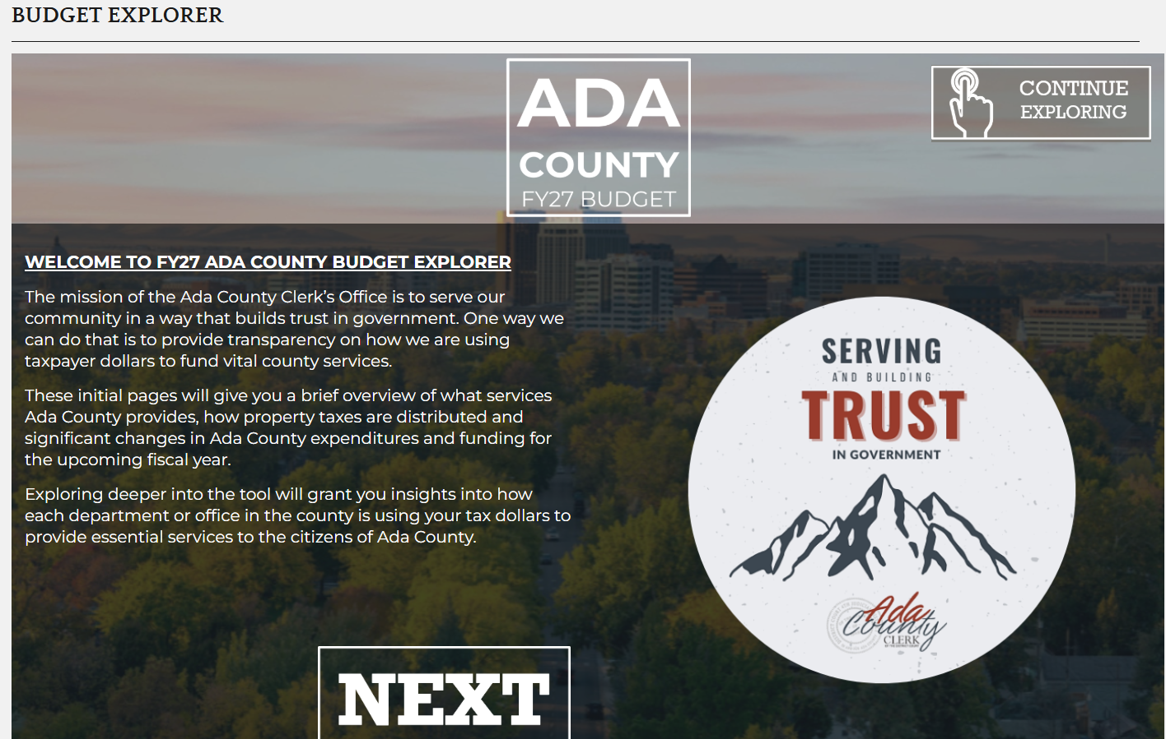

Slide 15

CLOSING
Key Takeaways
Balanced on paper isn’t the same as structurally sound — run the test.
Know your reserve ratio against GFOA’s 16.7% minimum benchmark.
One written policy — starting with fund balance — builds institutional memory.
Circle April 30 and your September hearing window now.
Check spending against the 50%-by-month-6 rule of thumb.

Slide 16
Government Finance Officers Association (GFOA)
Benefits & Resources for Idaho County Clerks
Professional development, best practices, and networking to strengthen county financial management

Slide 17
What is GFOA?
Government Finance Officers Association
A professional association for public finance professionals in the U.S. and Canada
They support state and local governments with education, guidance, and best practices
They provide resources to improve financial management, transparency, and accountability
Their organization-based membership allows eligible county employees to access member benefits

Slide 18
Their Professional Development Offerings Help
Build Knowledge & Skills
Discounted Annual Conference registration
Reduced-cost webinars and training
Complimentary educational webinars
On-demand learning opportunities
Certified Public Finance Officer (CPFO) certification program
Benefit to Idaho Counties:
Keeps county clerks and finance staff current on public finance standards and emerging issues.

Slide 19
Their Financial Management Resources Have
Tools for Better County Operations
Members have access to:
Best practice documents
Budgeting and financial reporting guidance
Accounting resources
Grant management tools
Internal control guidance
Research reports and policy recommendations
Benefit to Idaho Counties:
Provides proven templates and guidance instead of creating policies from scratch.

Slide 20
Networking & Collaboration Helps
Connect Clerks with Public Finance Professionals
Online Member Community
Peer-to-peer problem solving
Discussion forums
Affinity groups
Opportunities to learn from counties nationwide
Benefit to Idaho Counties:
Share solutions and learn from other local governments facing similar challenges.

Slide 21
Recognition & Leadership Provides
Opportunities to Grow
Budget and financial reporting awards
Leadership Academy
Committee participation
Help in shaping national best practices
Benefit to Idaho Counties:
Promotes professional growth and recognizes excellence in county government.

Slide 22
Publications & Current Information Help You
Stay Informed
Members receive:
Government Finance Review magazine
Weekly newsletters
Public finance updates
New guidance and emerging issues
Legislative and regulatory information
Benefit to Idaho Counties:
Helps counties stay informed about changes affecting local government finance.

Slide 23
Why GFOA Matters for Idaho County Clerks
Practical Benefits
GFOA resources help counties:
✓ Improve budgeting
✓ Strengthen financial reporting
✓ Enhance grant management
✓ Improve internal controls
✓ Increase transparency
✓ Stay current with accounting standards
✓ Access proven best practices
✓ Connect with experienced public finance professionals

Slide 24
Organization-Based Membership
If an Idaho county is a GFOA member:
Eligible county employees can activate individual member accounts
No separate individual membership fee for eligible staff
Access to training, publications, and online resources

Slide 25
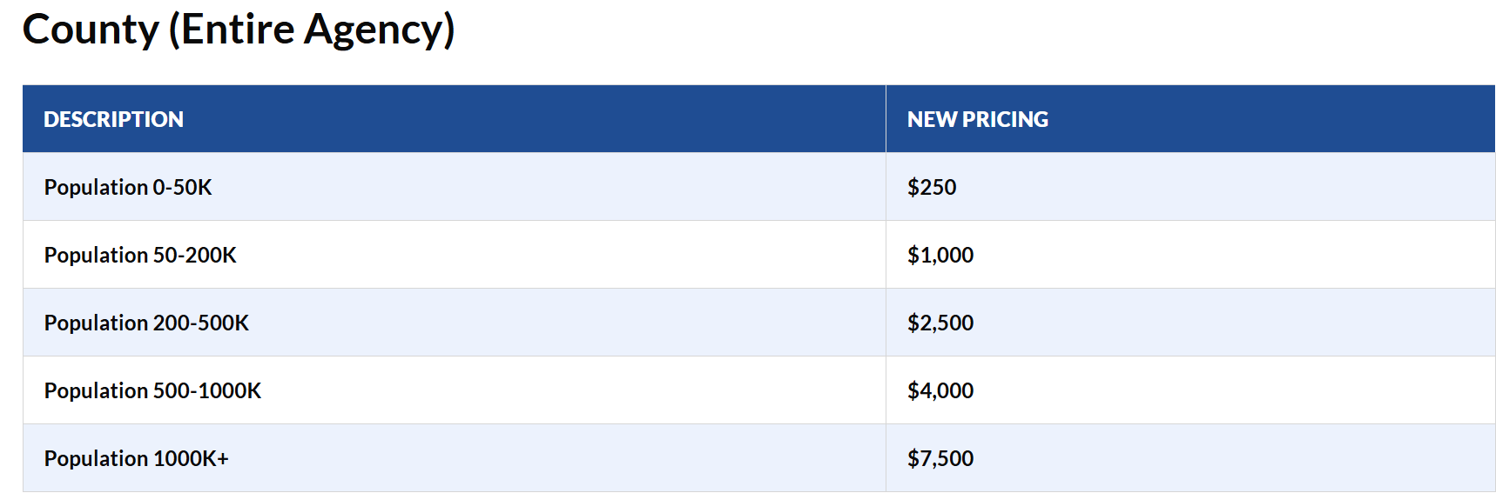

Slide 26
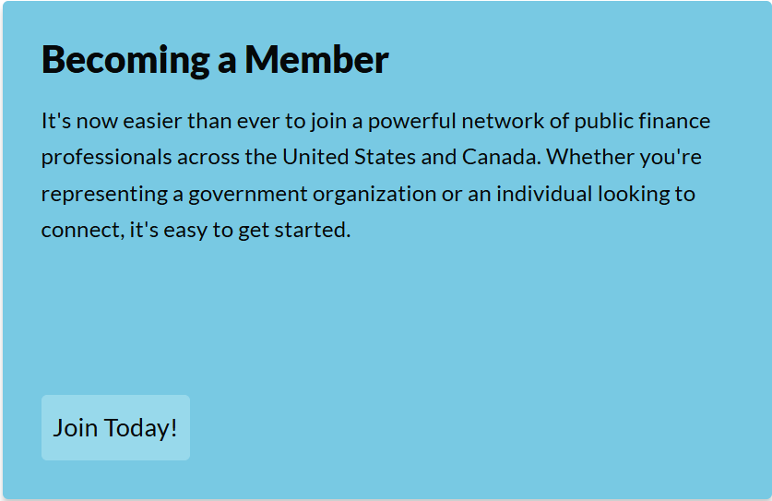
https://www.gfoa.org/membership

Slide 27
Key Takeaways:
GFOA Supports Strong County Government
Professional education
Best-practice guidance
Networking opportunities
Financial management resources
Leadership development
Recognition programs
The result: Better-informed decisions, stronger financial stewardship, and improved service to Idaho

Slide 28
Questions?
Tim Sturges | Director of Finance & Budget, Ada County Clerk's Office

